Slide 1
Web Design: Responsive Layouts
Sarah Murto
09/29/2015
4662W - Graduate Workshop

Slide 2
What is a Responsive Layout?

Slide 3
[Screen Shots/Demo 1] (I’d caution against live demos on real sites. Localhost OK.)

Slide 4
How we got here…

Slide 5
Where and when is this useful?

Slide 6
How do we do this?

Slide 7
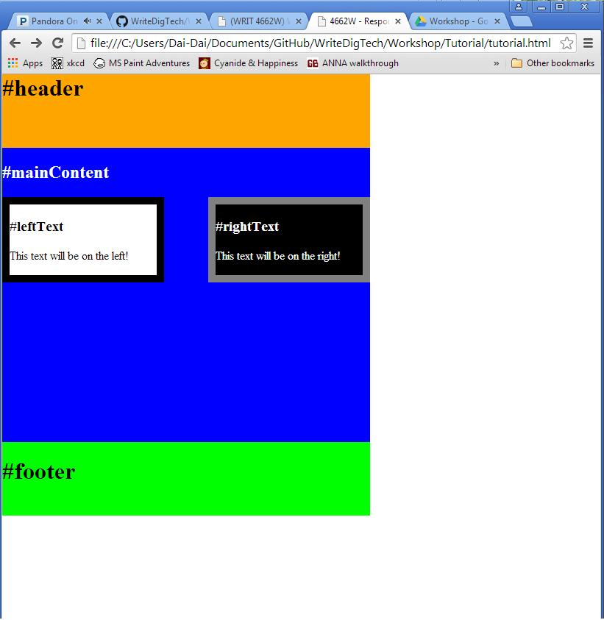
Try it yourself!
Make this page responsive:
Should take up 100% of the screen
Should resize when the browser size is adjusted.

Slide 8
Try it yourself!
https://github.com/murtosl/WriteDigTech/tree/master/Workshop/Tutorial
Download or copy tutorial.html
Adjust the CSS inside the style tags to make the page responsive.
<style type="text/css">
#header{
background-color: orange;
width: 500px;
height: 100px;
}
</style>
<style type="text/css">
#header{
background-color: orange;
width: 100%;
height: 20%;
min-height: 50px;
}
</style>

Slide 9
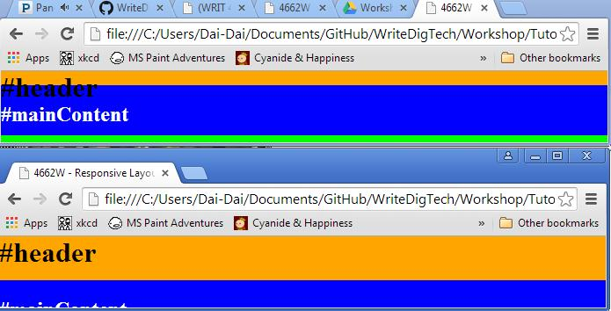
Try it yourself!
Bonus Points: Use min-width and min-height to prevent text overlap:
Bad:
Good:

Slide 10
Try it yourself!
How do I do this?
Once you have tutorial.html on your computer, and saved, click and drag this file to your browser.
The file will appear just like any other website.
Adjust the CSS in the file and save.
Refresh the page in your browser to see your changes.

Slide 11
Try it yourself!
https://github.com/murtosl/WriteDigTech/tree/master/Workshop/Tutorial
Download Tutorial.html
If you’re stuck, there are also solutions!
Make the page take up 100% of the screen
Make the page resize when the browser size is adjusted.
Optionally use min-width and min-height

Slide 12
Citations

