Slide 1
Web Design: Responsive Layouts
Sarah Murto
09/29/2015
4662W - Graduate Workshop

Slide 2
What is a Responsive Layout?

Slide 3
[Screen Shots/Demo 1] (I’d caution against live demos on real sites. Localhost OK.)

Slide 4
How we got here…

Slide 5
Where and when is this useful?

Slide 6
How do we do this?

Slide 7
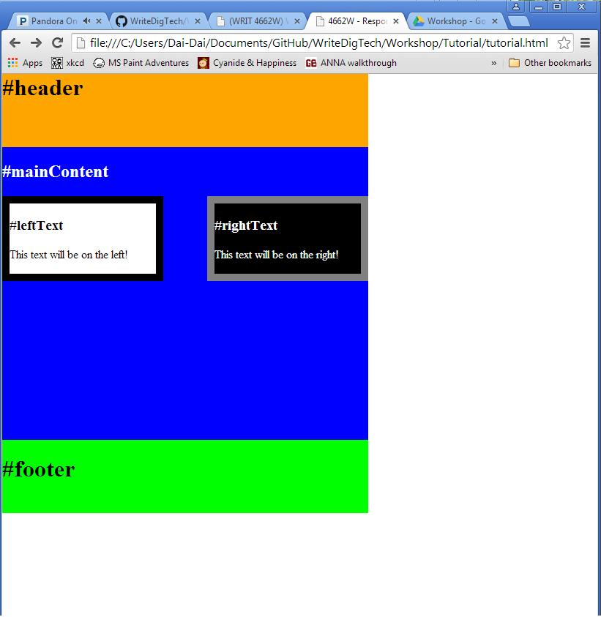
Try it yourself!
Make this page responsive:
Should take up 100% of the screen
Should resize when the browser size is adjusted.

Slide 8
Try it yourself!
https://github.com/murtosl/WriteDigTech/tree/master/Workshop/Tutorial
Download or copy tutorial.html
Adjust the CSS inside the style tags to make the page responsive.
<style type="text/css">
#header{
background-color: orange;
width: 500px;
height: 100px;
}
</style>
<style type="text/css">
#header{
background-color: orange;
width: 100%;
height: 20%;
min-height: 50px;
}
</style>

Slide 9
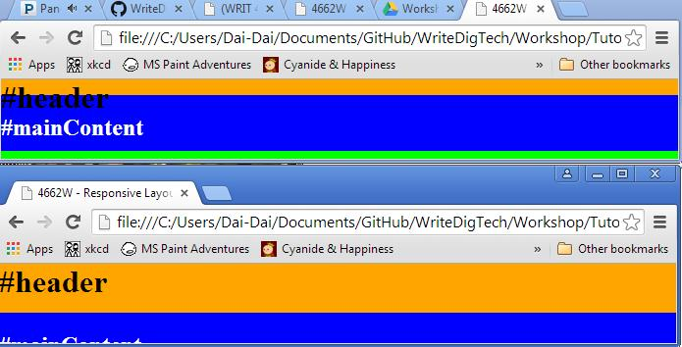
Try it yourself!
Bonus Points: Use min-width and min-height to prevent text overlap:
Bad:
Good:

Slide 10
Citations

