Slide 1

CAPSTONE PROJECT
Final Project - online food orders feedback prediction using rnn
Presented By
Ramesh Patel D
711721244040
III Btech CSBS
KGISL Istitute Of Technology
3/21/2024 Annual Review
1

Slide 2

PROJECT TITLE
Feedback Forecasting: Enhancing Online Food Ordering Experiences with Recurrent Neural Networks
3/21/2024 Annual Review
1

Slide 3



AGENDA
1. Problem Statement
2. Project Overview
3. End Users
4. Solution and Value Proposition
5. The Wow Factor in Your Solution
6. Modelling
7. Results
3/21/2024 Annual Review
3

Slide 4

PROBLEM STATEMENT
Existing methods for predicting online food feedback lack precision and reliability, presenting significant challenges for businesses in the food industry that rely on accurate feedback analysis.
Inaccurate predictions can lead to decreased customer satisfaction, hampered business growth, and inefficient resource allocation.
3/21/2024 Annual Review
4

Slide 5

PROJECT OVERVIEW
Our project aims to construct an innovative time series prediction model specialized in forecasting feedback trends from online food orders.
Utilizing cutting-edge machine learning methodologies, our primary goal is to furnish precise and dependable feedback forecasts to empower decision-making across the online food industry.
By conducting thorough data analysis, model refinement, and validation, our objective is to furnish stakeholders with a robust solution for enhancing customer satisfaction, operational efficiency, and strategic decision-making in response to evolving feedback dynamics.
3/21/2024 Annual Review
4

Slide 6

WHO ARE THE END USERS?
1.Online Food Platforms and Restaurants: These entities rely on accurate feedback predictions to enhance their services, optimize menus, and improve overall customer satisfaction.
2.Delivery Personnel and Customer Support Teams: Delivery personnel and customer support teams utilize feedback predictions to anticipate and address potential issues, ensuring seamless order deliveries and customer interactions.
3/21/2024 Annual Review
4

Slide 7

YOUR SOLUTION AND ITS VALUE PROPOSITION
Our solution employs advanced recurrent neural networks (RNNs) to predict online food order feedback accurately.
By analyzing various factors like order details and customer profiles, our model generates actionable insights to enhance service quality and tailor offerings.
This approach empowers businesses to optimize customer experiences, refine strategies, and stay ahead in the competitive food industry.
3/21/2024 Annual Review
4

Slide 8

THE WOW IN YOUR SOLUTION
Our solution's stacked LSTM architecture ensures unprecedented precision in feedback prediction.
Real-time integration of environmental data enhances adaptability and accuracy, setting a new standard in predictive analytics.
Empowering businesses with actionable insights, our solution revolutionizes customer feedback strategies, driving growth and satisfaction.
A pioneering leap in predictive analytics, our solution transforms industries by redefining how businesses understand and respond to feedback.
3/21/2024 Annual Review
10

Slide 9
MODELLING
Our modeling approach centers around a stacked LSTM (Long Short-Term Memory) architecture, renowned for its proficiency in capturing temporal dependencies within sequential data.
We implement dropout regularization techniques to prevent overfitting, thereby enhancing the model's generalization capabilities.
Collaboratively, our team integrates wireframes to visualize and iterate on the model design, fostering transparency and effective communication throughout the development process.
Through iterative refinement, we continuously optimize the forecasting model, ensuring robust performance and reliability in predicting online food order feedback.
3/21/2024 Annual Review
10

Slide 10
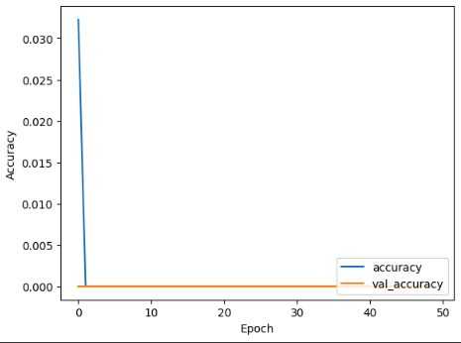
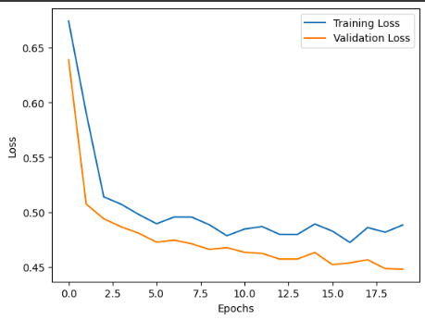
RESULTS
Demo Link
3/21/2024 Annual Review
10

