Slide 1
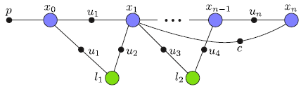
Localization using GTSAM and ROS
Bonus project for IN315002 Autonomous Driving
Technical University of Munich
Robotics and Embedded Systems
SS 2017
Source: MIT isam

Slide 2
Motivation: why localization?
Autonomous cars need to know their position at any time
GPS alone error-prone and not always available
Car odometry inaccurate which leads to accumulating error
Sensors such as Lidar or cameras can give us information about our surroundings and the own position
In localization, a map is available which represents the environment (landmarks, images, scans, pointclouds…)

Slide 3
Motivation: why factor graphs?
Localization can be solved using Bayes/Kalman Filters, Monte Carlo Localization…
Factor graphs are the most flexible solution, as they
  give us free control over the type and amount of factors we incorporate
  allow the usage of non-linear motion and measurement models
  can deal with multi-modal beliefs
  break the task down into a graph problem that scales well with large environments and state representations
More on the theory and GTSAM here and here

Slide 4
Task
1. Define and visualize a rectangular vehicle
2. Parametrize sensor position and field of view as well as accuracy
3. Define a few landmarks
4. Let the rectangular car drive a curve between the landmarks
5. Localize the vehicle with GTSAM based on the parametrized positions and sensors

Slide 5
Implementation
Usage of GTSAM 4.0
  one of the most complete c++ libraries for factor graphs and SLAM
  comes with a Matlab interface for fast evaluation/plotting
Usage of ROS Kinetic LTS
  Open Source Framework
  includes many efficient libraries and tools for robotic applications
  solves communication between separated packages in real time

Slide 6
System architecture
Every 100 ms the controller sends odometry commands (+ error estimates) that cause the car to drive in a circle
After receiving the commands, the car
  simulates the driving (to get the ground truth position)
  senses the landmarks in a local circle around the ground truth and according to a prespecified detection accuracy
  localizes itself given odometry and sensed landmarks
Real time visualization (in rviz) of
  the path and position of the ground truth, the localization result and the accumulated odometry
  landmark map and currently sensed local landmarks
Global
LM csv
Map
Local landmarks
Car
- drive
- sense
- localize
Controller
Odometry
commands

Slide 7
Localization
Factors used are:
  Initial factor for initial pose estimation
  Between factor for relative (odometry) commands
  Unary factors from the measurements
Motion model:
Measurement model:
, altern.

Slide 8
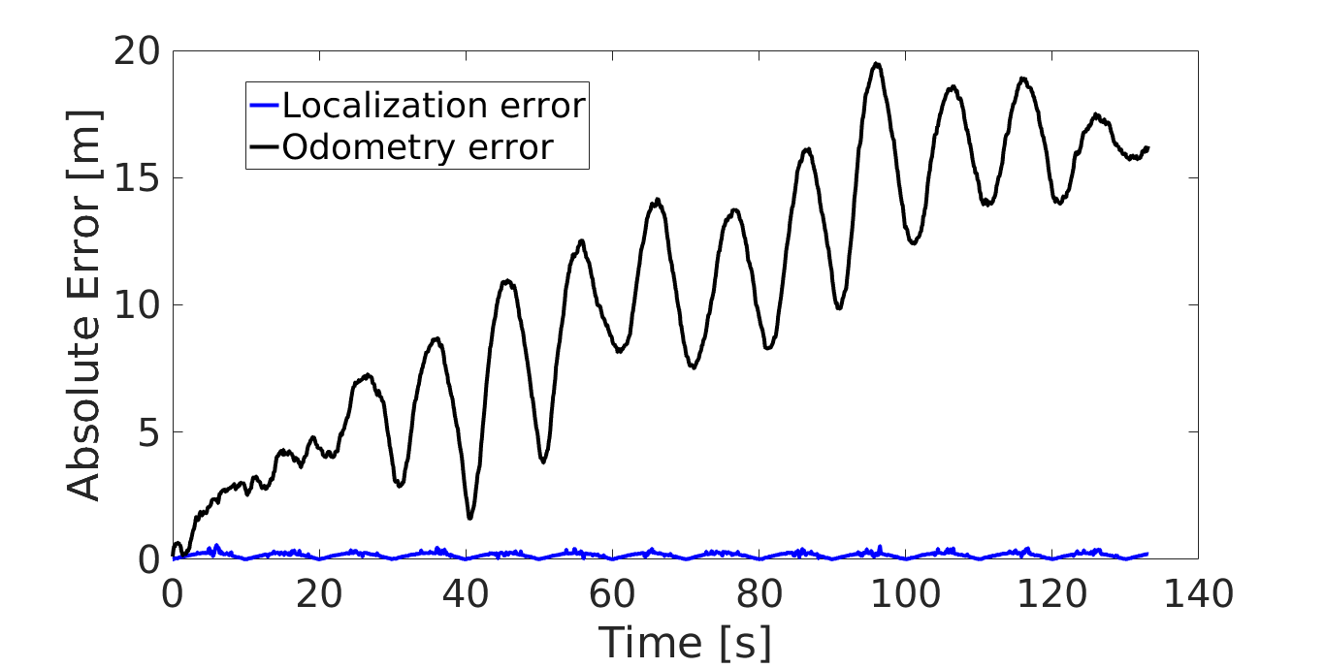
Error analysis
car_node.cpp writes the localization result, the ground truth and the accumulated odometry into a csv file
This file is read by a Matlab script that plots the error over time

Slide 9
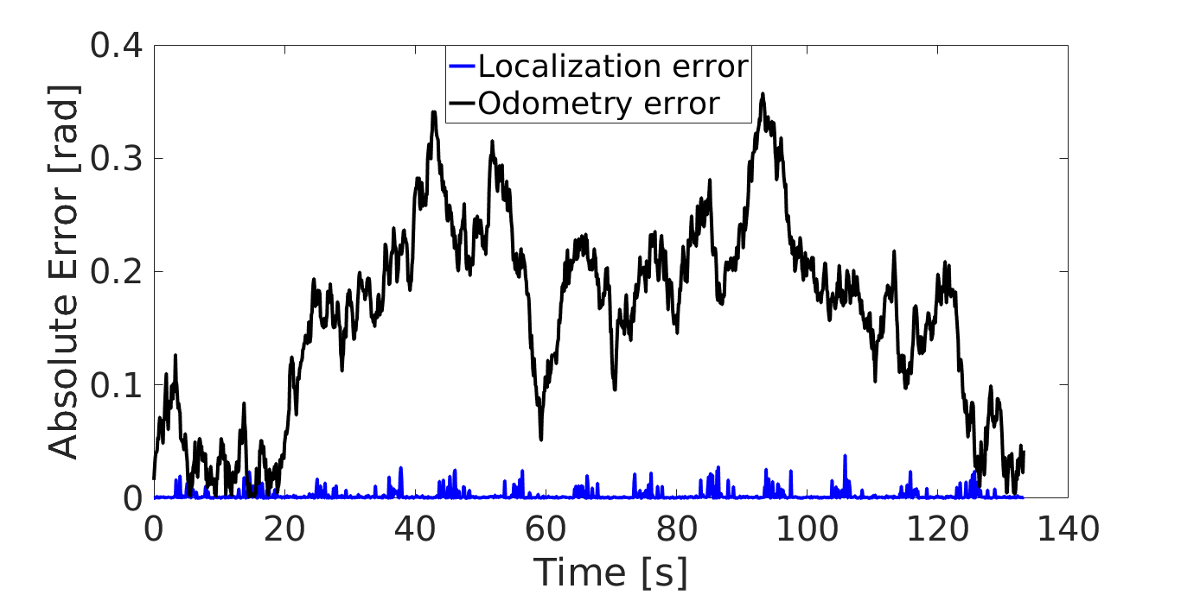
Error analysis
car_node.cpp writes the localization result, the ground truth and the accumulated odometry into a csv file
This file is read by a Matlab script that plots the error over time

Slide 10
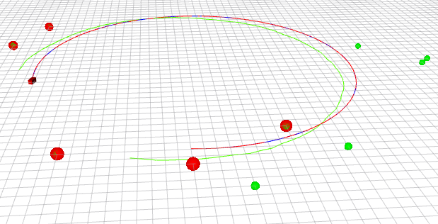
Try it yourself!
1. Requirements
  ROS
  GTSAM
2. Download from this repository
3. Create a catkin workspace and
  copy the files into it
4. Invoke the following commands
  catkin_make
  source devel/setup.bash
  roscore
  rosrun car car_node
  rosrun controller controller_node
5. For visualization, invoke rosrun rviz rviz and make sure that rviz subscribes to the topics specified in car/src/car_node.cpp

Slide 11
Try it yourself!
6. Experiment with:
  Odometry (commands and noise)
  Landmarks (change map and measurement noise)
  Maximum size of graph
7. Build your own projects!

