Slide 1
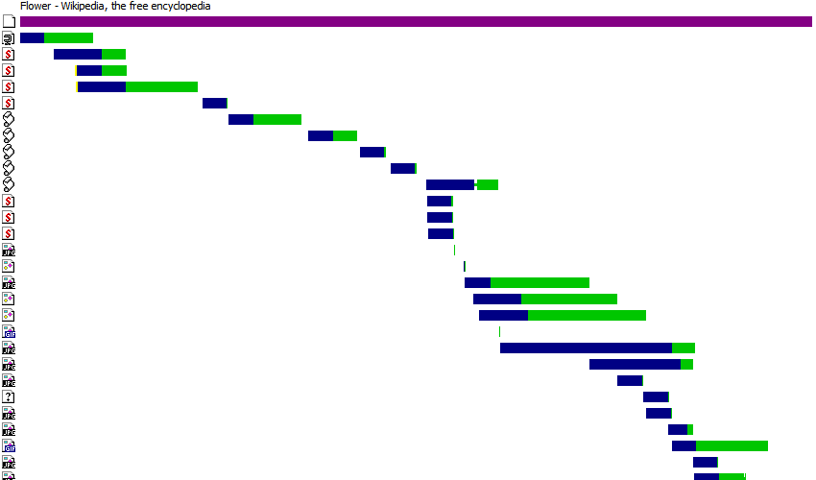
Example of Scattered Scripts

