Slide 1
Linux Boot Camp
Hardware, Firmware, BASH Scripting, Real Time Operating Systems, and Conventional Operating Systems

Slide 2
About Me
PhD in Information Technology with a specialization in Cybersecurity
Dissertation Topic: Technology Acceptance Modeling
Work at SAIC ~10 years & Amphenol before that
~20 years of Linux experience in both conventional operating systems and avionics, embedded, and real time operating systems
Follow me on LinkedIn @https://www.linkedin.com/in/linuxgeeked/

Slide 3
Goals of this session
Hopefully, you walk away with a deeper understanding of Linux use cases and capabilities
I want to touch on principles of Linux, software engineering, and DevSecOps
Designed to be an interactive discussion. It’s your camp, so get the most out of it

Slide 4
GitHub
If you aren’t familiar with GitHub, it is a great way to store and manage your programs and showcase to employers what experience you have.
You can link it to your LinkedIn and put it on your resume
https://github.com/linuxgeeked/public.git

Slide 5
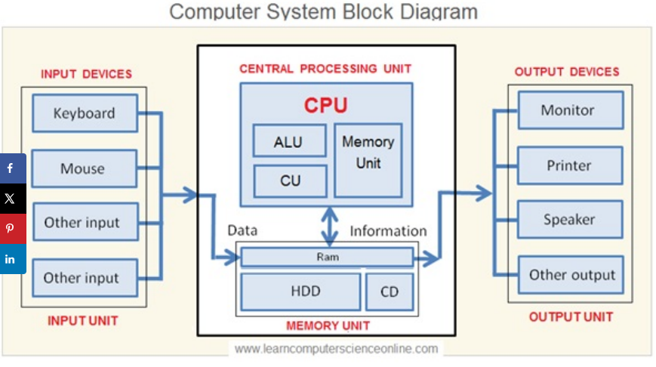
Hardware Refresher
Discussion about hardware components

Slide 6
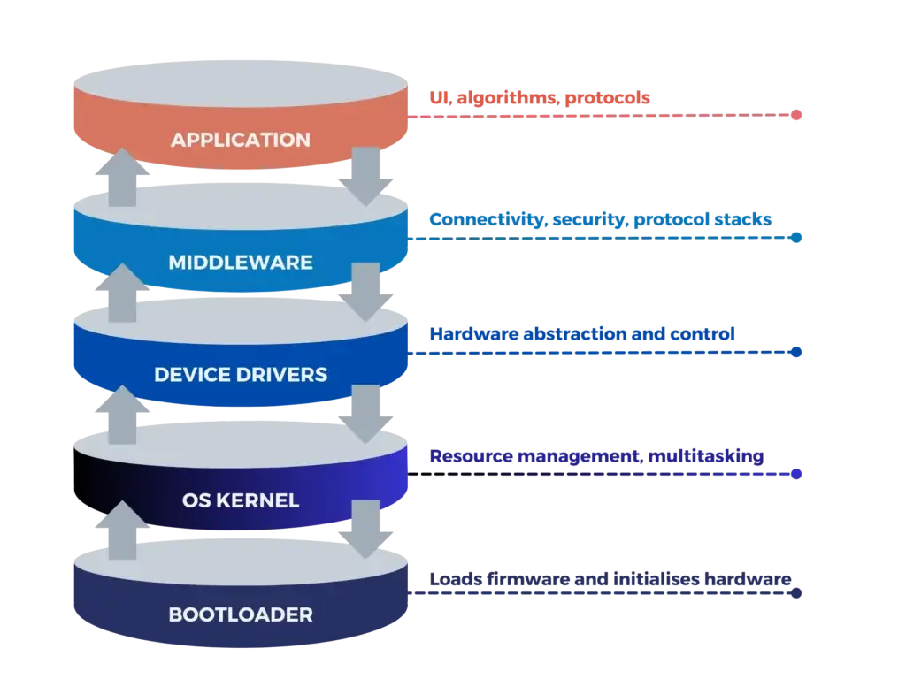
Device Driver Stack
Variety of programming languages
BASH script
Network Manager
/dev/
Almost always written in C
Linux OS
Grub

Slide 7
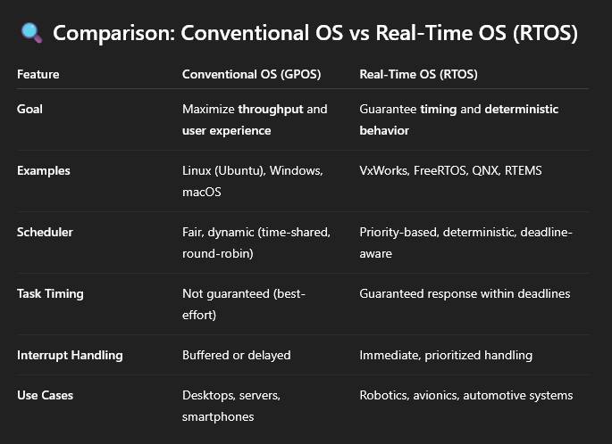
Real time versus conventional computing

Slide 8
BASH
BASH is a shell — a command-line interface that also acts as a scripting environment
BASH is not a general-purpose programming language, but it supports control structures, variables, and functions for automation and system tasks
Compiled languages like C or Swift are translated into machine code before execution, producing fast, standalone binaries
Scripting languages like BASH, Python, and JavaScript are typically interpreted — they are run line-by-line by an interpreter
Some scripting languages (like Python and JavaScript) can also use JIT (Just-In-Time) or AOT (Ahead-of-Time) compilation for improved performance

Slide 9
Make a directory for our work
mkdir cyberCamp #Makes a directory (camelback notation)
touch helloWorld.sh #Makes sure you have permissions to make files

Slide 10
Hello World (Application level)
#!/bin/bash
echo "Hello, world!"

Slide 11
Execute helloWorld.sh
chmod +x helloWorld.sh
./helloWorld.sh

Slide 12
Reading from command line (Application)
#!/bin/bash
echo "What's your name?"
read name
echo "Hi $name, welcome to BASH!"

Slide 13
Loops and Conditions (Application)
# If-statement
if [ "$name" == "Alice" ]; then
echo "Welcome back, Alice!"
fi
# Loop
for i in {1..5}; do
echo "Loop $i"
done

Slide 14
BASH Practical Application
Suppose your c developers need to build an application, and need a build environment to do it. You wouldn’t want to have to keep installing the same tools on dozens of machines in your job, so you would make a BASH script to automatically deploy their tools.
If you do DevSecOps work, you might also make a tool that will automatically build their code and run it to prove it works, so you don’t have a situation where there are differences in how developers build and execute their code.

Slide 15
BASH Practical Application
Suppose your c developers need to build an application and need a build environment to do it. You wouldn’t want to have to keep installing the same tools on dozens of machines in your job, so you would make a BASH script to automatically deploy their tools.
If you do DevSecOps work, you might also make a tool that will automatically build their code and run it to prove it works, so you don’t have a situation where there are differences in how developers build and execute their code.

Slide 16
C Program
In this example we make a simple C program to read the packets in a .pcap file. (In the real world, we might do this to understand what the packets are doing if they aren’t in a known format - like malware)
#include <pcap.h>
#include <stdio.h>
int main() {
char errbuf[PCAP_ERRBUF_SIZE];
pcap_t *handle = pcap_open_offline("capture.pcap", errbuf);
if (!handle) {
fprintf(stderr, "Couldn't open file: %s\\n", errbuf);
return 1;
}
struct pcap_pkthdr *header;
const u_char *packet;
int count = 0;
while (pcap_next_ex(handle, &header, &packet) == 1) {
count++;
}
printf("Total packets: %d\\n", count);
pcap_close(handle);
return 0;
}

Slide 17
BASH script to install the dependencies
#!/bin/bash
# Install tools needed to write, compile, and run C packet analysis
echo "🔧 Installing required packages..."
sudo apt update
sudo apt install -y gcc libpcap-dev tcpdump
echo "📁 Creating workspace directory at ~/packet_lab"
mkdir -p ~/packet_lab
echo "📌 Please write your C program as 'packet_counter.c' in ~/packet_lab"

Slide 18
BASH script to capture packets
#!/bin/bash
# Captures a small packet sample for analysis
cd ~/packet_lab || exit
echo "📡 Capturing 50 packets from 'any' interface..."
sudo tcpdump -i any -c 50 -w capture.pcap
echo "✅ Saved as 'capture.pcap' in ~/packet_lab"

Slide 19
BASH Script to build and run the C Program
#!/bin/bash
# Compiles and runs the student's packet analysis program
cd ~/packet_lab || exit
if [ ! -f packet_counter.c ]; then
echo "❌ Error: 'packet_counter.c' not found. Please write your C program first."
exit 1
fi
echo "🧹 Cleaning previous build..."
rm -f packet_counter
echo "🛠️ Compiling..."
gcc packet_counter.c -o packet_counter -lpcap
if [ $? -eq 0 ]; then
echo "🚀 Running packet_counter:"
./packet_counter
else
echo "❌ Compilation failed."
fi

