Slide 1
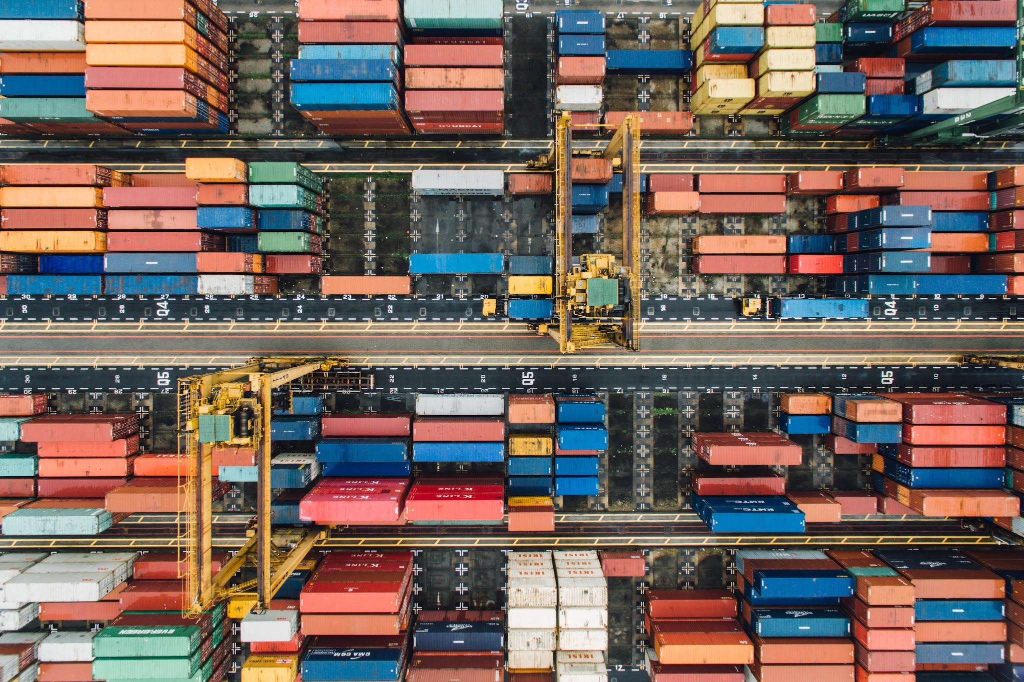
Containers
A 10,000 Foot View

Slide 2
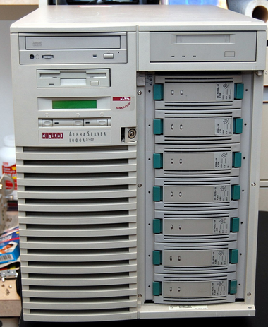
Install “Application X” on the server…
“Application X” requires library version 1.0.
Notes:
To know where we’re headed, it helps to know where we’ve been. When I started out in IT, almost 30 years ago now, a systems administrator was responsible for maintaining physical, bare-metal servers.
This is one of the systems I maintained, a Digital AlphaServer (1000a) running Unix, or Win NT 3.5.
A typical day in the life would involve the boss asking me to install “Application X” onto the server and configuring it for our end-users.

Slide 3
Install “Application Y” on the server along with “Application X”…
“Application Y” requires library version 2.0.
But, “Application X” still requires library version 1.0.
Notes:
The next day, the boss might ask me to install Application Y on the server that’s already hosting Application X.
Now we have a problem, because libraries used by application Y conflict with the libraries used by application X.
Making this work was an experimental process that involved a lot of after-hours work to avoid production downtime. Our ‘best bet’ strategy was to try to ‘meet in the middle’ on library versions even if support wasn’t documented.

Slide 4
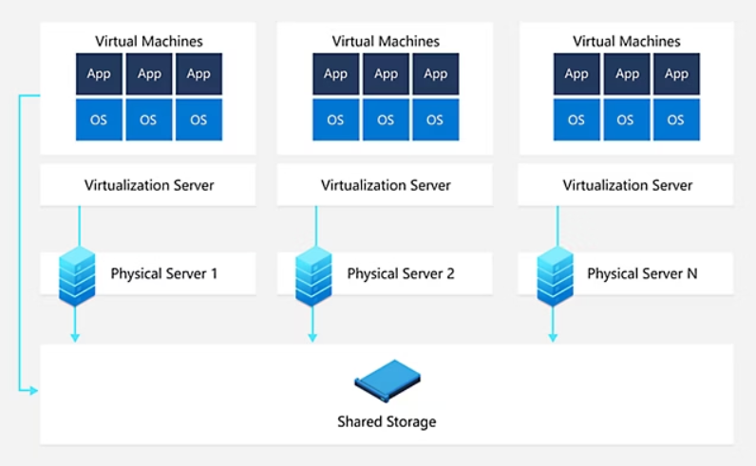
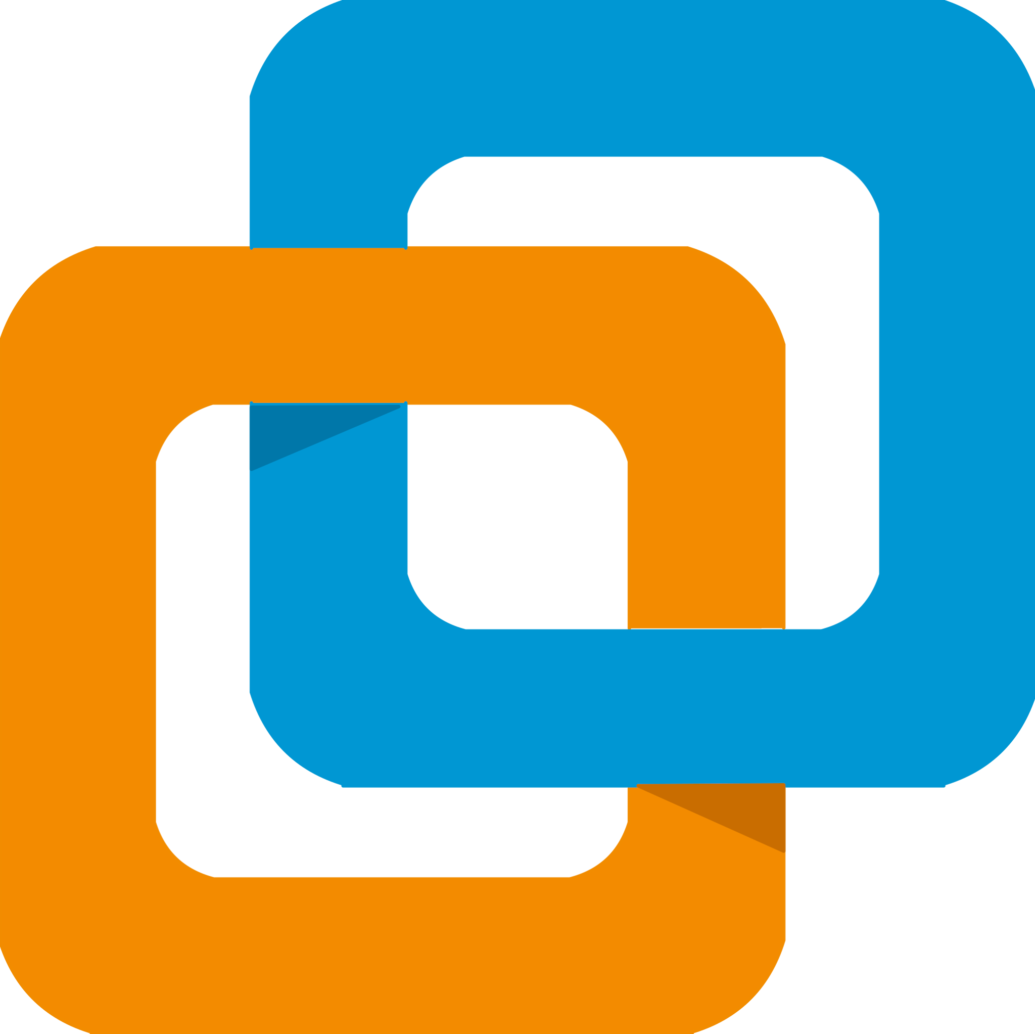

VMware ESX to the rescue…
One machine for each workload (or set of compatible workloads)
The hypervisor manages the physical hardware and schedules the use of them by the virtual machines
The virtual OS ‘thinks’ it has physical resources, like RAM, CPU, and storage
Virtualization allows the overprovisioning of resources that the physical machine may not have available
The scheduler will not degrade system performance unless there is contention for resources
Notes:
When VMWare released ESX we believed that our savior had arrived. Now instead of having to deconflict the dependencies of libraries and network ports needed by different applications, we could just spin up a new Virtual Machine for every managed application. This allowed us to take one large machine and divy up its resources among several virtual machines.
A physical server running one application may be mostly unused in terms of resource consumption. Instead of letting that extra processing power go to waste, we have several machines running alongside one another with one set of physical resources backing those machines.
Virtualization allows us to overcommit resources like CPU, RAM, and Disk Space in the case of Thin Provisioning. This means that we can tell the virtual machine that it has more resources than actually exist. An example where this is useful might be a case where you have 16GB of RAM on the physical machine, and want to run two virtual machines that require 16GB each. If neither of those machines ever actually gets up to using 8GB of RAM, then there will be no contention for resources and both machines are happy. If both machines need 16GB of RAM at the same time, the hypervisor will step in and schedule the access to memory and use other techniques to ensure both machines continue to run, even if it is with degraded performance.
Virtual machine resources are not limited beyond their configured limits, unless there is contention for resources
VMs can be configured to guarantee that a certain amount of resources will be available if there is contention. Such as in the case where some machines can have degraded performance, but others must stay running at ‘full power’.

Slide 5
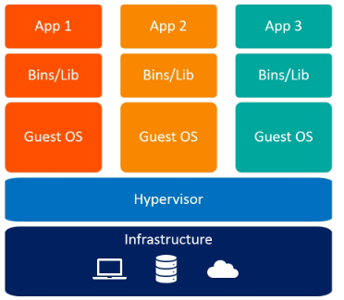
What is a Virtual Machine…
A virtual machine is files on a disk
Virtualization is not emulation
Some features may be emulated
The OS does not need to know or care about the underlying setup
A virtual machine can be set up to directly access hardware
A virtual machine runs independently of other virtual machines*
Notes:
A virtual machine is just files on a disk determining what capabilities and resources the operating system will have access to
In the case of ESXi, this is a VMX file, which can be opened in a text editor and you can see what the hypervisor will present to the operating system
Some features of a VM are virtualized, like the BIOS, network cards, and disc drives
From the perspective of the operating system, it is able to address memory and CPU the same way it would on a physical box. When those resources are accessed, the hypervisor takes over.
The OS doesn’t need to know or care about the underlying physical setup.
A VM can be set up to directly access hardware, like GPUs or disk drives, if desired. In these cases, the commands are not scheduled from ESXi, but instead are simply passed through from the requesting OS to the physical devices
A VM runs independently of the other VMs. Even if memory is low on the physical server, the machine in question will still think it has full resources and has no knowledge about the other VMs
The asterisk is because that’s the intention of a VM, and through vulnerabilities, there may be ways to escape one VM and access the host directly, or other VMs. The STIG process helps mitigate that by enforcing stricter isolation between VMs and between a VM and the host

Slide 6
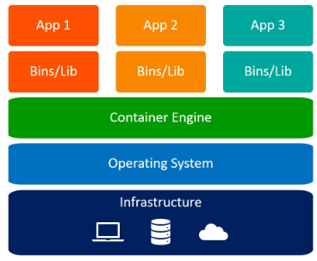
What is a Container…
A container is a running instance of a container image.
A container image is an archive of an application and all of its dependencies.
Notes:
Please remember this mantra: A container is a running instance of a container image. A container image is an archive of an application and it’s dependencies.
A container-image becomes a running container when it’s executed by a container-engine, like Podman, CRI-O (Container Runtime Interface (for) Openshift, or docker. A container doesn’t require any of the trappings of a physical computer and operating system beyond what’s provided by the system running the container-engine.
This offers containers some advantages over virtual machines for particular use cases, for instance…

Slide 7
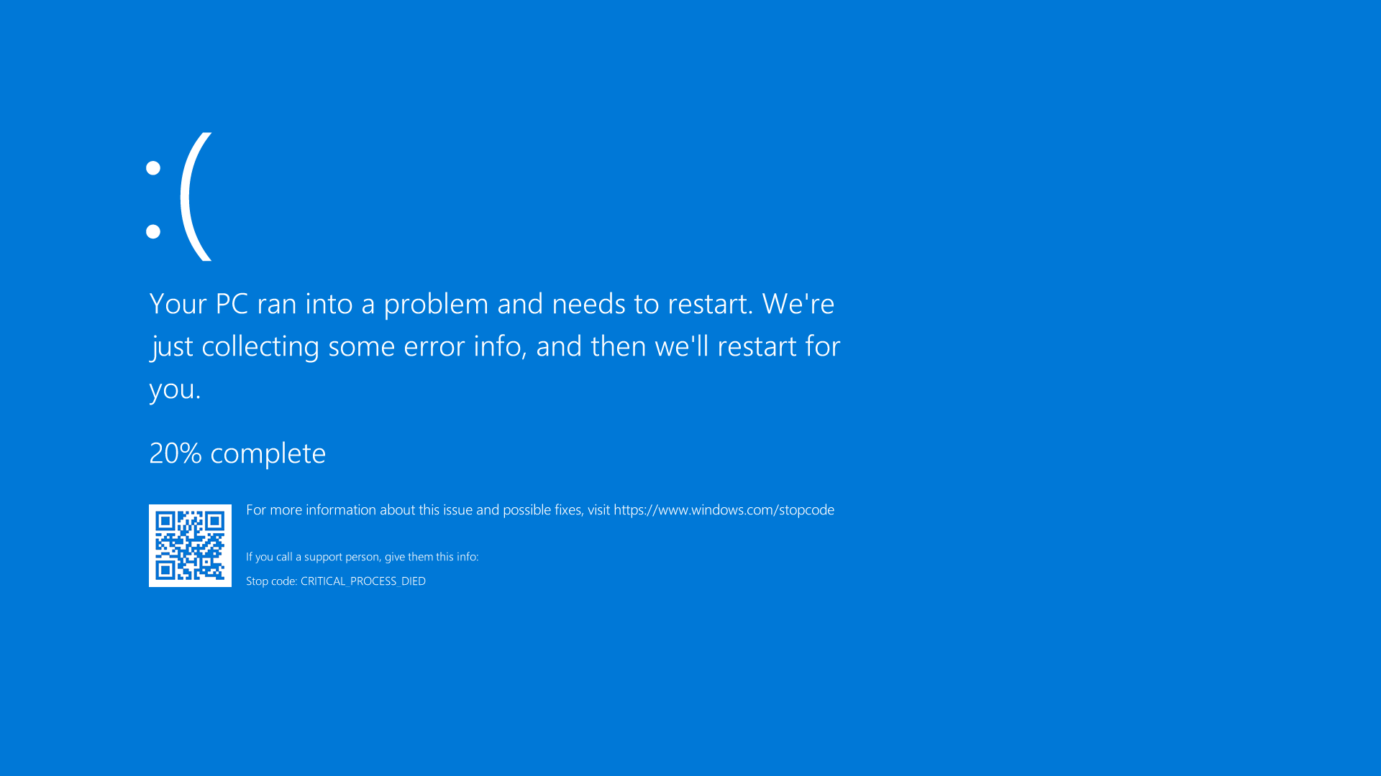
Containers solve the “It works on my computer” problem
Notes:
When we integrate a new application we often develop the integration inside of what we believe to be a “representative sample” of a production area. A domain of computers with a Windows AD server, Group Policy settings at version x.x, etc.
But do we know whether or not everything in our test environment is configured EXACTLY the way we’re expecting it to be in production?
It would be impossible to answer this in the affirmative because there may be variances in production that are happening in real time, and variances that aren’t documented anywhere.
Developing application integrations using containers means that the underlying state of the production environment doesn’t impact our work as long as our container-image is capable of being successfully executed by the container runtime.

Slide 8
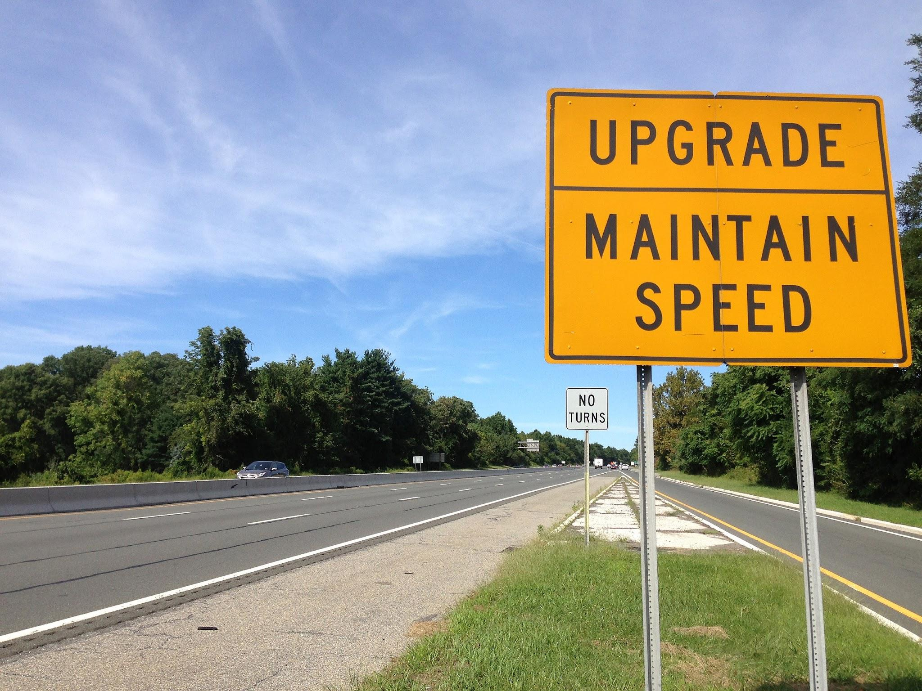
Containers ease the burden of application updates…
Notes:
Our operational guidelines mandate that we keep our supported applications updated to supported versions. But can we update to the latest version of “Application Y” confidently without fear? Remember the physical-server problem, where “Application Y” requires library version 2.0. How would an application update be possible if that version of the library is unsupported by the underlying OS.
Remember that container-images are archives that contain the application and ALL of its dependencies. This means that we can update a containerized application without fear safe in the knowledge that it will work as intended as long as it’s capable of being executed by the container runtime, whether we’re executing the container from within our test-environment, or in production.

Slide 9
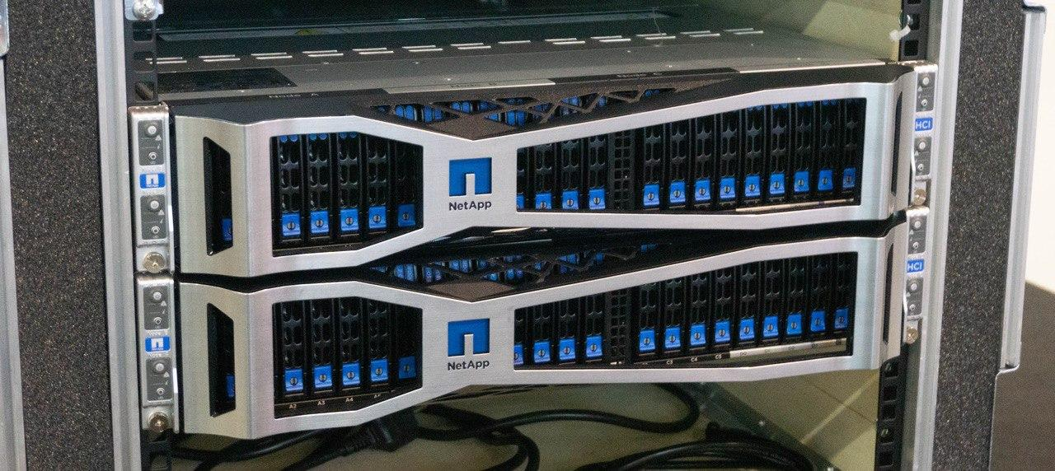
Containers are resource thrifty…
Containers are composed of reusable layers that are de-duplicated by default.
Notes:
Traditional applications are like packing everything in individual suitcases for each trip—even things you always bring, like socks and shampoo. Every time you go somewhere, you pack all the same essentials again, taking up a lot of space.
Containerized applications, on the other hand, are like using a shared packing list. Instead of packing everything from scratch each time, you reuse the same base components (layers) and only add what’s different for each trip. This saves a lot of space.
In the same way, containerized apps reuse shared layers, so they don’t have to include everything from scratch. As a result, they take up less storage space than traditional apps,
which often repeat the same files over and over.

Slide 10
Containers
A 10,000 Foot View

