Slide 1
PyLoRaWebChat
Dezentrales Echtzeitchat mit LoRa
Quellcode: https://github.com/linuxluigi/PyLoRaWebChat
Dokumentation: https://pylorawebchat.readthedocs.io/en/latest/

Slide 2
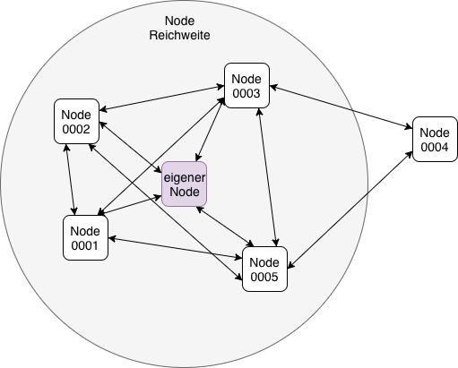
LoRa Netzwerk
Quellcode: https://github.com/linuxluigi/PyLoRaWebChat
Dokumentation: https://pylorawebchat.readthedocs.io/en/latest/

Slide 3
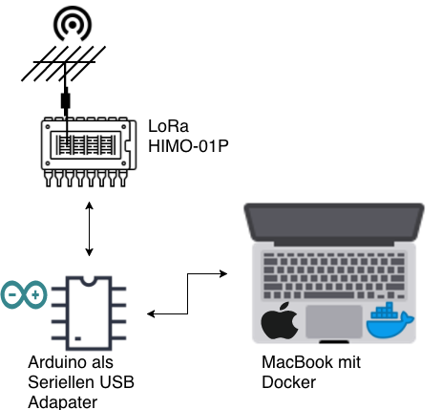
Ziel Aufbau
Quellcode: https://github.com/linuxluigi/PyLoRaWebChat
Dokumentation: https://pylorawebchat.readthedocs.io/en/latest/

Slide 4
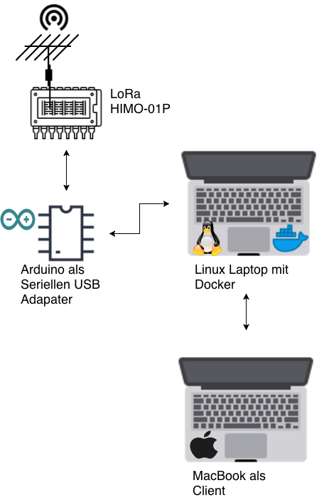
Umgesetzter Aufbau
Quellcode: https://github.com/linuxluigi/PyLoRaWebChat
Dokumentation: https://pylorawebchat.readthedocs.io/en/latest/

Slide 5
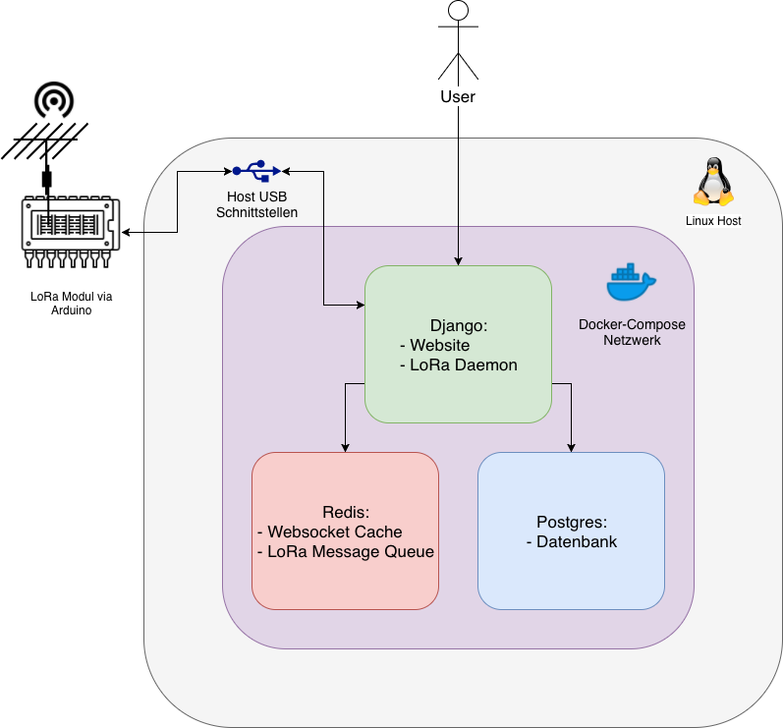
Docker
Quellcode: https://github.com/linuxluigi/PyLoRaWebChat
Dokumentation: https://pylorawebchat.readthedocs.io/en/latest/

Slide 6
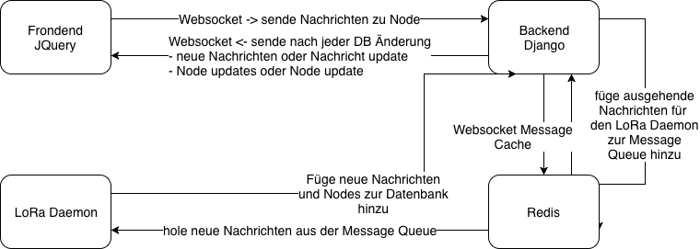
Website
Quellcode: https://github.com/linuxluigi/PyLoRaWebChat
Dokumentation: https://pylorawebchat.readthedocs.io/en/latest/

