Slide 1
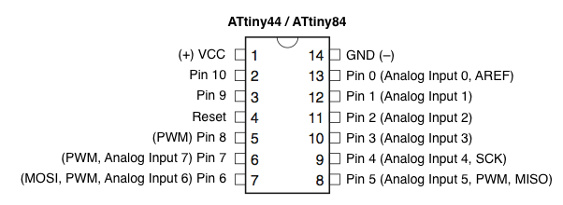
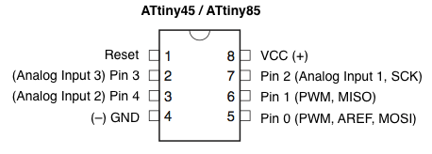
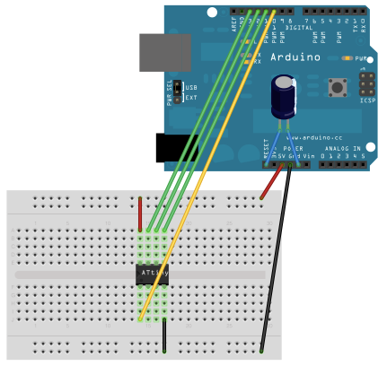
Pin connections:
ATtiny Pin 2 to Arduino Pin 13 (or SCK of another programmer)
ATtiny Pin 1 to Arduino Pin 12 (or MISO of another programmer)
ATtiny Pin 0 to Arduino Pin 11 (or MOSI of another programmer)
ATtiny Reset Pin to Arduino Pin 10 (or RESET of another programmer)

Slide 2
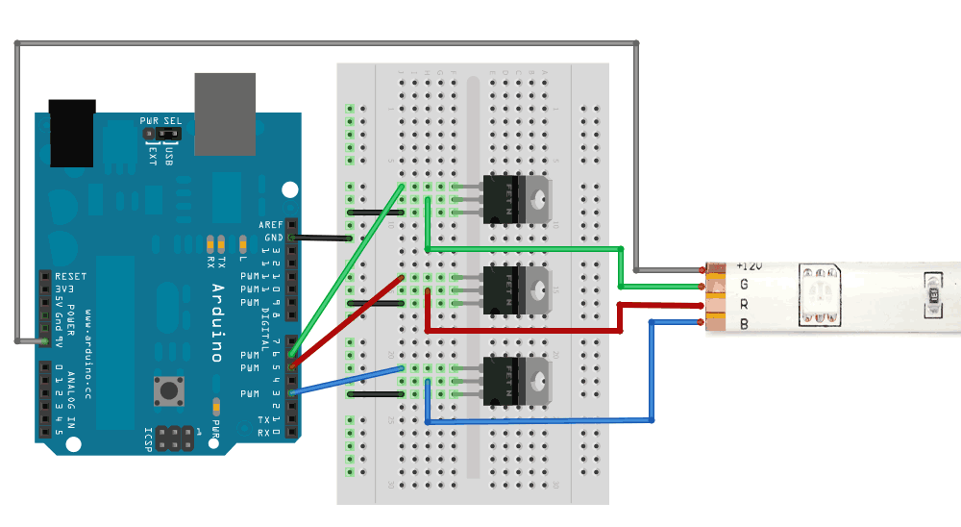
This diagram shows connecting up with N-Channel MOSFETs where the Gate is pin 1, the Drain is pin 2 and the Source is pin 3

Slide 3
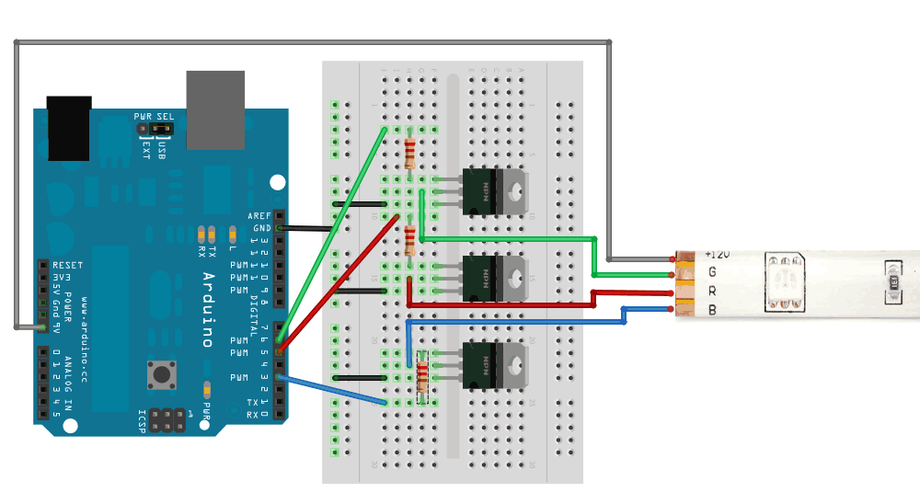
This diagram shows connecting up with power NPN transistors such as TIP120, where Base is pin 1, Collector is pin 2 and Emitter is pin 3. Its very similar except this time we have 100-220 ohm resistors between the PWM output pin and the base.

