Slide 1
MySurveillance
Security monitoring system application

Slide 2


INTRODUCTION
Collects and analyzes security reports from all network devices and system applications
MySurveillance client-server architecture helps to monitor from a central
Malaysian Administrative Modernisation and Management Planning Unit

Slide 3
FEATURES
Support log files generated by various devices and applications
Real-time analysis
Built-in event log filter
Data to be collected and correlated from sensors deployed on supported devices
Malaysian Administrative Modernisation and Management Planning Unit

Slide 4
COMPONENTS
Operating System : CentOS 5
High Availability Server / Central : Prelude-manager
Log Analyzer : Prelude-lml
Console : Prewikka
Web Based : Apache
Database : MySQL
Malaysian Administrative Modernisation and Management Planning Unit

Slide 5
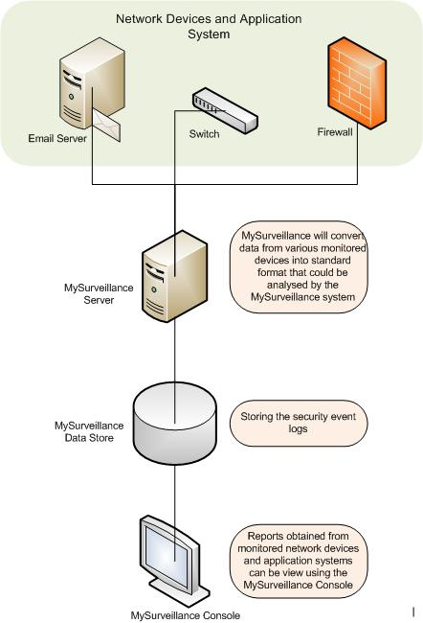
ARCHITECTURE
Malaysian Administrative Modernisation and Management Planning Unit

Slide 6
For more information:
Alamat :
Open Source Competency Centre (OSCC), MAMPU
Tingkat 3, Apt E302-304, Lot 12076, Persiaran APEC
Enterprise Building 3, 63000 Cyberjaya, Malaysia
Telefon : 603-83191200
Fax : 603-83193206
Laman Web :
http://mysurveillance.oscc.org.my
http://oscc.org.my
Malaysian Administrative Modernisation and Management Planning Unit

