Slide 1
MyWorkSpace
E-mail Collaboration Suite

Slide 2


INTRODUCTION
An E-mail collaboration suite which provide Calendar, Address Book, Notes and Task Todo.
It is an open Source applications, based on PHP and the Horde Framework.
Malaysian Administrative Modernisation and Management Planning Unit

Slide 3
FEATURES
Public and shared resources
Integrated user management, group support and permission system with the tools from third party
Synchronization with PDAs, mobile phones and groupware clients
Message filtering and searching
Spell checking
Quota support
Malaysian Administrative Modernisation and Management Planning Unit

Slide 4
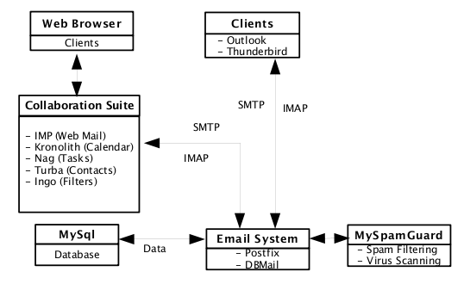
ARCHITECTURE
Malaysian Administrative Modernisation and Management Planning Unit

Slide 5
OSS BASE SOLUTION
CentOS
Operating system that is based on Red Hat Enterprise Linux. It is to be 100% binary compatible with the upstream product and, within its mainline and updates along with other Free and Open Source Software RPM-based packages.
Horde-Webmail
A PHP-based Web application framework.It offers applications such as the Horde IMP email client and groupware package (calendar, notes, tasks, file manager).
Malaysian Administrative Modernisation and Management Planning Unit

Slide 6
OSS BASE SOLUTION
Mnemo
Mnemo is the Horde notes and memos application. It lets users keep free-text notes and other bits of information which doesn't fit as a contact, a todo item, an event, etc. It is very similar in functionality to the Palm Memo application.
Kronolith
Kronolith is the Horde calendar application. It provides a stable and featureful individual calendar system for every Horde user, with integrated collaboration/scheduling features. It makes extensive use of the to Horde Framework provide integration with other applications
Malaysian Administrative Modernisation and Management Planning Unit

Slide 7
OSS BASE SOLUTION
Nag
Nag is the Horde task list application. It stores todo items, things due later this week, etc. It is very similar in functionality to the Palm ToDo application
Turba
Turba is the Horde contact management application. It is a production level address book, and makes heavy use of the Horde framework to provide integration with IMP and other Horde applications
Malaysian Administrative Modernisation and Management Planning Unit

Slide 8
OSS BASE SOLUTION
Postfix
Postfix attempts to be fast, easy to administer, and secure, while at the same time being sendmail compatible enough to not upset existing users.
DBMail
Dbmail is the name of a group of programs that enable the possiblilty of storing and retrieving mail messages from a database. Currently MySQL, PostgreSQL and SQLite can be used as database backends
Malaysian Administrative Modernisation and Management Planning Unit

Slide 9
OSS BASE SOLUTION
MySQL
The MySQL database has become the world's most popular open source database because of its consistent fast performance, high reliability and ease of use.
Malaysian Administrative Modernisation and Management Planning Unit

Slide 10
COMPONENTS
Operating System : CentOS 5
Framework : Horde-webmail
Mail Transport Agent : Postfix
Mail Delivery Agent : DBMail
Database : MySQL
Web Server : Apache
Malaysian Administrative Modernisation and Management Planning Unit

Slide 11
FUTURE ENHANCEMENTS
Module PASSWD : Easy for end-user to manage their own password
Gollem : File sharing purpose
Malaysian Administrative Modernisation and Management Planning Unit

Slide 12
MYWORKSPACE IN AGENCY
Southeast Asia Regional Centre for Counter Terrorism (SEARCCT)
Jabatan Kebajikan Masyarakat (JKMM)
Polis DiRaja Malaysia (PDRM)
Institut Integriti Malaysia (IIM)
Collaborative uElectronic Design Excellence Centre (CEDEC), USM
Malaysian Administrative Modernisation and Management Planning Unit

Slide 13
For more information:
Alamat :
Open Source Competency Centre (OSCC), MAMPU
Tingkat 3, Apt E302-304, Lot 12076, Persiaran APEC
Enterprise Building 3, 63000 Cyberjaya, Malaysia
Telefon : 603-83191200
Fax : 603-83193206
Laman Web :
http://myworkspace.oscc.org.my
http://oscc.org.my
Malaysian Administrative Modernisation and Management Planning Unit

