Slide 1
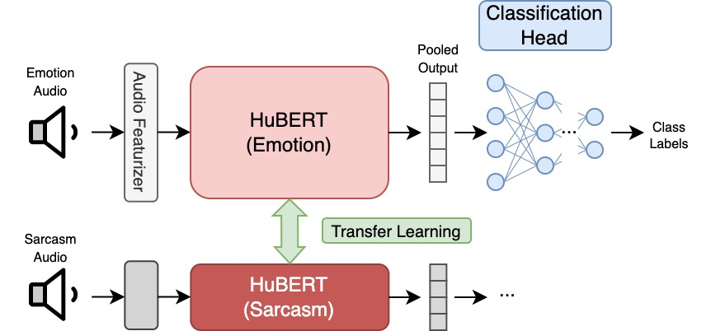

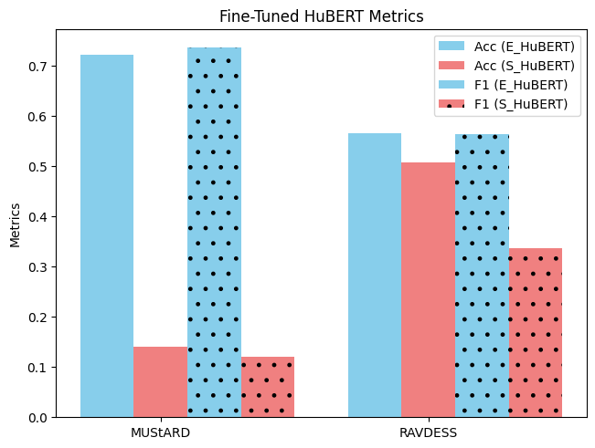
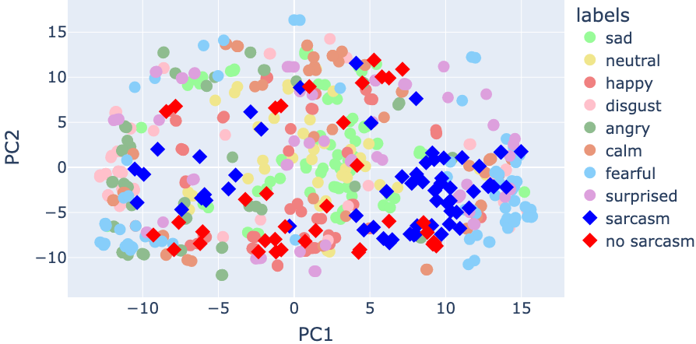
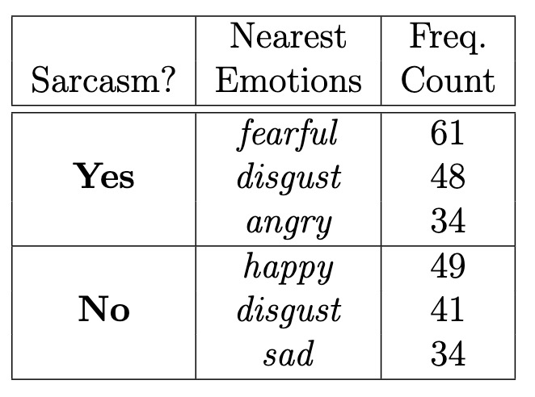
Transfer Learning with HuBERT Audio Classification for Sarcasm and Emotion Detection Vincent Lin¹
¹ MIT
Motivation
Method
Sarcasm is a very subtle aspect of speech for even humans to identify
Multiple modalities of input: speech prosody, visual expressions, textual context
Can neural networks learn to detect sarcasm with a learned representation of speech emotion detection?
Research Question: Can sarcasm detection be improved via Transfer Learning from HuBERT fine-tuned on emotion detection data?
Research Question: Are learned representations of emotions in HuBERT conducive to better representations of sarcasm?
Data
MUStARD: sarcasm classification
RAVDESS: 8-emotion classification
Method
Model: Wav2vec2 featurizer, HuBERT audio encoder, linear classifier
Transfer Learning: fine-tune HuBERT on emotion data, test on sarcasm data
Results
Conclusions
Takeaways
Relationship between prosody of emotional speech and that of sarcastic speech
Discussion
Subtleties of emotion/sarcasm exaggerated in data
Joint training of multimodal sarcasm detection + emotion detection?

