Slide 1
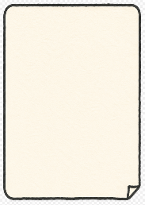
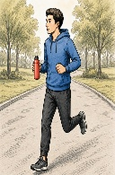
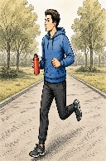
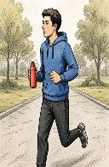
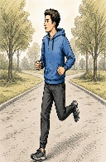
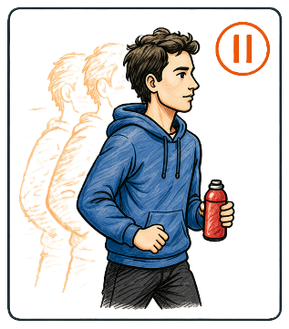
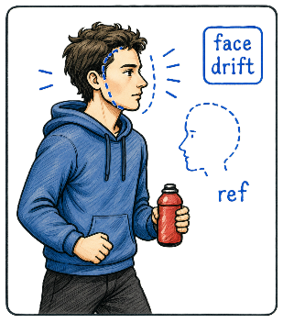
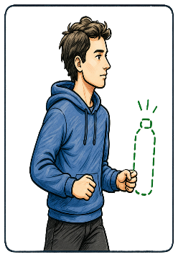




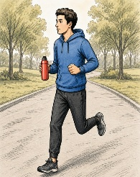
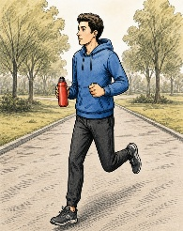

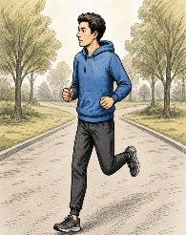
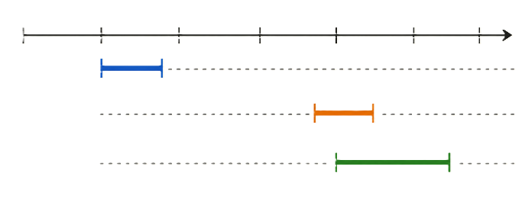
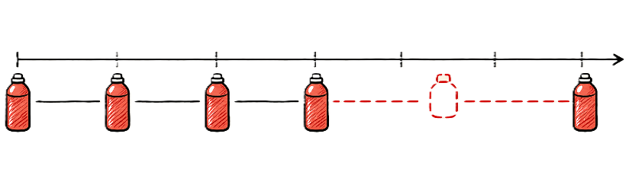

Diagnosis Suite
Localized Evidence View
Repair Suite
Prompt
Generated Video
Evidence Keyframes
A man in a blue hoodie jogging in the park,holding a red water bottle
t=1.2s
t=4.0s
t=4.6s
ID_FACE_DRIFT
1.0s-1.4s
MO_FROZEN_FRAME
3.8s-4.2s
AL_PROP_MISSING
4.0s-5.0s
Face
Drift
Repair Plan
t=0s
t=2s
t=4s
t=6s
ref
Code+Span+Target
Evidence Encoder
Executable Patch Bundle
Generated Video
Inject Reference
Identity
Motion
Prop
Temporal
Motion Constraint
Evidence
Grounding
Inject Prop
Diagnosis Records
Conditioned on Records
ID_FACE_DRIFT | 1.0s-1.4s | Identity inconsistency
MO_FROZEN_FRAME | 3.8s-4.2s | Motion stalled
AL_PROP_MISSING | 4.0s-5.0s | Red bottle missing
ST_STYLE_FLICKER | 2.0s-3.6s | Style flicker
SC_SCENE_JUMP | 5.2s-5.6s | Scene jump
Repair
Loop
t=2s
t=6s
Re-generated Video
t=0s
t=4s
Evidence Timeline
ID_FACE_DRIFT
1.0s-1.4s
Repair
Planning
MO_FROZEN_FRAME
3.8s-4.2s
t=0s
t=2s
t=4s
t=6s
AL_PROP_MISSING
4.0s-5.0s
Failure Code Groups
Prop Track(Red Bottle)
Verification Check
0s
1s
2s
3s
4s
5s
6s
0s
1s
2s
3s
4s
5s
6s
ID_*
CA_*
MO_*
AL_*
ST_*
SC_*
Missing
(4.0s-5.0s)
Resolved
Remaining ‡ 0

