Slide 1





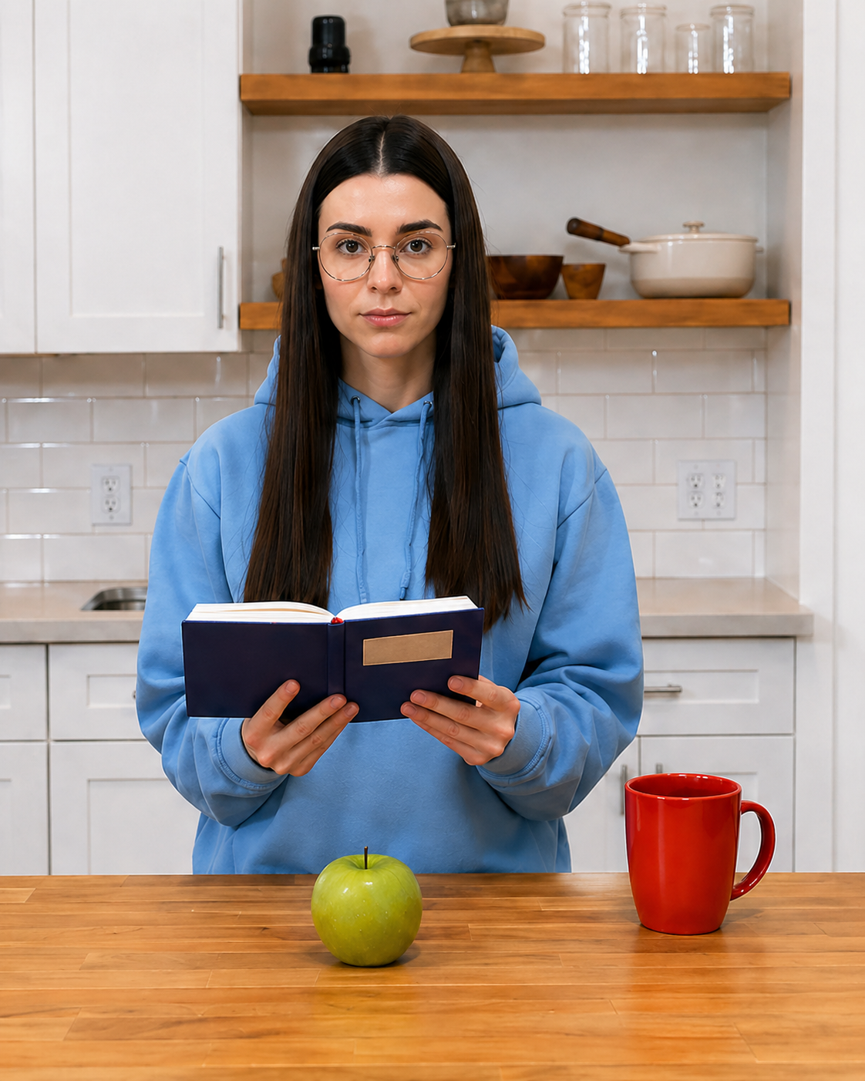

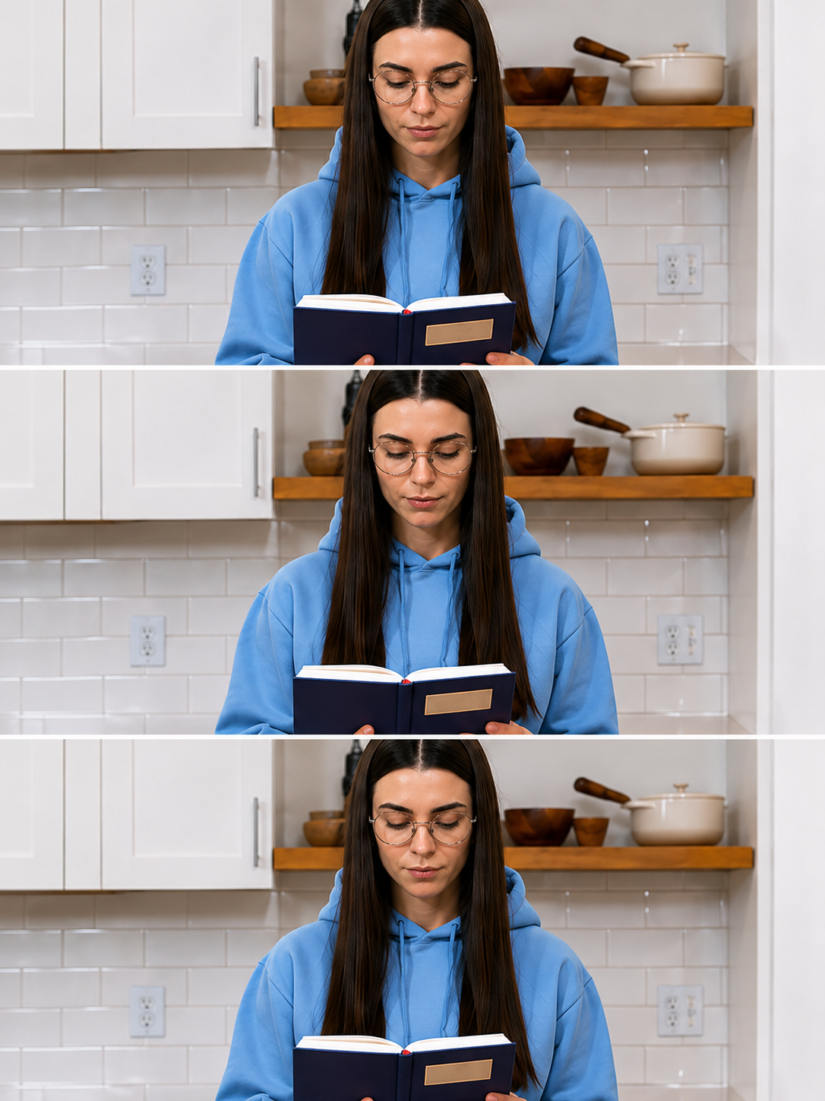
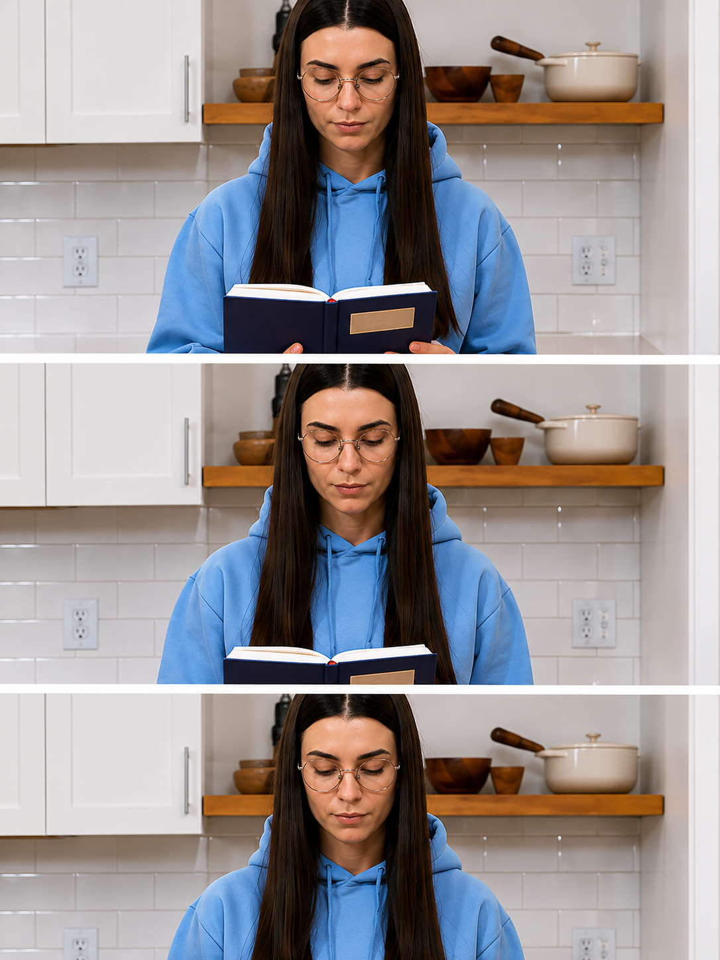
(a) Reference Frame
(b) Face Drift
(c) Prop Missing
Expected
Observed
Expected
Observed
t=1.2s-1.4s
t=2.3s-2.4s
(d) Camera Deviation
(e) Frozen Frame
Expected
Observed
Expected
Observed
t=3.1s-3.4s
t=4.6s-4.7s

