Slide 1
Scripting Blender File
Linxiao Wu

Slide 2
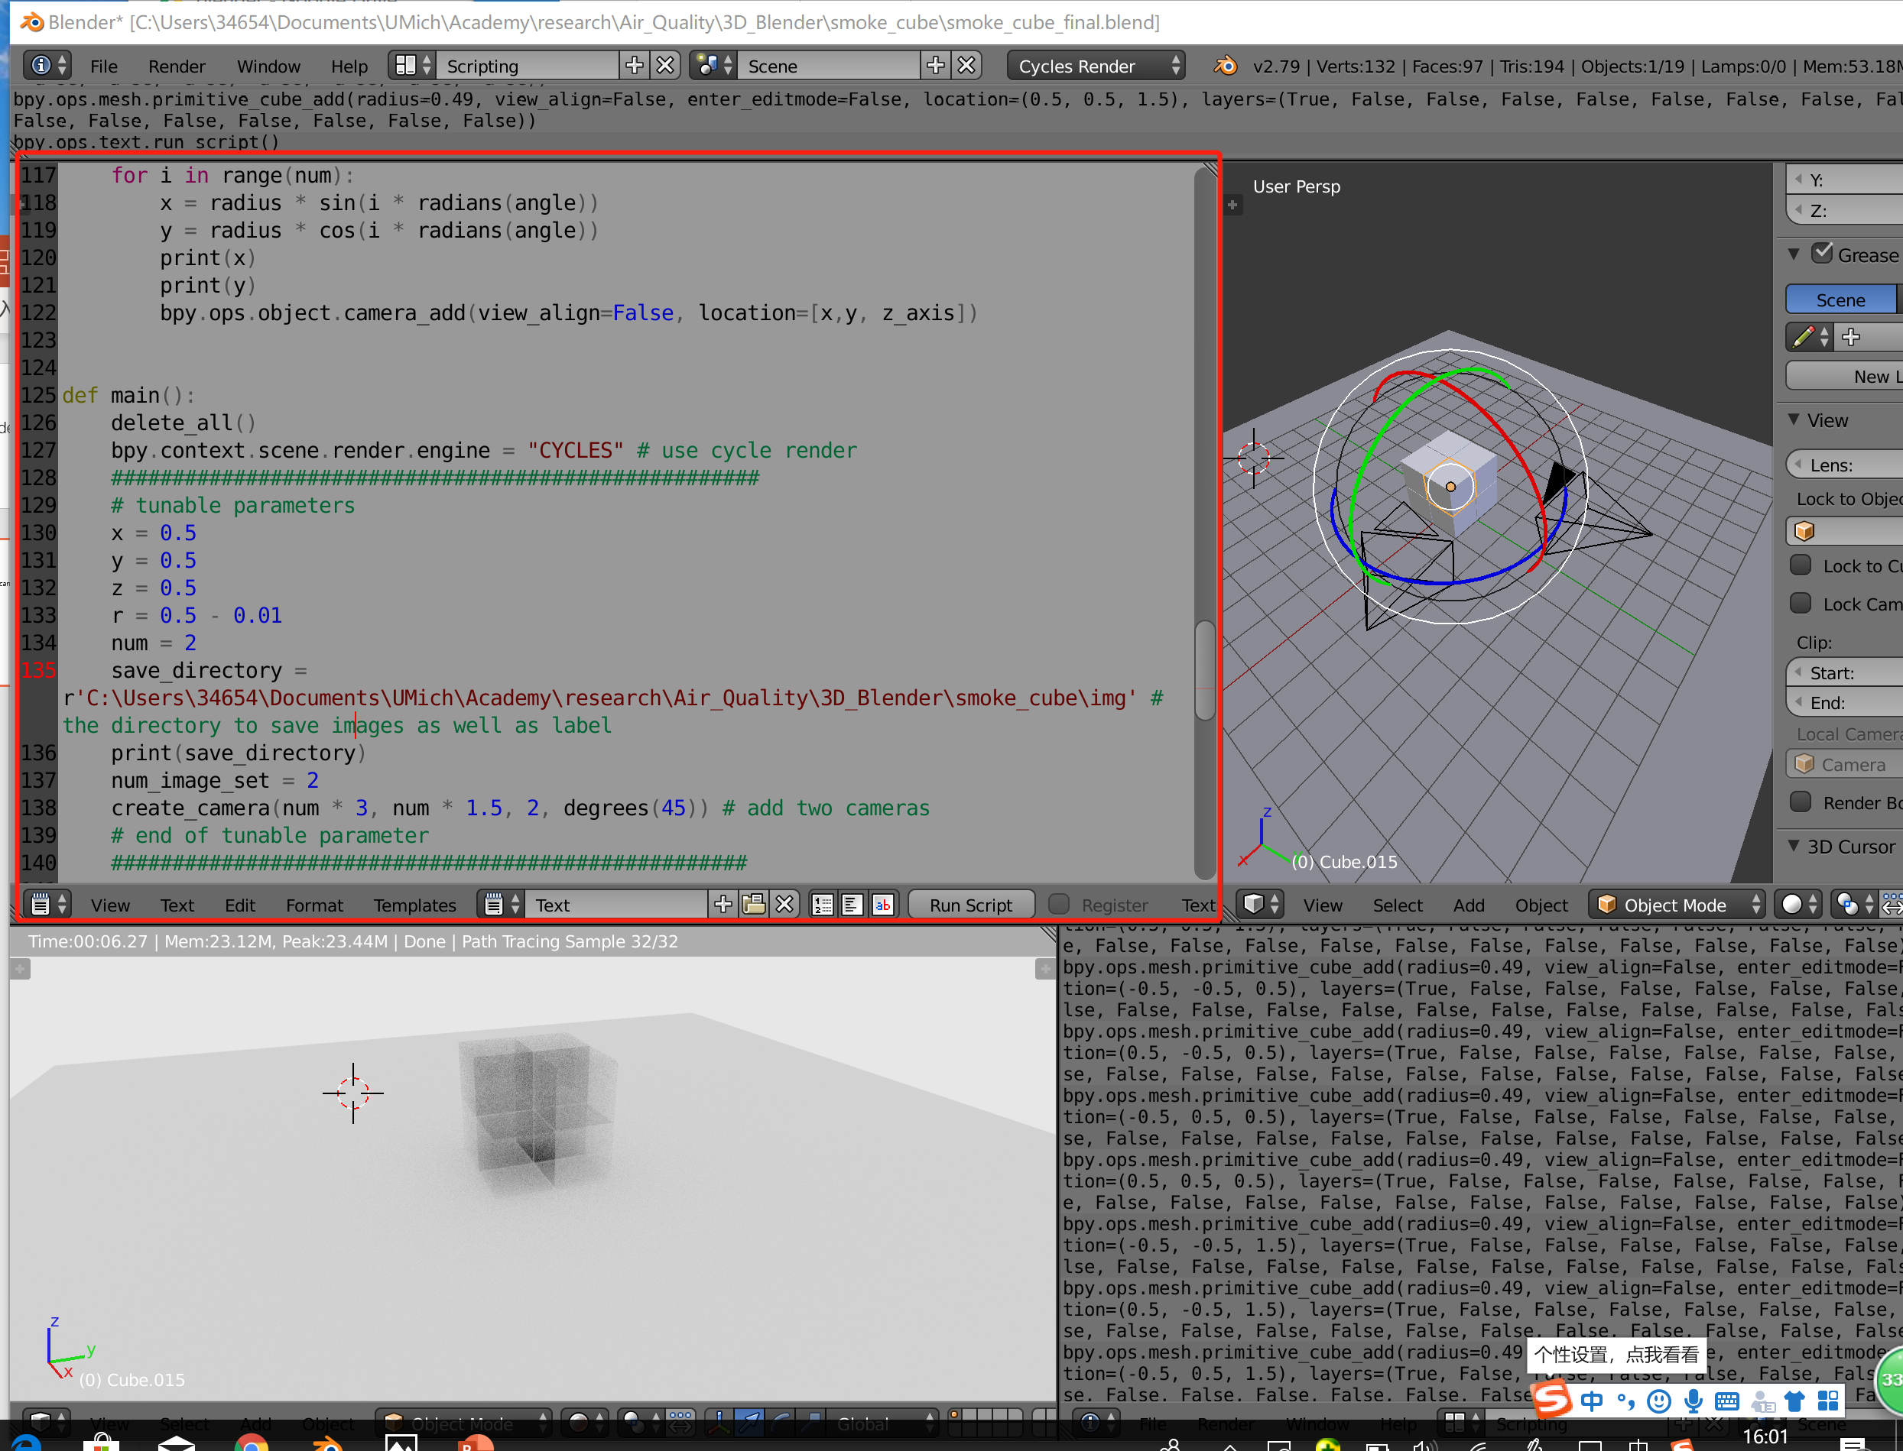
Overview
This code is used within blender, which can be downloaded online

Slide 3
Usage and Function
Create piled cubes with different parameters of Volume Scatter in order to simulate haze(smoke). In this function I set it to a uniform distribution of [0.1, 0.3]
Output a .txt which specifies the parameter of each cube(See Appendix for the format)
Generate customized multiple views from camera, and save to a customized directory
Should set ambient light parameters within blender(did not set it within code)

Slide 4
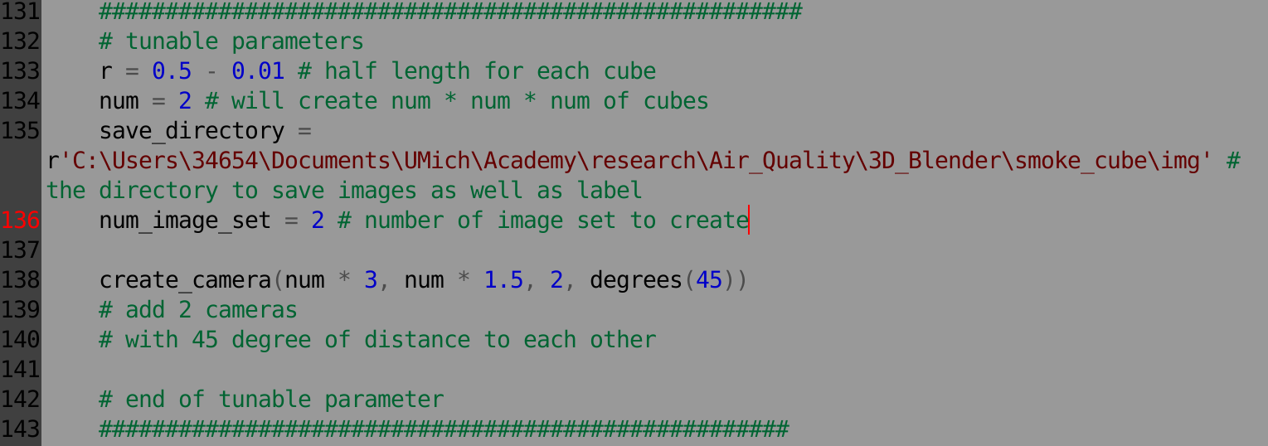
Tunable Parameter
Each image set means a set of images generated from each camera, and will be attached with a label to specify the parameters(volume scatter)
In this case, Each camera lies with in a arc with radius num * 3 in this case, and each with 45 degrees away from each other
If you set to like 6 camera, each with 60 degree distance, then it will form complete circle views, each camera point at the circle

Slide 5
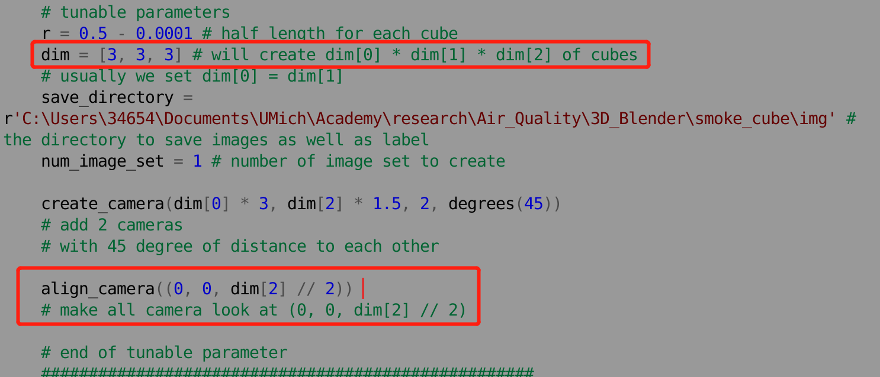
Tunable Parameter(2019 0710 Version 2)
I made camera to look at an exact coordination. See the comment in blender file second version. Also I make dimension of cubes to be tuned by 3 dimensions

Slide 6
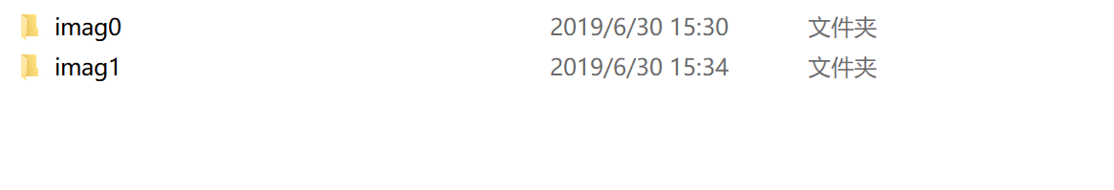
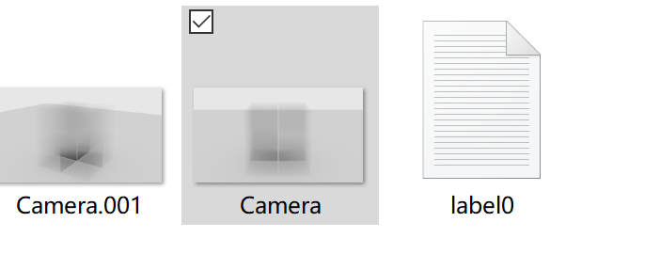
Sample Output

Slide 7
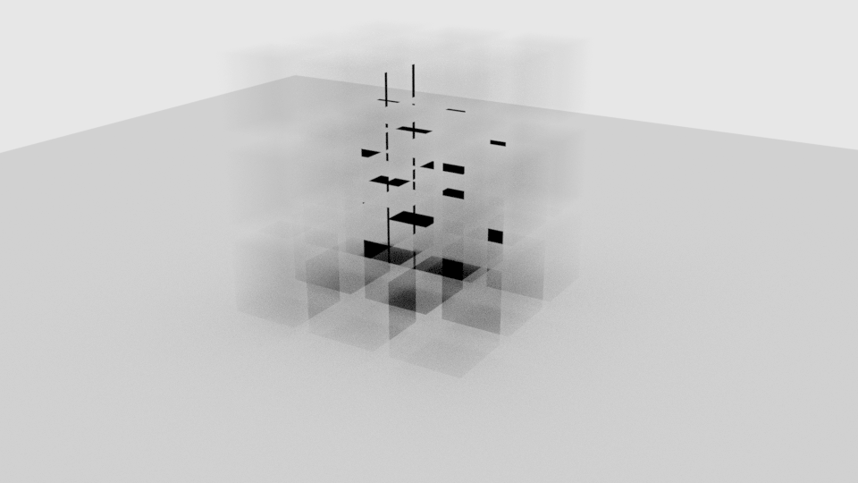
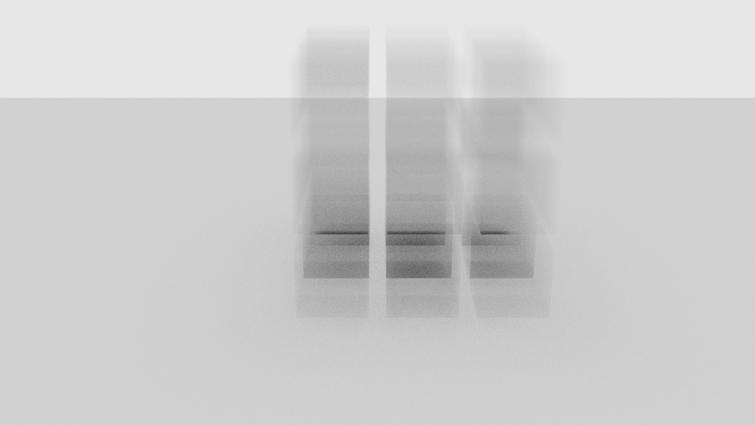
Problem to be Solved(updating)
Strange shade from overlapping(3 * 3 * 3, with r = 0.5 – 0.1, which means there is gap between each cube)

Slide 8
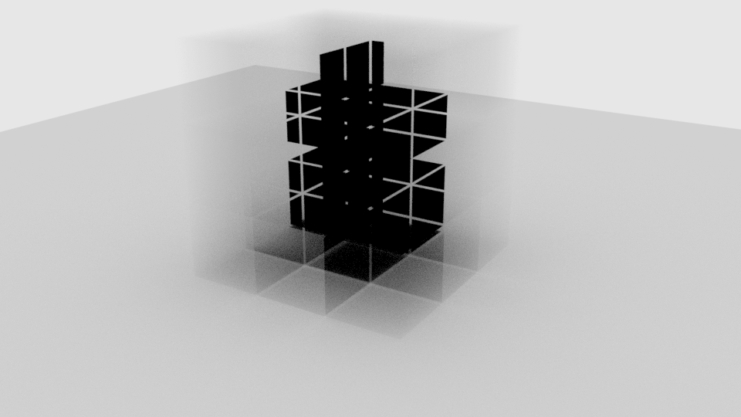
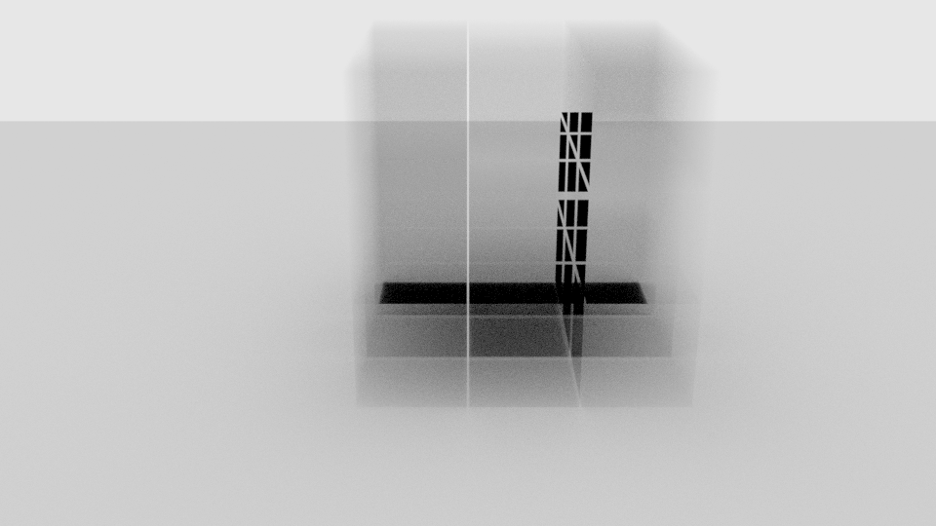
Problem to be Solved(Resolved)
Strange shade from overlapping(3 * 3 * 3, with r = 0.5 – 0.01 , which means there is a little gap between each cube)

Slide 9
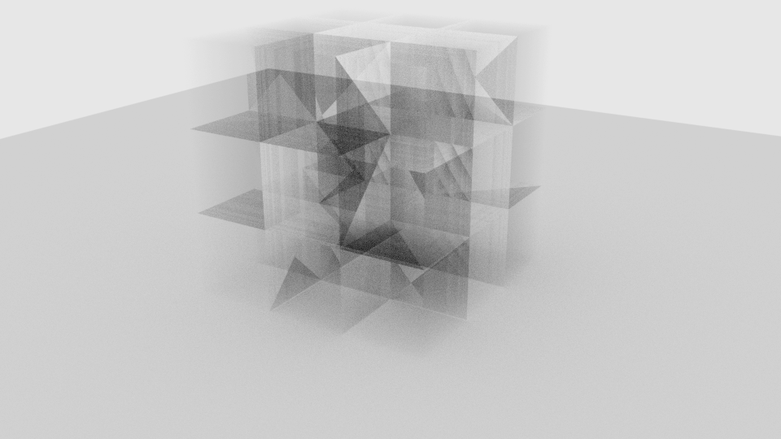
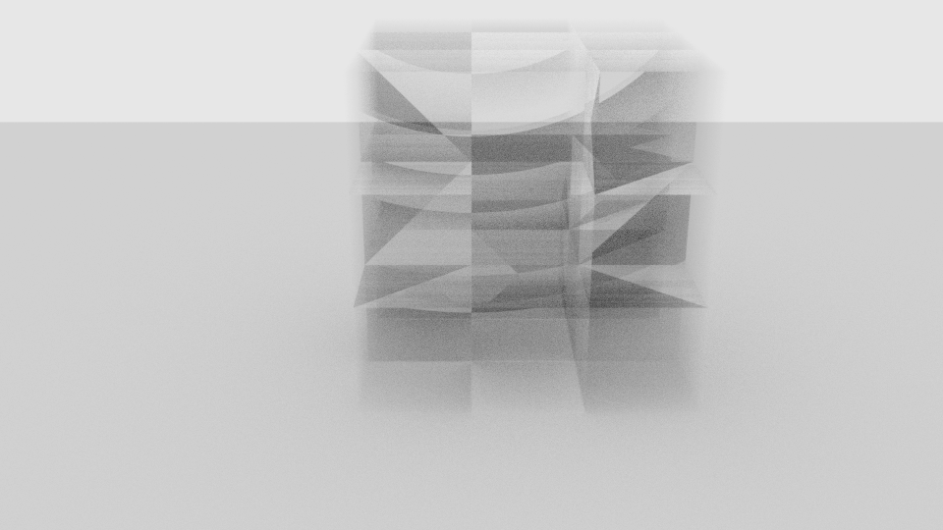
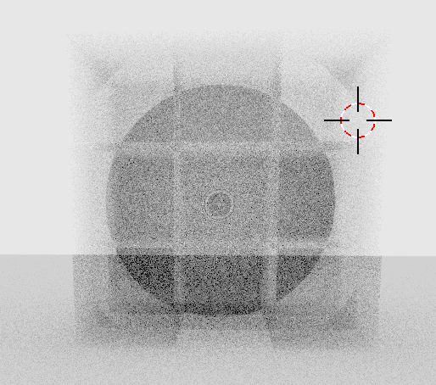
Problem to be Solved(updating)
Strange shade from overlapping(3 * 3 * 3, with r = 0.5, which means there is no gap between each cube, touch each other)

Slide 10
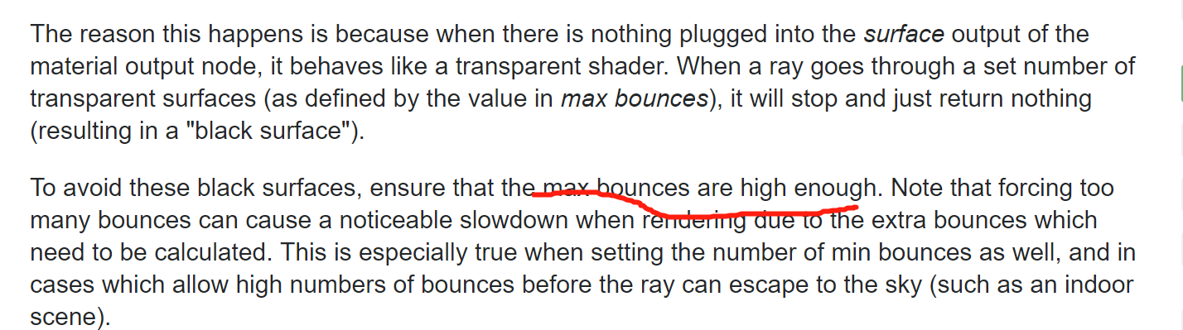
Problem resolved (updating)2019 0703
https://blender.stackexchange.com/questions/18857/how-to-eliminate-cycles-artifacts-with-many-overlapping-volumes

Slide 11
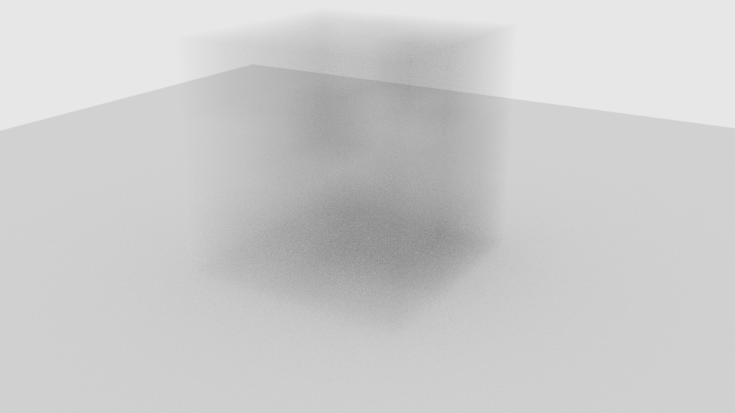
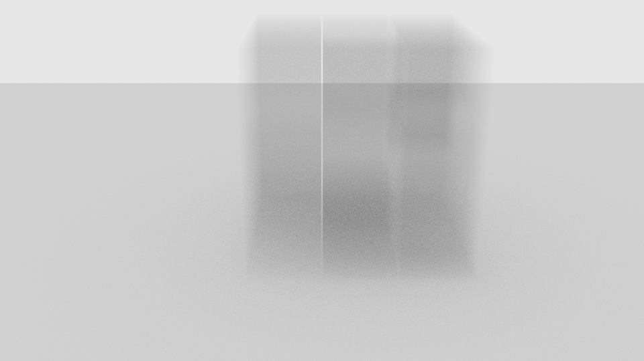
Problem to be Solved(Resolved)
Strange shade from overlapping(3 * 3 * 3, with r = 0.5 – 0.01 , which means there is a little gap between each cube)

Slide 12
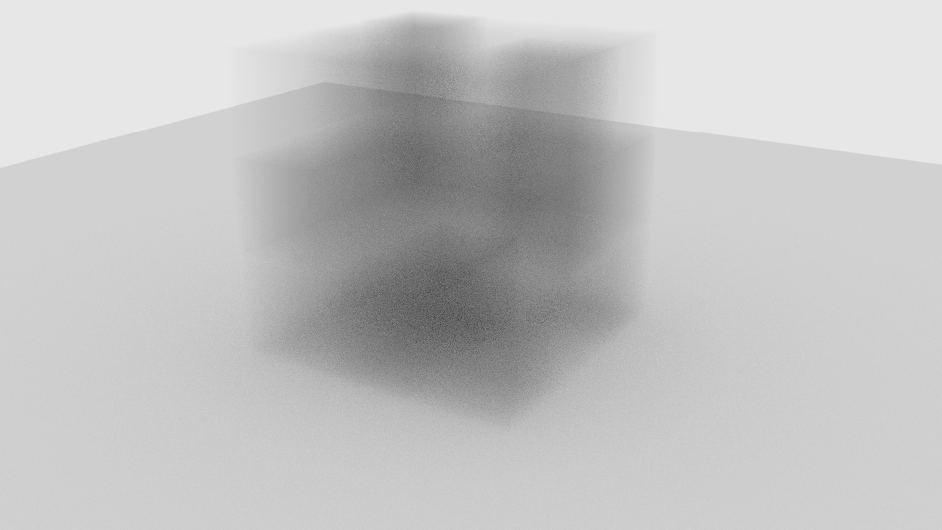
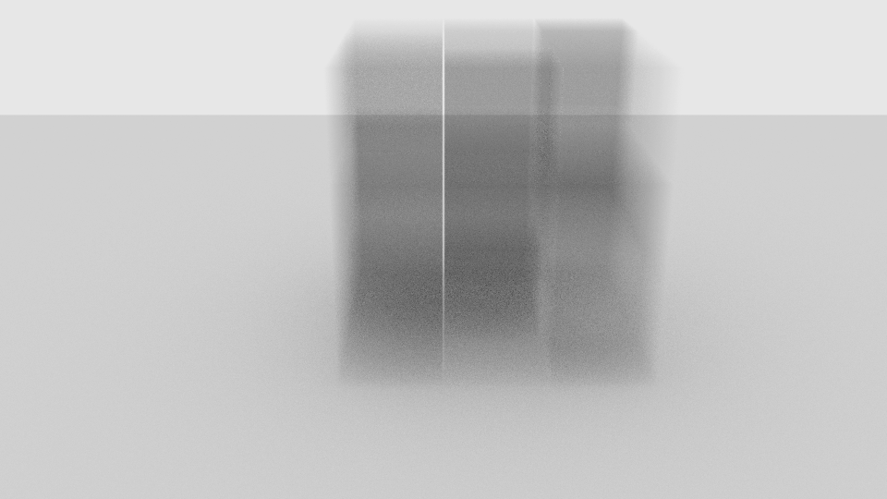
Problem to be Solved(Resolved)
With more variations: uniform(0.1, 0.8)

Slide 13
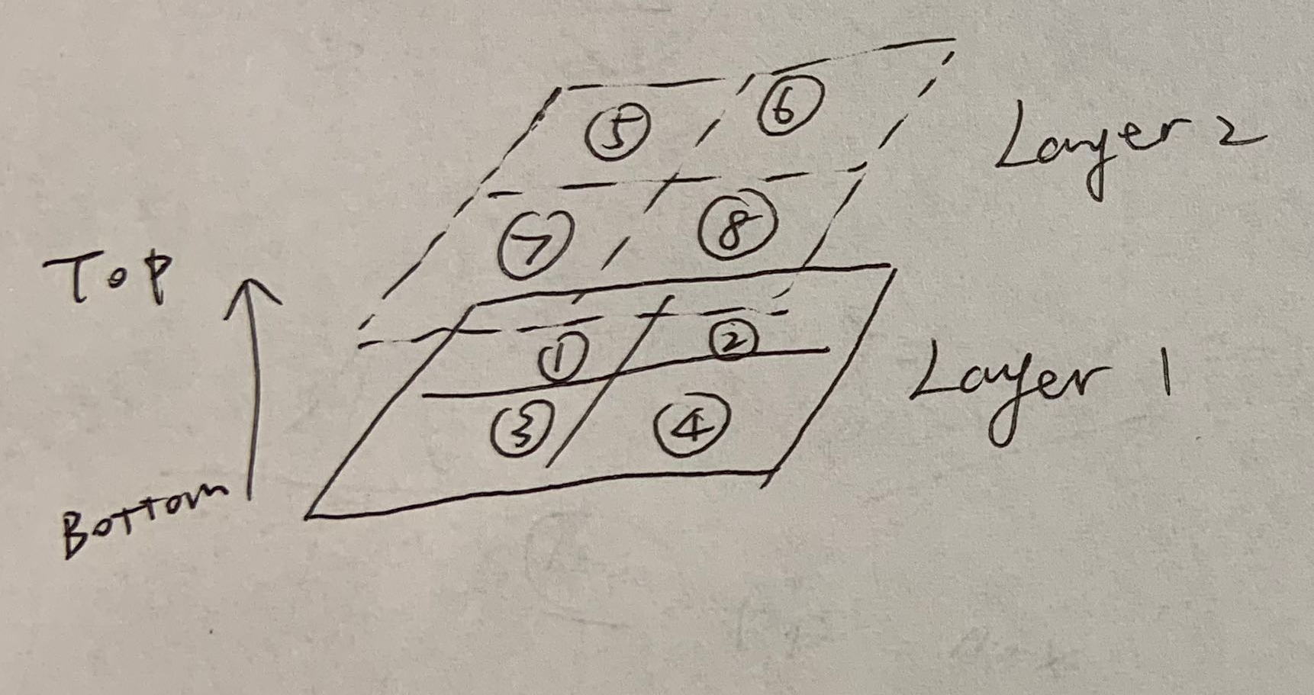
Appendix
Output file format(label)
Each layer a matrix to specify its volume scatter
For each layer: from bottom to top
With each layer: from row to row
eg:(Take the right picture as example)
Layer0:
1 2
3 4
Layer1:
5 6
7 8

