Slide 1
Exercise and Practice
Rui Ren
2018-09-19

Slide 2
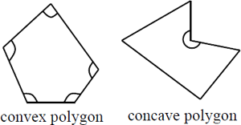
Background
Concave Polygon（凹多边形） VS. Convex Polygons（凸多边形）

Slide 3
Practice
Requirements
Basic:
Print the type of the polygon according to given points.
Sample input file
0,0 2,2 3,1
Print
Advanced:
If the polygon is concave, split it into some convex polygons.
Store the results in convex.out
If the polygon is concave, split it into some convex polygons.
Store the results in triangle.out

Slide 5
Example
0,3 3,3 3,2 5,4 5,2
4,2 4,1 5,1 6,5 6,1
3,0

Slide 6
谢谢！

