Slide 1
Largest Rectangle in Histogram
Alan Lin Hsu
2018-11-14

Slide 2
3
2
1

Slide 3
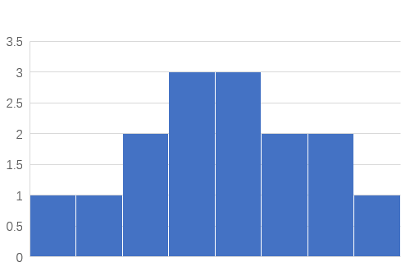
0 1 2 3 4 5 6 7

