Slide 1
Exercise and Practice
Alan Lin
2018-10-10

Slide 2
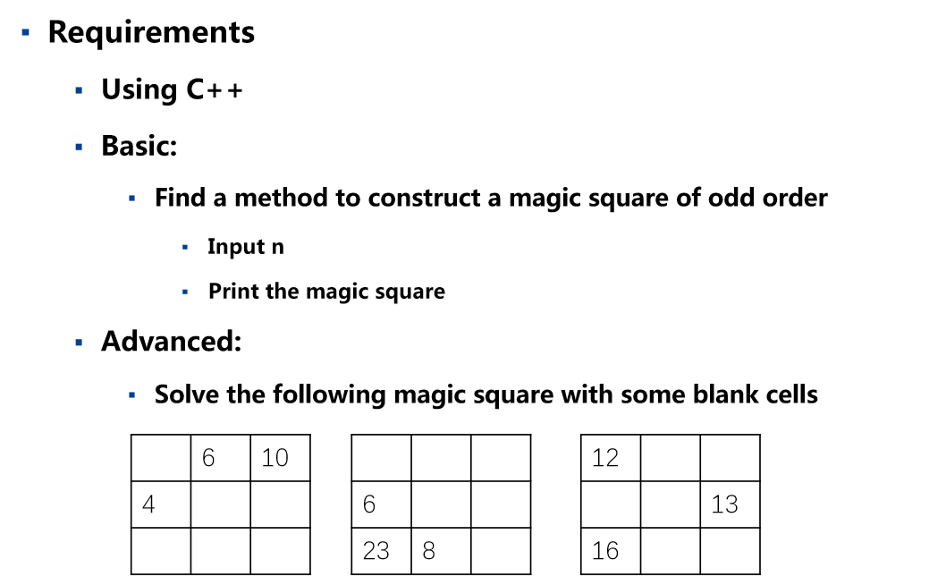
Background

Slide 3
Solution:
Directly Calculating;
Equation Set;
Laws of three order magic square.

Slide 4
Equation Set:
Equation of degree one with n unknown
a+6+10 = sum
a+b+c = sum
d+e+f = sum
a+4+d = sum
6+b+c = sum
10+c+f = sum
a+b+f = sum
10+b+d = sum
a | 6 | 10
4 | b | c
d | e | f
 | 6 | 10
4
Notes:
再构造一个增广矩阵，然后高斯消元，得到一个下三角

Slide 5
Equation Set:
Equation of degree one with one unknown
Sum = x +16
 | 6 | 10
4
 | 6 | 10
4 | x-6 | 18
12 | 16 | 22-x
X
X
0 0
0 1 0
0 0 -1

Slide 6
Equation Set:
Equation of degree one with three unknown
The three numbers across the center point make up an arithmetic progression
X

Slide 7
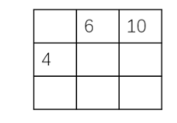
Equation Set:
Equation of degree one with three unknown
X+y | x-y-z | X+z
X-y+z |  | X+y-z
X-z | X+y+z | X-y
x-y+z = 4
x-y-z = 6
x+z =10
X
-1 1
1 -1 -1
1 0 1
4
6
10

Slide 8
Laws of three order magic square:
 | 6 | 10
4
17
11
18
12
16
5

Slide 9
Thanks

