Slide 1
Microservices
Your first choice of software architecture

Slide 2
Outline
Monoliths
Microservices
Conclusion

Slide 3
Monoliths: the way we were

Slide 4
Starting out – simple monolithic application
Dev Team 1
When monolithic application is not large …

Slide 5
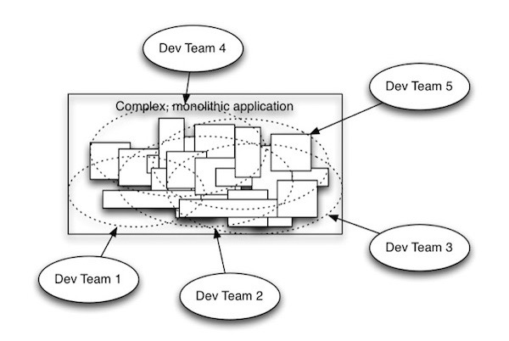
Your once-simple application has become large and complex…

Slide 6
Microservices

Slide 7
Microservices Architecture

Slide 8
Microservices and containers

Slide 9
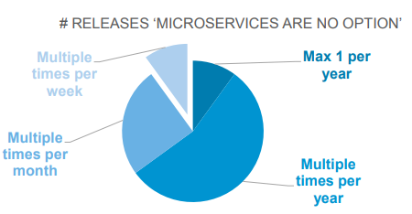
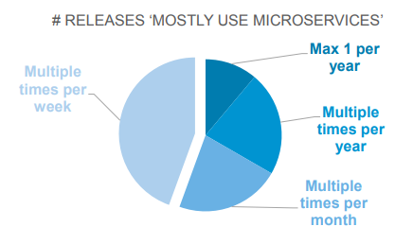

A Survey of Microservices(leanIX 2017)
Notes:
To present microservices applied in the real world, here we show a survey that was carried out by leanIX in 2017. (动画) This pie chart shows the frequency of application releases of companies that do not adopt microservices. As we can see, most companies only release multiple times a year, and very few companies release multiple times per week. However, things become different with microservices applying. (动画)
From this new chart, we could find that most companies have multiple times of release per week. Actually, the more frequently the company release applications, the more rapidly it could react to changing requirements of customers. This could decide on the market share of applications significantly, especially of applications in developing markets. (动画)
For example, Wechat released several times per day in its early time. Thus, if you want to build a super application like Wechat, you’d better adopt microservices to release more frequently.

Slide 10
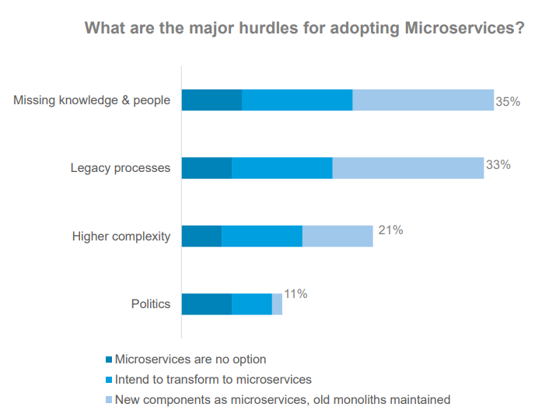
A Survey of Microservices(leanIX 2017)
Notes:
The bar chart in the left shows the difficulties companies meet when adopting microservices. Missing knowledge and people, legacy processes and higher complexity are all common hurdles. (动画)
The complex microservices architecture, as the graph displayed in the right, could be blamed for these hurdles. There are often more components involved in microservices architecture, and those components have more interconnections.

Slide 11
Conclusion

Slide 12
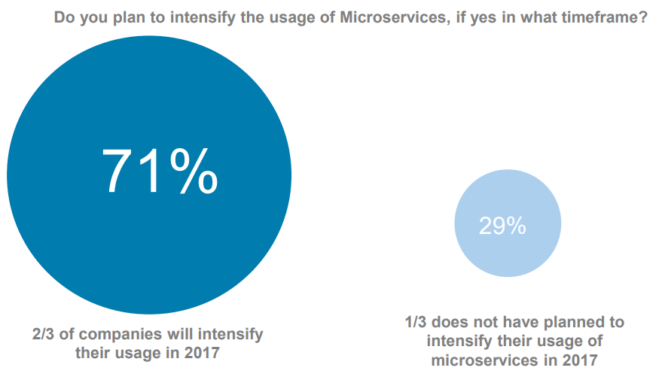
Microservices: popular and powerful
Advantages:
Scalability
Maintainability
Agility
Hurdles
Complexity
Worth it
Notes:
In conclusion, developing applications in microservices would improve scalability, maintainability, and agility. Although there are hurdles due to the complexity of the architecture, the benefits worth it. (动画)
As the graph shows, up to 71% of companies would intensify the usage of microservices. Therefore, microservices is strongly suggested to be adopted in your applications, especially for newly set up ones.

Slide 13
Thanks
Notes:
That’s it for our talk today and thank you for your attention. Any questions, please?

