Slide 1
Transactional Memory: Architectural Support for Lock-Free Data Structures
By Maurice Herlihy and J. Eliot B. Moss
Presented by Ashish Jha
PSU SP 2010 CS-510
05/04/2010

Slide 2
Agenda
Conventional locking techniques and its problems
Lock free synchronization & its limitations
Idea and Concept of TM (Transactional Memory)
TM implementation
Test Methodology and Results
Summary

Slide 3
Conventional Synch Technique
Proc A
Proc B
Lo-priority
Holds Lock A
Pre-emption
Hi-priority
Priority Inversion
Can’t proceed
Get Lock A
Holds Lock A
De-scheduled
Convoying
Get Lock A
Can’t proceed
Ex: Quantum expiration,
Page Fault, other interrupts
//CS
Lock A
Lock B
do_something
UnLock B
UnLock A
Deadlock
Holds Lock A
Can’t proceed
Holds Lock B
Can’t proceed
Get Lock B
Get Lock A
Uses Mutual Exclusion
  Blocking i.e. only ONE process/thread can execute at a time
Easy to use
Typical problems as seen in highly concurrent systems makes it less acceptable

Slide 4
Lock-Free Synchronization
SW=Software, HW=Hardware, RMW=Read-Modify-Write
Non-Blocking as doesn’t use mutual exclusion
Lots of research and implementations in SW
  Uses RMW operations such as CAS, LL&SC
    limited to operations on single-word or double-words (not supported on all CPU arch)
  Difficult programming logic
  Avoids common problems seen with conventional Techniques such as Priority inversion, Convoying and Deadlock
Experimental evidence cited in various papers, suggests
  in absence of above problems and as implemented in SW, lock-free doesn’t perform as well as their locking-based ones

Slide 5
Basic Idea of Transactional Memory
Leverage existing ideas
HW - LL/SC
  Serves as atomic RMW
  MIPS II and Digital Alpha
    Restricted to single-word
SW - Database
    Transactions
      How about expand LL&SC to multiple words
    Apply ATOMICITY
      COMMIT or ABORT

Slide 6
TM - Transactional Memory
Allows Lock-free synchronization and implemented in HW
  Provides mutual exclusion and easy to use as in conventional techniques
Why a Transaction?
  Concept based on Database Transactions
    EXECUTE multiple operations (i.e. DB records) and
    ATOMIC i.e. for “all operations executed”, finally
      COMMIT – if “no” conflict
      ABORT – if “any” conflict
  Replaces the Critical Section
How Lock-Free?
  allows RMW operations on multiple, independently chosen words of memory
    concept based on LL & SC implementations as in MIPS, DEC Alpha
      But not limited to just 1 or 2 words
  Is non-blocking
    Multiple transactions for that CS could execute in Parallel (on diff CPU’s) but
      Only ONE would SUCCEED, thus maintaining memory consistency
Why implemented in HW?
  Leverage existing cache-coherency protocol to maintain memory consistency
  Lower cost, minor tweaks to CPU’s
    Core
    Caches
    ISA
    Bus and Cache coherency protocols
  Should we say, HW more reliable than SW

Slide 7
A Transaction & its Properties
Proc A
Proc B
SEARIALIZABILITY
//finite sequence of machine instructions
[A]=1
[B]=2
[C]=3
x=VALIDATE
Incremental changes
//finite sequence of machine instructions
z=[A]
y=[B]
[C]=y
x=VALIDATE
No interleaving with ProcB
//we will see later HOW and WHY?
If(x)
COMMIT
ELSE
ABORT
If(x)
COMMIT
ELSE
ABORT
ATOMICITY
Wiki: Final outcome as if Tx executed “serially” i.e. sequentially w/o overlapping in time
//COMMIT i.e. make all above changes visible to all Proc’s
ALL
or NOTHING
//ABORT i.e. discard all above changes
If for ProcB, say
  all timings were same as ProcA, then both would have ABORT’ed
  All timings different, then both would have COMMIT’ed
    guaranteed Atomic and Serializable behavior
Assumption
  a process executes only one Tx at a time

Slide 8
ISA requirements for TM
NI for Tx Mem Access
NI for Tx State Mgmt
READ-SET
Y
DATA-SET
Updated?
FALSE
VALIDATE current
Tx status
LT reg, [MEM]
//pure READ
N
TRUE
ABORT
//Discard changes
to WRITE-SET
Y
WRITE-SET
Read by any other Tx?
DATA
SET
WRITE-SET
//cur Tx Aborted
//DISCARD
tent. updates
//cur Tx not yet
Aborted
//Go AHEAD
LTX reg, [MEM]
//READ with intent to WRITE later
N
ST [MEM], reg //WRITE to local cache,
//value globally visible only
after COMMIT
COMMIT
//WRITE-SET visible
to other processes
A Transaction consist of above NI’s
  allows programmer to define
    customized RMW operations
    operating on “independent arbitrary region of memory” not just single word
NOTE
  Non-transactional operations such as LOAD and STORE are supported but does not affect Tx’s READ or WRITE set
  Left to implementation
    Interaction between Tx and non-Tx operations
    actions on ABORT under circumstances such as Context Switch or interrupts (page faults, quantum expiration)
    Avoid or resolve serialization conflicts

Slide 9
TM NI Usage
LOCK-FREE usage of Tx NI’s
LT or LTX
//READ set of locations
F
VALIDATE
//CHECK if READ values are consistent
T
Critical Section
ST
//MODIFY set of locations
Fail
COMMIT
Pass
//HW make changes PERMANENT
Tx’s intended to replace “short” critical section
  No more acquire_lock, execute CS, release_lock
Tx satisfies Atomicity and Serializability properties
Ideal Size and duration of Tx’s implementation dependent, though
  Should complete within single scheduling quantum
  Number of locations accessed not to exceed architecturally specified limit
    What is that limit and why only short CS? – later…

Slide 10
TM – Implementation
Design satisfies following criteria
  In absence of TM, Non-Tx ops uses same caches, its control logic and coherency protocols
  Custom HW support restricted to “primary caches” and instructions needed to communicate with them
  Committing or Aborting a Tx is an operation “local” to the cache
    Does not require communicating with other CPU’s or writing data back to memory
TM exploits cache states associated with the cache coherency protocol
  Available on Bus based (snoopy cache) or network-based (directory) architectures
  Cache State could be in one of the forms - think MESI or MOESI
    SHARED
      Permitting READS, where memory is shared between ALL CPUs
    EXCLUSIVE
      Permitting WRITES but exclusive to only ONE CPU
    INVALID
      Not available to ANY CPU (i.e. in memory)
BASIC IDEA
  The cache coherency protocol detects “any access” CONFLICTS
    Apply this state logic with Transaction counterparts
      At no extra cost
  If any Tx conflict detected
    ABORT the transaction
  If Tx stalled
    Use a timer or other sort of interrupt to abort the Tx

Slide 11
TM – Paper’s Implementation
Example Implementation in the Paper
1st level $
2nd level … 3rd level
Main Mem
Proteus Simulator
32 CPUs
Two versions of TM implementation
  Goodmans’s snoopy protocol for bus-based arch
  Chaiken directory protocol for Alewife machine
L1D
Direct-mapped
Exclusive
2048 lines x 8B
Core
L2D
L3D
Tx $
Fully-associative
Exclusive
64 lines x 8B
1 Clk
4 Clk
Two Primary caches
  To isolate traffic for non-transactional operations
Tx $
  Small – note “small” – implementation dependent
  Exclusive
  Fully-associative
    Avoids conflict misses
  single-cycle COMMIT and ABORT
  Similar to Victim Cache
    Holds all tentative writes w/o propagating to other caches or memory
  ABORT
    Lines holding tentative writes dropped (INVALID state)
  COMMIT
    Lines could be snooped by other processors
    Lines WB to mem upon replacement

Slide 12
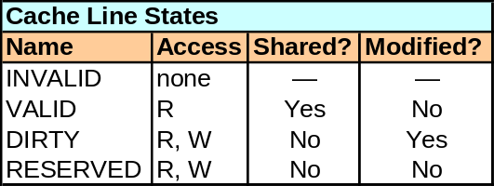
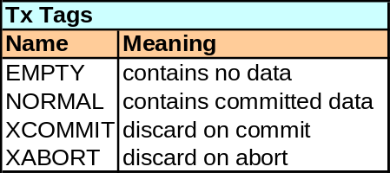
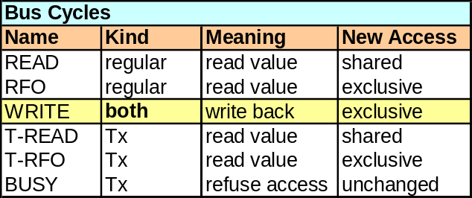
TM Impl. – Cache States & Bus Cycles
Tx Cache Line Entry, States and Replacement
a Tx Op
COMMIT
ABORT
CL Entry & States
XCOMMIT
Old value
EMPTY
XCOMMIT
Old value
XCOMMIT
2 lines
NORMAL
Old value
XABORT
New Value
NORMAL
XABORT
New Value
XABORT
EMPTY
New Value
CL Replacement
search
EMPTY
NP
NORMAL
NP
XCOMMIT
P
P
P
replace
replace
If DIRTY then WB to mem
replace
A dirty value “originally read” must either be
  WB to mem, or
  Allocated to XCOMMIT entry as its an “old” entry
    avoids continuous WB’s to memory and improves performance
Tx requests REFUSED by BUSY response
  Tx aborts and retries
    Prevents deadlock or continual mutual aborts
    Theoretically subject to starvation
      Could be augmented with a queuing mechanism
Every Tx Op takes 2 CL entries
  Tx cache cannot be big due to perf considerations - single cycle abort/commit + cache management
    Hence, only short Tx size supported

Slide 13
TM Impl. – CPU Actions
CPU Flags
TACTIVE – is Tx in Progress? Implicitly set when Tx executes its first Op – meaning start of CS
TSTATUS – TRUE if Tx is Active, FALSE if Aborted
TSTATUS=TRUE
LT reg, [Mem]
//search Tx cache
LTX reg, [Mem]
ST [Mem], reg
VALIDATE [Mem]
ABORT
COMMIT
//Miss Tx $
//UPDATE
Return TSTATUS
Return TSTATUS
Return DATA
Y
Is
XABORT DATA?
XABORT DATA
XCOMMIT DATA
Y
T_RFO cycle
XABORT NEW OLD DATA
!TSTATUS
For ALL entries
1. Drop XABORT
2. Set XCOMMIT
to NORMAL
For ALL entries
1. Drop XCOMMIT
2. change XABORT
to NORMAL
XABORT NORMAL DATA
XCOMMIT DATA
Is
NORMAL DATA?
T
OK Res.
//Miss Tx $
XABORT DATA
XCOMMIT DATA
T_READ cycle
TSTATUS=TRUE
TACTIVE=FALSE
TSTATUS=TRUE
TACTIVE=FALSE
TSTATUS=TRUE
TACTIVE=FALSE
BUSY Res.
Return arbitrary DATA
//ABORT Tx, For ALL entries
1. Drop XABORT
2. Set XCOMMIT to NORMAL
TSTATUS=FALSE
CL State as Goodman’s proto for LD
CL State as Goodman’s proto for ST
ST to Tx $ only!!!
Other conditions for ABORT
  Interrupts
  Tx $ overflow
Commit does not force changes to memory
  Taken care (i.e. mem written) only when CL is evicted or invalidated by cache coherence protocol

Slide 14
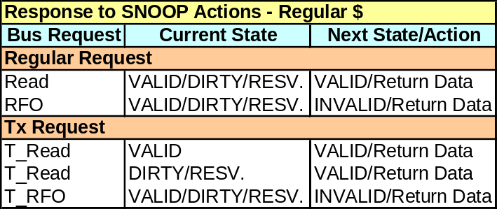
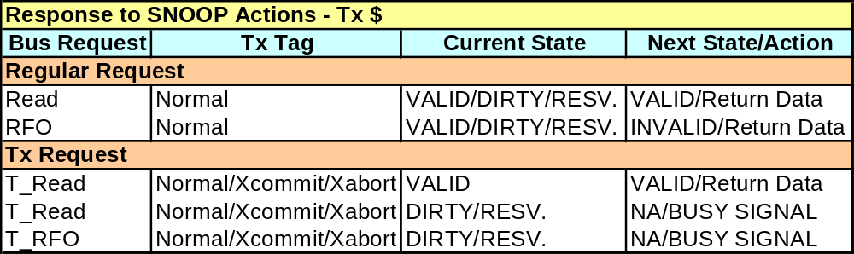

TM Impl. – Snoopy$ Actions
CPU Flags
TACTIVE – is Tx in Progress? Implicitly set when Tx executes its first Op – meaning start of CS
TSTATUS – TRUE if Tx is Active, FALSE if Aborted
Both Regular and Tx $ SNOOP on the bus
  For a Data Miss, the request goes to memory which responds to the following requests
    READ, RFO, T_READ, T_RFO and WRITE

Slide 15
Test - Methodology
TM implemented in Proetus sim - execution driven simulator from MIT
  Two versions of TM implementation
    Goodman’s snoopy protocol for bus-based arch
    Chaiken directory protocol for (simulated) Alewife machine
  32 Processors
    mem latency of 4 clks
    1st level $ latency of 1 clk
      2048x8B Direct-mapped Regular $
      64x8B fully-associative Tx $
  Strong Memory Consistency Model
Compare TM to 4 different implementation Techniques
  SW
    TTS (test-and-test-and-set) spinlock with exponential backoff
    SW queuing
      Process unable to lock puts itself in the queue, eliminating poll time
  HW
    LL/SC (LOAD_LINKED/STORE_COND) with exponential backoff
    HW queuing
      Queue maintenance incorporated into cache-coherency protocol
        Goodman’s QOSB protocol - head in mem, elements in unused CL’s
Benchmarks
  Counting
    LL/SC directly used on the single-word counter variable
  Producer & Consumer
  Doubly-Linked List

Slide 16
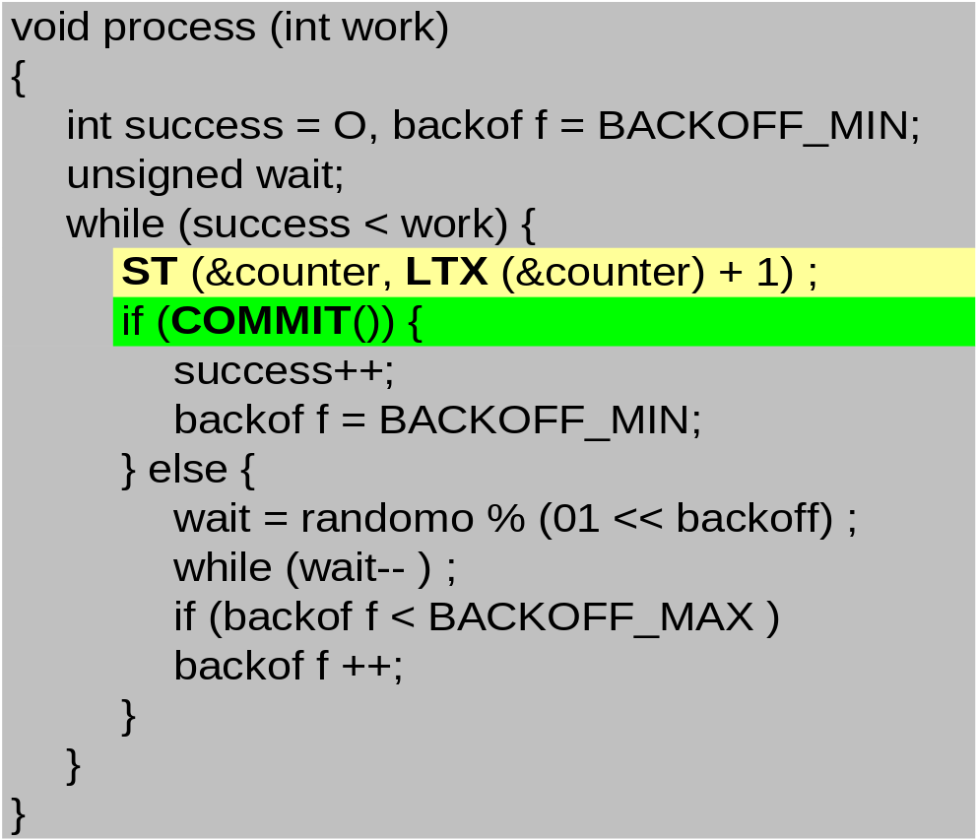
Test – Counting Benchmark
SOURCE:
from paper
N processes increment shared counter 2^16/n times, n=1 to 32
Short CS with 2 shared-mem accesses, high contention
In absence of contention, TTS makes 5 references to mem for each increment
  RD + test-and-set to acquire lock + RD and WR in CS
TM requires only 3 mem accesses
  RD & WR to counter and then COMMIT

Slide 17
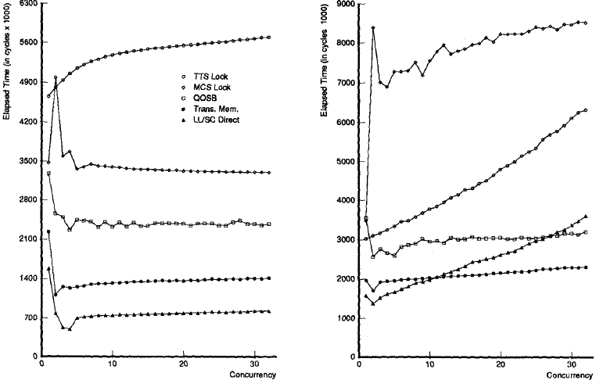
Test – Counting Results
Cycles needed to complete the Benchmark
SOURCE: Figure copied from paper
Concurrent Processes
BUS
NW
TM has high TPT than any other mechanisms at all levels of concurrency
  TM uses no explicit locks and so fewer access to memory
LL& SC outperforms TM
  LL&SC directly to counter var, no explicit commit required
  For other benchmarks, adv lost as shared object spans more than one word – only way to use LL&SC is as a spin lock

Slide 18
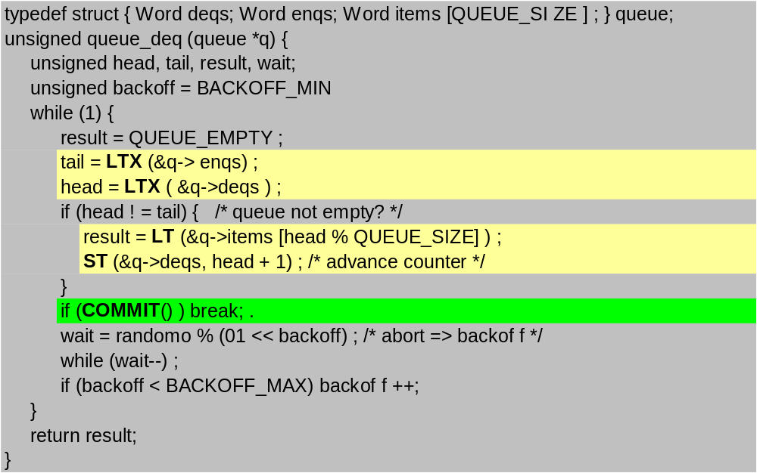
Test – Prod/Cons Benchmark
SOURCE:
from paper
N processes share a bounded buffer, initially empty
  Half produce items, half consume items
Benchmark finishes when 2^16 operations have completed

Slide 19
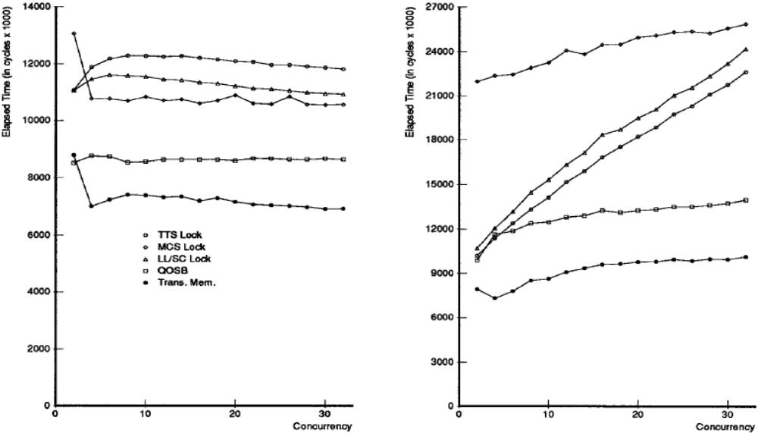
Test – Prod/Cons Results
Cycles needed to complete the Benchmark
SOURCE: Figure copied from paper
Concurrent Processes
BUS
NW
In Bus arch, almost flat TPT
  TM yields higher TPT but not as dramatic as counting benchmark
In NW arch, all TPT suffers as contention increases
  TM suffers the least and wins

Slide 20
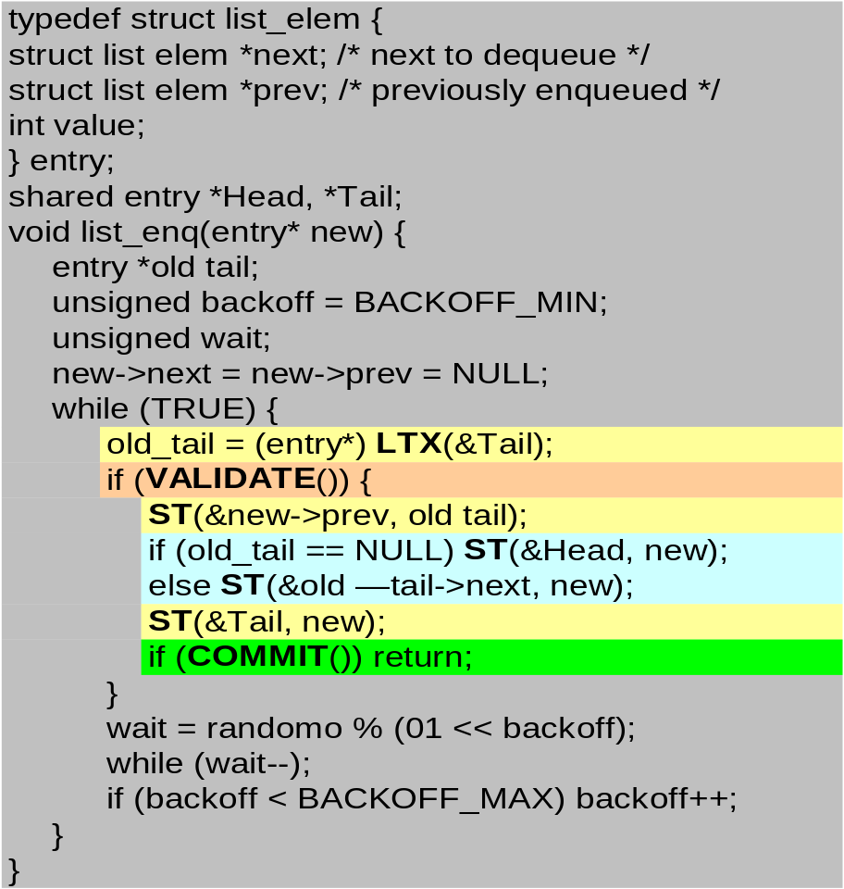
Test – Doubly-Linked List Benchmark
SOURCE:
from paper
N processes share a DL list anchored by Head & Tail pointers
  Process Dequeues an item by removing the item pointed by tail and then Enqueues it by threading it onto the list as head
  Process that removes last items sees both Head & Tail to NULL
  Process that inserts item into an empty list set’s both Head & Tail point to the new item
Benchmark finishes when 2^16 operations have completed

Slide 21
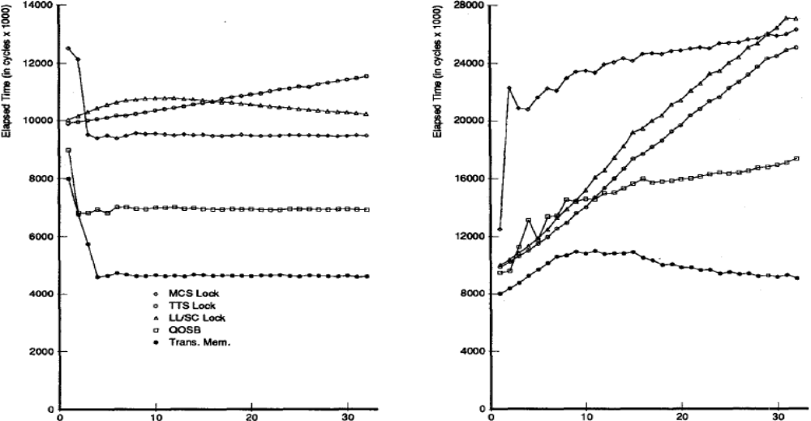
Test – Doubly-Linked List Results
Cycles needed to complete the Benchmark
SOURCE: Figure copied from paper
BUS
NW
Concurrent Processes
Concurrency difficult to exploit by conventional means
  State dependent concurrency is not simple to recognize using locks
    Enquerers don’t know if it must lock tail-ptr until after it has locked head-ptr & vice-versa for Dequeuers
    Queue non-empty: each Tx modifies head or tail but not both, so enqueuers can (in principle) execute without interference from dequeuers and vice-versa
    Queue Empty: Tx must modify both pointers and enqueuers and dequeuers conflict
  locking techniques uses only single lock
    Lower TPT as they don’t allow overlapping of enqueues and dequeues
TM naturally permits this kind of parallelism

Slide 22
Summary
TM is direct generalization from LL&SC of MIPS II & Digital Alpha
  Overcoming single-word limitation long realized
    Motorola 68000 implemented CAS2 – limited to double-word
TM is a multi-processor architecture which allows easy lock-free multi-word synchronization in HW
  exploiting cache-coherency mechanisms, and
  leveraging concept of Database Transactions
TM matches or outperforms atomic update locking techniques (shown earlier) for simple benchmarks
  Even in absence of priority inversion, convoying & deadlock
    uses no locks and thus has fewer memory accesses
Pros
  Easy programming semantics
  Easy compilation
  Mem consistency constraints caused by OOO pipeline & cache coherency in typical locking scenarios now taken care by HW
  More parallelism and hence highly scalable for smaller Tx sizes
  Complex locking scenarios such as doubly-linked list more realizable through TM than by conventional locking techniques
Cons
  Still SW dependent
    Example such as to disallow starvation by using techniques such as adaptive backoff
  Small Tx size limits usage for applications locking large objects over a longer period of time
    HW constraints to to meet 1st level cache latency timings and
      parallel logic for commit and abort to be in a single cycle
    Longer Tx increases the likelihood of being aborted by an interrupt or scheduling conflict
      Though Tx cache overflow cases could be handled in SW
  Limited only to primary $ - could be extended to other levels
  Weaker consistency model would require explicit barriers at start and end, impacting perf
  Other complications make it more “difficult” to implement in HW
    Multi-level caches
    Nested Transactions
    Cache coherency complexity on Many-Core SMP and NUMA arch’s

