Slide 2
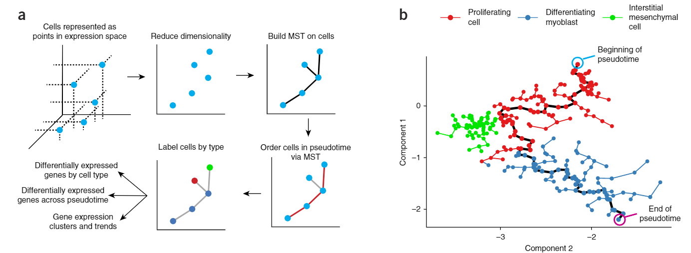
LM0414

Slide 3
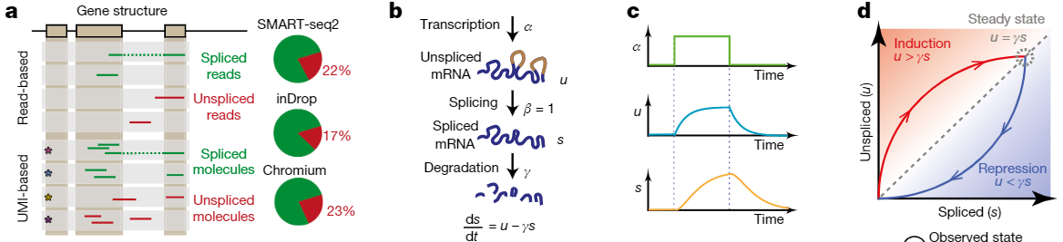


Slide 4
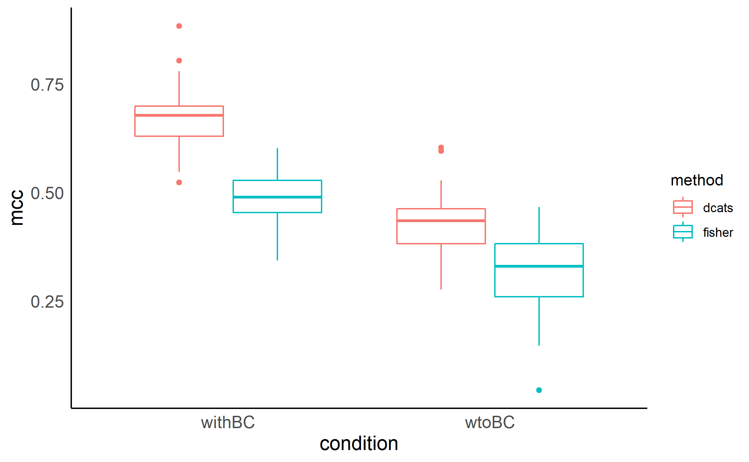
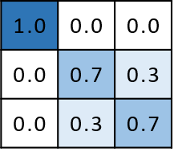

Slide 5
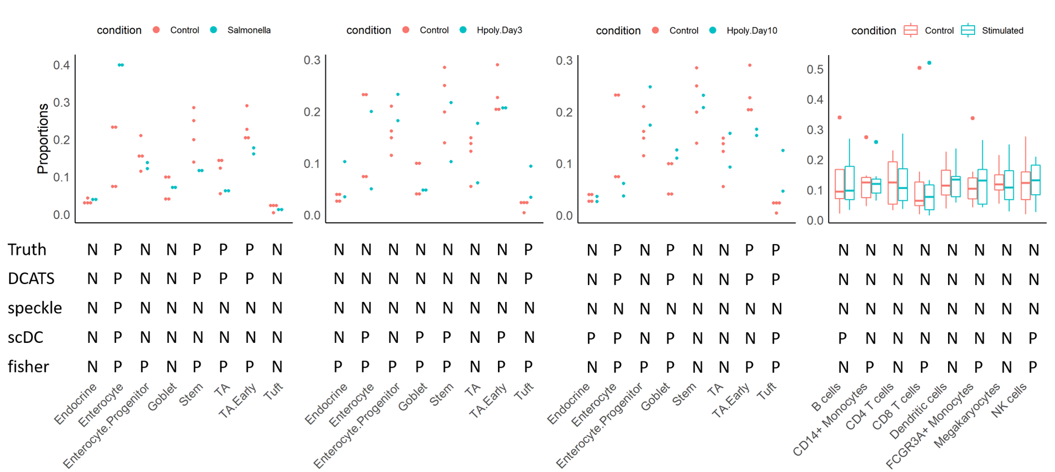
Haber 2017 Kang 2017

Slide 6
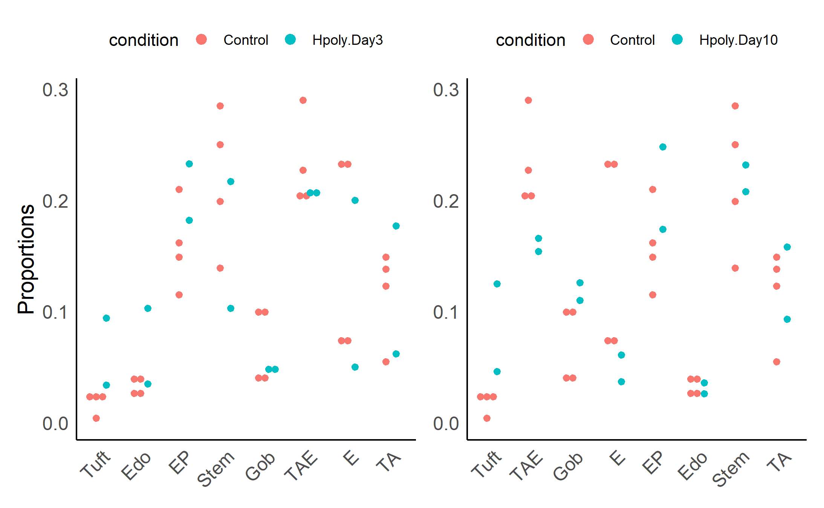
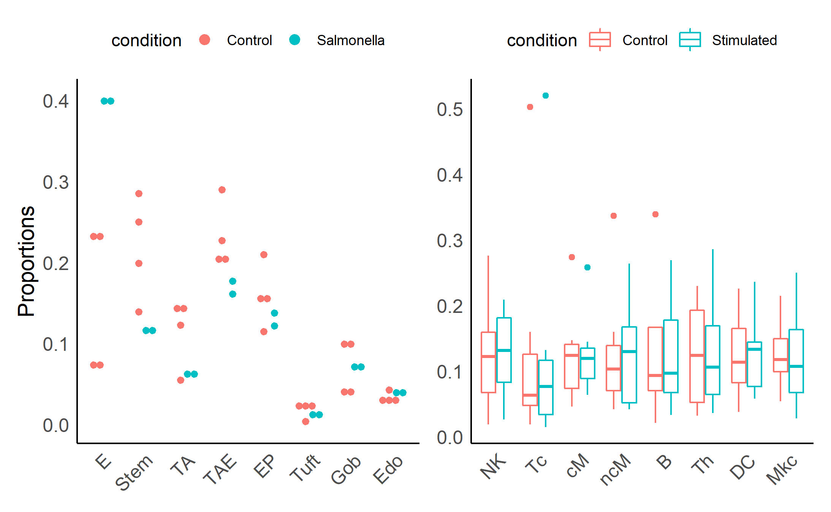
Truth | P | P | P | P | N | N | N | N
DCATS | P | P | P | P | N | N | N | N
speckle | P | N | N | N | N | N | N | N
scDC | P | N | N | N | N | N | N | N
fisher | P | P | P | P | P | N | N | N
P | N | N | N | N | N | N | N
P | N | N | N | N | N | N | N
N | N | N | N | N | N | N | N
N | N | N | P | P | P | P | N
P | P | P | P | P | P | P | N
P | P | P | P | N | N | N | N
P | P | P | P | N | N | N | N
N | N | N | N | N | N | N | N
P | N | P | P | N | P | N | N
P | P | P | P | P | N | N | N
N | N | N | N | N | N | N | N
N | N | N | N | N | N | N | N
N | N | N | N | N | N | N | N
P | N | N | N | P | N | N | N
P | P | P | P | N | N | N | N

Slide 7
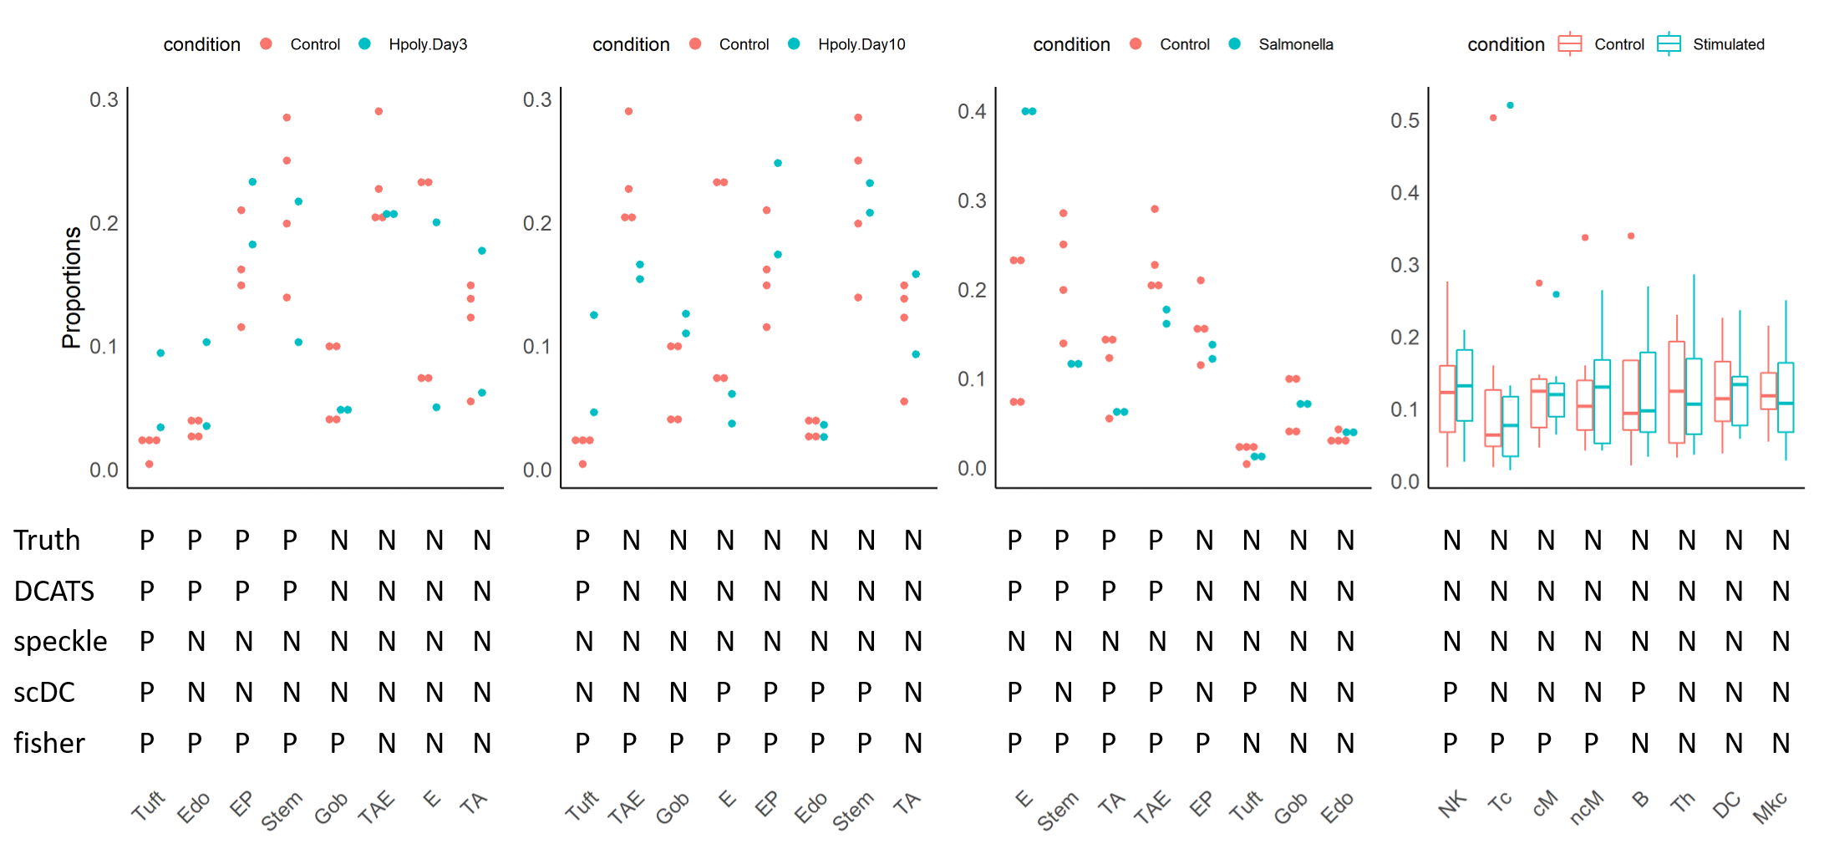
Haber 2017 Kang 2017

Slide 8
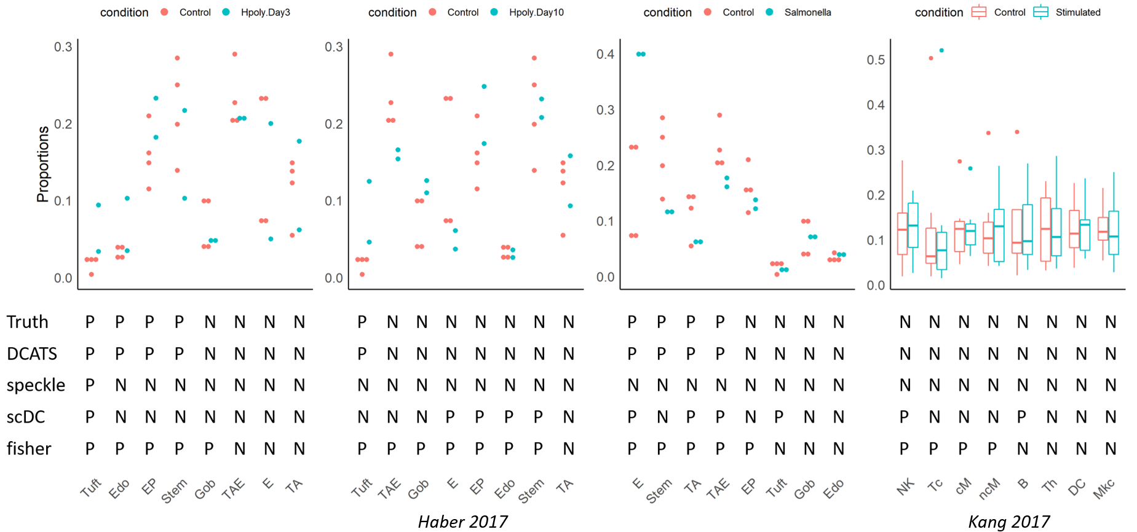

Slide 9
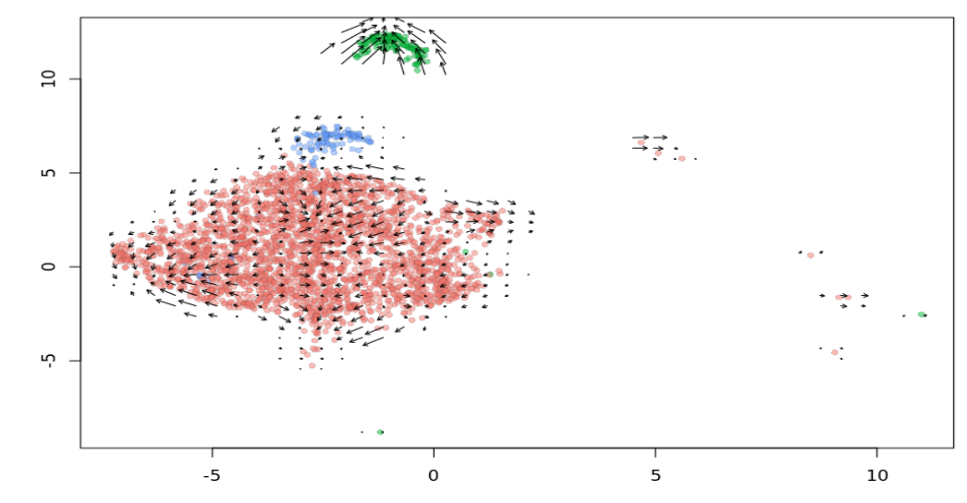
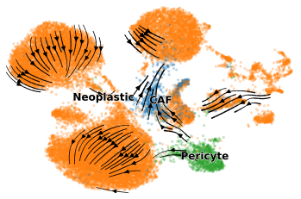
Pericyte
CAF
Neoplastic

Slide 10
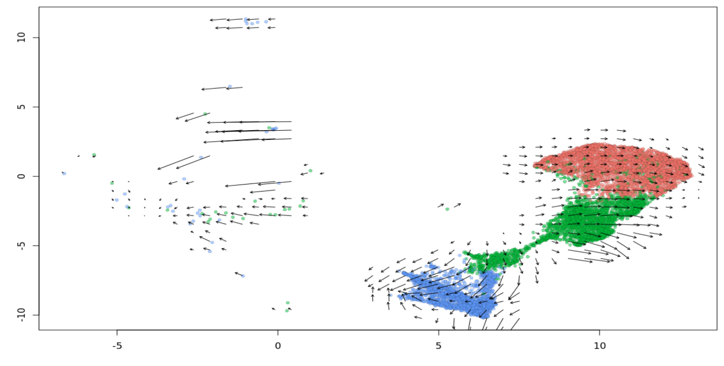
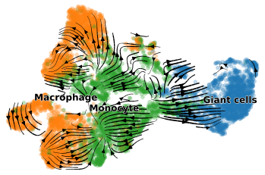
Macrophage
Monocyte
Gaint cells

Slide 11
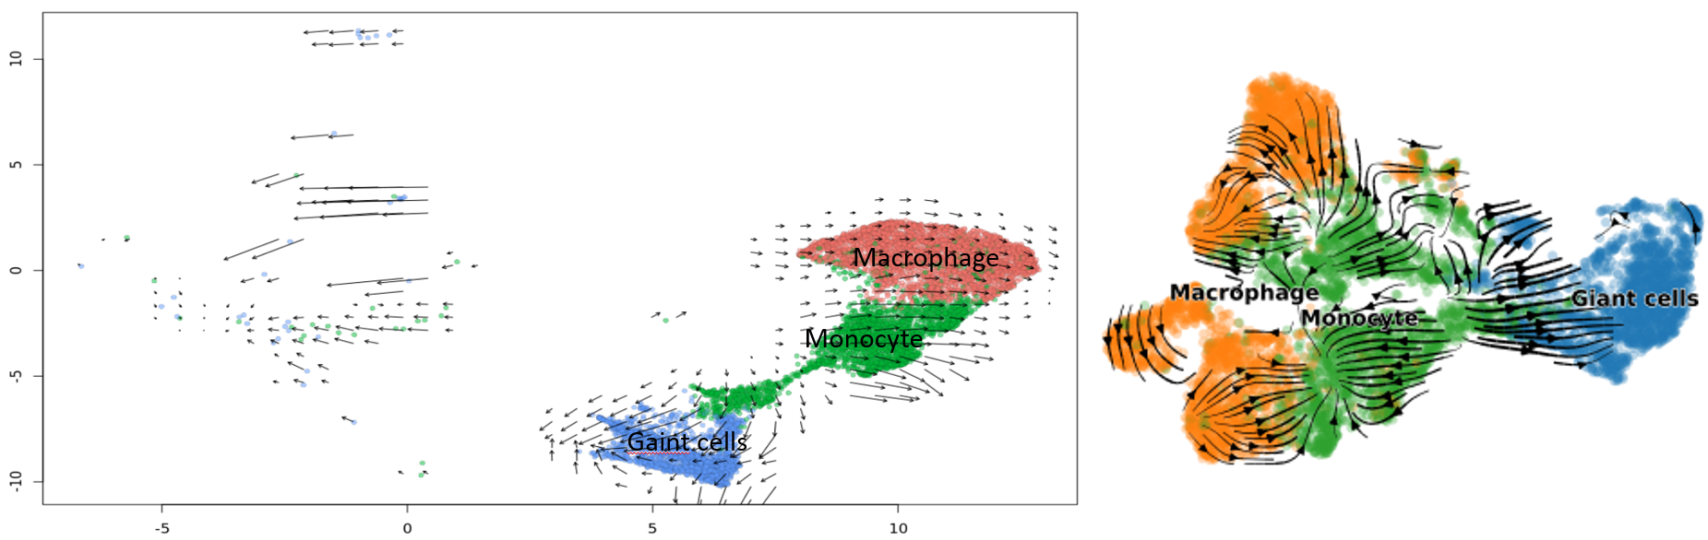

Slide 12
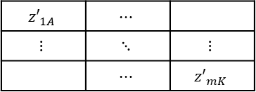
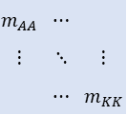
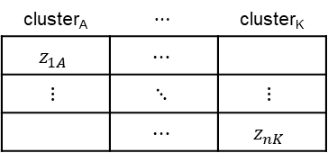
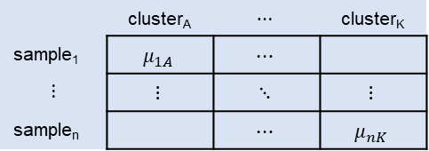
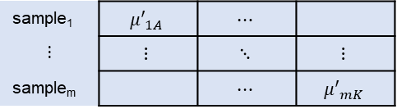
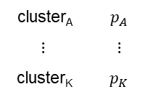

DCATS supplementary
Condition1
Confusion Matrix
Latent True Matrix
Result
 | cluster_{A} | $$⋯$$ | cluster_{K}
sample₁ | $$μ_{1A}$$ | $$⋯$$
$$⋮$$ | $$⋮$$ | $$⋱$$ | $$⋮$$
sample_{n} |  | $$⋯$$ | $$μ_{nK}$$
$$m_{AA}$$ | $$⋯$$
$$⋮$$ | $$⋱$$ | $$⋮$$
 | $$⋯$$ | $$m_{KK}$$
cluster_{A} | $$⋯$$ | cluster_{K}
$$z_{1A}$$ | $$⋯$$
$$⋮$$ | $$⋱$$ | $$⋮$$
 | $$⋯$$ | $$z_{nK}$$
$$BetaBin GLM| C$$
cluster_{A} | $$p_{A}$$
$$⋮$$ | $$⋮$$
cluster_{K} | $$p_{K}$$
Condition2
sample₁ | $${μ′}_{1A}$$ | $$⋯$$
$$⋮$$ | $$⋮$$ | $$⋱$$ | $$⋮$$
sample_{m} |  | $$⋯$$ | $${μ′}_{mK}$$
$${z′}_{1A}$$ | $$⋯$$
$$⋮$$ | $$⋱$$ | $$⋮$$
 | $$⋯$$ | $${z′}_{mK}$$

