Slide 2
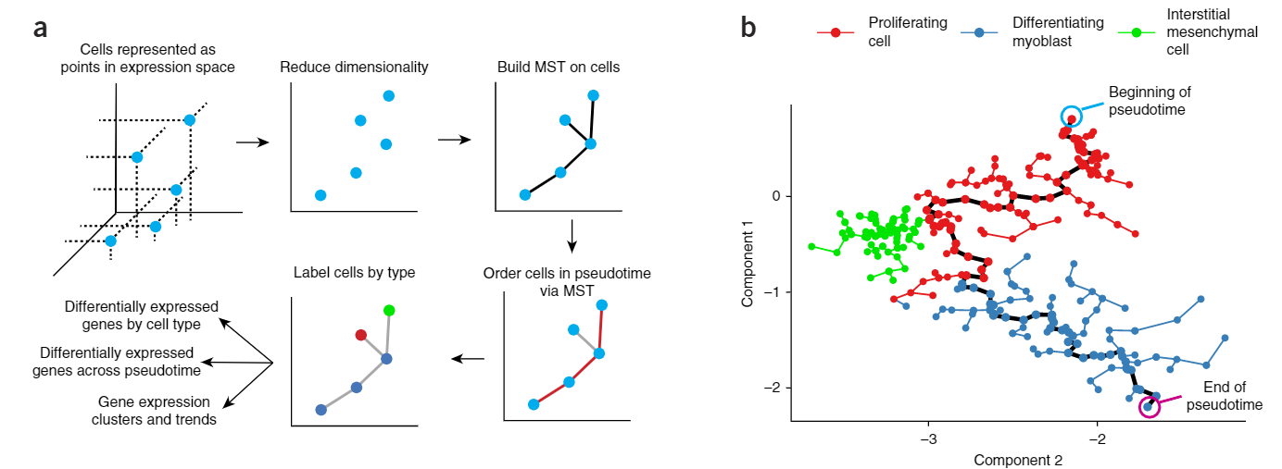
LM0414

Slide 3
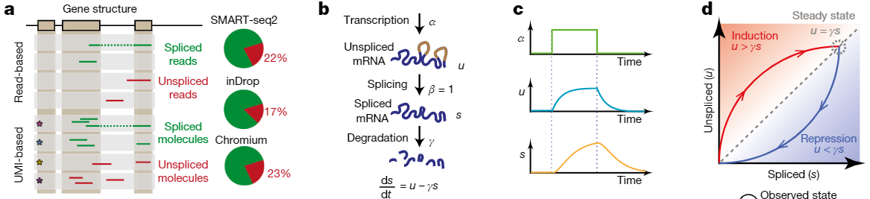


Slide 4
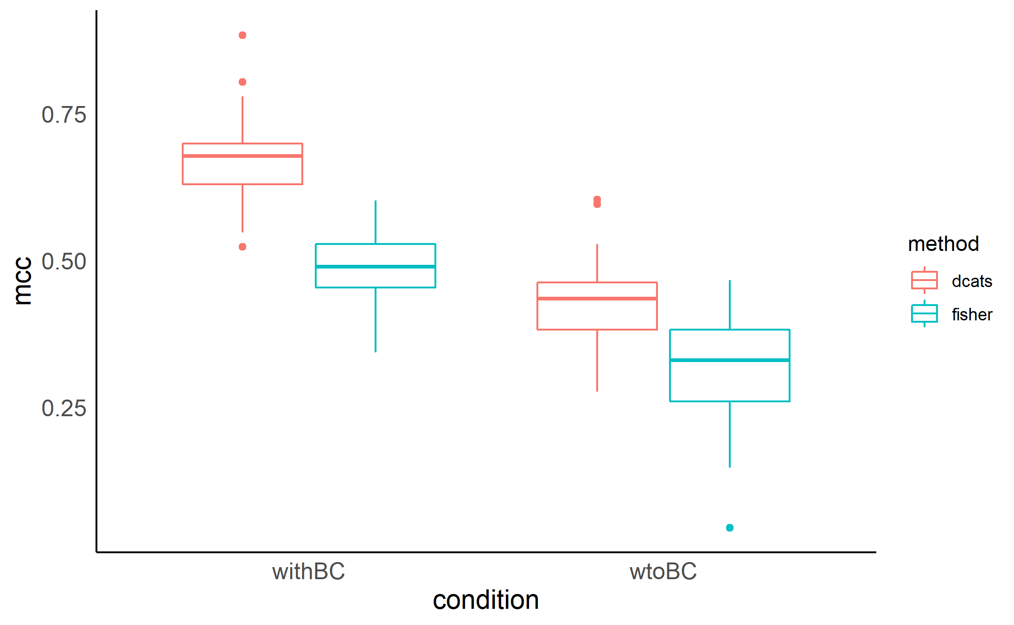
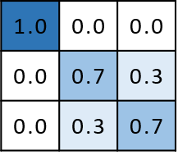

Slide 5
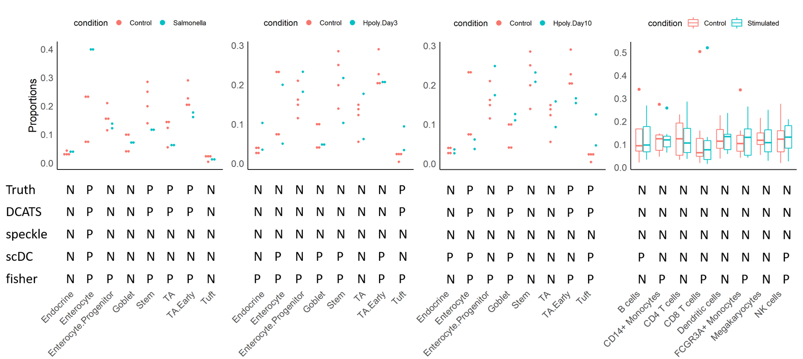
Haber 2017 Kang 2017

Slide 6
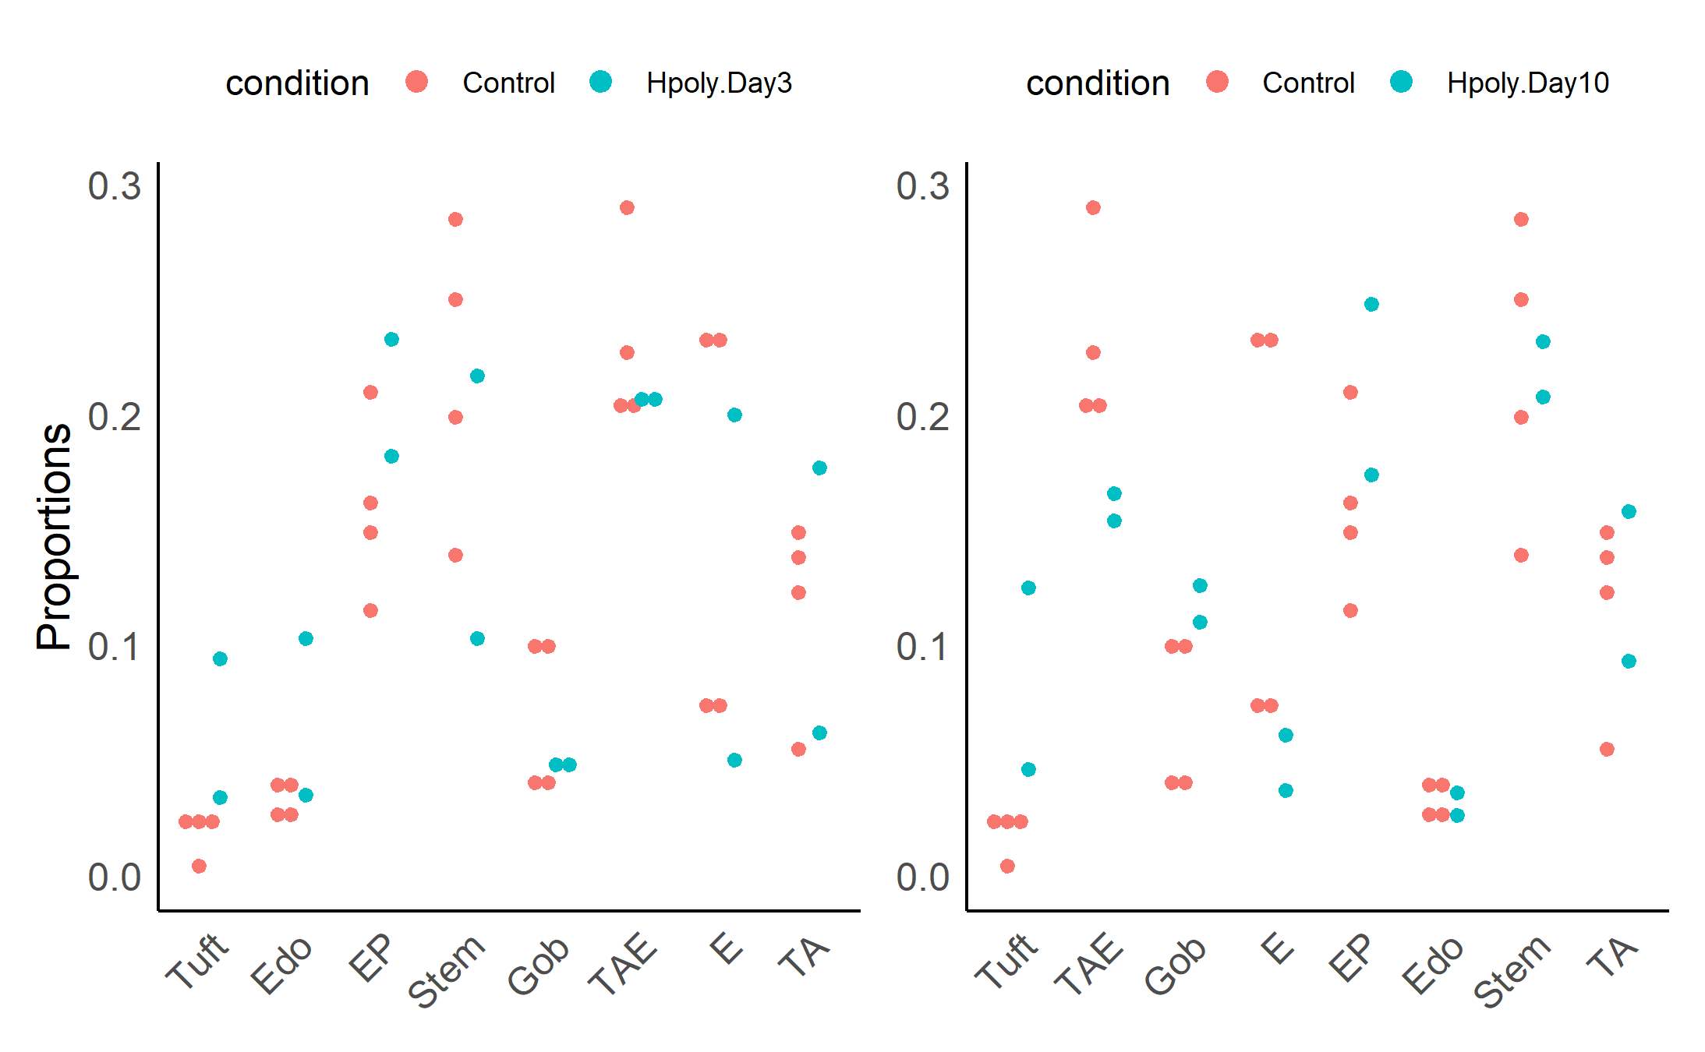
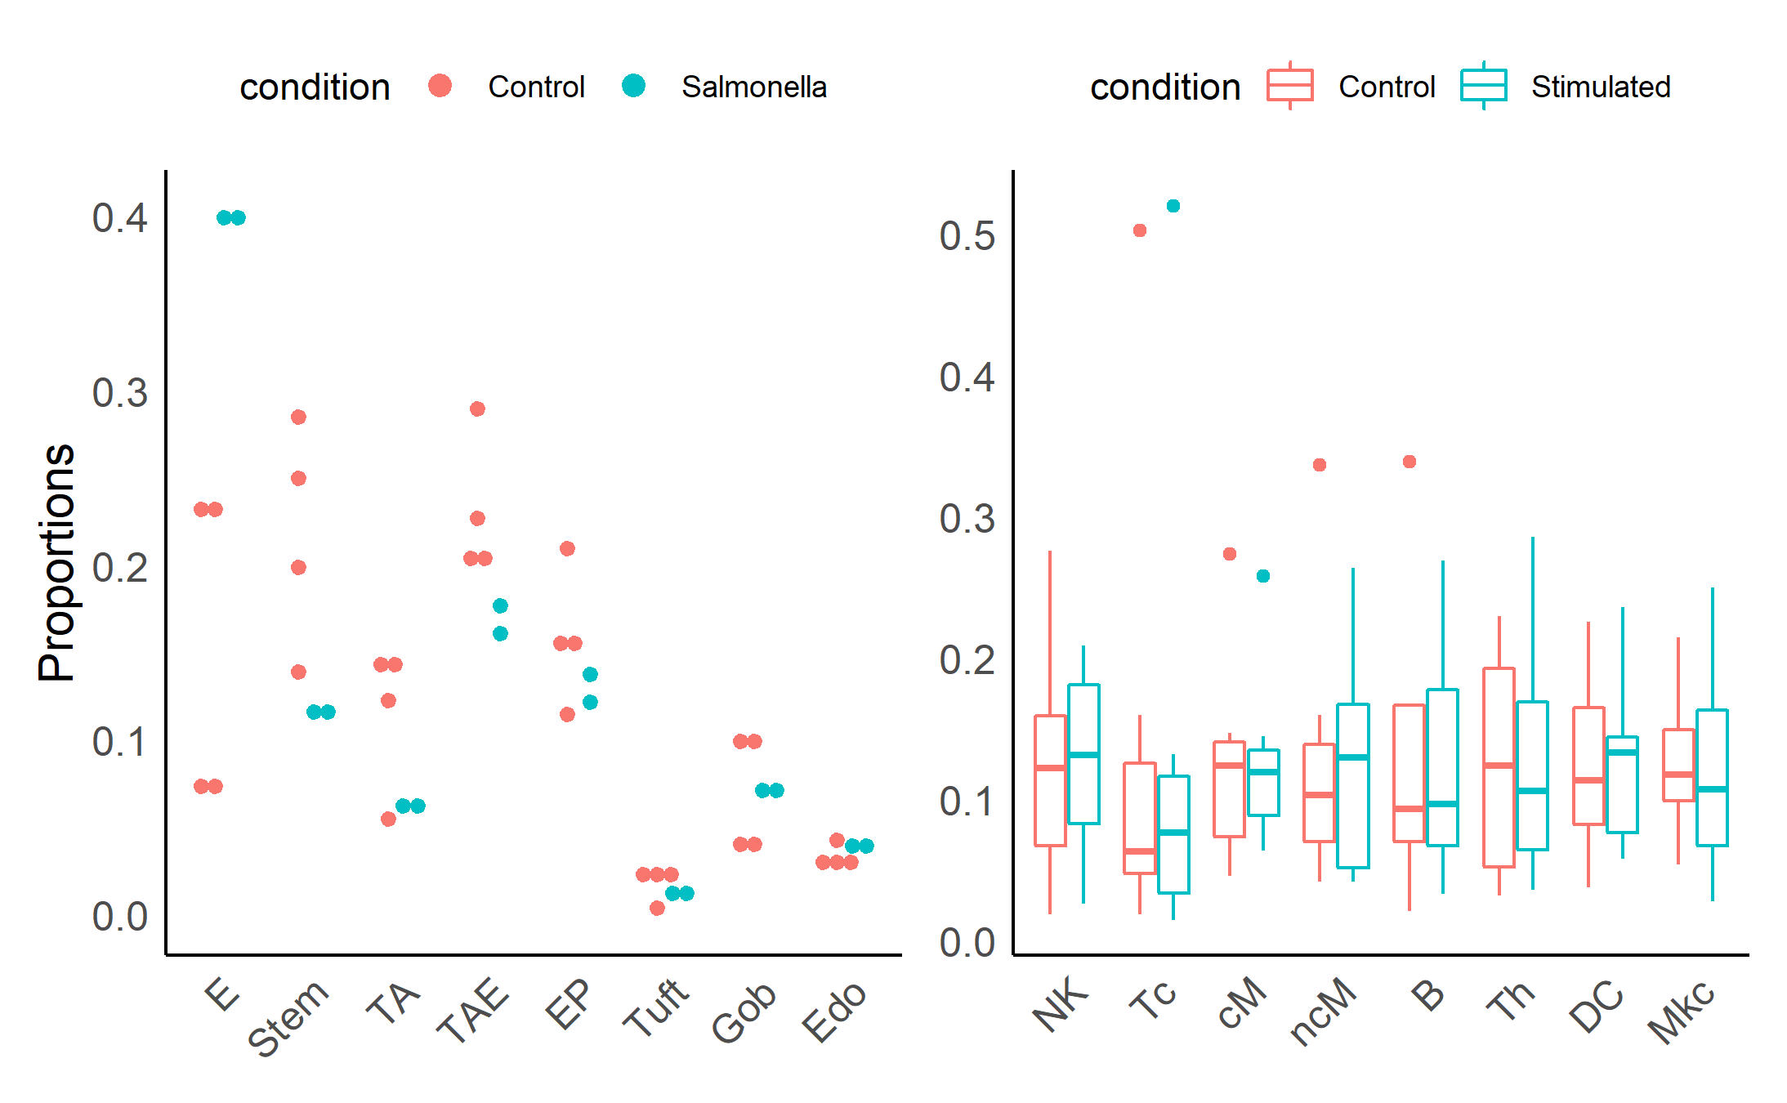
Truth | P | P | P | P | N | N | N | N
DCATS | P | P | P | P | N | N | N | N
speckle | P | N | N | N | N | N | N | N
scDC | P | N | N | N | N | N | N | N
fisher | P | P | P | P | P | N | N | N
P | N | N | N | N | N | N | N
P | N | N | N | N | N | N | N
N | N | N | N | N | N | N | N
N | N | N | P | P | P | P | N
P | P | P | P | P | P | P | N
P | P | P | P | N | N | N | N
P | P | P | P | N | N | N | N
N | N | N | N | N | N | N | N
P | N | P | P | N | P | N | N
P | P | P | P | P | N | N | N
N | N | N | N | N | N | N | N
N | N | N | N | N | N | N | N
N | N | N | N | N | N | N | N
P | N | N | N | P | N | N | N
P | P | P | P | N | N | N | N

Slide 7
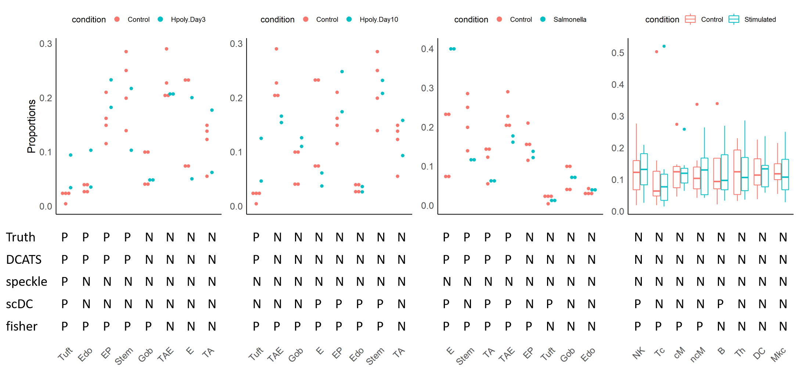
Haber 2017 Kang 2017

Slide 8
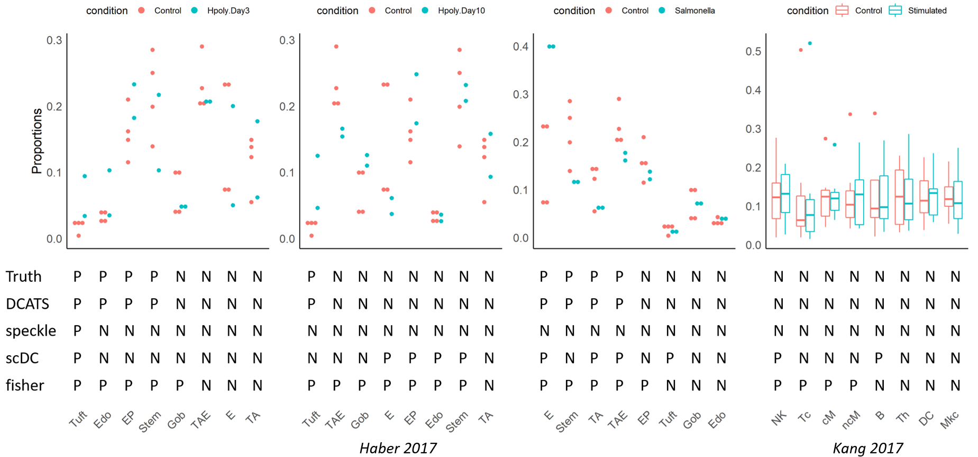

Slide 9
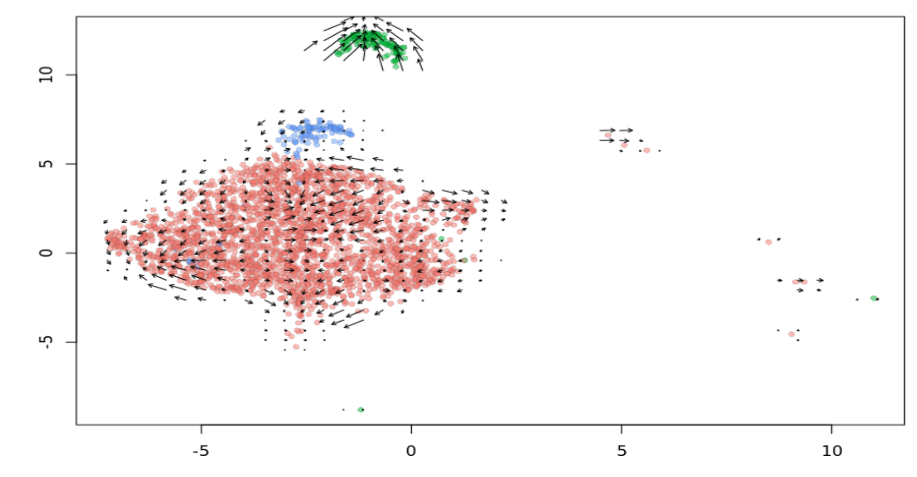
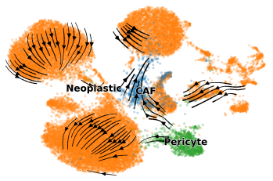
Pericyte
CAF
Neoplastic

Slide 10
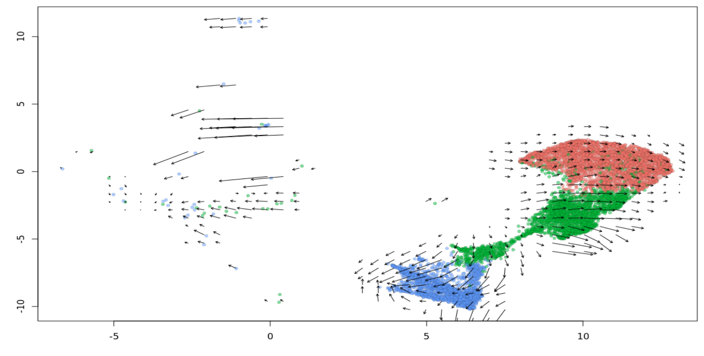
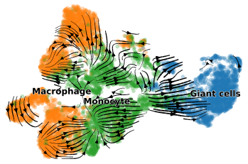
Macrophage
Monocyte
Gaint cells

Slide 11
