Slide 2
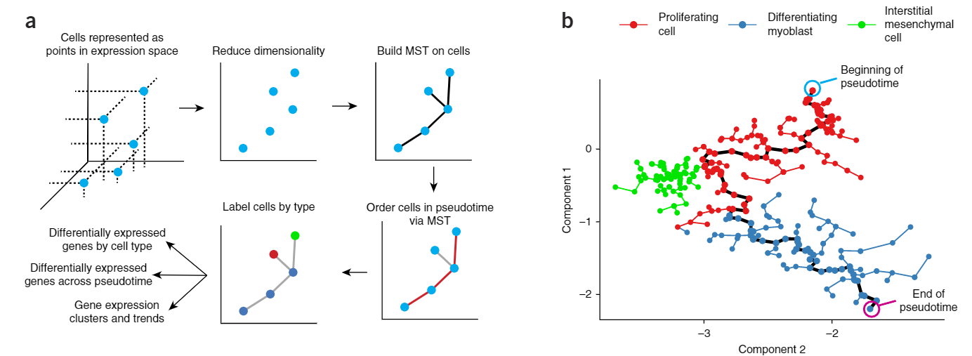
LM0414

Slide 3
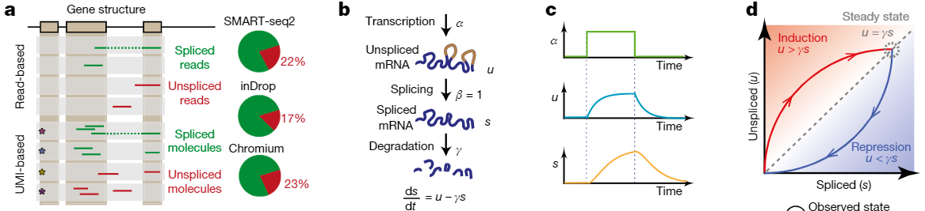


Slide 4
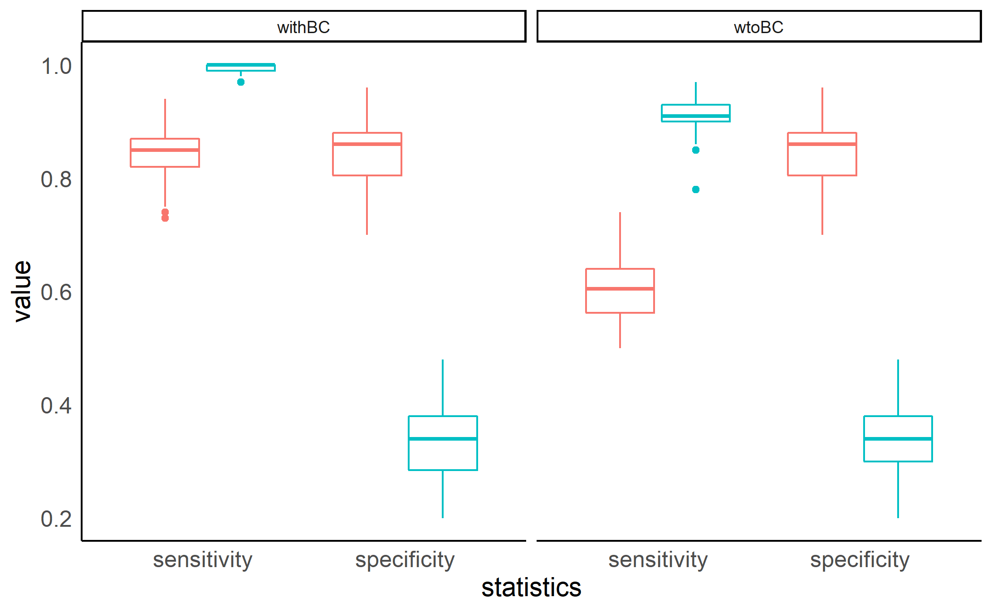
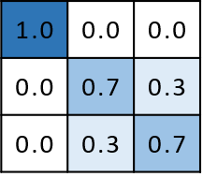
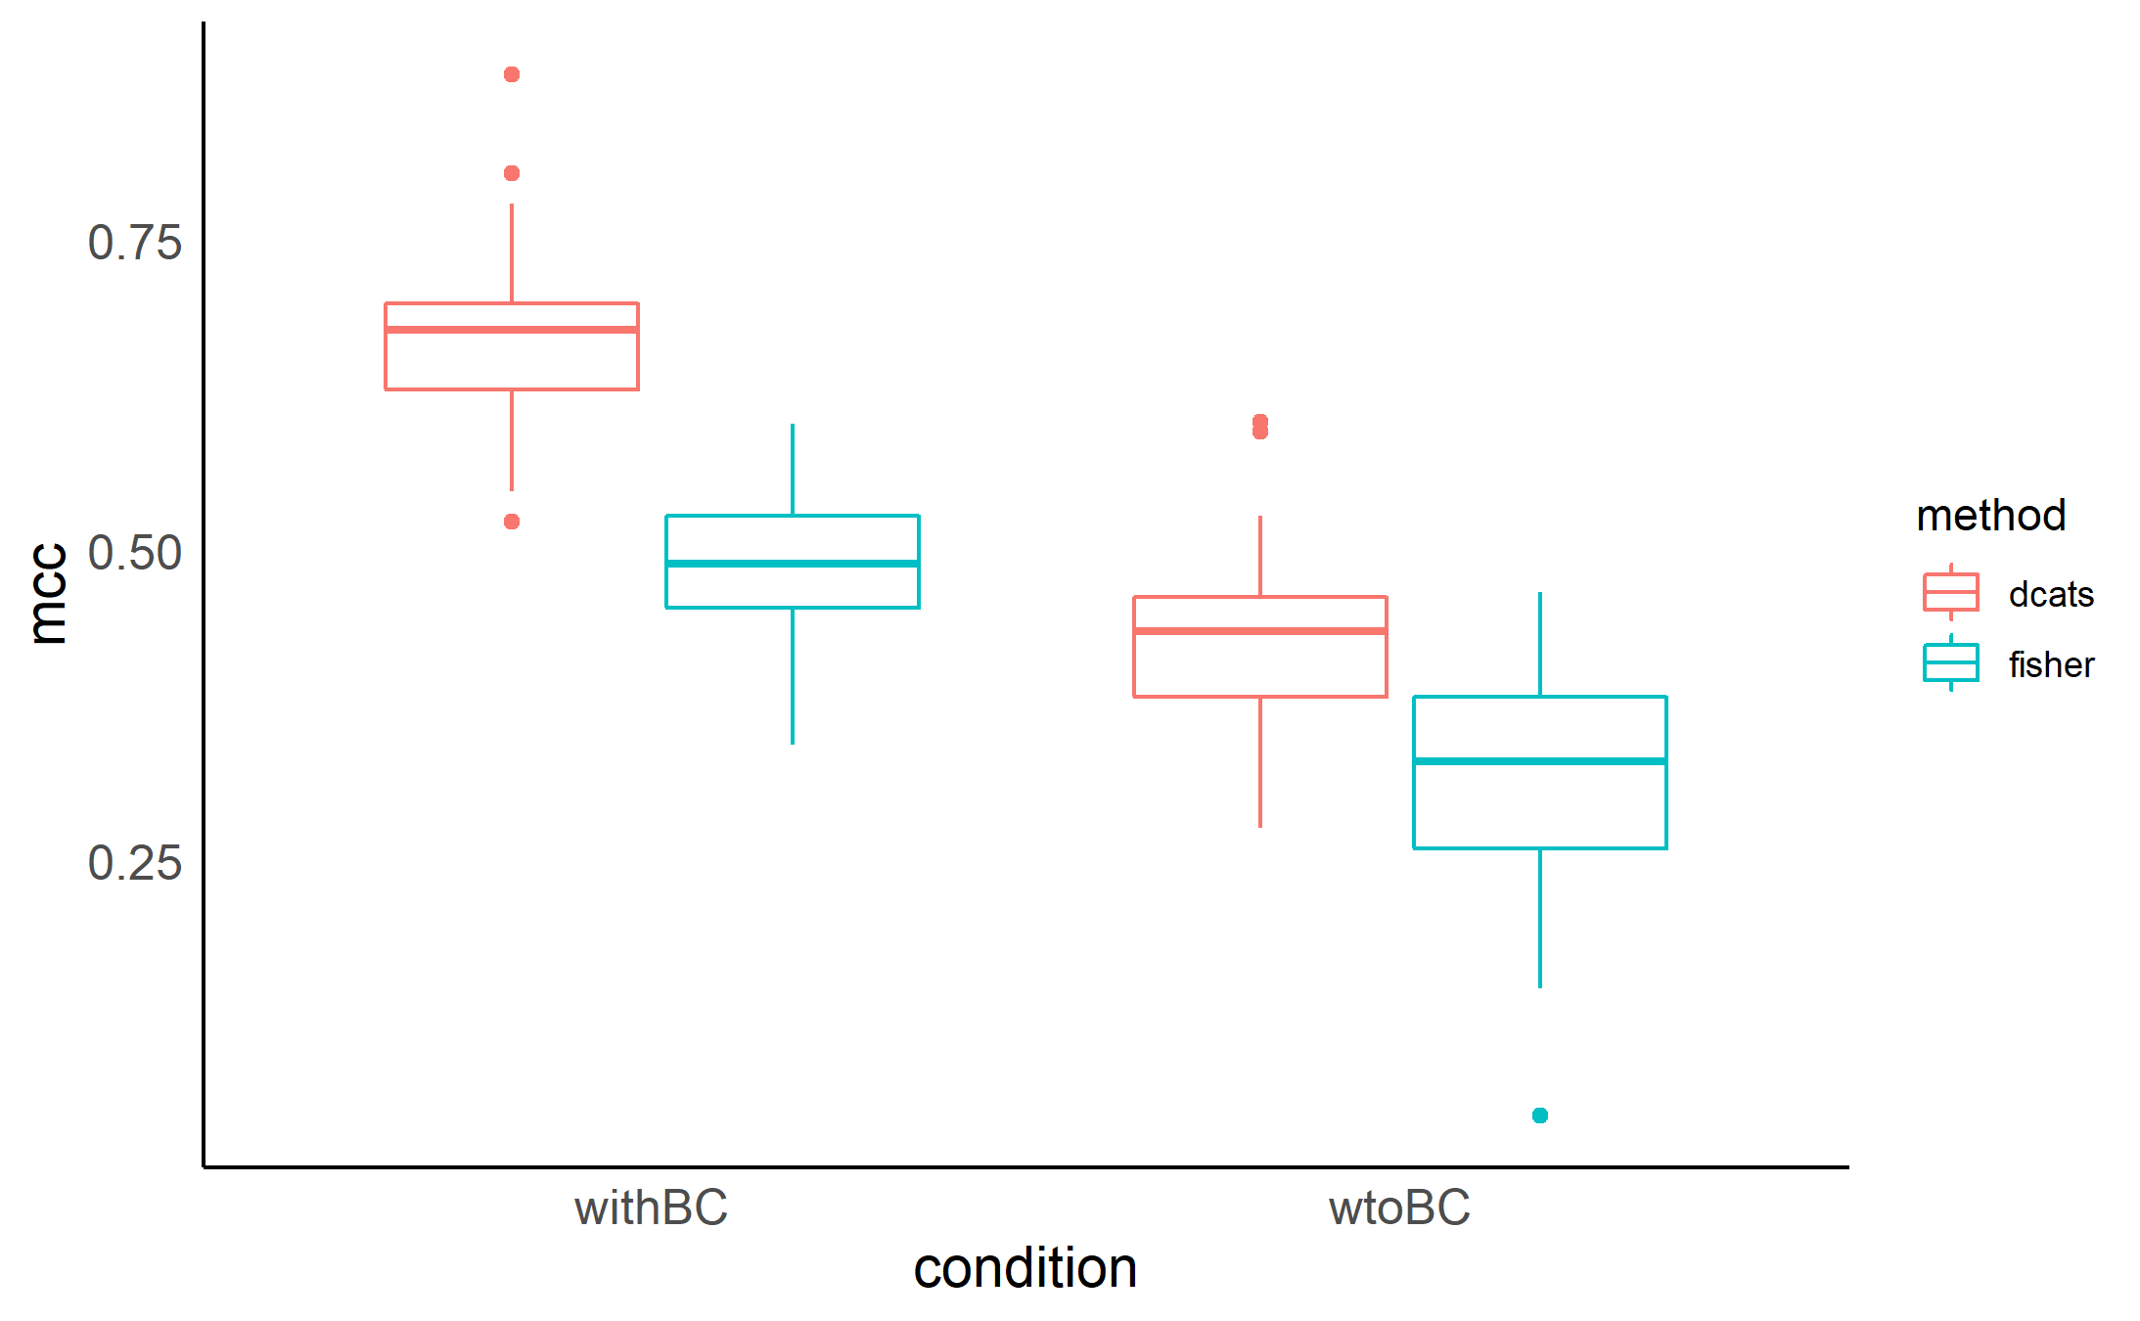

Slide 5
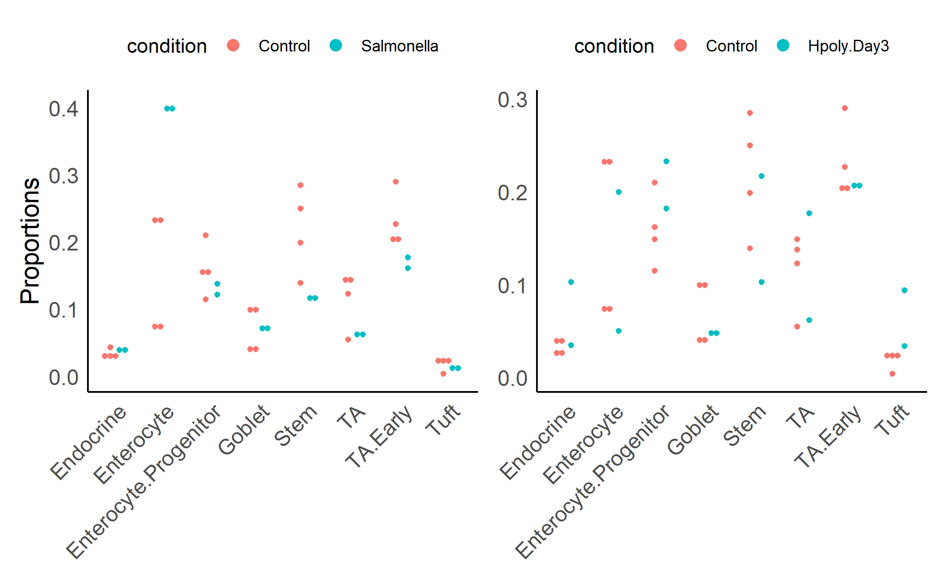
Truth | N | P | N | N | P | P | P | N
DCATS | N | P | N | N | P | P | P | N
speckle | N | P | N | N | N | N | N | N
scDC | N | P | N | N | N | N | N | N
fisher | N | P | P | N | P | P | P | N
N | N | N | N | N | N | N | P
N | N | N | N | N | N | N | P
N | N | N | N | N | N | N | N
N | P | N | P | P | N | P | N
P | P | P | P | P | N | P | P

Slide 6
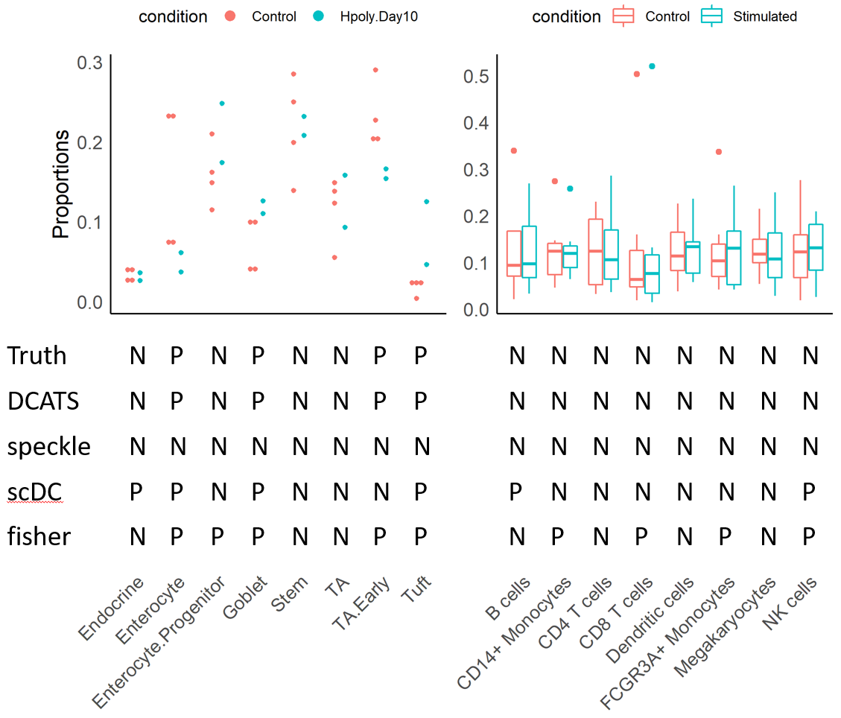

Slide 7
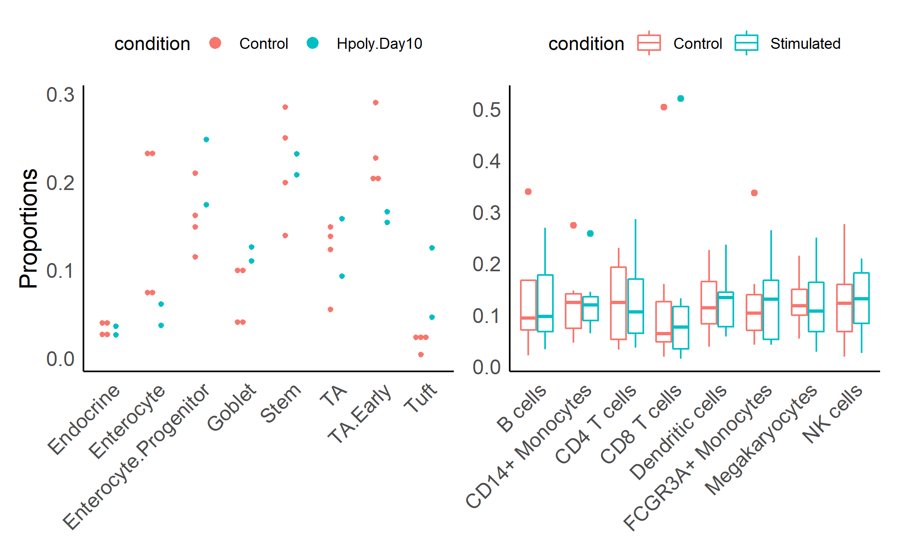
Truth | N | P | N | P | N | N | P | P
DCATS | N | P | N | P | N | N | P | P
speckle | N | N | N | N | N | N | N | N
scDC | P | P | N | P | N | N | N | P
fisher | N | P | P | P | N | N | P | P
N | N | N | N | N | N | N | N
N | N | N | N | N | N | N | N
N | N | N | N | N | N | N | N
P | N | N | N | N | N | N | P
N | P | N | P | N | P | N | P

