Slide 1
MTH9877 — Interest Rates & Credit
Assignment 3 — Part E Extensions
Mortgage Prepayment & Default | Survival Analysis Extensions
Rose Lin · Baruch MFE · May 2026

Slide 2
Part E — Overview
Four extension tracks
• E(i) Competing Risks Framework — Aalen-Johansen CIF, KM bias, stratified CIF, cause-specific Cox, Fine-Gray
• E(ii) Time-Dependent Covariates — Andersen-Gill counting-process Cox with monthly macro
• E(iii) Neural Survival Models — DeepHit framework (architecture overview)
• E(iv) Scenario Analysis — Prepayment sensitivity to ±200 bp rate shocks

Slide 3
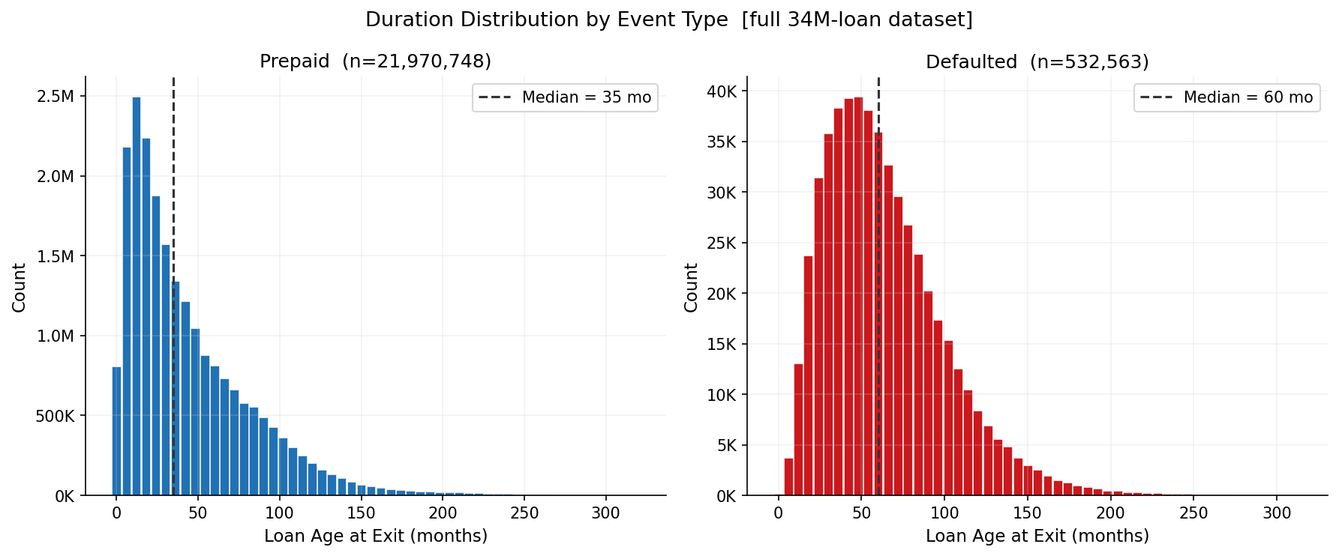
E(i)(a) — EDA: Duration Distributions & Covariate Profiles
Prepaid: median ~40 mo | Defaulted: median ~55 mo | full 34M-loan dataset

Slide 4
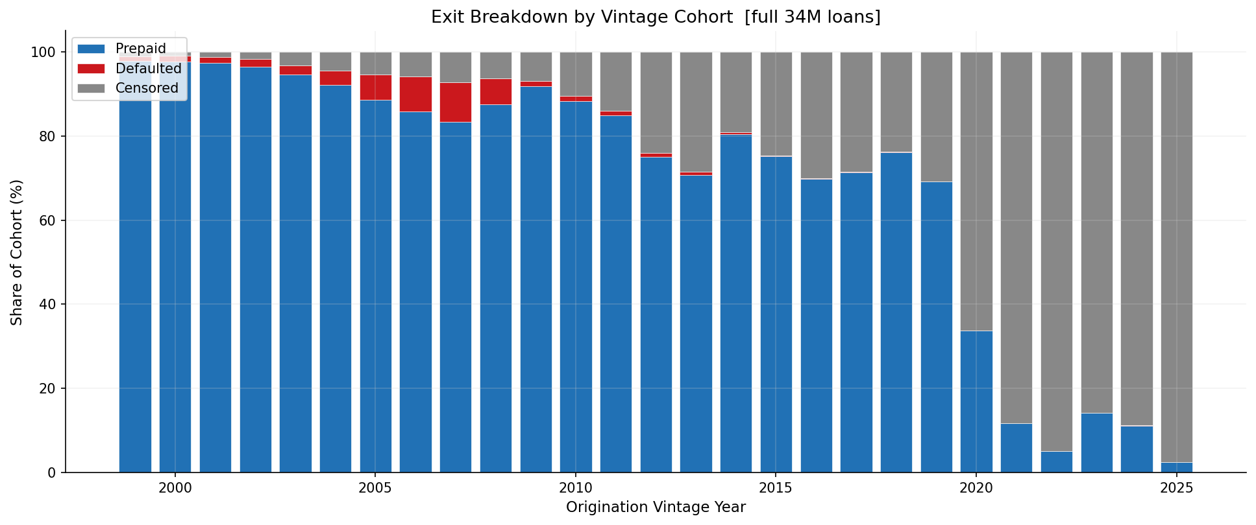
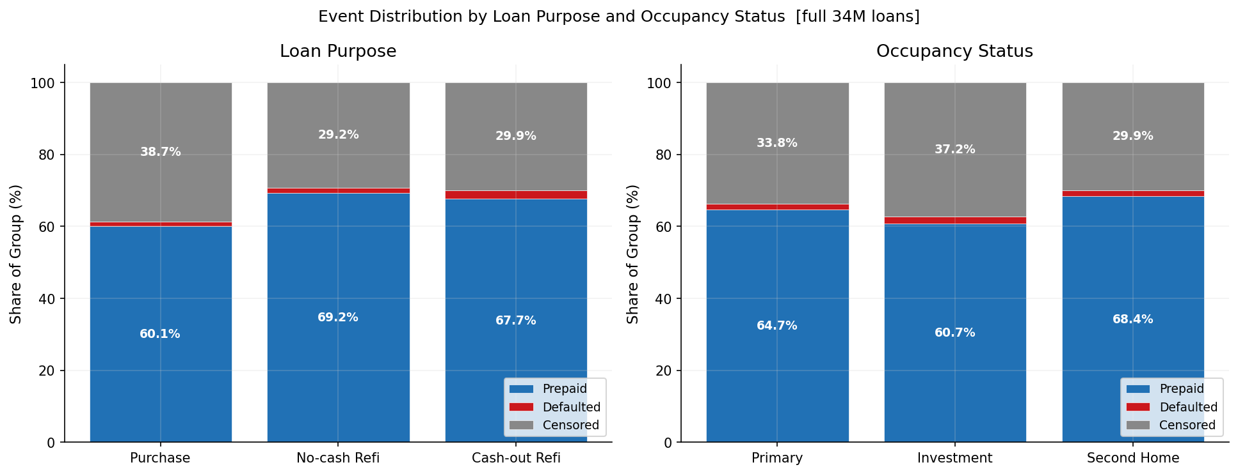
E(i)(a) — EDA: Vintage Cohort & Categorical Breakdown

Slide 5
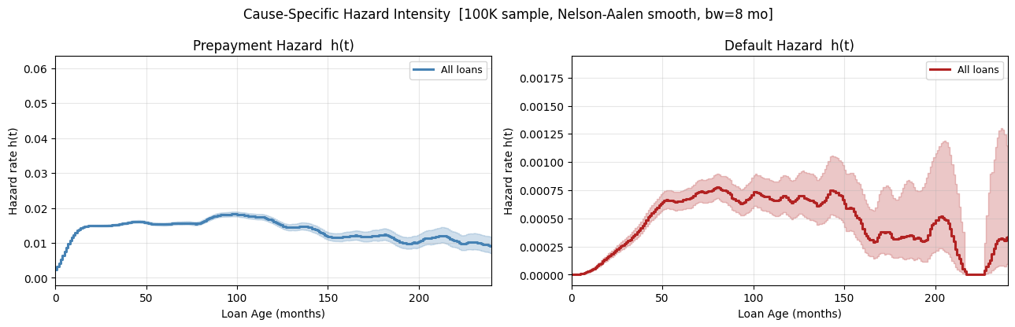
E(i)(a) — Hazard Intensity: Prepayment Peaks Early, Default Rises Slowly
Cause-specific Nelson-Aalen smooth · burnout visible in prepayment hazard · 100K sample

Slide 6
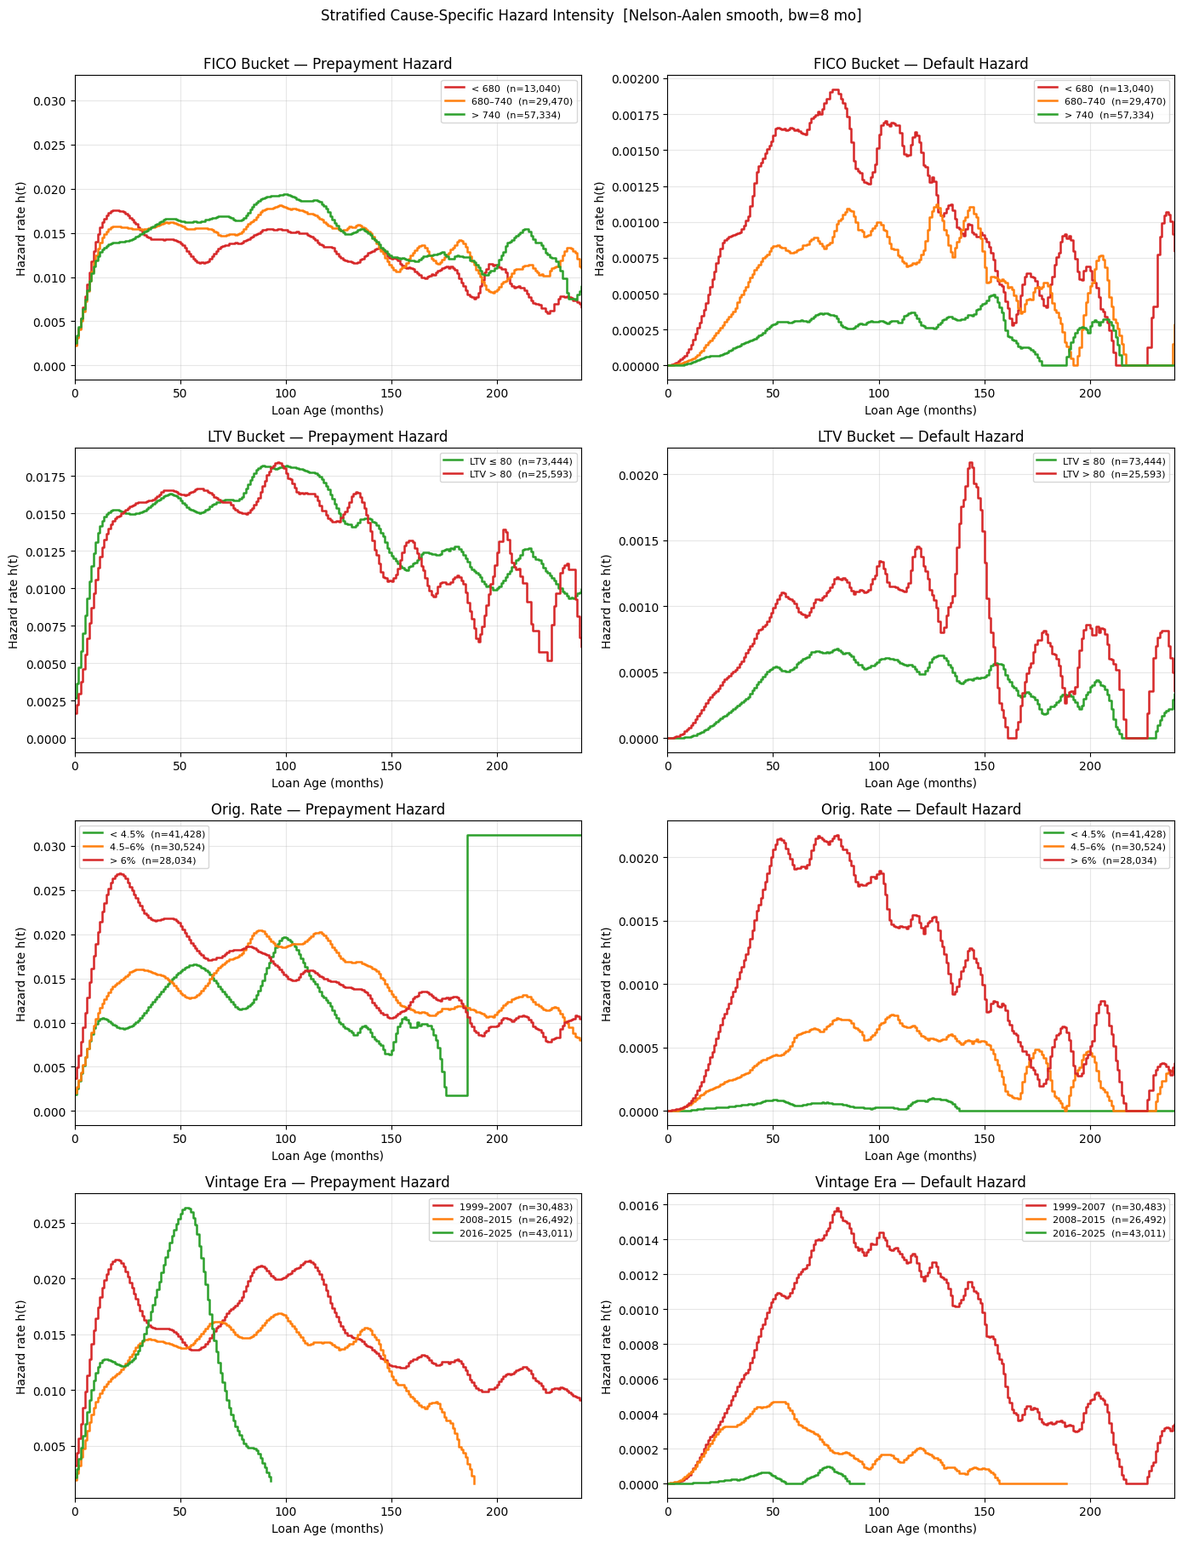
E(i)(a) — Stratified Hazard Intensity by FICO · LTV · Rate · Vintage
High-FICO refinances fastest · High-LTV defaults persist longer · GFC vintages spike

Slide 7
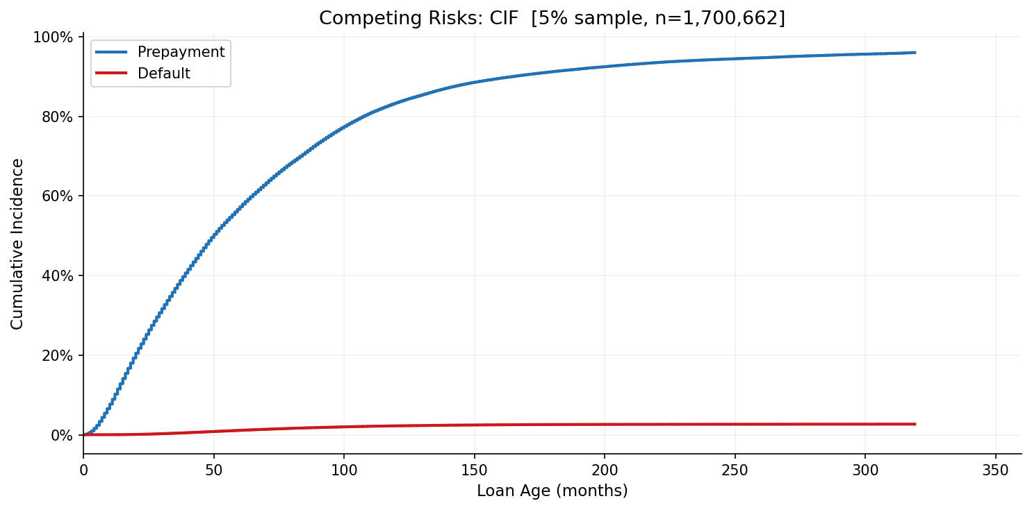
E(i)(b) — Aalen-Johansen CIF: Formula & Contrast
AJ correctly weights each increment by the overall survival probability
Kaplan-Meier (INCORRECT — treats competing exits as censored)
S_KM(t) = PROD_{t_i <= t} (1 - d_i^(k) / n_i)
F_KM^(k)(t) = 1 - S_KM(t) ← overcounts cause-k hazard
Aalen-Johansen (CORRECT)
F_k(t) = SUM_{t_j <= t} S(t_j-) * d_{kj} / n_j
F_k(t) : CIF for cause k at loan age t
d_{kj} : cause-k exits at time t_j
n_j : loans at risk just before t_j
S(t_j-): overall survival before t_j — uses ALL exits
Partition identity (impossible under KM):
SUM_k F_k(t) + S(t) = 1 for all t

Slide 8
E(i)(b) — AJ CIF: 10-yr Prepay 83% · Default 2.2% · Active 14.5%
S_KM over-estimates each cause; AJ partition sums exactly to 1

Slide 9
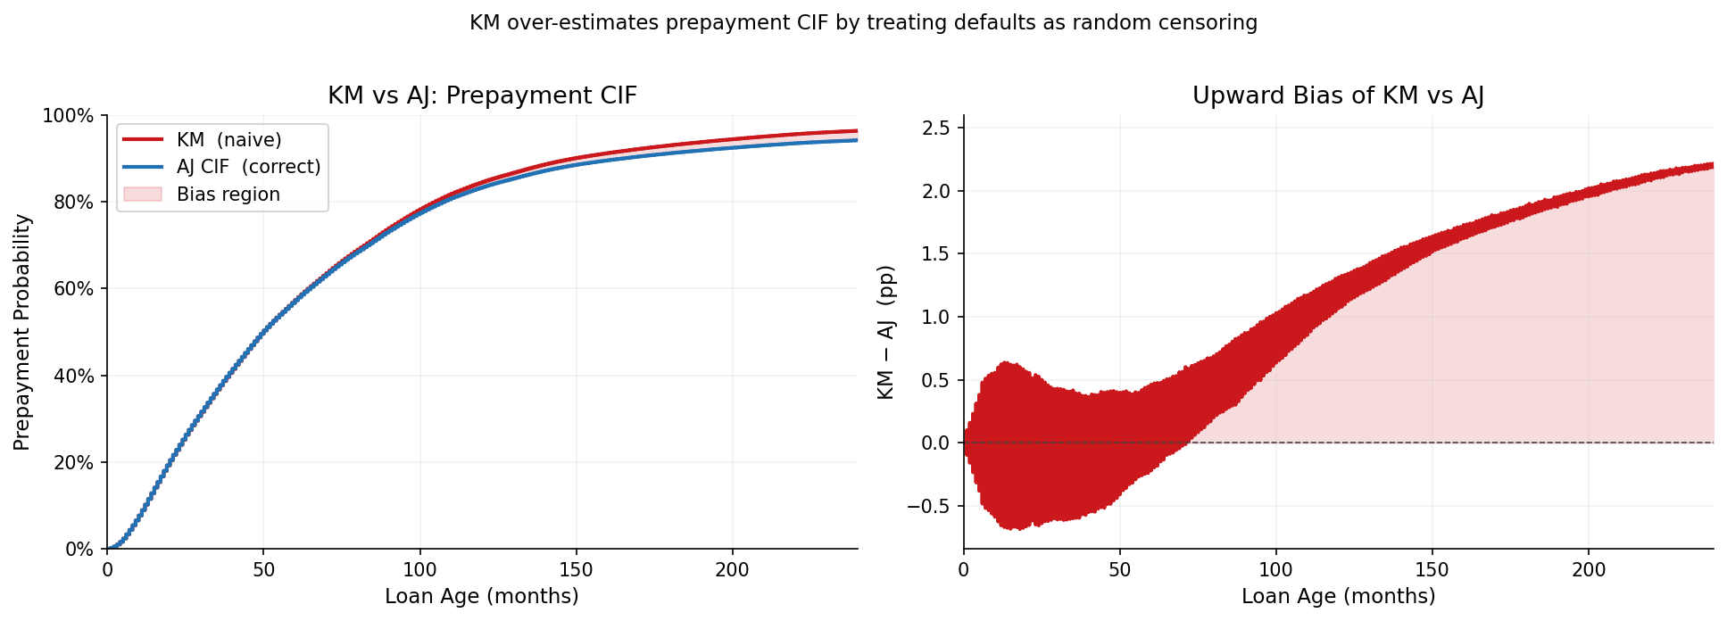
E(i)(c) — KM vs AJ: Why Defaults Cannot Be Treated as Censorings
Every AJ increment ≤ KM increment → F_AJ(t) ≤ F_KM(t) → growing bias
KM increment at t_j (defaults excluded from denominator n_j^KM < n_j):
ΔF_KM(t_j) = S_KM(t_j-) * d_{1j} / n_j^KM ← n_j^KM underestimates risk set
AJ increment at t_j (overall survival, full risk set):
ΔF_AJ(t_j) = S(t_j-) * d_{1j} / n_j ← S(t_j-) ≤ S_KM(t_j-) always
Consequence — bias compounds over time:
• 5 yr: KM over-estimates prepayment CIF by ~+0.45 pp
• 10 yr: bias ≈ +1.31 pp
• 20 yr: bias ≈ +2.23 pp (gap widens as defaulted loans accumulate)

Slide 10
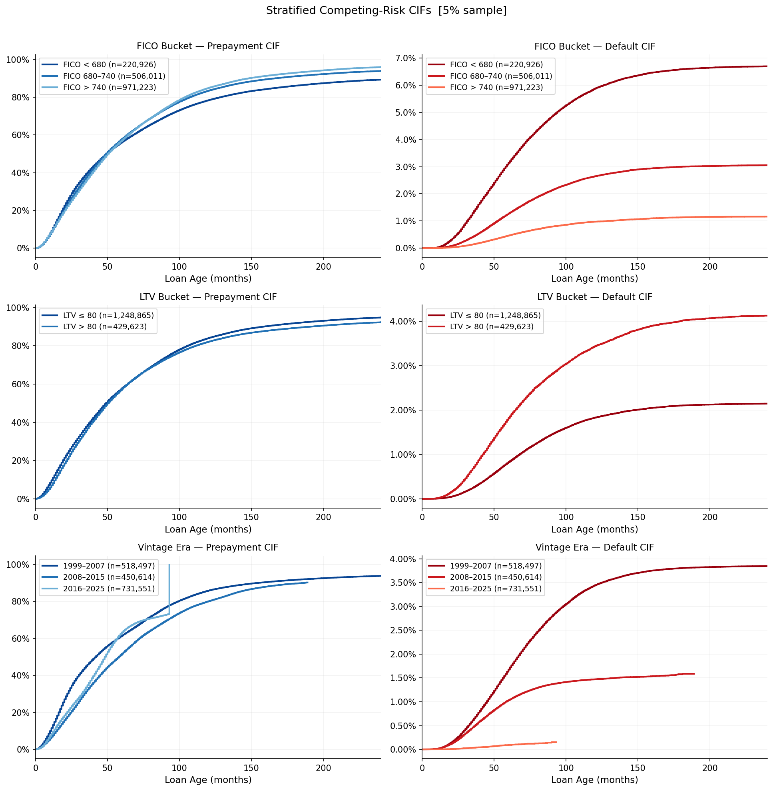
E(i)(d) — Stratified CIF
High-FICO → elevated prepayment, near-zero default; high-LTV → inverted

Slide 11
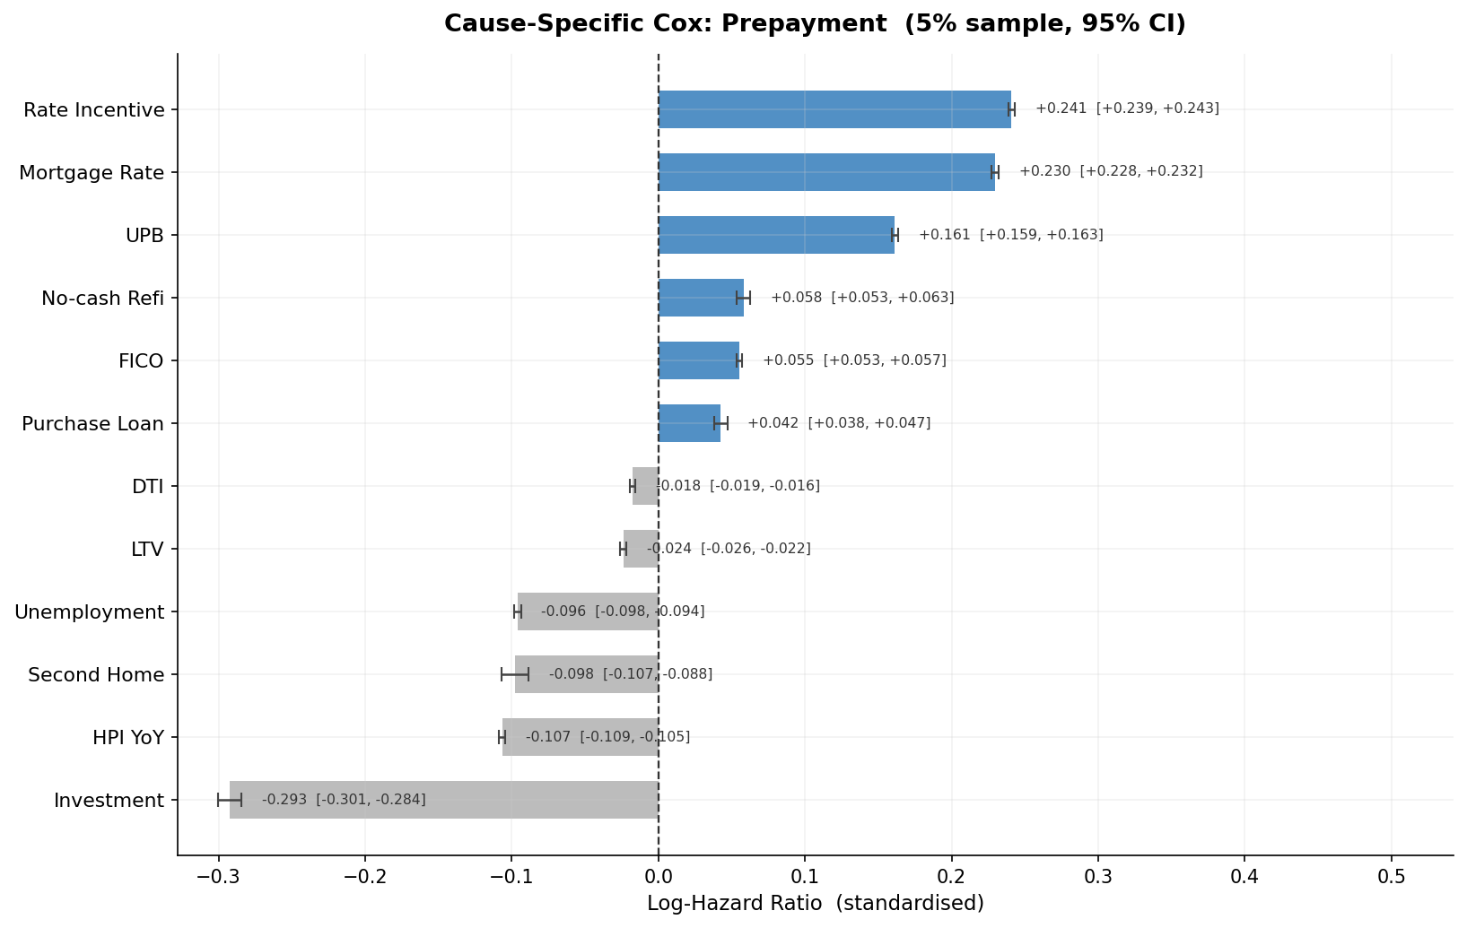
E(i)(e) — Cause-Specific Cox: Prepayment (sorted ascending)
Rate incentive & Purchase purpose → highest refi hazard · 12 features · 95% CI

Slide 12
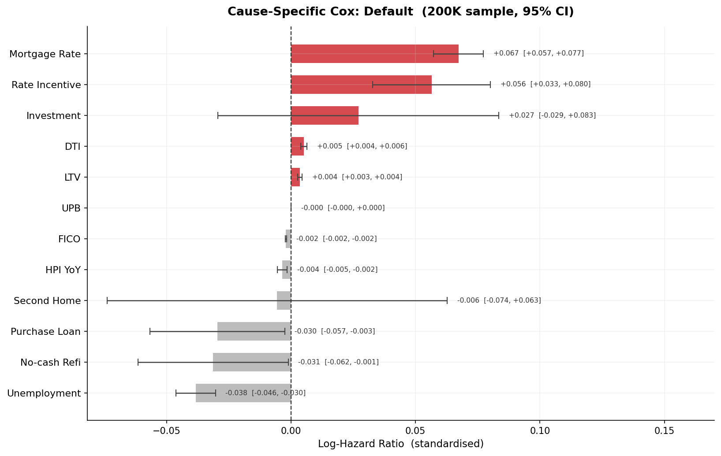
E(i)(e) — Cause-Specific Cox: Default (sorted ascending)
LTV & DTI → highest default hazard · CreditScore opposite sign to prepayment

Slide 13
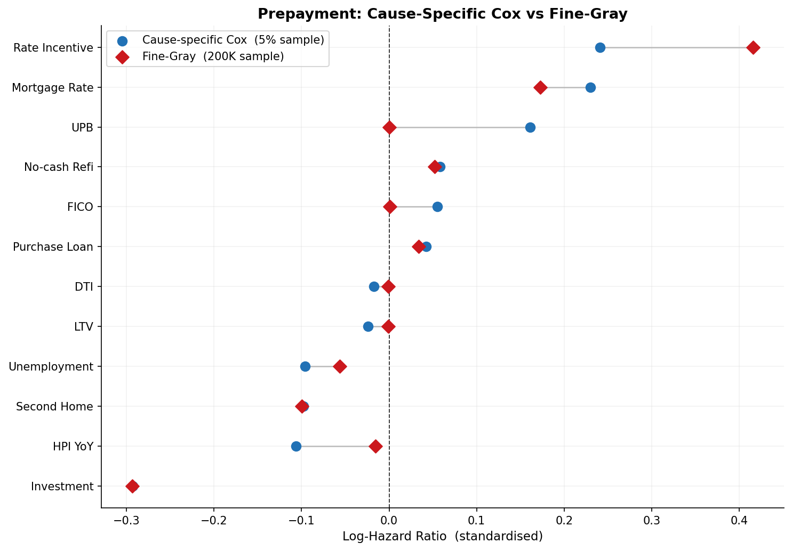
E(i)(f) — Fine-Gray Subdistribution Hazard
IPCW-weighted Cox · coefficients directly target the CIF
• Defaulted loans KEPT in prepayment risk set (IPCW-weighted)
• rate_incentive: LARGER under Fine-Gray — high-incentive loans also less likely to default first
• FICO: ATTENUATED under Fine-Gray — elevated default risk for low-FICO reduces measured prepayment propensity
• Use Fine-Gray for CIF prediction / loss forecasting
• Use cause-specific Cox for economic mechanism estimation

Slide 14
E(ii) — Time-Dependent Covariates
Andersen-Gill counting-process Cox — monthly rate_incentive, unemployment, HPI
• Panel dataset: 93M rows × 2M loans — mortgage_rate, unemployment, HPI YoY, rate_incentive updated monthly
• 10,000 loans stratified by vintage → ~500K counting-process rows (tstart, tstop, event)
• 11 features: 7 static (FICO, LTV, DTI, UPB + 3 one-hot) + 4 time-varying
• Key finding: current rate_incentive coefficient LARGER than origination-vintage snapshot
• Static Cox: rate_incentive locked at origination — high-rate era loans always look attractive
• TV Cox: tracks actual monthly refi option value — more responsive to rate cycles
• Unemployment: contemporaneous job loss predicts default better than vintage average
• Limitation: origination LTV used (not ELTV) — adding current LTV would improve default hazard

Slide 15
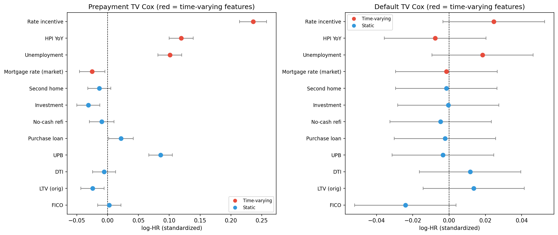
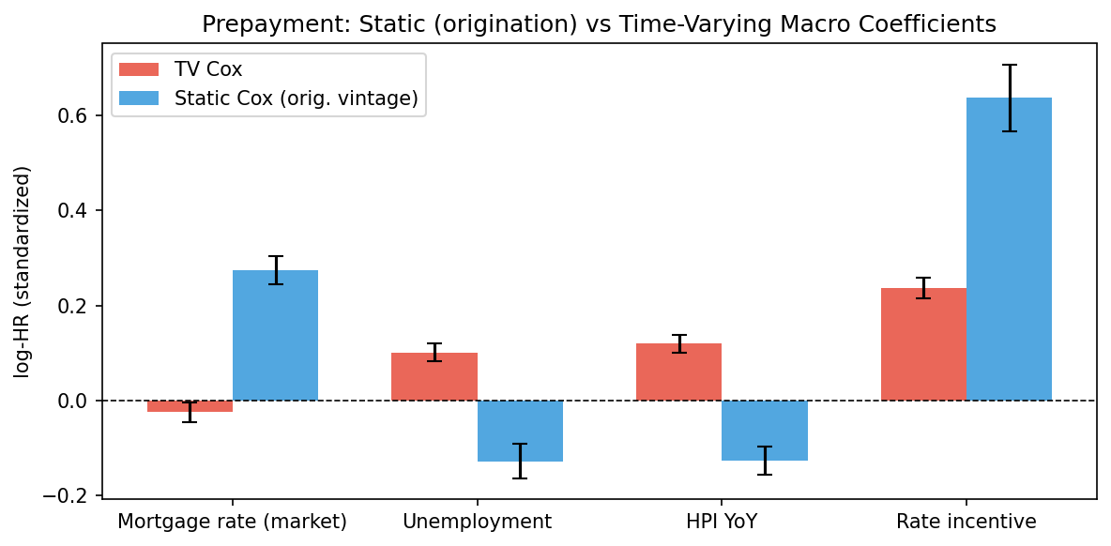
E(ii) — TV Cox Results

Slide 16
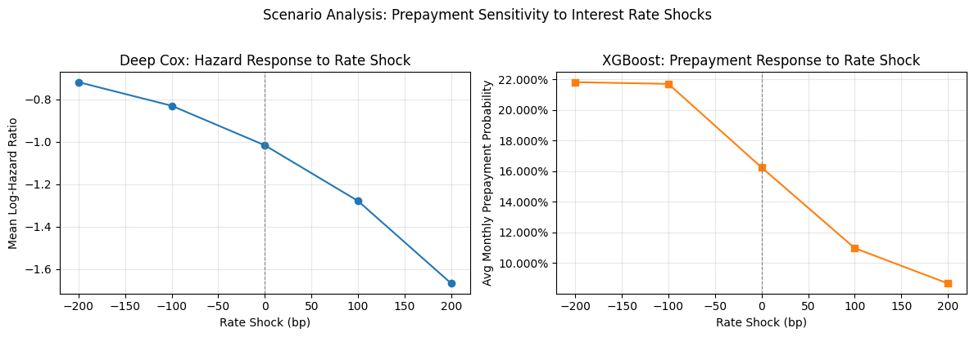
E(iv) — Scenario Analysis: Interest Rate Shocks
±100 bp and ±200 bp shocks to mortgage_rate (rate_incentive updated consistently)

Slide 17
E(iv) — Scenario Analysis: Interpretation
• XGBoost: clear monotone CONVEX response — rate cuts raise prepayment probability more than rate rises suppress it
• Deep Cox: monotone but smoother — log-hazard is a less non-linear function of rate_incentive
• Asymmetry (−200 bp effect > +200 bp effect) reflects the BURNOUT effect:
• most rate-sensitive borrowers have already prepaid → muted upside response to cuts
• Both models agree on direction → robustness of rate-incentive channel across architectures
• Implication for MBS pricing: prepayment option has POSITIVE CONVEXITY —
• rate decline creates more prepayment than rate rise suppresses it

Slide 18
Summary
E(i)(b)
Aalen-Johansen CIF
10-yr prepay ≈ 45%; default ≈ 2%
E(i)(c)
KM vs AJ bias
KM over-estimates by +0.5–2.2 pp at 5–20 yr
E(i)(d)
Stratified CIF
Crisis vintages 8–12× higher default CIF
E(i)(e)
Cause-specific Cox
CreditScore / LTV opposite signs across causes
E(i)(f)
Fine-Gray
rate_incentive HR larger vs cause-specific Cox
E(ii)
Andersen-Gill TV Cox
Current rate_incentive > origination snapshot
E(iv)
Scenario analysis
Convex, asymmetric prepayment response to rate shocks

