Slide 1
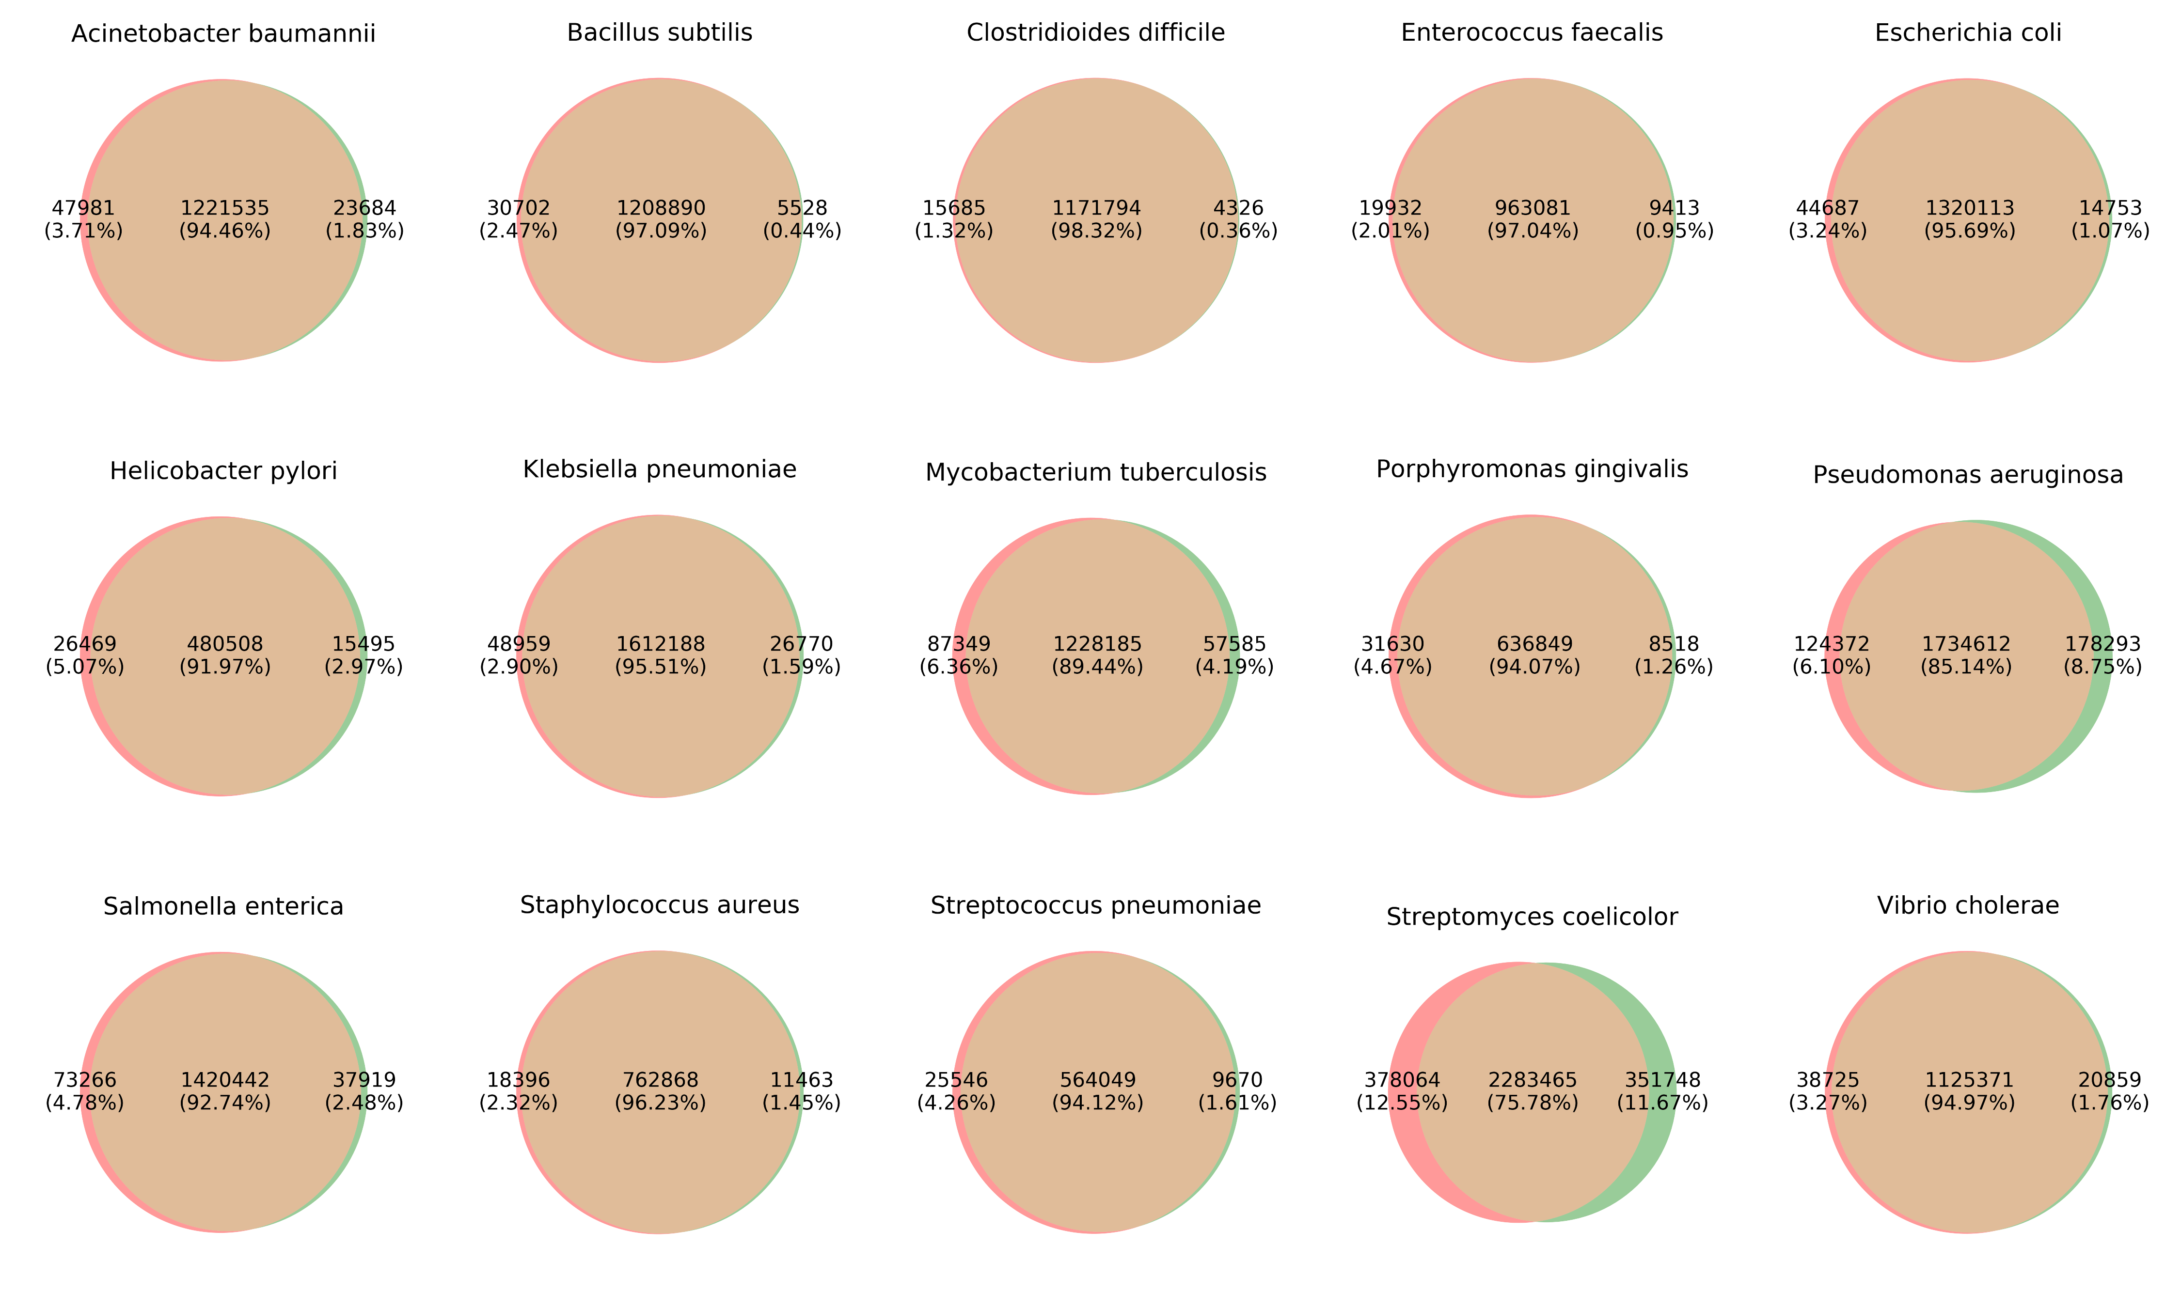
True codon positions
Predicted codon positions

