Slide 1
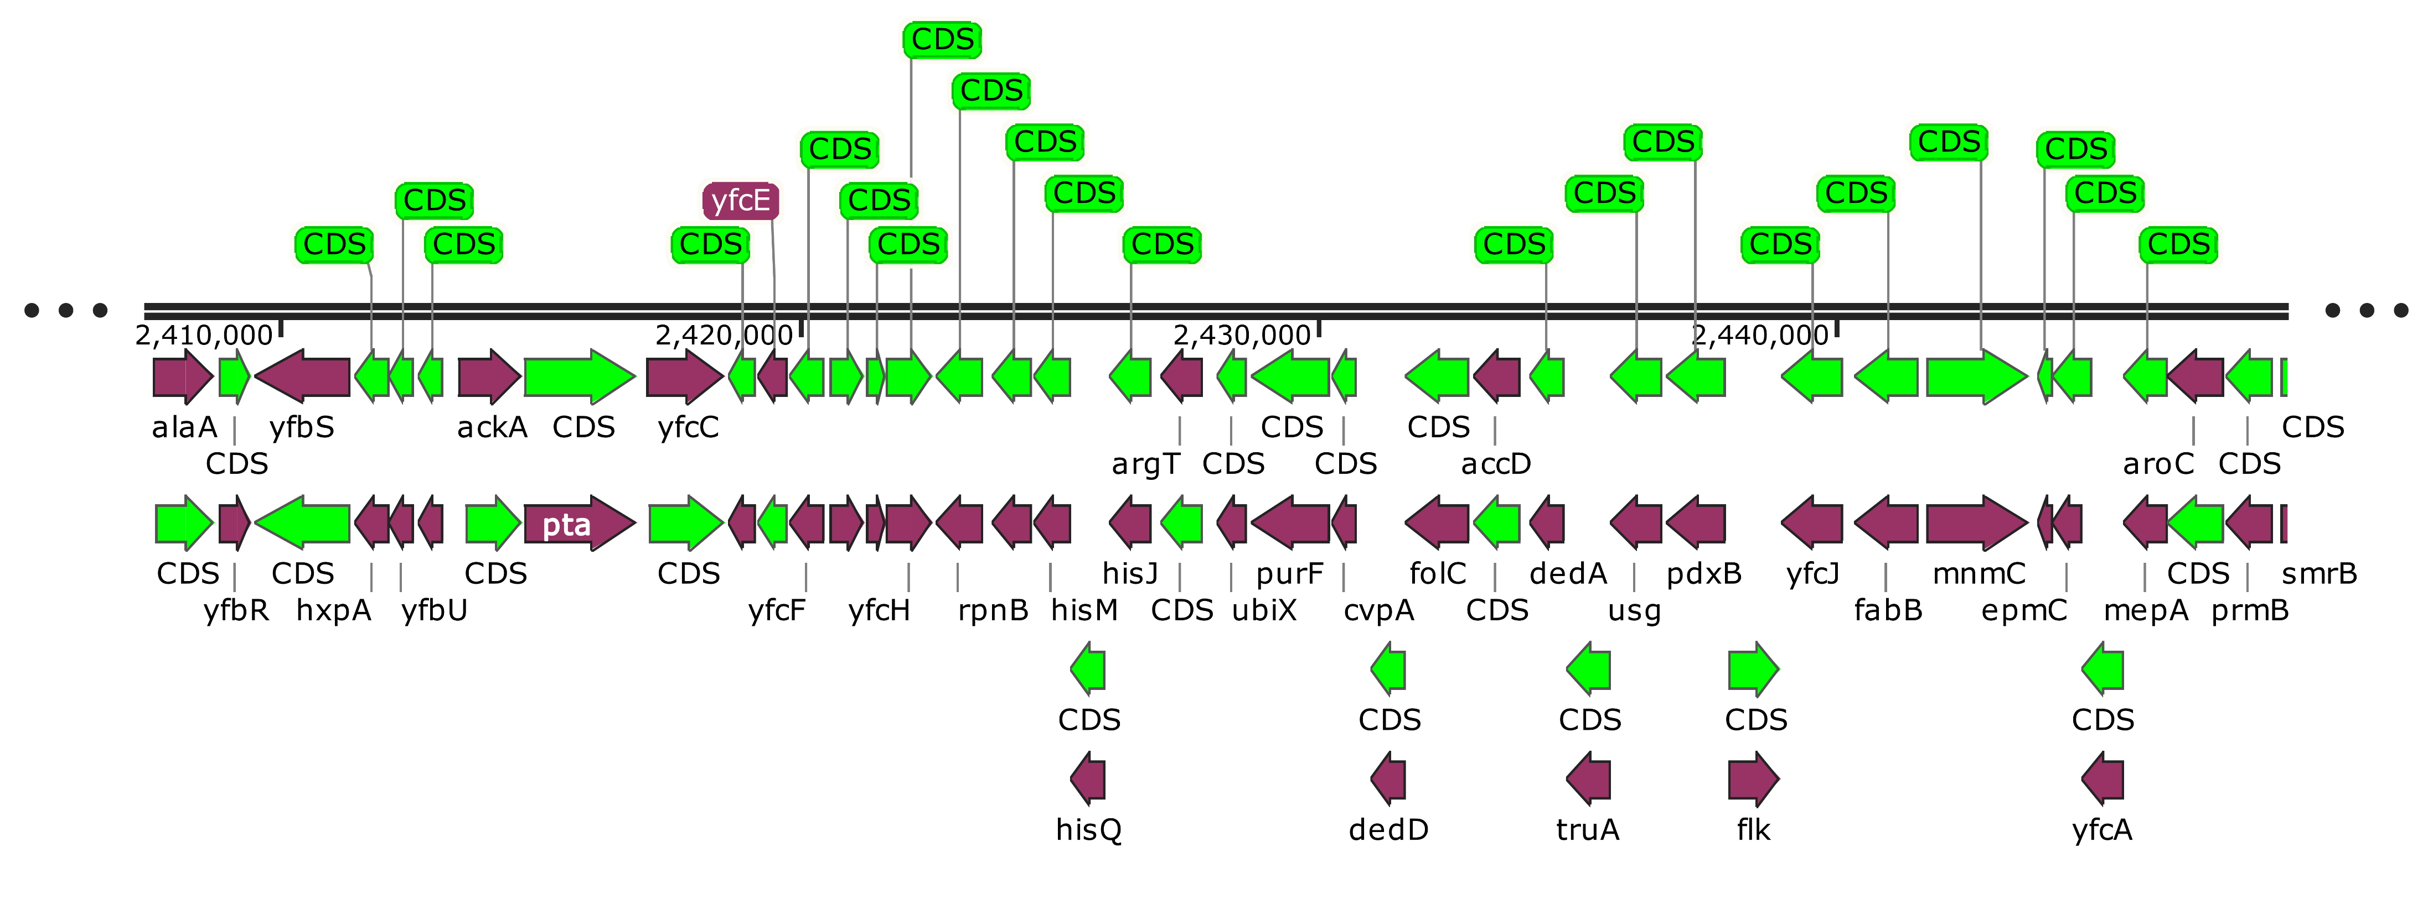
Original CDS
Predicted CDS

