Slide 1
Lab
Yijun
7/8

Slide 2
Introduction
2nd-year Ph.D. student in Computer Science, USC
M.S. in Data Informatics, USC and B.S. in Information Security, Tongji University
Research interests
Data Mining – Discovering interesting patterns in large-scale data
Spatial-Temporal Data Analysis – Learning spatial and temporal relationships in the data
Machine Learning – Building machine learning/deep learning models to automatically extract useful information to solve real world problem
Application – building an explainable system to predict fine-scale air quality values with multi-source data (e.g., meteorological and geographic information)

Slide 3
Lab Topics
Item-based Collaborative Filtering Recommendation System
Yelp Datasets Introduction (7/8)
Pearson Correlation (7/8)
Weighted Average for Prediction (7/9)
Model Evaluation (7/9)
Spatial Data Visualization
QGIS Tutorial (7/8)
Visualization with Yelp Datasets (7/9)
Spatial Computing using QGIS (7/9)

Slide 4
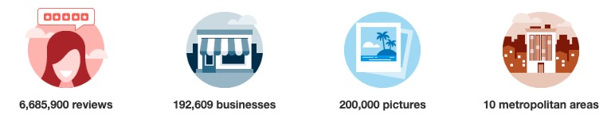
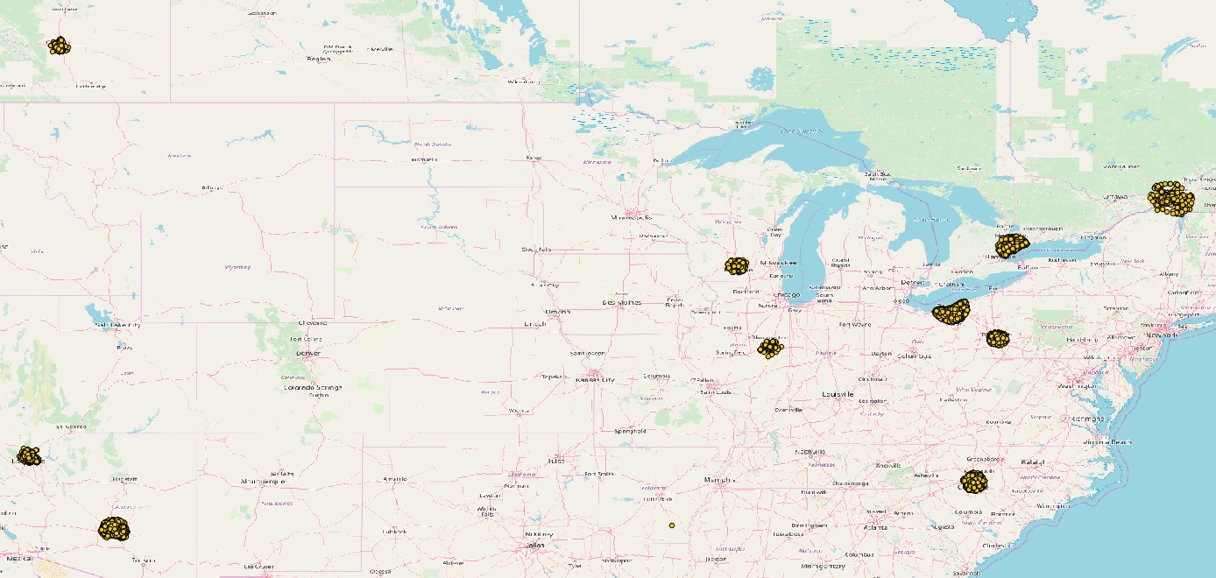
Yelp Datasets
Main components: Users, Businesses, Reviews
You can download the Yelp open dataset from https://www.yelp.com/dataset
Business Locations

Slide 5
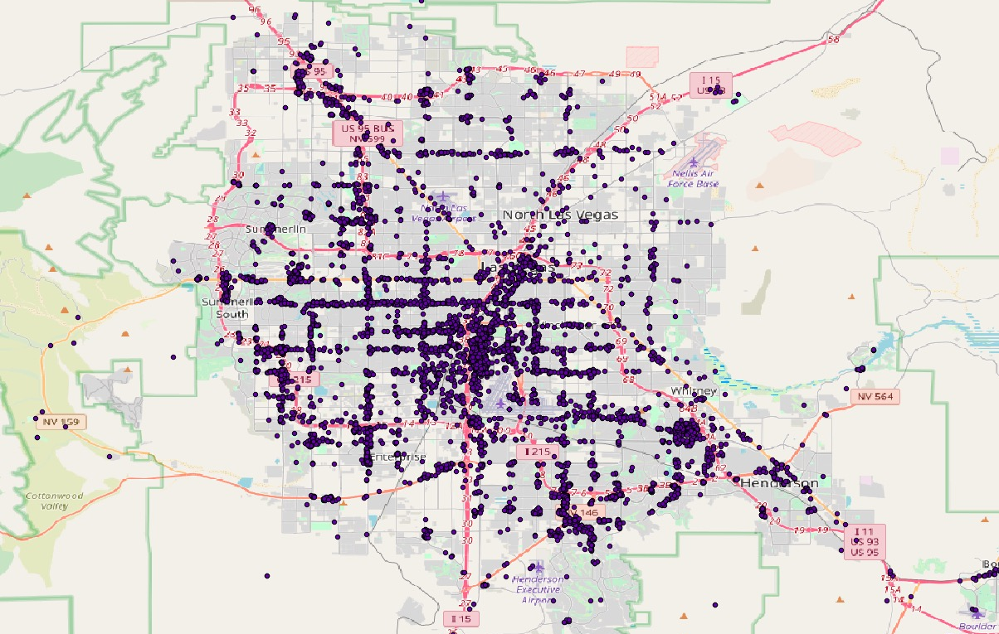
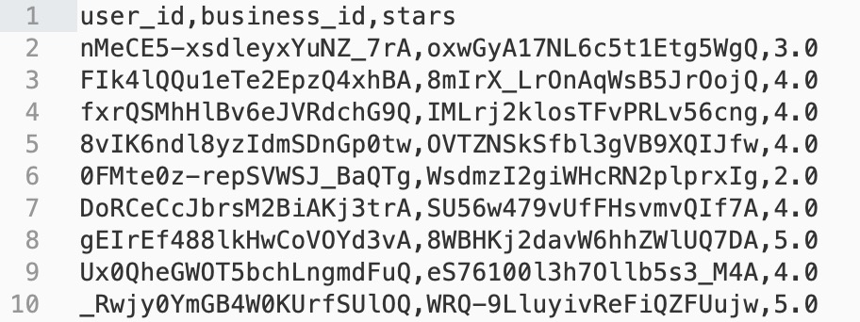
Yelp Datasets
Extracting the businesses in Las Vegas
Business type = “Restaurant”
About 2161 locations
Generating a subset of review data
About 200,000 reviews
Splitting into training and testing data
80% training and 20% testing
Business Locations in NV
Preview of Review Data

Slide 6
Lab Tasks (7/8)
Set up Python environment
Download and Explore the given Yelp datasets
what attributes?
Start your recommendation system
- Implement the functions to compute Pearson similarity for given business pairs
Set up QGIS environment - if you have time ☺

Slide 7

Review: Recommendation System
Item-based Collaborative Filtering Recommendation System
?

Slide 8
Review: Recommendation System
Item-based Collaborative Filtering Recommendation System
?
5.0
3.0
4.0

Slide 9
Review: Recommendation System
Item-based Collaborative Filtering Recommendation System
If the similarity of two businesses is high => similar ratings
?
Similarity
(
)
= ?
5.0
3.0
4.0
Similarity
(
)
= ?
Similarity
(
)
= ?

Slide 10




Review: Recommendation System
Item-based Collaborative Filtering Recommendation System
Compute similarity based on the ratings from co-rated users
Other users who rated on both items

Slide 11


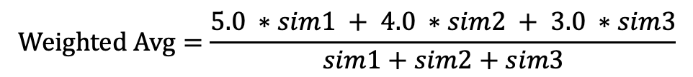

Review: Recommendation System
Item-based Collaborative Filtering Recommendation System
(
)
Similarity
= $sim1$
(
)
Similarity
= $sim2$
(
)
Similarity
= $sim3$
5.0
3.0
4.0
$$Weighted Avg=\frac{5.0 ∗sim1 + 4.0 ∗sim2 + 3.0 ∗sim3}{sim1+sim2+sim3}$$

Slide 12
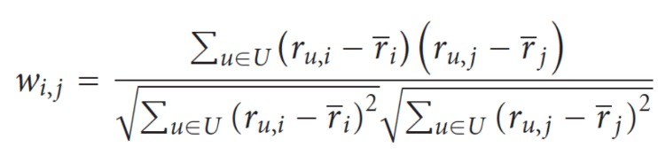
Review: Pearson Correlation
where $r_{u,i}$ is the rating of user $u$ on item $i$, $\overline{r}$ is the average rating of item $i$ by those users
Note: Only consider the users who rated both items $i$ and $j$

Slide 13
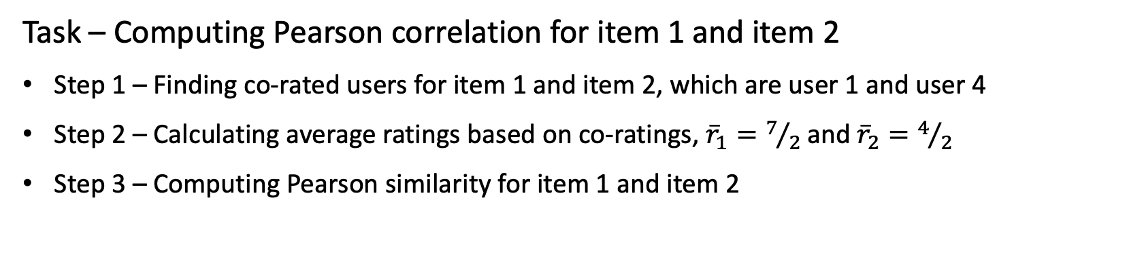
Pearson Correlation Example
user 4 | user 3 | user 2 | user 1
5 |  | 3 | 2 | item 1
3 | 4 |  | 1 | item 2
- unknown rating
- rating between 1 to 5
Task – Computing Pearson correlation for item 1 and item 2
Step 1 – Finding co-rated users for item 1 and item 2, which are user 1 and user 4
Step 2 – Calculating average ratings based on co-ratings, ${\overline{r}}_{1}=7/2$ and ${\overline{r}}_{2}=4/2$
Step 3 – Computing Pearson similarity for item 1 and item 2
$$W_{1,2}= \frac{\left(r_{1,1} −{ \overline{r}}_{1}\right)\left(r_{1,2} −{ \overline{r}}_{2}\right) + \left(r_{4,1} −{ \overline{r}}_{1}\right)\left(r_{4,2} −{ \overline{r}}_{2}\right)}{\sqrt{{\left(r_{1,1} −{ \overline{r}}_{1}\right)}^{2} + {\left(r_{4,1} −{ \overline{r}}_{1}\right)}^{2}}\sqrt{{\left(r_{1,2} −{ \overline{r}}_{2}\right)}^{2} + {\left(r_{4,2} −{ \overline{r}}_{2}\right)}^{2}}}=\frac{\left(2 − 3.5\right)\left(1 − 2\right) + \left(5 − 3.5\right)\left(5 − 2\right)}{\sqrt{{\left(2 − 3.5\right)}^{2} + {\left(5 − 3.5\right)}^{2}}\sqrt{{\left(1 − 2\right)}^{2} + {\left(5 − 2\right)}^{2}}}=1$$

Slide 14
Pearson Correlation Implementation
Write a function to find co-rated users for the targeting business pair
Write a function to compute Pearson similarity for business 1 and business 2
Write the code to compute the weight matrix for all business pairs
Write the code the save the weight matrix for later use

Slide 15

Pearson Correlation Edge Cases I
When computing Pearson correlation for item 1 and item 2,
if there is no co-rated users ?
$W_{1,2}$= 0.0
user 4 | user 3 | user 2 | user 1
5 |  | 3 |  | item 1
 | 4 |  | 1 | item 2

Slide 16

Pearson Correlation Edge Cases II
When computing Pearson correlation for item 1 and item 2,
if there is only one co-rated users ?
$W_{1,2}$= 0.0 because of too few information
user 4 | user 3 | user 2 | user 1
5 |  | 3 |  | item 1
 | 4 | 5 | 1 | item 2

Slide 17

Pearson Correlation Edge Cases III
When computing Pearson correlation for item 1 and item 2,
if a user has the same ratings on the co-rated items?
Causing the denominator to be 0.0
$W_{1,2}$= 0.0 or using average ratings based on all ratings
user 4 | user 3 | user 2 | user 1
3 |  | 2 | 3 | item 1
3 | 4 |  | 2 | item 2

Slide 18
Start Your Recommendation System…
Git clone the repository: https://github.com/linyijun/lab201907.git
Follow the Tutorial <recommendation_system_tutorial _part_1.docx>

