Slide 1
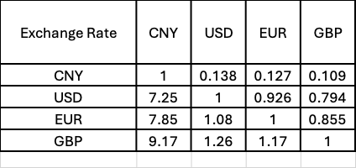
Updated rate:
USD to CNY=7.02

