Slide 1

Exploring the Differences of Spatial Terms in Chinese and English Language Networks.
Yu-Hsuan Lin ( Psychology )
National Taiwan University
Taiwan Hub

Slide 2
Outline
Topic
Literature review
Results
Future prospects
Discussion
Notes:
I’ve divided my speech / presentation into 5 parts.
First of all, I’m going to start with… , and then talk about… .

Slide 3
Research Question
Do we generate differences in brain representations due to language usage variations in the comprehension of spatial terms?
Notes:
Previous research on the spatial differences between Chinese and English has found that Chinese often uses vertical concepts to represent temporal sequence (Boroditsky, L. (2008)). For example, expressions like "下一周" (next week, direct translation-lower week) and "上個學期" (previous semester, direct translation-upper semester) embody this characteristic, which is also reflected in the top-to-bottom writing style prevalent in Chinese. Researchers have also conducted behavioral studies by grouping participants based on their native language and their first foreign language. They asked and studied how these participants represent their understanding of time. By asking questions like "If today is here, where is tomorrow?", the researchers identified that native Chinese speakers are more likely than native English speakers to indicate relative positions using vertical arrangements.

Slide 4
Languages Shape Our Thoughts
Language-specific phoneme representations revealed by electric and magnetic brain responses. (Näätänen, et al., 1997)
Prototype of phonetic processing
When researchers present infrequent stimuli, native speakers of different languages demonstrate different prototypes for sounds, which is reflected electrically as the mismatch negativity (MMN) in subjects.
Notes:
Different native languages have different prototypes for recognizing speech sounds. This information tells us that in the human brain's language processing system, there may be different brain representations for the same linguistic phenomenon due to variations in language usage.
We presented to Finnish subjects the Finnish phoneme prototype /e/ as the frequent stimulus, and other Finnish phoneme prototypes or a non-prototype (the Estonian prototype /õ/) as the infrequent stimulus. We found that the brain's automatic change-detection response, reflected electrically as the mismatch negativity (MMN)
Mismatch negativity (MMN) response enhanced when the infrequent stimulus was a prototype relative to a non-prototype
Language-specific phonemic traces observed through MMN, with Estonians showing enhanced MMN for their native phoneme /õ/
Source of language-specific response enhancement located in the left hemisphere's auditory cortex through whole-head magnetic recordings

Slide 5
Languages Shape Our Thoughts
Unconscious effects of language-specific terminology on preattentive color perception. (Thierry, et al., 2009)
Greek speakers with two color terms (ghalazio and ble) for light and dark blue show better discrimination than English speakers
Visual mismatch negativity is similar for blue and green stimuli among English speakers
Greek speakers exhibit significantly larger mismatch negativity for blue stimuli compared to green stimuli
Notes:
Not only in speech perception, but also in the observation of colors, language habits similarly influence.
Implication: Language-specific terminology has an implicit impact on human color perception
Unfortunately, current research on spatial differences in cognition mostly focuses on differences in language presentation. We cannot rule out the possibility that language has not developed alternative ways of expression. Whether these differences are reflected in more fundamental brain representations remains an unexplored territory. Therefore, this article aims to present the differences in the use of spatial terms in Chinese and English texts through text analysis, and further investigate whether these linguistic differences are reflected in brain representations.

Slide 6
Research Method
1
4
Checking the co-location of
The Little Prince
In the Ch & EN version
Match with the fMRI Brain Database
2
3
Investigate the differences
- Frequency of each spatial term
Checking the differences in connected words in each spatial term between Chinese and English.
Notes:
I chose "The Little Prince" as the text for recognizing spatial terms because I need to align it with open brain imaging databases. However, when it comes to cross-linguistic brain data, "The Little Prince" is the only available resource I found on the internet.
The first step is that I choose 8 different spatial terms based on the prior study, and use python to check the colocation of these spatial terms
2 step
3 step

Slide 7
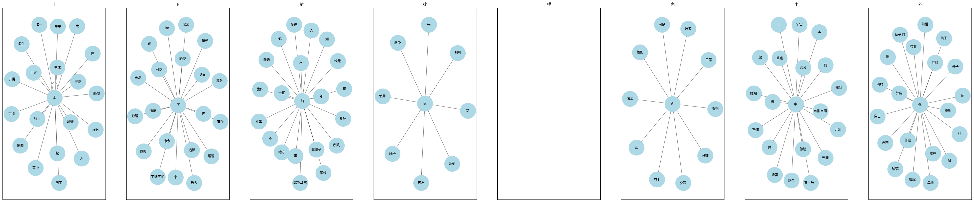
Results-CH
Co-location of spatial terms- Terms definition by Cheng-Hsien Chen, NTNU

Slide 8
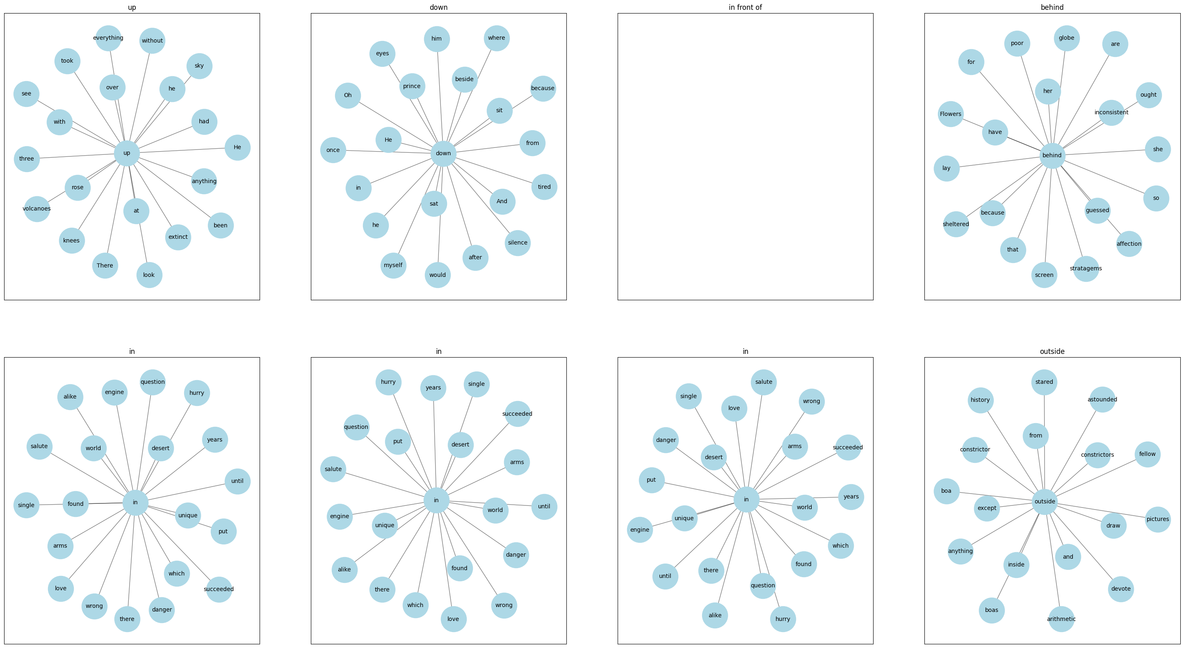
Results-EN
Co-location of spatial terms- Terms definition by Cheng-Hsien Chen, NTNU

Slide 9
Results-CH
Co-location of spatial terms- Terms definition by Cheng-Hsien Chen, NTNU

Slide 10
Results-EN
Co-location of spatial terms- Terms definition by Cheng-Hsien Chen, NTNU

Slide 11
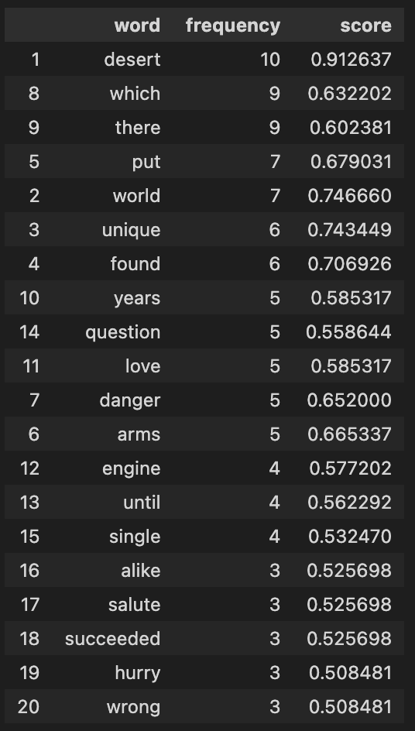
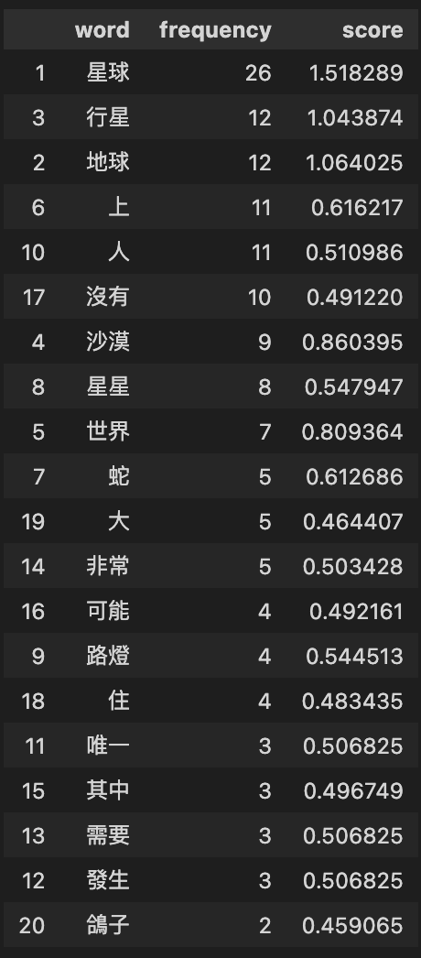
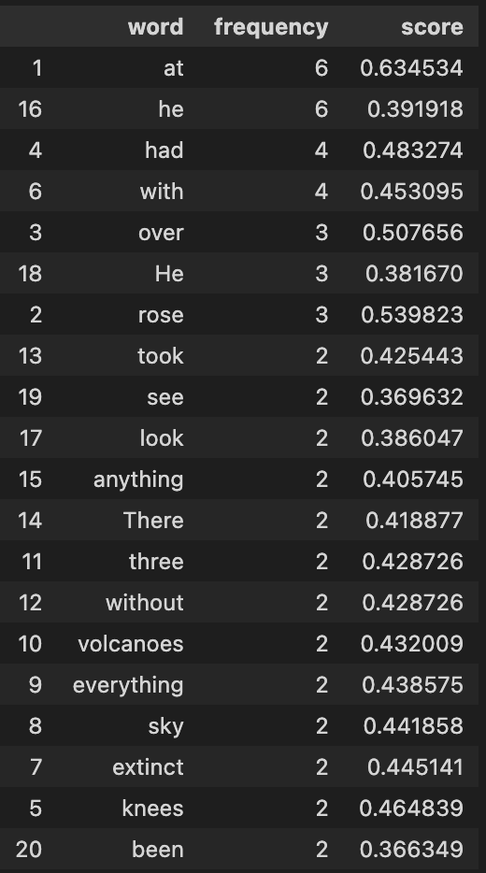
Results - Frequency of the spatial term
In
上
On
Abstract concepts
Objects different
from EN text

Slide 12
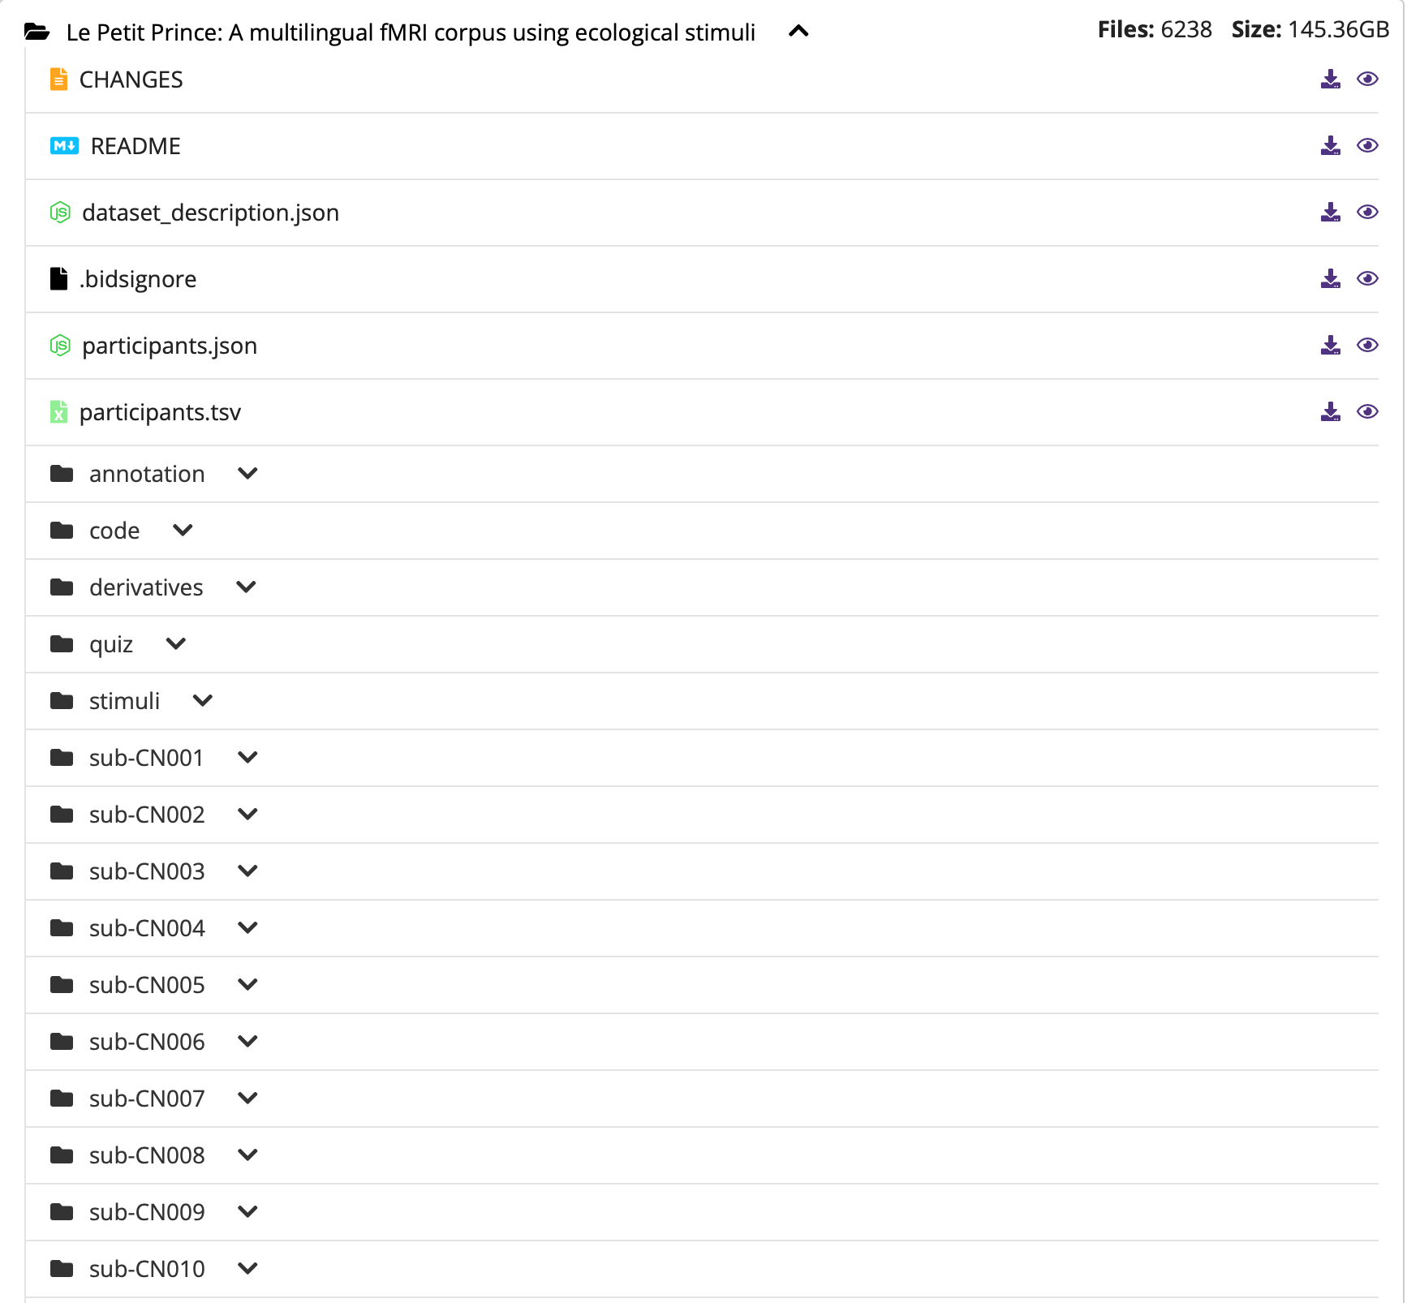

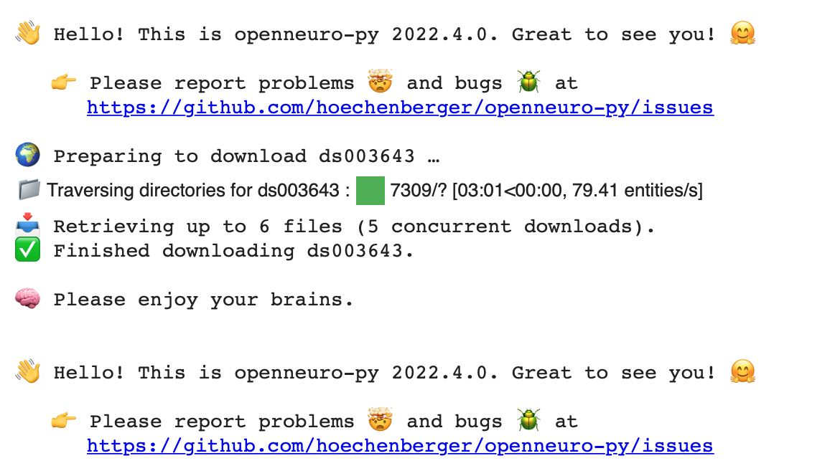
Results - fMRI dataset

Slide 13
Next Steps
Find the corresponding spatial terms in the database
Compare the differences in brain responses to these spatial terms between Chinese and English language users.

Slide 14
Summary
Use Python to assist in analyzing spatial terms in text and corpus.
Understand the different categories between languages.
Extract specific data from open brain database.
Spatial terms in EN version refer to some abstract concepts
The same object in different languages have preference in using spatial terms
The characteristics of fMRI are not suitable for studying short-term differences in the brain.
Interpreting results from fMRI data is challenging.

Slide 15
Discussion
In order to correspond to the brain database, the accuracy of the co-location plot decrease.
How to infer results from corpus data to brain data?

Slide 16
References
Lakoff, G., & Johnson, M. (2008). Metaphors we live by. University of Chicago press.
Näätänen, R., Lehtokoski, A., Lennes, M., Cheour, M., Huotilainen, M., Iivonen, A., ... & Alho, K. (1997). Language-specific phoneme representations revealed by electric and magnetic brain responses. Nature, 385(6615), 432-434.
Thierry, G., Athanasopoulos, P., Wiggett, A., Dering, B., & Kuipers, J. R. (2009). Unconscious effects of language-specific terminology on preattentive color perception. Proceedings of the National Academy of Sciences, 106(11), 4567-4570.
Whorf, Benjamin Lee (1956) [1936?]. “An American Indian model of the universe”. In Carroll, J. B. (ed.). Language, Thought, and Reality: Selected Writings of Benjamin Lee Whorf. Cambridge, Massachusetts: Technology Press of Massachusetts Institute of Technology. pp. 57–64.
Boroditsky L., Gaby, A. (2010). “Remembrances of times East: Absolute Spatial Representations of time in an Australian Aboriginal Community.” Sci.
Boroditsky, L. (2008). Do English and Mandarin Speakers think Differently about Time? Proceedings of the 30th annual conference of the cognitive science society. pp. 64-70
Chen, Alvin Cheng-Hsien. "Words, constructions and corpora: Network representations of constructional semantics for Mandarin space particles" Corpus Linguistics and Linguistic Theory, vol. 18, no. 2, 2022, pp. 209-235. https://doi.org/10.1515/cllt-2020-0012
Stehwien, S., Henke, L., Hale, J., Brennan, J., & Meyer, L. (2020, May). The Little Prince in 26 languages: Towards a multilingual neuro-cognitive corpus. In Proceedings of the Second Workshop on Linguistic and Neurocognitive Resources(pp. 43-49).
https://alvinntnu.github.io/presentations/NCCU06282021/NCCU-TALK-2021-06-28.html#/
https://www.kaggle.com/code/bbqlp33/word2vec-gensim

