Slide 1
Plastic
Michael 3778
Richard 3774

Slide 2
Classification
Plastics are usually classified by their chemical structure of the polymer's backbone and side chains. Some important groups in these classifications are the acrylics, polyesters, silicones, polyurethanes, and halogenated plastics. Plastics can also be classified by the chemical process used in their synthesis, such as condensation, polyaddition, and cross-linking.

Slide 3
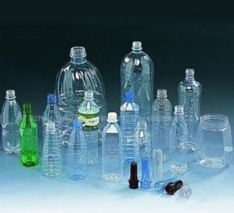

Introduction
Plastic is a material consisting of any of a wide range of synthetic or semi-synthetic organic compounds that are malleable and can be molded into solid objects. Plastics are typically organic polymers of high molecular mass, but they often contain other substances. They are usually synthetic, most commonly derived from petrochemicals, but many are made from renewable materials such as polylactic acid from corn or cellulosic from cotton linters. Plasticity is the general property of all materials that are able to irreversibly deform without breaking, but this occurs to such a degree with this class of moldable polymers that their name is an emphasis on this ability.

Slide 4
Advantages of plastic
Relatively low cost
Ease of manufacture
Versatility
Imperviousness to water

Slide 5
Usage of plastic
plastics are used in an enormous and expanding range of products, from paper clips to spaceships. They have already displaced many traditional materials, such as wood, stone, horn and bone, leather, paper, metal, glass, and ceramic, in most of their former uses. In developed countries, about a third of plastic is used in packaging and another third in buildings such as piping used in plumbing or vinyl siding. Other uses include automobiles (up to 20% plastic), furniture, and toys. In the developing world, the ratios may be different - for example, reportedly 42% of India's consumption is used in packaging. Plastics have many uses in the medical field as well, to include polymer implants, however the field of plastic surgery is not named for use of plastic material, but rather the more generic meaning of the word plasticity in regard to the reshaping of flesh.

Slide 6
Disadvantages
Most plastics are durable and degrade very slowly; the very chemical bonds that make them so durable tend to make them resistant to most natural processes of degradation. However, microbial species and communities capable of degrading plastics are discovered from time to time, and some show promise as being useful for bio remediating certain classes of plastic waste.

Slide 7
How to prevent
Reuse plastic bags
Throw the plastic rubbishes into a specific rubbish bin
Start to use cloth bag
Use recycled plastic

Slide 8
Thank you for watching

