Slide 1
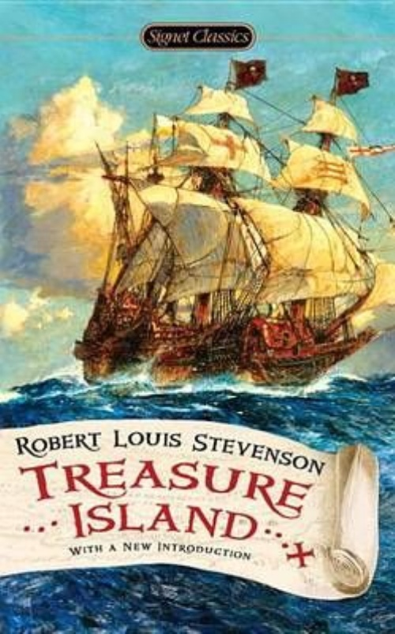
Treasure island
Michael 3778

Slide 2
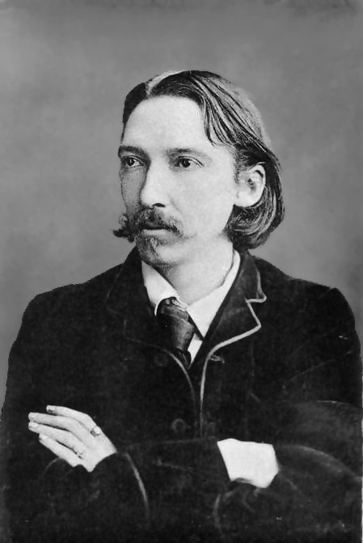
Robert Louis Balfour Stevenson

Slide 3
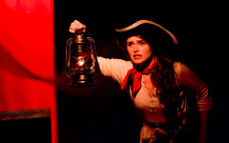
characters
Jim Hawkins
Dr. Livesey
Long John Silver
Captain Smollett
Squire Trelawney

Slide 4
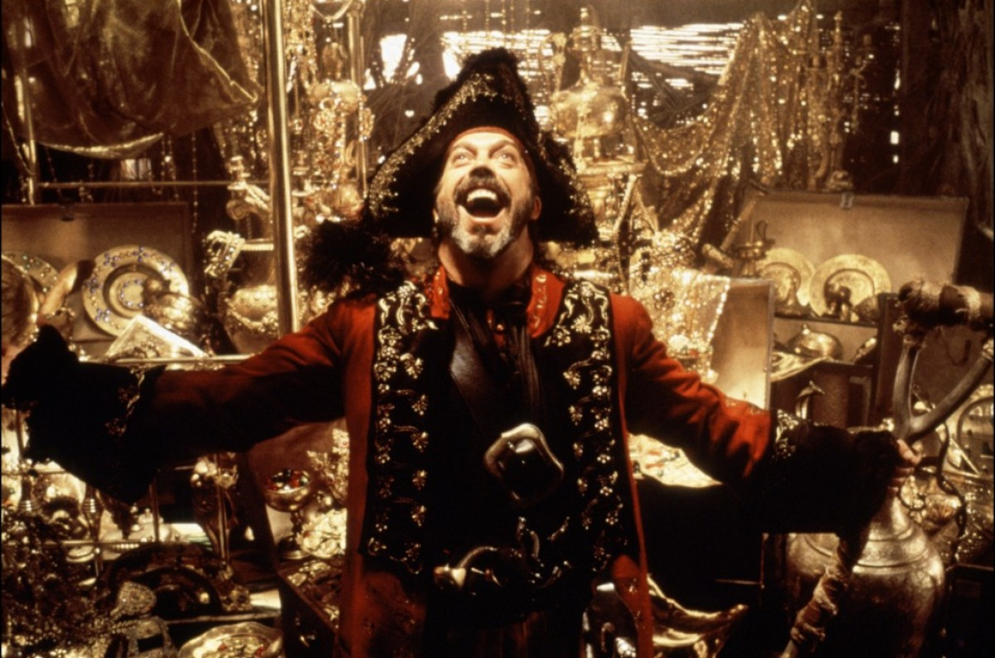
Brief story

Slide 5
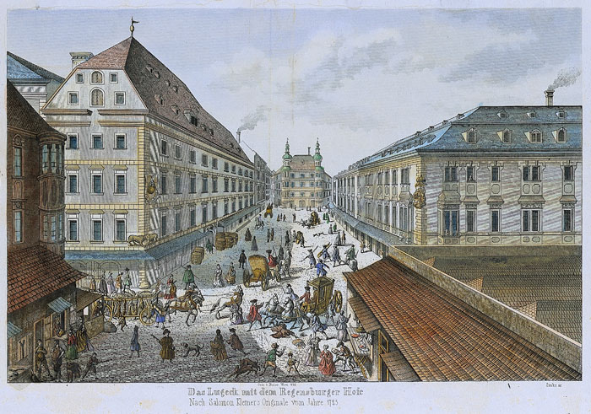
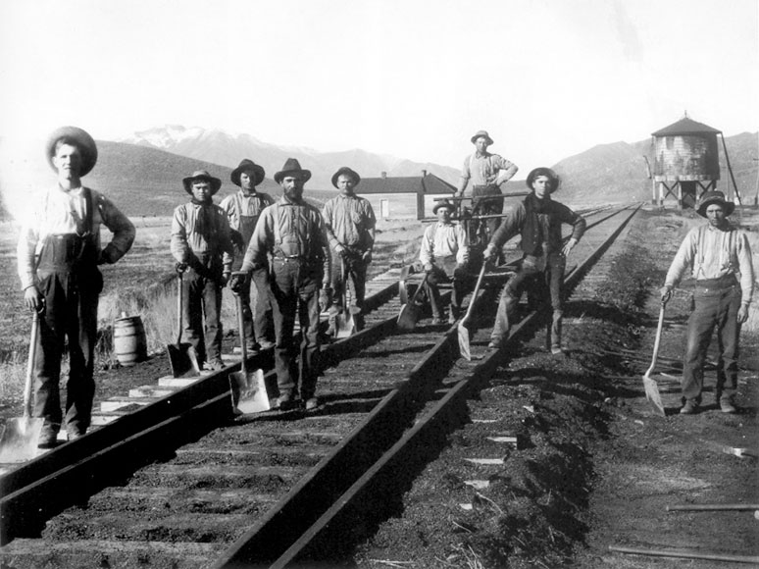
ABOUT 19 century

Slide 6

THANK YOU

