Slide 1
Customer Insights &
Product Recommendations
Blackwell Electronics - Data Mining Team
Team Insights
Snow Li, Lin Zhao, Susana Womack, Mariam Jiranu

Slide 2
Objectives
Customer Brand Preferences
Almost 15,000 customers surveyed
34% of surveys incomplete
Predict brand preference of incomplete surveys
New Product Profitability
Tracked sales performance of existing products
Predict sales volume by product type for new products
Assess impact of reviews on sales performance
Electronidex Customer Buying Patterns
One month of Electronidex online sales purchases
~10,000 transactions with 125 different products
Analyze product associations

Slide 3

Customer Brand Preference
Completed Surveys
financials
education
location
vehicle
brand preference
build data model
Incomplete Surveys
financials
education
location
vehicle
??
predict brand
apply
data model

Slide 4


Customer Brand Preference…
out of almost 15,000 customer surveys
62%
38%

Slide 5
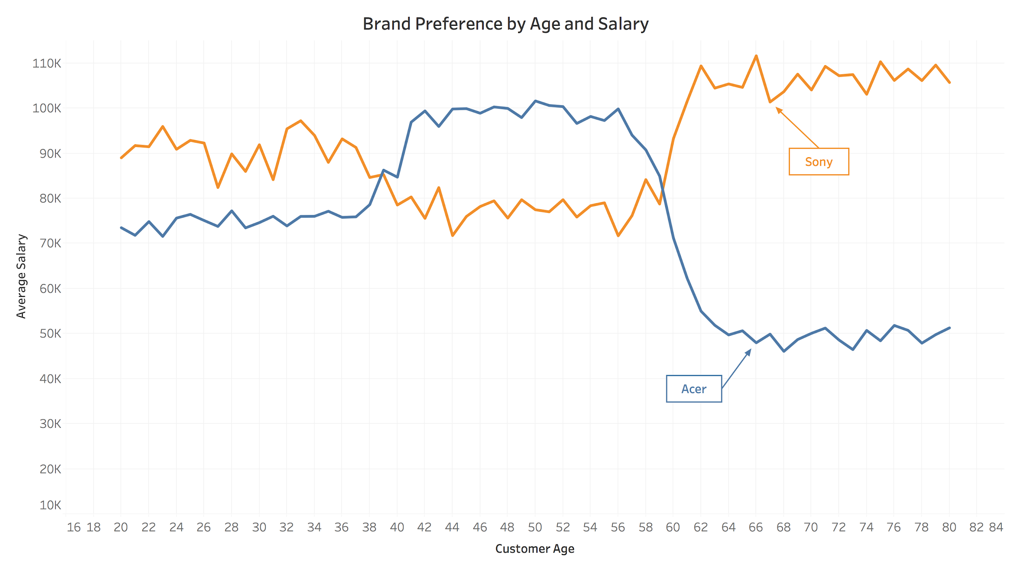
Customer Brand Preference...
While Sony is the overall preferred brand, we can see that the preference does vary by our customer’s age and average salary. This can be taken into consideration in marketing efforts.

Slide 6

New Product Profitability
Existing Products
Product Type
Price
Customer Reviews
Service Reviews
Sales Rank
Dimensions
Profit Margin
Sales Volume
build data model
New Products
Product Type
Price
Customer Reviews
Service Reviews
Sales Rank
Dimensions
Profit Margin
??
predict sales volume
calculate profitability
apply
data model

Slide 7
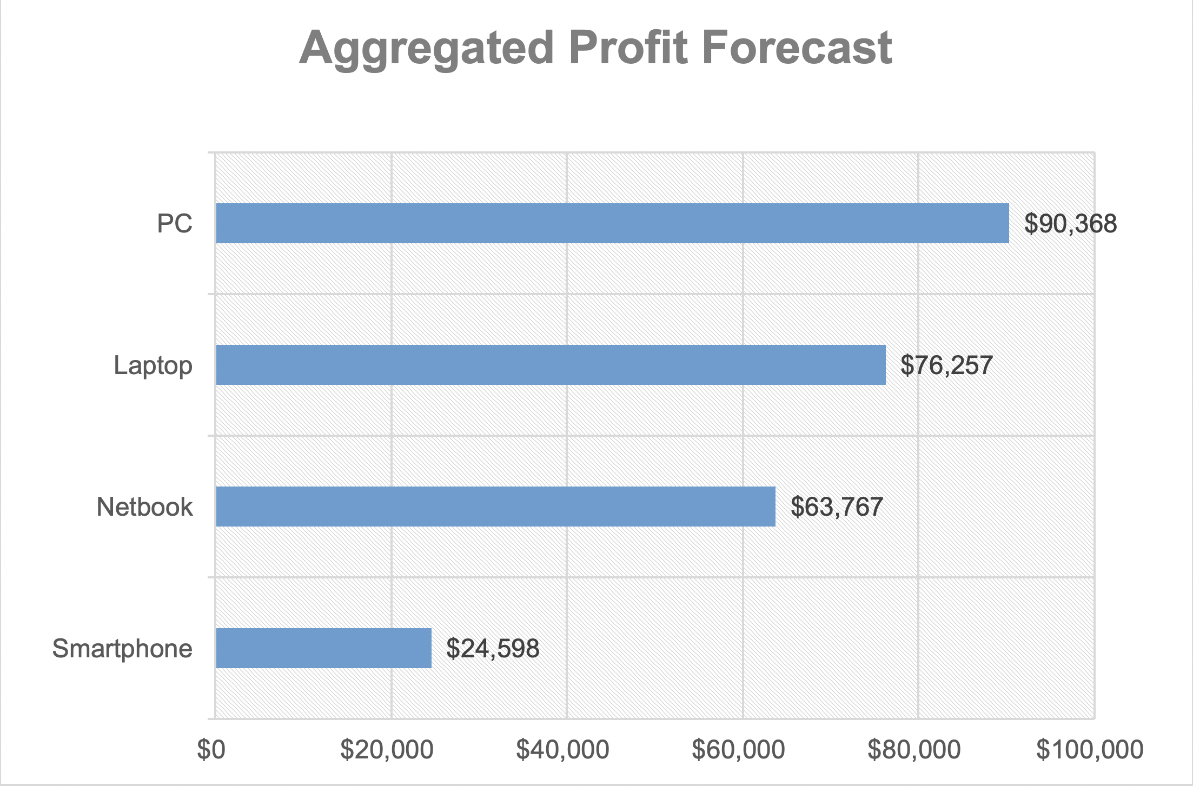
Product Profitability Predictions...

Slide 8
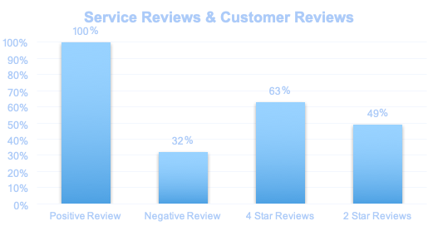
Sales Volume Predictors...
The impact services reviews and customer reviews on sales of different product types:

Slide 9

Electronidex Buying Patterns
Market Basket Analysis
Online sales transactions:
~10,000 purchases
125 products
Determines:
Purchase frequency of products
Associations between purchased products

Slide 10
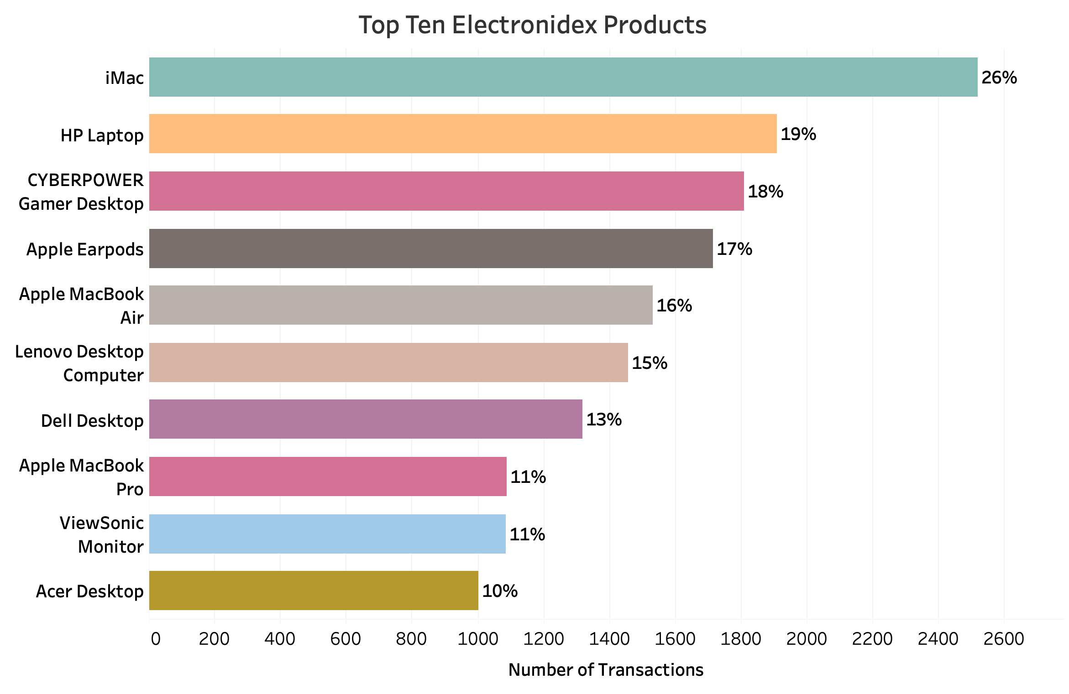
Electronidex Product Frequency
Recommend to focus on these higher profitable products.
Opportunities for promotions.

Slide 11
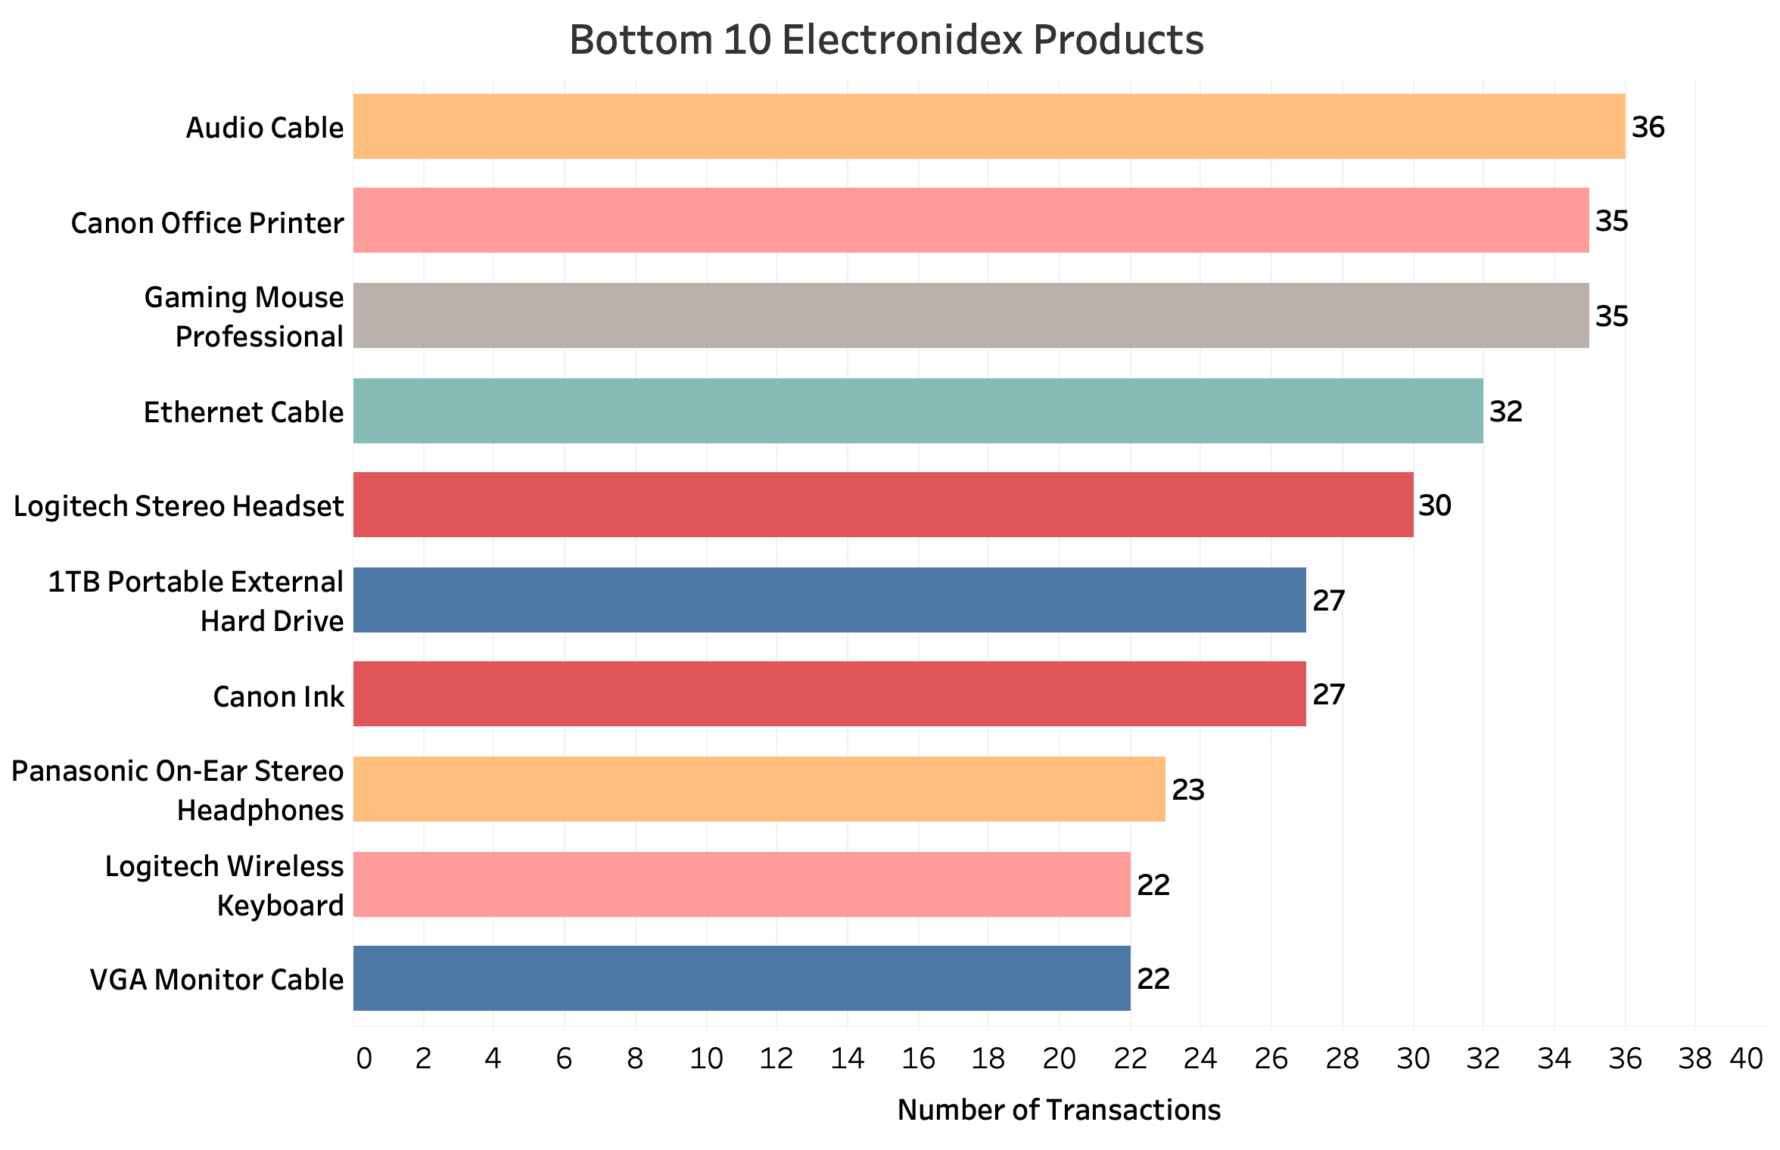
Electronidex Recommendations
Recommend to remove low frequency items due to no strong relationships with more frequently purchased items.

Slide 12
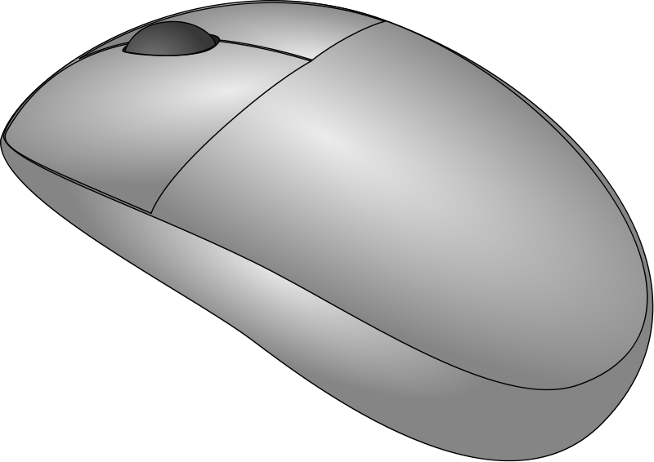


Electronidex Recommendations
Cross Selling Opportunities:
Slim Wireless Mouse
Apple Earpods
Apple Magic Keyboard
iMac
Computer Game
Intel Desktop
Dell Desktop
ASUS 2 Monitor
Belkin Mouse Pad
Dell Desktop
Microsoft Office Home and Student 2016
Rii LED Gaming Keyboard & Mouse Combo

Slide 13
Future Data Mining Opportunities
Recommended areas to enhance with data mining:
Market Segmentation
Customer Value/Potential
Product Offerings
Product Associations
Trend Analysis
Vendor Performance
Data mining can be deployed to maximize revenues while providing our customers a personalized experience through:
Merchandising Allocation
Product Offerings
Product Promotions
Product Placement
Loyalty Rewards
Marketing Vehicles
Customer Retention
Fraud Detection

