Slide 1
MID-TERM PROGRESS / TOPIC SELECTION
Mean Flows for One-step
Generative Modeling
Research focus: does interval normalization
change stop-gradient training?
MLT 2026 / Progress presentation / November 4 & 6
Selected paper: Geng et al., arXiv:2505.13447v1, 2025.
MLT mid-term / MeanFlow (Geng et al., 2025) / selected paper
01
Notes:
ENGLISH SCRIPT
My project studies Mean Flows for One-step Generative Modeling. I chose this paper because it connects an exact dynamical identity to fast generative modeling. My proposed research asks whether its interval normalization is also a good choice for optimization, especially when the training target uses stop-gradient.
中文参考
【第1页，约25秒】我的项目研究 MeanFlow。我选择这篇论文，是因为它用一个明确的动力学恒等式实现快速生成。后续研究重点是：平均速度所使用的区间归一化，是否也是 stop-gradient 训练中的合适选择？

Slide 2
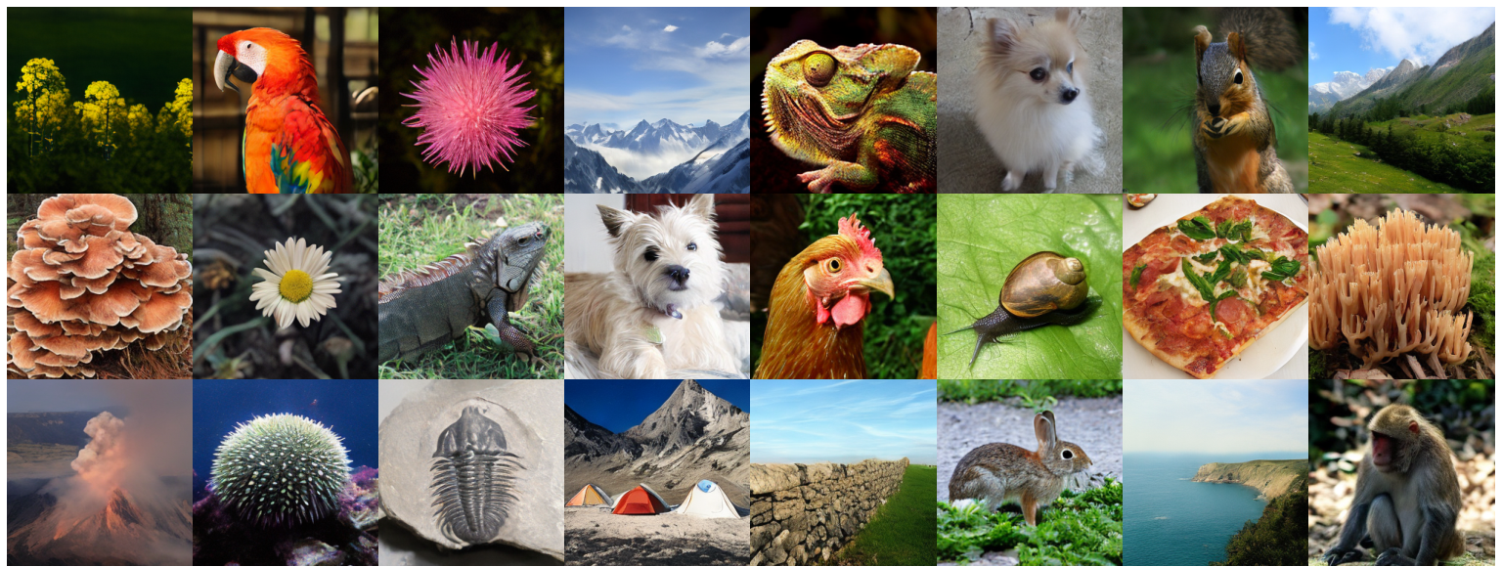
EXPLICIT ANSWER / WHY THIS PAPER?
Why did I choose MeanFlow?
Selected paper: Mean Flows for One-step Generative Modeling — Geng et al., 2025.
Images generated in one evaluation
PRACTICAL VALUE
Reduce sampling cost; study quality versus compute.
CLEAR MATHEMATICS
An exact identity becomes a neural training target.
MY QUESTION
How does normalization affect stopped-target training?
Source: MeanFlow v1, Fig. 5 (cropped).
Author-curated samples, not my results.
Paper evidence: ImageNet 256 × 256, 1 NFE, FID 3.43 (XL/2; pretrained VAE).
MLT mid-term / MeanFlow (Geng et al., 2025) / motivation; Table 2
02
Notes:
ENGLISH SCRIPT
I chose MeanFlow for three reasons. First, reducing network evaluations addresses the practical cost of image generation. Second, the method has a clear mathematical basis: an average-velocity identity becomes a training target. Third, it gives me a precise research question: does its normalization help optimization, or could another choice work better? The paper reports strong one-step image generation, motivating this question.
中文参考
【第2页，约30秒】我选择 MeanFlow 有三个原因：第一，减少生成时的网络调用，具有实际价值；第二，方法从平均速度恒等式出发，数学逻辑清晰；第三，我关心归一化如何影响停止梯度训练，能够提出明确、可验证的问题。论文已展示较强的一步生成结果，因此值得深入研究。

Slide 3
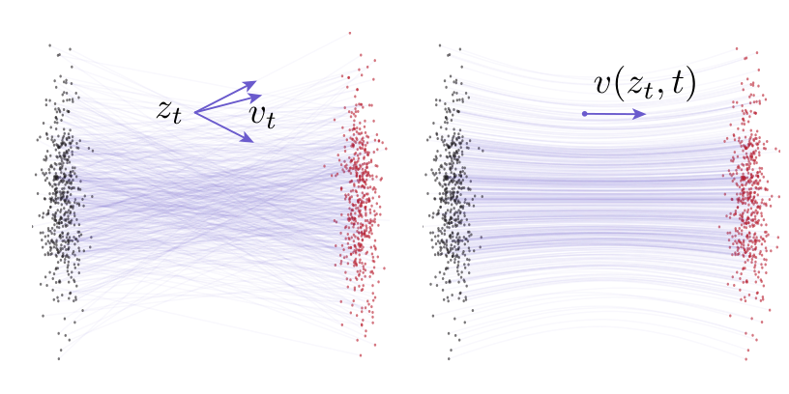
EXPLICIT ANSWER / RELEVANCE TO MACHINE LEARNING
How is MeanFlow related to machine learning?
It changes what a neural network learns and how that network is optimized.
GENERATIVE LEARNING
Learn noise-to-image transport.
Flow Matching: instantaneous velocity.
MeanFlow: interval-average velocity.
Train with data, JVP and stopped targets.
Source: MeanFlow v1, Fig. 2 (cropped).
Left: conditional flows. Right: marginal flows.
My focus: representation → optimization → generative performance.
MLT mid-term / MeanFlow (Geng et al., 2025) / ML relevance; Sec. 3–4
03
Notes:
ENGLISH SCRIPT
Its connection to machine learning is concrete. A neural network learns to transport noise into the data distribution. Flow Matching predicts local velocity, while MeanFlow predicts average velocity for a finite interval. This changes the learning target and uses Jacobian-vector products and stopped targets during optimization. My project examines how this representation choice affects training and generation quality, rather than only changing model size.
中文参考
【第3页，约30秒】它与机器学习的关系很具体：神经网络学习从噪声到数据的输运。Flow Matching 学局部速度，MeanFlow 学有限区间的平均速度，改变了学习目标，并使用 JVP 与停止梯度进行优化。我的项目研究表示方式、优化过程与生成效果之间的联系。

Slide 4
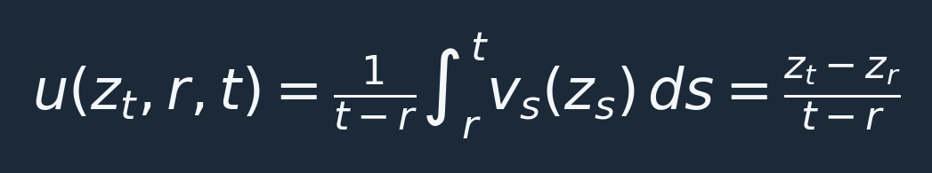
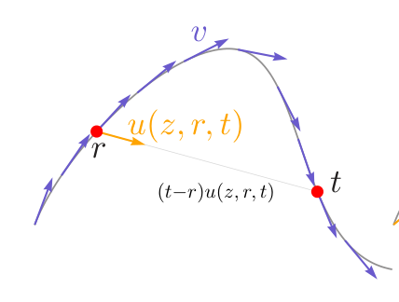
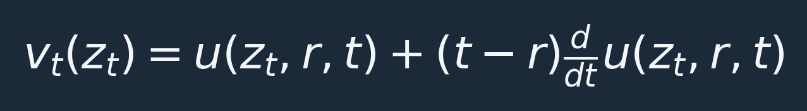

PROBLEM FORMALISATION / ORIGINAL PAPER
MeanFlow turns a calculus identity into a target.
Use h = t − r. Data are at t = 0; noise is at t = 1.
Instantaneous v: tangent
Average u: displacement direction
Source: Fig. 3, left panel (cropped).
Train u against a stopped target; sample once: x̂ = ε − uθ(ε, 0, 1).
MLT mid-term / MeanFlow (Geng et al., 2025) / Eq. 3–11; Algorithms 1–2
04
Notes:
ENGLISH SCRIPT
The average velocity is the trajectory displacement divided by the interval length. Holding the starting time fixed and differentiating gives instantaneous velocity equal to average velocity plus interval length times its total derivative. MeanFlow turns this identity into a regression target and stops gradients through that target. The derivative is computed by a Jacobian-vector product. The ground-truth identity concerns marginal trajectories; training substitutes the available conditional velocity, epsilon minus x.
中文参考
【第4页，约40秒】平均速度是位移除以区间长度。固定 r 求全导数，得到 v=u+h du/dt。MeanFlow 据此构造回归目标，并停止目标梯度；全导数由 JVP 计算。恒等式沿总体流轨迹定义，训练则使用可获得的条件速度 ε−x。

Slide 5
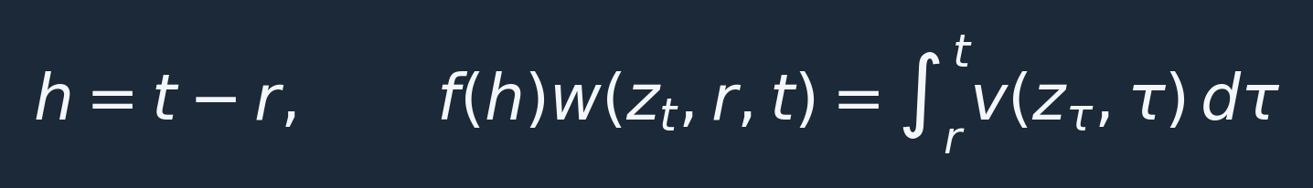
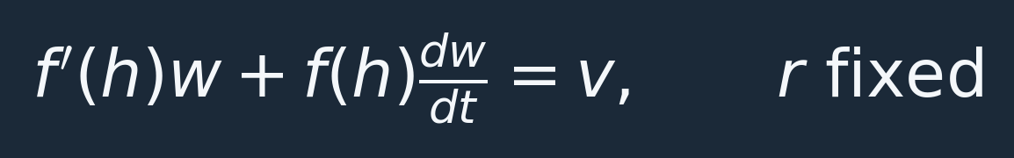
PROPOSED RESEARCH / MATHEMATICAL DEFINITION
Generalize the normalization, keep the physical flow.
MeanFlow uses f(h) = h. A different f changes the learned representation.
REGULARITY
INFERENCE
Require f(0)=0 and f′(h)>0.
Keep a finite, nonzero local limit.
Use displacement f(h)wθ directly.
No extra sampling evaluations.
MLT mid-term / MeanFlow (Geng et al., 2025) / proposed generalization
05
Notes:
ENGLISH SCRIPT
My extension replaces division by h with division by a chosen function f of h. The physical displacement remains unchanged: it is f times the network output. Differentiation now gives f prime times w plus f times its total derivative equal to velocity. I will use smooth functions that vanish at zero, have positive derivatives, and preserve a finite local limit. At inference, multiplying the prediction by f directly gives displacement, with no additional network evaluations.
中文参考
【第5页，约45秒】我的扩展把除以 h 改成除以 f(h)，物理位移仍是 f(h)w。对应恒等式变成 f′w+f dw/dt=v。首先限制光滑、零点正确且导数为正的函数，保留有限的局部极限。推理时直接乘 f 得到位移，不增加网络调用。

Slide 6
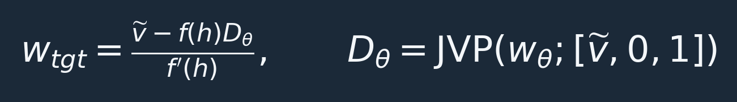
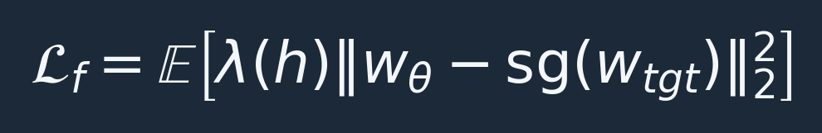
RESEARCH HYPOTHESIS / OPTIMIZATION
Equivalent fields need not give identical updates.
With stop-gradient, the target is frozen during each parameter update.
Hypothesis: f changes target scaling and interval-dependent updates;
some choices may improve training stability or sample quality.
Key alternative explanation: the benefit may be only interval reweighting.
A matched-weight control is essential; no improvement is claimed yet.
MLT mid-term / MeanFlow (Geng et al., 2025) / proposed training analysis
06
Notes:
ENGLISH SCRIPT
For a positive f prime, I can solve the identity for a regression target, just as in MeanFlow. Because that target is stopped, changing f changes the actual update, not just the written definition. My hypothesis is that suitable normalization could improve optimization. But there is a critical alternative explanation: the improvement may only come from reweighting time intervals. I have derived a matched-weight control to distinguish these effects. This is a research hypothesis, not an established improvement.
中文参考
【第6页，约45秒】f′ 为正时可以解出回归目标。由于目标停止梯度，改变 f 会改变实际更新。我假设合适的归一化可能改善优化，但也可能只是区间重加权的收益。因此我已推导匹配权重对照，区分两者，目前不宣称已有性能提升。

Slide 7
EXPERIMENTAL PLAN / REAL IMAGE BENCHMARK
Use the paper’s CIFAR-10 benchmark and U-Net.
CIFAR-10: unconditional 32 × 32 RGB generation in pixel space; no VAE needed.
MODEL & DATA
CANDIDATES
MEASURE
CIFAR-10 + ~55M U-Net.
Original f(h)=h baseline.
Same paper training recipe.
Fixed β = −0.5 / 0.5.
f′(0)=1 and f(1)=1.
Match interval weights.
FID-50K at 1 NFE.
3 seeds; matched budgets.
Gradient variation + time.
Reproduce the CIFAR-10 recipe; isolate reweighting in a squared-loss ablation.
Optional scale-up: ImageNet 256 × 256 with the paper’s DiT backbone.
MLT mid-term / MeanFlow (Geng et al., 2025) / planned experiments; Table 3; Appendix A
07
Notes:
ENGLISH SCRIPT
I will use the same real-image benchmark as the paper: CIFAR-ten, with its approximately fifty-five-million-parameter U-Net in pixel space. I will reproduce the paper recipe, then compare normalization functions under matched architectures and budgets. The primary metric is FID on fifty thousand generated images at one network evaluation, with three seeds and training-cost measurements. A squared-loss ablation will isolate reweighting. ImageNet with the paper’s transformer backbone is an optional scale-up, subject to available compute.
中文参考
【第7页，约45秒】使用原论文的真实图像基准 CIFAR-10，以及约5500万参数的 U-Net，在像素空间训练。先复现论文设置，再在相同架构和预算下比较归一化函数。主要报告1 NFE下的FID-50K、三个种子的波动和训练成本。用平方损失消融隔离重加权因素。ImageNet与论文的DiT骨干作为算力允许时的扩展。

Slide 8
PROGRESS & REMAINING-COURSE PLAN
Deliver a mechanism, not only a better metric.
Current status: paper and derivations checked; neural-model experiments are pending.
01 VERIFY
02 IMPLEMENT
03 EXPLAIN
Analytic identity checked.
Matched-update check passed.
Next: automatic JVP tests.
Reproduce the baseline.
Run candidates and controls.
Repeat with three seeds.
Separate scaling and weights.
Report negative results too.
Assess scope and prior work.
Research question: can a better normalization help beyond simple reweighting?
MLT mid-term / MeanFlow (Geng et al., 2025) / progress and plan
08
Notes:
ENGLISH SCRIPT
So far, I have checked the paper, derived the generalized identity and matched-update relation, and verified them in analytic numerical checks. I have not trained the neural models yet. Next I will test automatic differentiation, reproduce the baseline, and run controlled comparisons. If a gain disappears under matched reweighting, I will report that explanation rather than claim a new mechanism. The final goal is to understand when normalization matters, supported by both derivation and reproducible experiments.
中文参考
【第8页，约35秒】目前已核对论文，完成广义恒等式、匹配更新关系和解析数值检查，尚未训练神经网络。后续验证自动微分、复现基线、完成对照。如果收益被匹配重加权解释，就报告这个结论，不包装成新机制。最终目标是以推导和可复现实验说明归一化何时重要。

