Slide 1
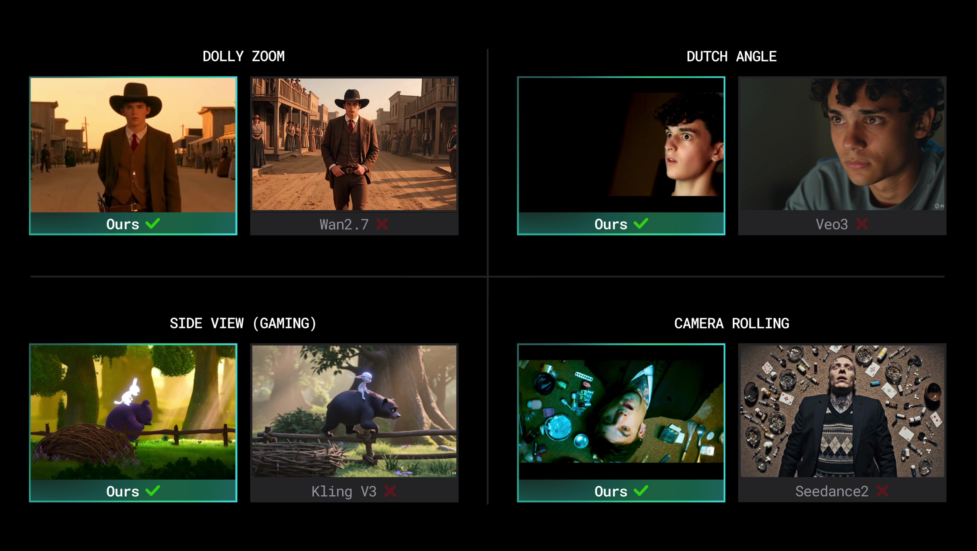
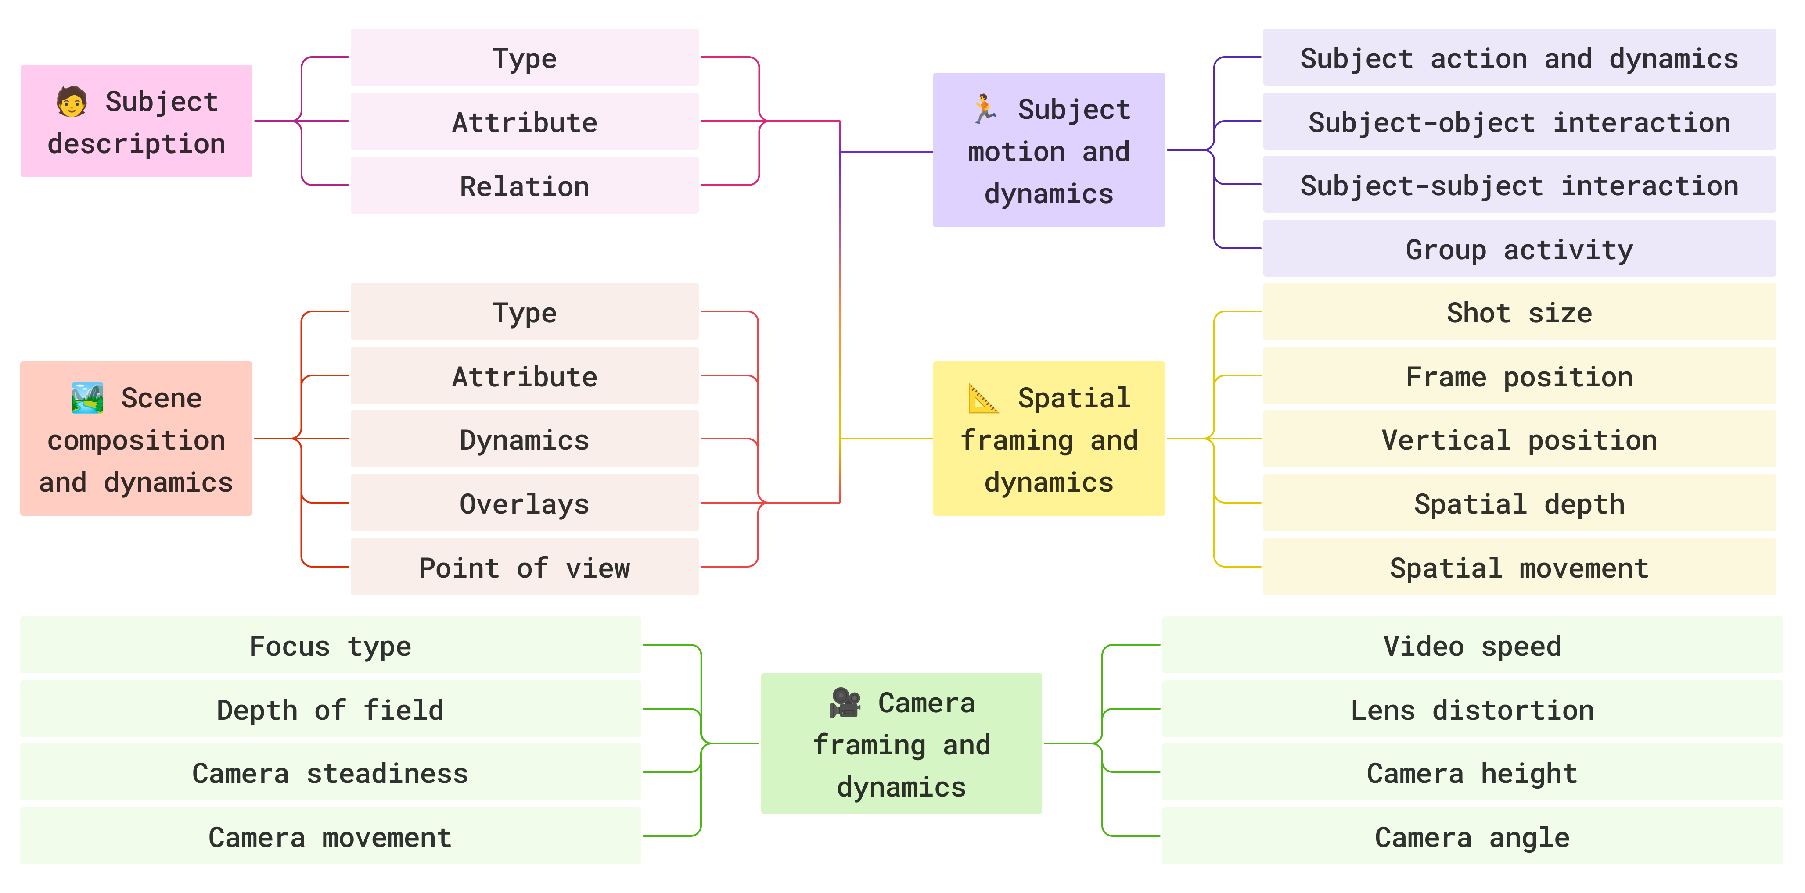
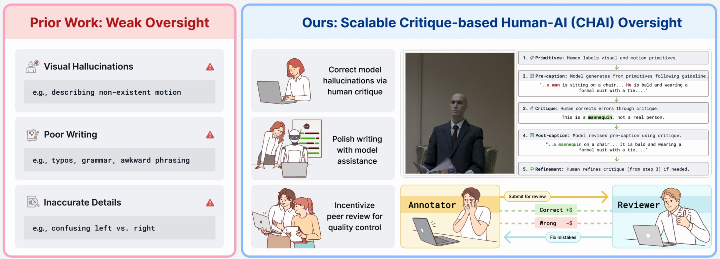
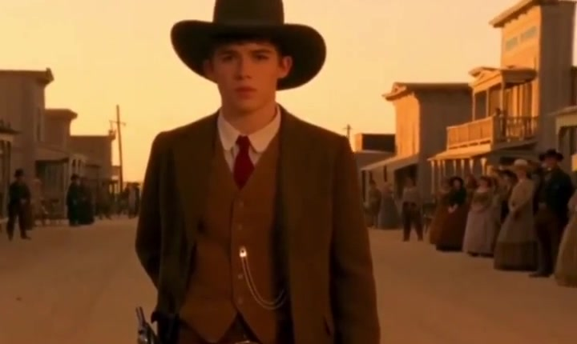
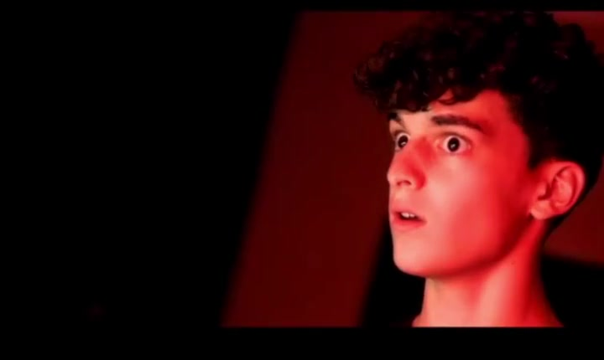
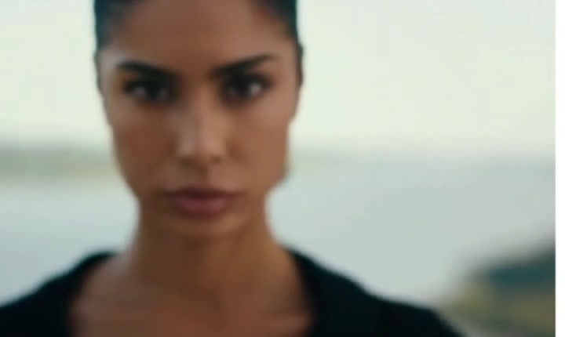
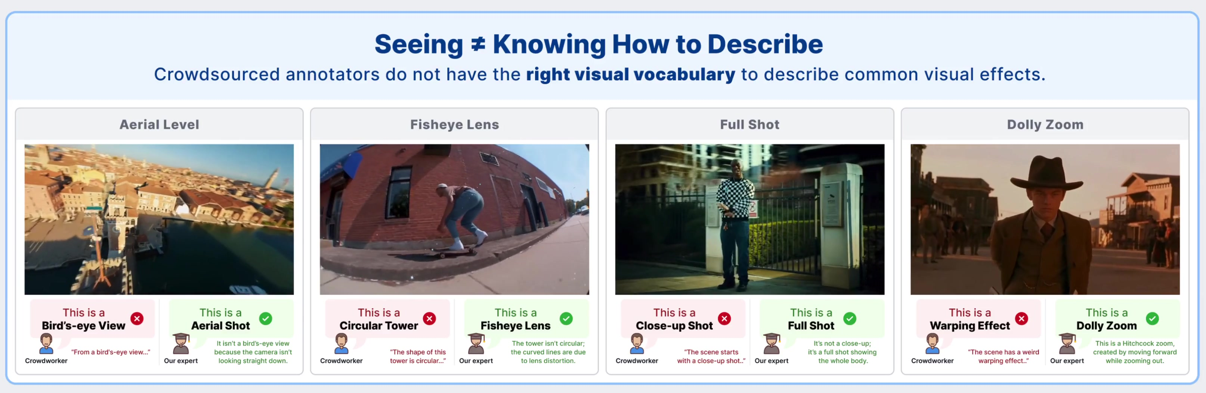
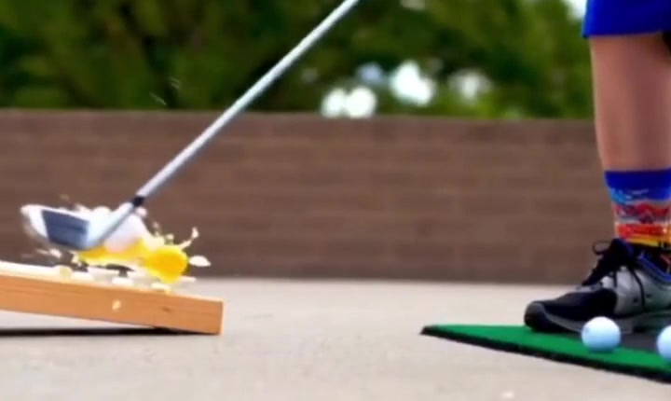
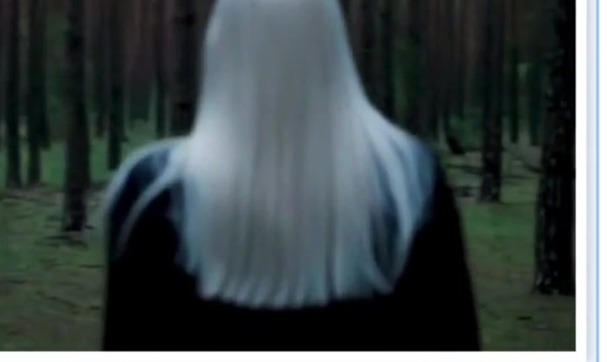
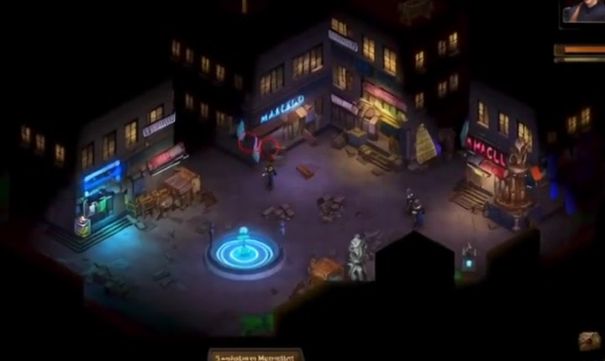
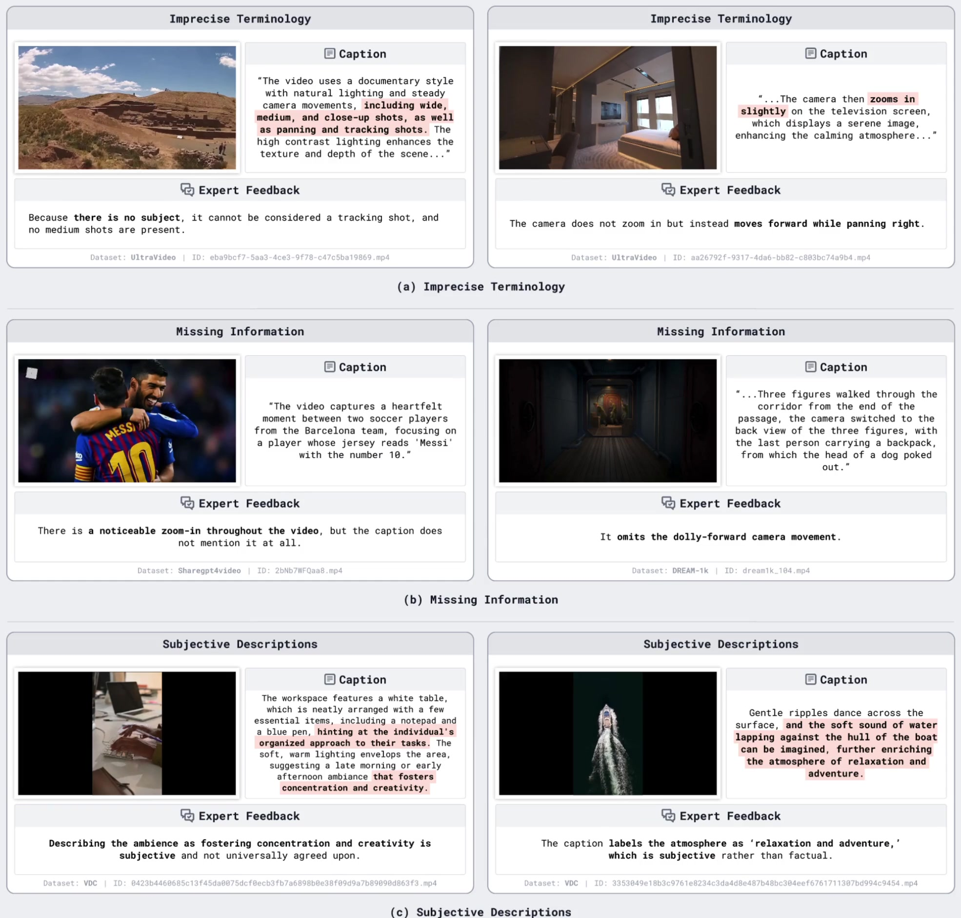
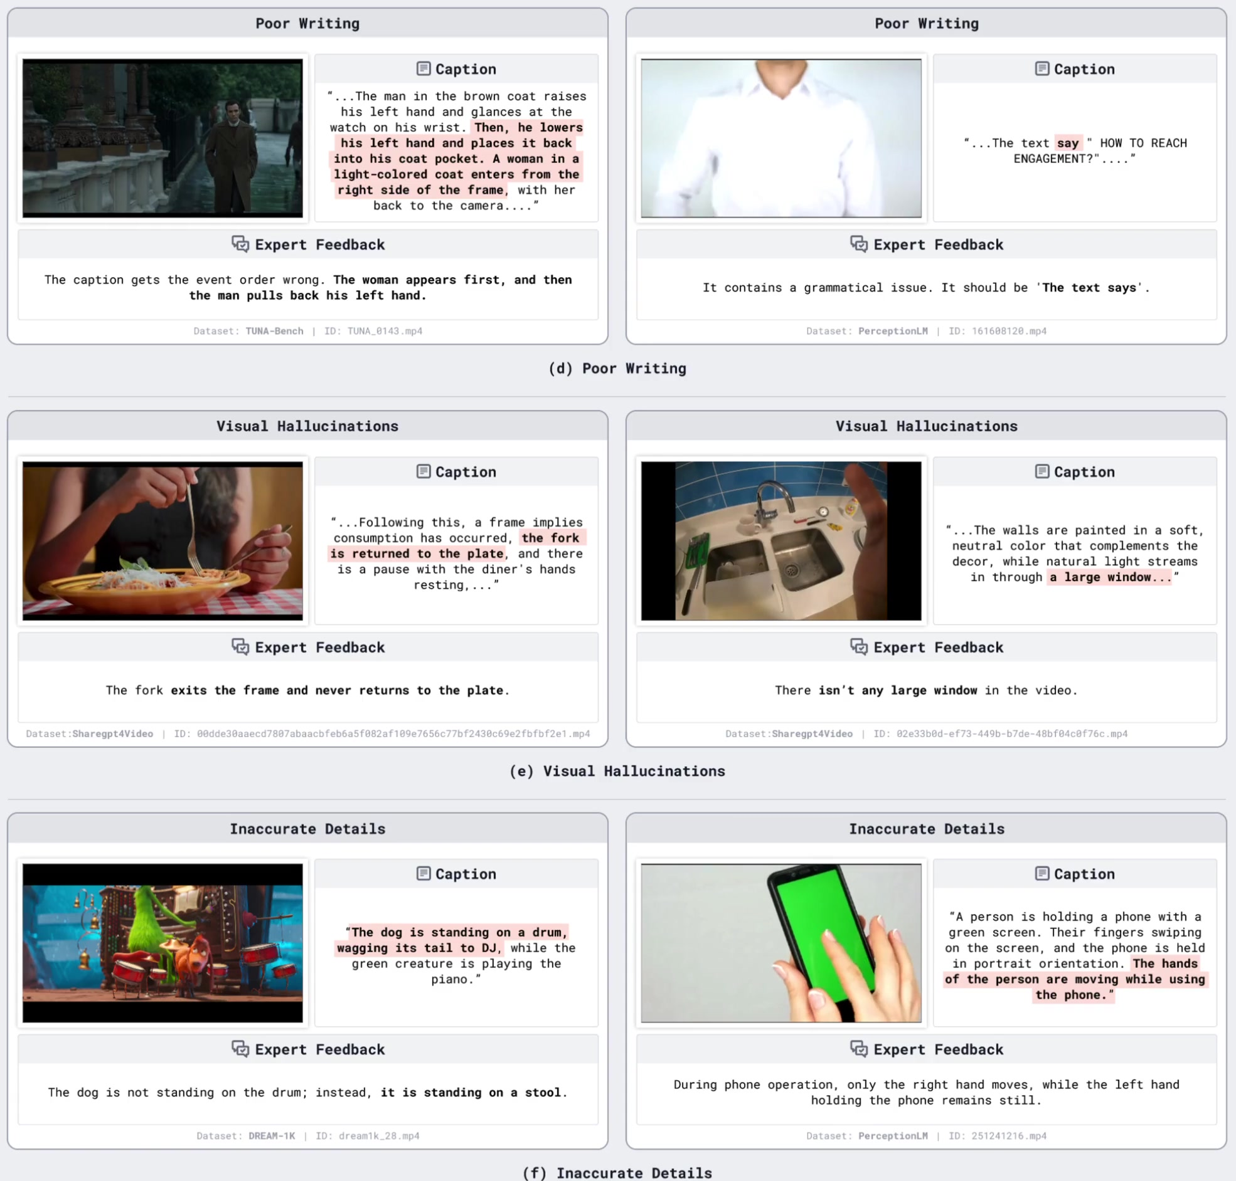
Before AI can generate professional videos, it needs to see like a professional.
CHAI
Building a Precise Video Language
with Human–AI Oversight
CVPR 2026 HIGHLIGHT
TOP 3% OF SUBMISSIONS
CRITIQUE-BASED HUMAN-AI OVERSIGHT
Zhiqiu Lin¹ · Chancharik Mitra¹ · Siyuan Cen¹ · Isaac Li¹ · Yuhan Huang¹ · Yu Tong Tiffany Ling¹ · Hewei Wang¹ · Irene Pi¹ · Shihang Zhu¹ · Ryan Rao¹ · George Liu¹ · Jiaxi Li¹ · Ruojin Li¹ · Yili Han¹ · Yilun Du² · Deva Ramanan¹
PAPER
CODE
DATASET
PROJECT
¹ Carnegie Mellon University ² Harvard University
linzhiqiu.github.io/papers/chai
WHY CHAI?
1 · SPECIFICATION
3 · POST-TRAINING
Try prompting any video generator for a dolly zoom, Dutch angle, POV, or speed ramp. You'll get a generic push-in or slow-mo. These techniques require a language of cinema current models do not speak. We built that language.
Teaching AI the shared language of cinema
An 8B model beats GPT-5 & Gemini-3.1
Filmmakers coordinate on set with precise terms — rack focus, Dutch angle, medium full shot. We formalized that vocabulary, co-designed with 100+ professional creators over a year-long collaboration.
Qwen3-VL-8B
Subject
Scene
Motion
Spatial
Camera
OUTPERFORMS GPT-5 · GEMINI-3.1-PRO
5 aspects · 200+ visual primitives · 17 skill categories
on caption generation, reward modeling, and critique generation — trained from CHAI's (pre, critique, post) triplets.
Critique quality is the bottleneck
Weakening any single dimension (precision · recall · constructiveness) degrades post-training.
CRITIQUE TYPE | PREC. | REC. | CONSTR. | CAPTION | REWARD | CRITIQUE
Blind Gemini-2.5 | — | — | — | 10.9 | 44.5 | 21.1
Gemini-2.5 | — | — | — | 12.7 | 62.0 | 26.2
Inaccurate critique | ✗ | ✓ | ✓ | 12.1 | 47.1 | 21.9
Incomplete critique | ✓ | ✗ | ✓ | 12.5 | 56.6 | 28.7
Unhelpful critique | ✓ | ✓ | ✗ | 13.4 | 67.2 | 32.9
CHAI (no quality check) | — | — | — | 14.8 | 73.1 | 35.7
CHAI (with quality check) | ✓ | ✓ | ✓ | 18.2 | 89.8 | 41.7
Same prompt. Wan2.2 baseline (left) ignores cinematic language; CHAI-tuned Wan2.2 (right) executes dolly zooms, Dutch angles, rack focus, and speed ramps faithfully.
KEY FINDINGS
THE RECIPE
Explicit preference + critique supervision improves SFT and RL.
Critique quality (precision · recall · constructiveness) is THE bottleneck.
Inference-time best-of-N with our reward model adds further gains — no extra labels.
Four pieces of a precise video language
PRECISE SPECIFICATION
1
SCALABLE OVERSIGHT
2
The full taxonomy — each of 5 aspects decomposed into sub-aspects, grounded by 200+ primitives.
Structured language of subject, scene, motion, spatial framing, and camera dynamics — 200+ visual primitives co-designed with cinematographers.
AI drafts captions; humans critique. Shifts effort from generation to verification — leveraging what each does best.
2 · OVERSIGHT
4 · APPLICATION
AI writes. Humans critique.
Better understanding → better generation
LLMs write fluently but hallucinate what they see. Humans spot visual errors but write with typos. CHAI lets each do what they're best at.
We re-caption professional videos (films, ads, music videos, games) and fine-tune Wan2.2 to follow 400-word cinematic prompts with precise control.
POST-TRAINING
3
BETTER GENERATION
4
(pre-caption · critique · post-caption) triplets unlock SFT, DPO, reward modeling, and inference-time scaling at once.
Re-captioned films, ads, and games fine-tune Wan2.2 to follow 400-word cinematic prompts with precise control.
WHY PRIOR WORK FALLS SHORT
AI pre-caption → expert critique → revised post-caption
Crowdworkers + 8 datasets (2016–2025)
Sample triplet — "Camera" aspect
CAMERA — angle · height · lens · focus · steadiness · movement
PRE
"A man stands on a street at sunset. The camera moves forward and zooms in. He has dark hair and looks forward while drawing a pistol from his left hip."
DOLLY ZOOM
DUTCH ANGLE
RACK FOCUS
CRITIQUE
The camera should dolly out while zooming in (dolly zoom out), not just push forward. Subject draws his pistol from his right hip — left/right is reversed.
Crowdworkers confuse dolly-in with zoom-in, call full shots "close-ups", describe fisheye distortion as "circular buildings."
POST
"Medium shot at sunset on a Western street. The camera executes a dolly zoom out — pulling back while the lens zooms in, compressing the background. The young man stares ahead, drawing a pistol from his right hip."
Why it works: the critique is specific (names the technique), actionable (tells the model how to fix it), and verifiable (left/right is checkable from the video). That's the 80% of caption quality prior datasets miss.
Lack of specification: imprecise terms, missing details, subjective adjectives.
Lack of oversight: poor writing, hallucinated objects, inaccurate details.
SPEED RAMP
SHOT SIZE → CLOSE-UP
ISOMETRIC (GAME)
linzhiqiu.github.io/papers/chai · github.com/chancharikmitra/CHAI · huggingface.co/datasets/chancharikm/CHAI_testset · Contact: zhiqiulin98@gmail.com · © 2026 CMU · Harvard

