Slide 1
Capstone Project
Clustering of restaurants In Paris
Zinan LIN

Slide 2
Paris is the captain city of France, it is famous for its history, arts, and food. Paris has 20 arrondissements, which are regions that the city is separated into, like the picture ^{[1]} showed below. There are about 40,000 ^{[2]} restaurants in Paris and it is currently the city with the second most Michelin starred restaurants in the world ^{[3]}. I am a food lover and I am motivated to find out more about the fine-dining places in Paris.

Slide 3
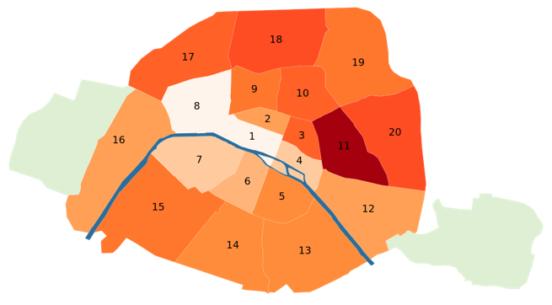

Slide 4
What are the similarities in the arrondissements of Paris in terms of restaurants?
Are the restaurants in the central (downtown) areas more favored by clients?
Optionally, how does the number of Michelin Starred restaurants affect the way that that restaurants are clustered?

Slide 5


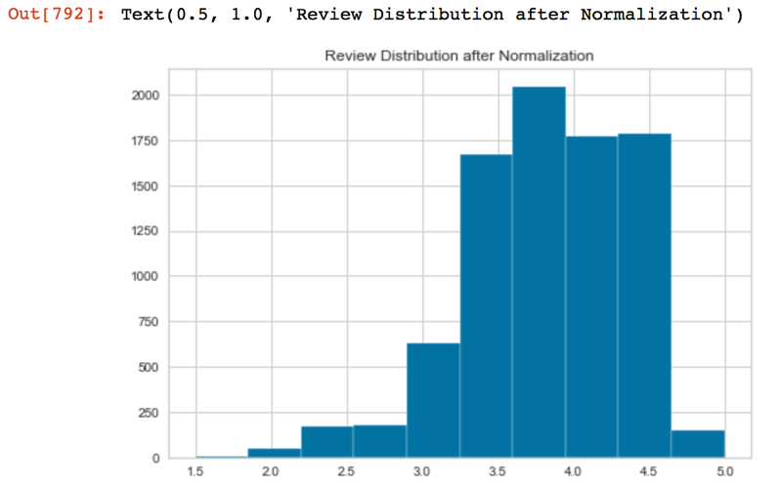
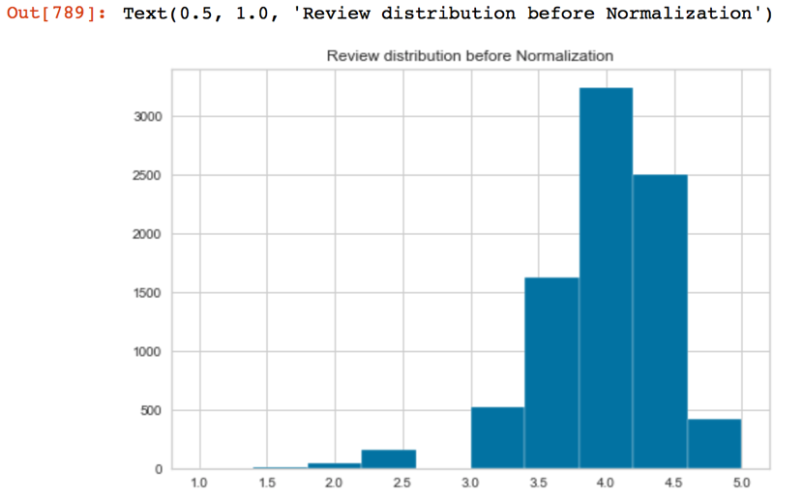



Data Normalizartion

Slide 6
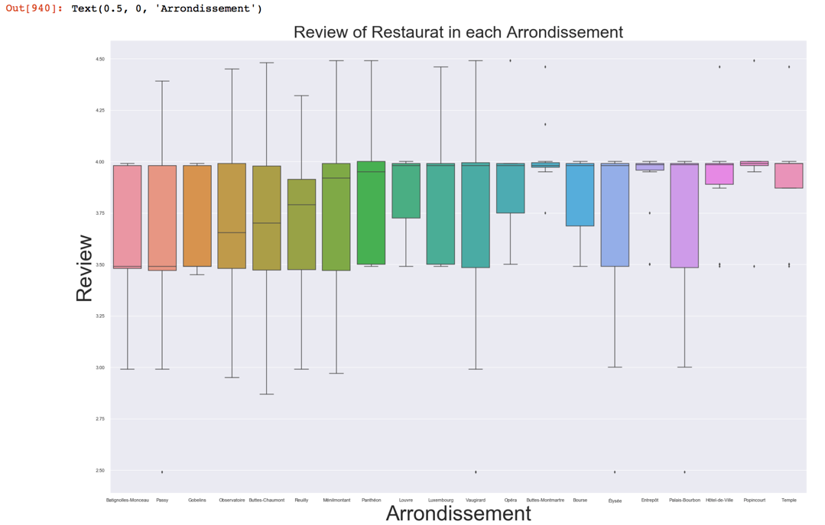
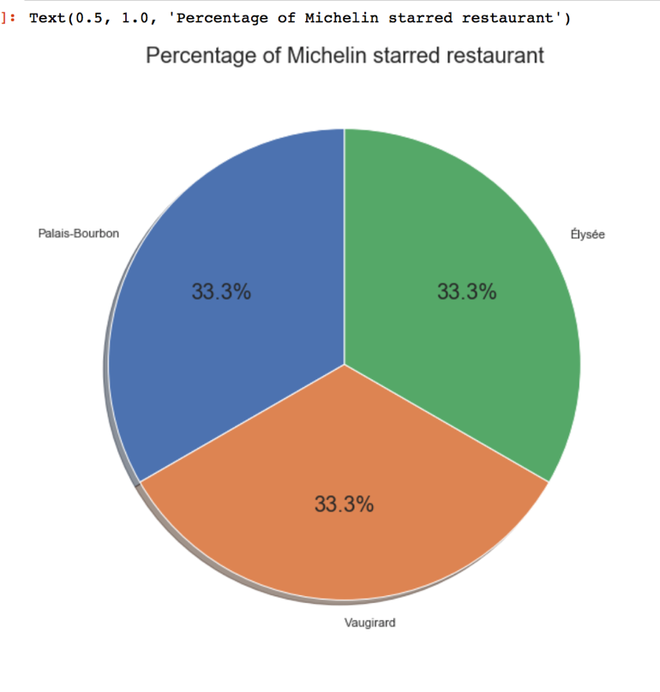
Data Visualiztion

Slide 7
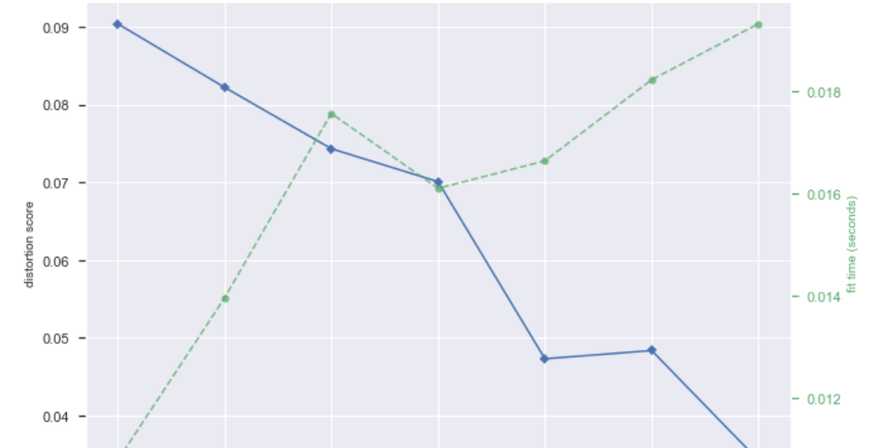
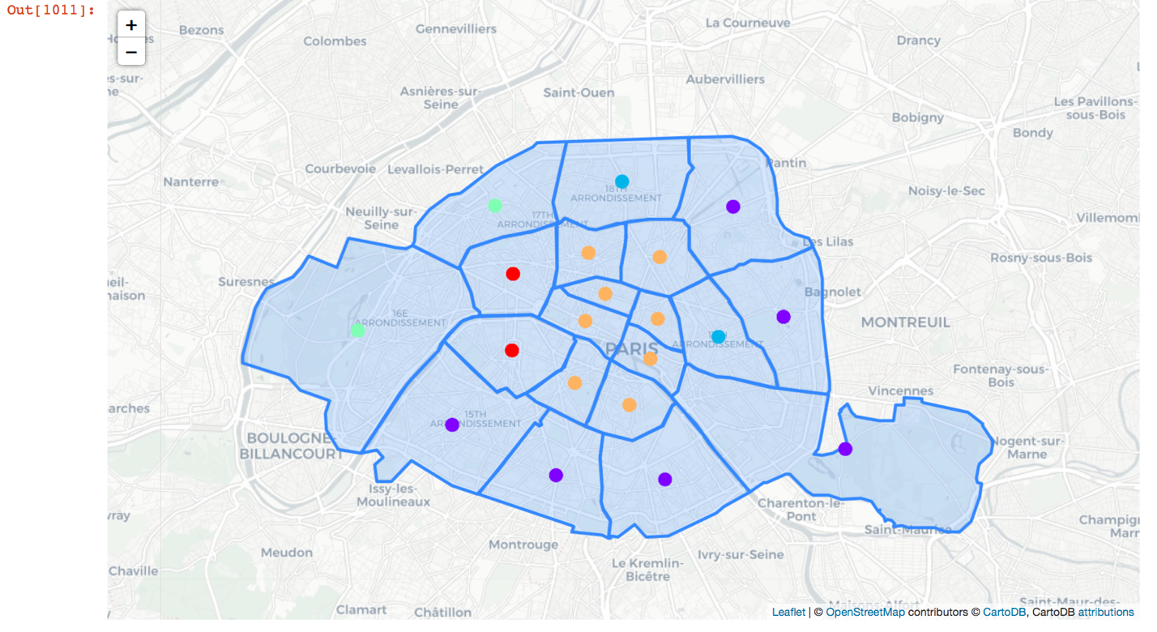
K-means clustering
I first use one-hot encoding to separate categorized fields in binary, such as price range and normalized rating. Then I use the elbow method to find the optimal k, the Elbow method is a method of interpretation and validation of consistency within cluster analysis designed to help finding the appropriate number of clusters in a dataset.

Slide 8
What are the similarities in the arrondissements of Paris in terms of restaurants?
It seems like the distance to the centre/ downtown of the city has a linear relationship with regard to the characteristic of the restaurants.

Slide 9
Are the restaurants in the central (downtown) areas more favored by clients?
From our clustered ratings, yes.

Slide 10
Optionally, how does the number of Michelin Starred restaurants affect the way that that restaurants are clustered?
Non-conclusive, will need more data and analysis.

Slide 11
Conclusion
I am happy that I utilized the knowledge I learned throughout the course in this project. Although there are many imperfections, I am satisfied with the results and output of this project given the limited time frame. I look forward to expanding and carry on with this idea and hope to learn more about machine learning.

Slide 12
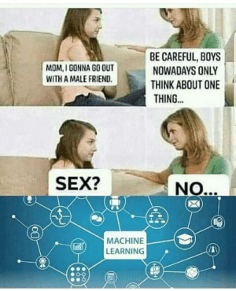
Thank you!

