Slide 1

Capstone project
Coursera IBM data science Specialization

Slide 2
Tech Requirements
Network
Satellite
Link

Slide 3

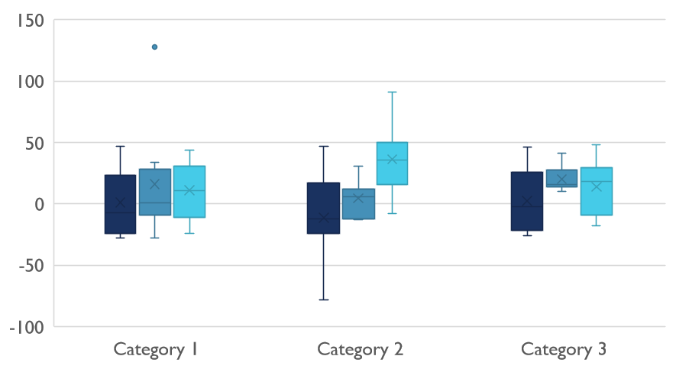
Competitive Landscape

Slide 4

Digital Communications
Cloud
Local
Hybrid

Slide 5

Thank You
someone@example.com

