Slide 1
GUI for UniSERS application

Slide 2








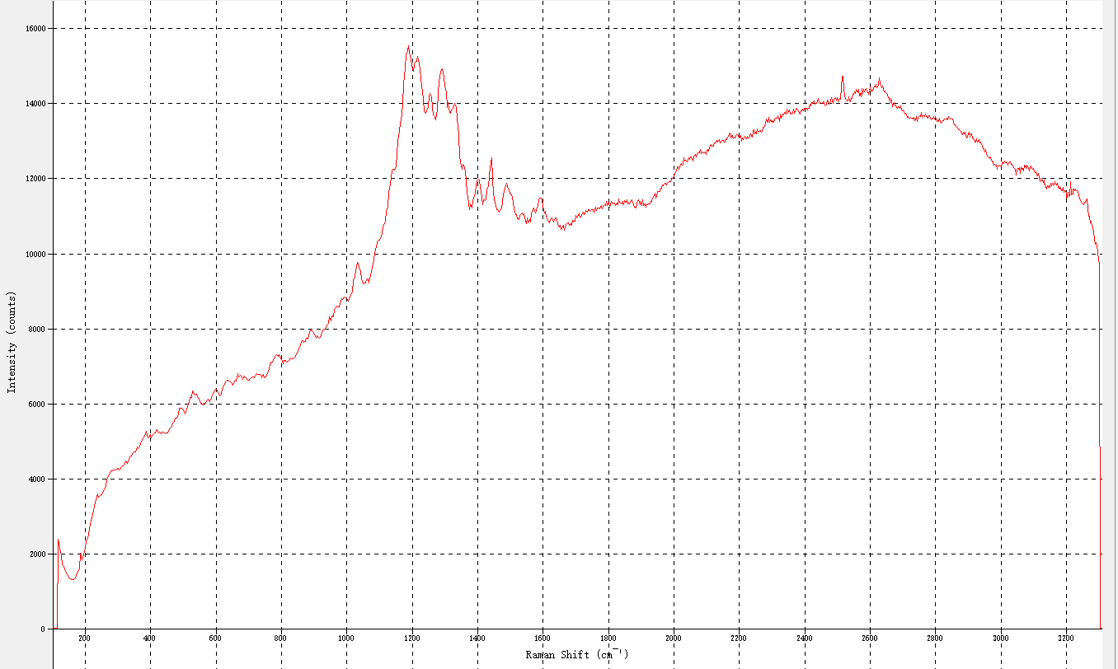



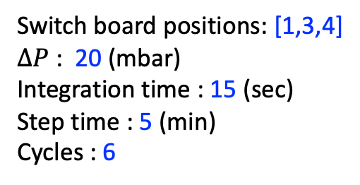
Gate 0
Gate 1
Gate 2
Gate 4
Gate 5
NPs
CrosLIn
Oil
NPs
CrosLIn
Water
Titrant
Reservoir
Mineral
Batch MD087
PEG, PEI, EBT
Evian water
EDTA 4mM
Water
Titrant
Switch board positions: [1,3,4]
$∆P$ : 20 (mbar)
Integration time : 15 (sec)
Step time : 5 (min)
Cycles : 6
X:
500
-
700
Y:
0
-
15000
Spectra/step = 20
Estimation time $≈$ 5 (hours)
Intensity (counts)
Reservoirs :
Oil - Mineral oil
NPs - batch MD087
CrosLIN – PEG, PEI, EBT
Water - Evian water
Titrant – EDTA 4mM
----------------
Start experiment at 16:29:08
Switch on port A is at position 1
Switch on port B is at position 1
stabilising ...
Switch on port A is at position 1
Switch on port B is at position 1
Applying = 690,450,580,460,460
Applying = 690,450,580,480,440
Wavelength (nm)

Slide 3
Read flow rate measured: Q_NPs, Q_CrosLIn, Q_Water, Q_Titrant
my_gates = [0,1,2,4,5]
Gate 0
Gate 1
Gate 2
Gate 4
Gate 5
NPs
CrosLIn
Oil
NPs
CrosLIn
Water
Titrant
Text input
Reservoir
Mineral
Batch MD087
PEG, PEI, EBT
Evian water
EDTA 4mM
could be nice if we can change them
during the experiment
my_ini_pressures =
[460,460,690,450,450]
Water
Titrant
Scale the xy range
to cover all the value
P_Oil_m,P_NPs_m,P_CrosLIn_m,
P_Water_m,P_Titrant_m
Read pressures measured
Zoom in xy range
my_ESS_input = np.array([1,3,4])
Switch board positions: [1,3,4]
$∆P$ : 20 (mbar)
Integration time : 15 (sec)
Step time : 5 (min)
Cycles : 6
Calculate = int((Step time*60)/Integration time)
X:
500
-
700
Y:
0
-
15000
delta_P = 20
Read self.intensities = self.spec.intensities()
In the future, I would like :
An option to appear the spectrum after baseline correction.
And finally, live titration and give the result directly within this application.
t_integration_s = 15
t_step_min = 5 #min
Spectra/step = 20
Estimation time $≈$ 5 (hours)
cycles = 6
Intensity (counts)
Reservoirs :
Oil - Mineral oil
NPs - batch MD087
CrosLIN – PEG, PEI, EBT
Water - Evian water
Titrant – EDTA 4mM
----------------
Start experiment at 16:29:08
Switch on port A is at position 1
Switch on port B is at position 1
stabilising ...
Switch on port A is at position 1
Switch on port B is at position 1
Applying = 690,450,580,460,460
Applying = 690,450,580,480,440
Wavelength (nm)
Launch the exp
Close()
Save the info of the printing on the left into a text file with the same name as the data name.
Print reservoirs info
Print the status of the experiment, have a scroll bar to come back to see what was going on before.
Calculate = len(switch_board_positions)*step_time*10*cycles

Slide 4
