Slide 1

MOSFETs
25CPES102 · ELECTRONIC MATERIALS AND DEVICES
Metal-oxide-semiconductor
field-effect transistors
LECTURE 3
Figure: Sedra & Smith, Microelectronic Circuits
Dr. Zahraa Ismail
Computer Engineering · Academic Year 2025/2026 · Semester One

Slide 2
Lecture map
LECTURE 3
1
Structure and operation
how a channel forms; the threshold voltage
BY THE END YOU CAN
2
I–V characteristics
Explain how v_{GS} creates a channel and how v_{DS} pinches it off
cutoff, triode and saturation
Pick the right region and use its i_{D} equation
3
MOSFETs in DC circuits
finding the operating point
Find the DC operating point of a MOSFET circuit
4
The MOSFET as an amplifier
transconductance, small-signal model
Find g_{m} and the gain of a simple MOSFET amplifier
5
The MOSFET as a switch
ELEC1 · Lecture 3 · MOSFETs
2

Slide 3
Structure and operation
01
1
Structure and operation
2
I–V characteristics
3
MOSFETs in DC circuits
4
The MOSFET as an amplifier
The device and its terminals
5
The MOSFET as a switch
No gate voltage: no current
The threshold voltage
Tapering and pinch-off
CMOS; n- and p-channel symbols

Slide 4
The n-channel enhancement MOSFET
1 · STRUCTURE AND OPERATION
Figure: Sedra & Smith, Microelectronic Circuits
Four terminals: source (S), gate (G), drain (D) and body (B).
ELEC1 · Lecture 3 · MOSFETs
4

Slide 5
The n-channel enhancement MOSFET
1 · STRUCTURE AND OPERATION
Figure: Sedra & Smith, Microelectronic Circuits
Four terminals: source (S), gate (G), drain (D) and body (B).
A thin oxide (SiO₂) insulates the gate, so the gate draws no current.
ELEC1 · Lecture 3 · MOSFETs
5

Slide 6
The n-channel enhancement MOSFET
1 · STRUCTURE AND OPERATION
Figure: Sedra & Smith, Microelectronic Circuits
Four terminals: source (S), gate (G), drain (D) and body (B).
A thin oxide (SiO₂) insulates the gate, so the gate draws no current.
The channel region between the n⁺ source and drain has length L and width W.
ELEC1 · Lecture 3 · MOSFETs
6

Slide 7
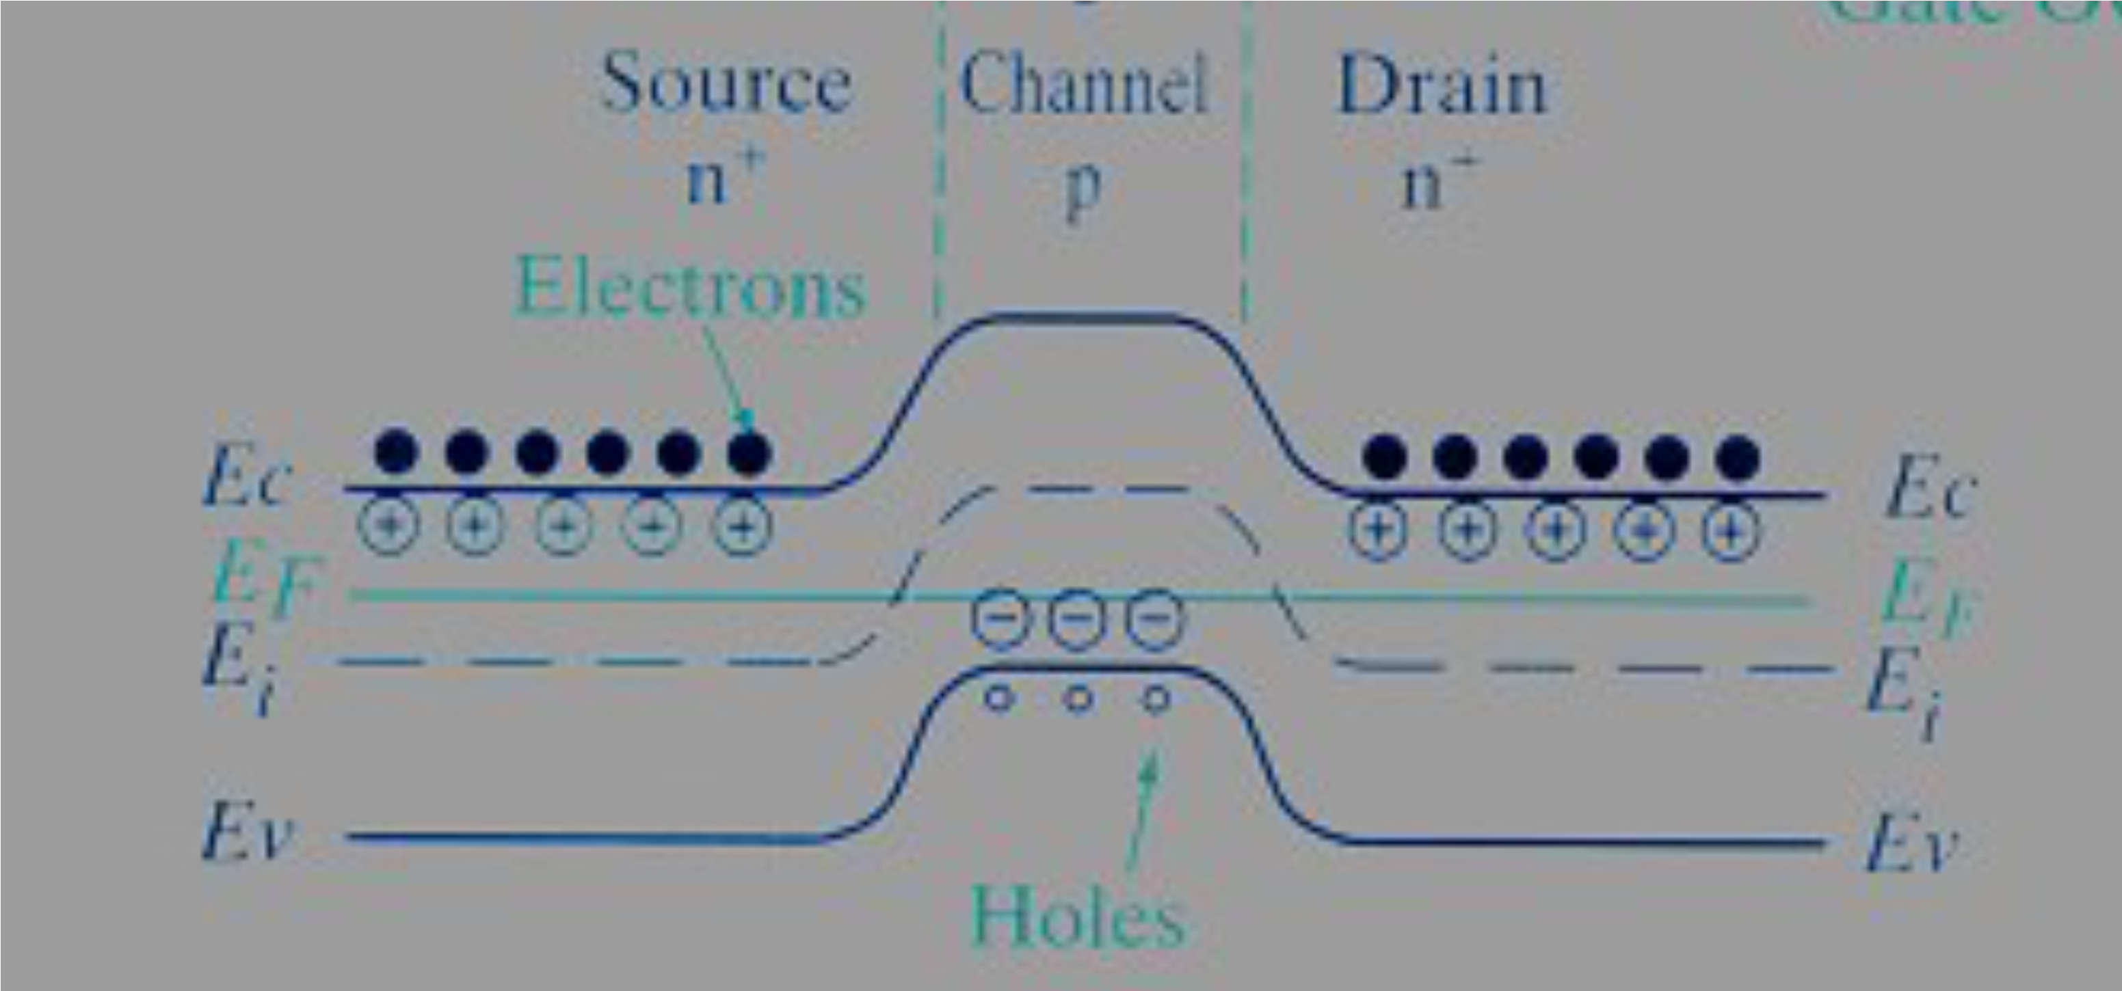
With no gate voltage, no current flows
1 · STRUCTURE AND OPERATION
Source and drain are n⁺, the body is p-type: two back-to-back pn junctions lie between source and drain.
Figure: web source, via the original lecture slides
ELEC1 · Lecture 3 · MOSFETs
7

Slide 8
With no gate voltage, no current flows
1 · STRUCTURE AND OPERATION
Source and drain are n⁺, the body is p-type: two back-to-back pn junctions lie between source and drain.
Whatever the polarity of v_{DS}, one junction is reverse-biased, so i_{D} ≈ 0.
Figure: web source, via the original lecture slides
ELEC1 · Lecture 3 · MOSFETs
8

Slide 9
With no gate voltage, no current flows
1 · STRUCTURE AND OPERATION
Source and drain are n⁺, the body is p-type: two back-to-back pn junctions lie between source and drain.
Whatever the polarity of v_{DS}, one junction is reverse-biased, so i_{D} ≈ 0.
The energy barrier (left) keeps the electrons of the source away from the drain.
Figure: web source, via the original lecture slides
ELEC1 · Lecture 3 · MOSFETs
9

Slide 10

Creating a channel: the threshold voltage
1 · STRUCTURE AND OPERATION
A positive v_{GS} pushes holes away from the region under the gate and draws electrons in from the n⁺ source and drain.
Figure: Sedra & Smith, Microelectronic Circuits
ELEC1 · Lecture 3 · MOSFETs
10

Slide 11
Creating a channel: the threshold voltage
1 · STRUCTURE AND OPERATION
A positive v_{GS} pushes holes away from the region under the gate and draws electrons in from the n⁺ source and drain.
Once enough electrons gather, they form an n-type inversion layer: the channel linking source to drain.
Figure: Sedra & Smith, Microelectronic Circuits
ELEC1 · Lecture 3 · MOSFETs
11

Slide 12
Creating a channel: the threshold voltage
1 · STRUCTURE AND OPERATION
A positive v_{GS} pushes holes away from the region under the gate and draws electrons in from the n⁺ source and drain.
Once enough electrons gather, they form an n-type inversion layer: the channel linking source to drain.
DEFINITION
Threshold voltage V_{t}: the value of v_{GS} at which the channel just forms.
Figure: Sedra & Smith, Microelectronic Circuits
ELEC1 · Lecture 3 · MOSFETs
12

Slide 13
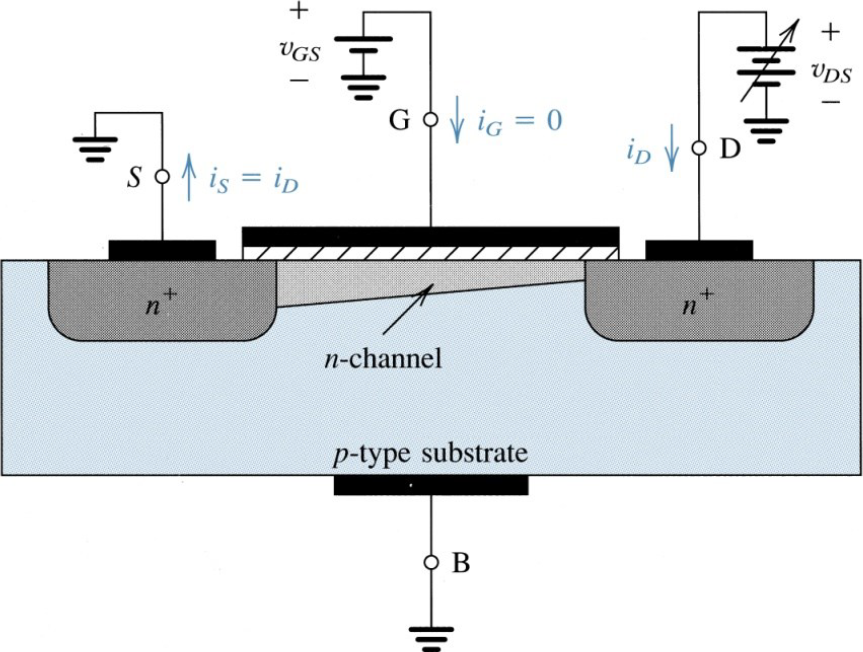
Increasing v_{DS}: the channel tapers and pinches off
1 · STRUCTURE AND OPERATION
Along the channel, the voltage rises from 0 at the source to v_{DS} at the drain.
Figure: Sedra & Smith, Microelectronic Circuits
ELEC1 · Lecture 3 · MOSFETs
13

Slide 14
Increasing v_{DS}: the channel tapers and pinches off
1 · STRUCTURE AND OPERATION
Along the channel, the voltage rises from 0 at the source to v_{DS} at the drain.
The gate-to-channel voltage therefore falls from v_{GS} to v_{GS} − v_{DS}: the channel gets shallower toward the drain.
Figure: Sedra & Smith, Microelectronic Circuits
ELEC1 · Lecture 3 · MOSFETs
14

Slide 15
Increasing v_{DS}: the channel tapers and pinches off
1 · STRUCTURE AND OPERATION
Along the channel, the voltage rises from 0 at the source to v_{DS} at the drain.
The gate-to-channel voltage therefore falls from v_{GS} to v_{GS} − v_{DS}: the channel gets shallower toward the drain.
PINCH-OFF
When v_{DS} = v_{GS} − V_{t}, the channel depth at the drain end falls to almost zero. Increasing v_{DS} further barely changes i_{D}: the current saturates.
Figure: Sedra & Smith, Microelectronic Circuits
ELEC1 · Lecture 3 · MOSFETs
15

Slide 16
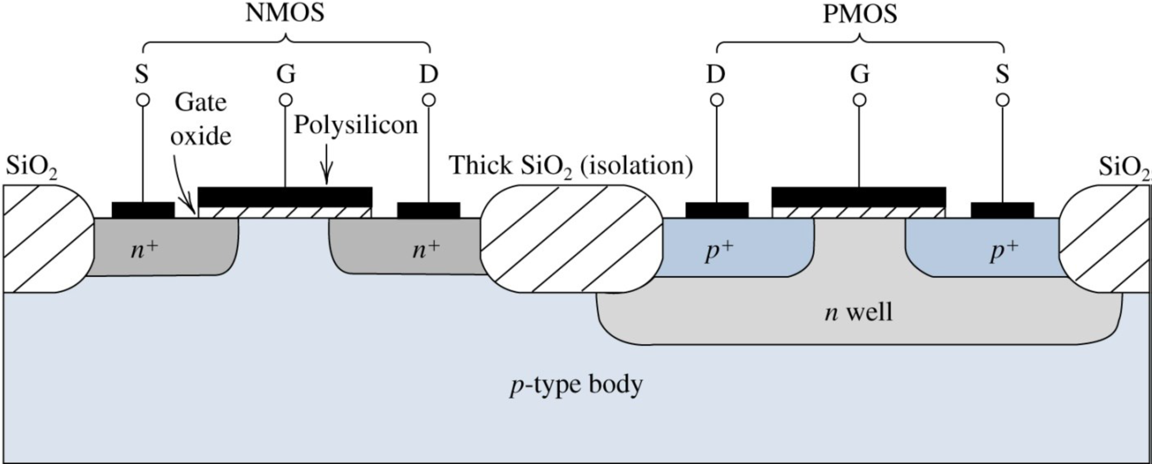
CMOS: NMOS and PMOS on one chip
1 · STRUCTURE AND OPERATION
Figure: Sedra & Smith, Microelectronic Circuits
The PMOS transistor is built in an n-well, with p⁺ source and drain.
ELEC1 · Lecture 3 · MOSFETs
16

Slide 17
CMOS: NMOS and PMOS on one chip
1 · STRUCTURE AND OPERATION
Figure: Sedra & Smith, Microelectronic Circuits
The PMOS transistor is built in an n-well, with p⁺ source and drain.
Thick oxide isolates neighbouring devices. CMOS circuits use both types together.
ELEC1 · Lecture 3 · MOSFETs
17

Slide 18
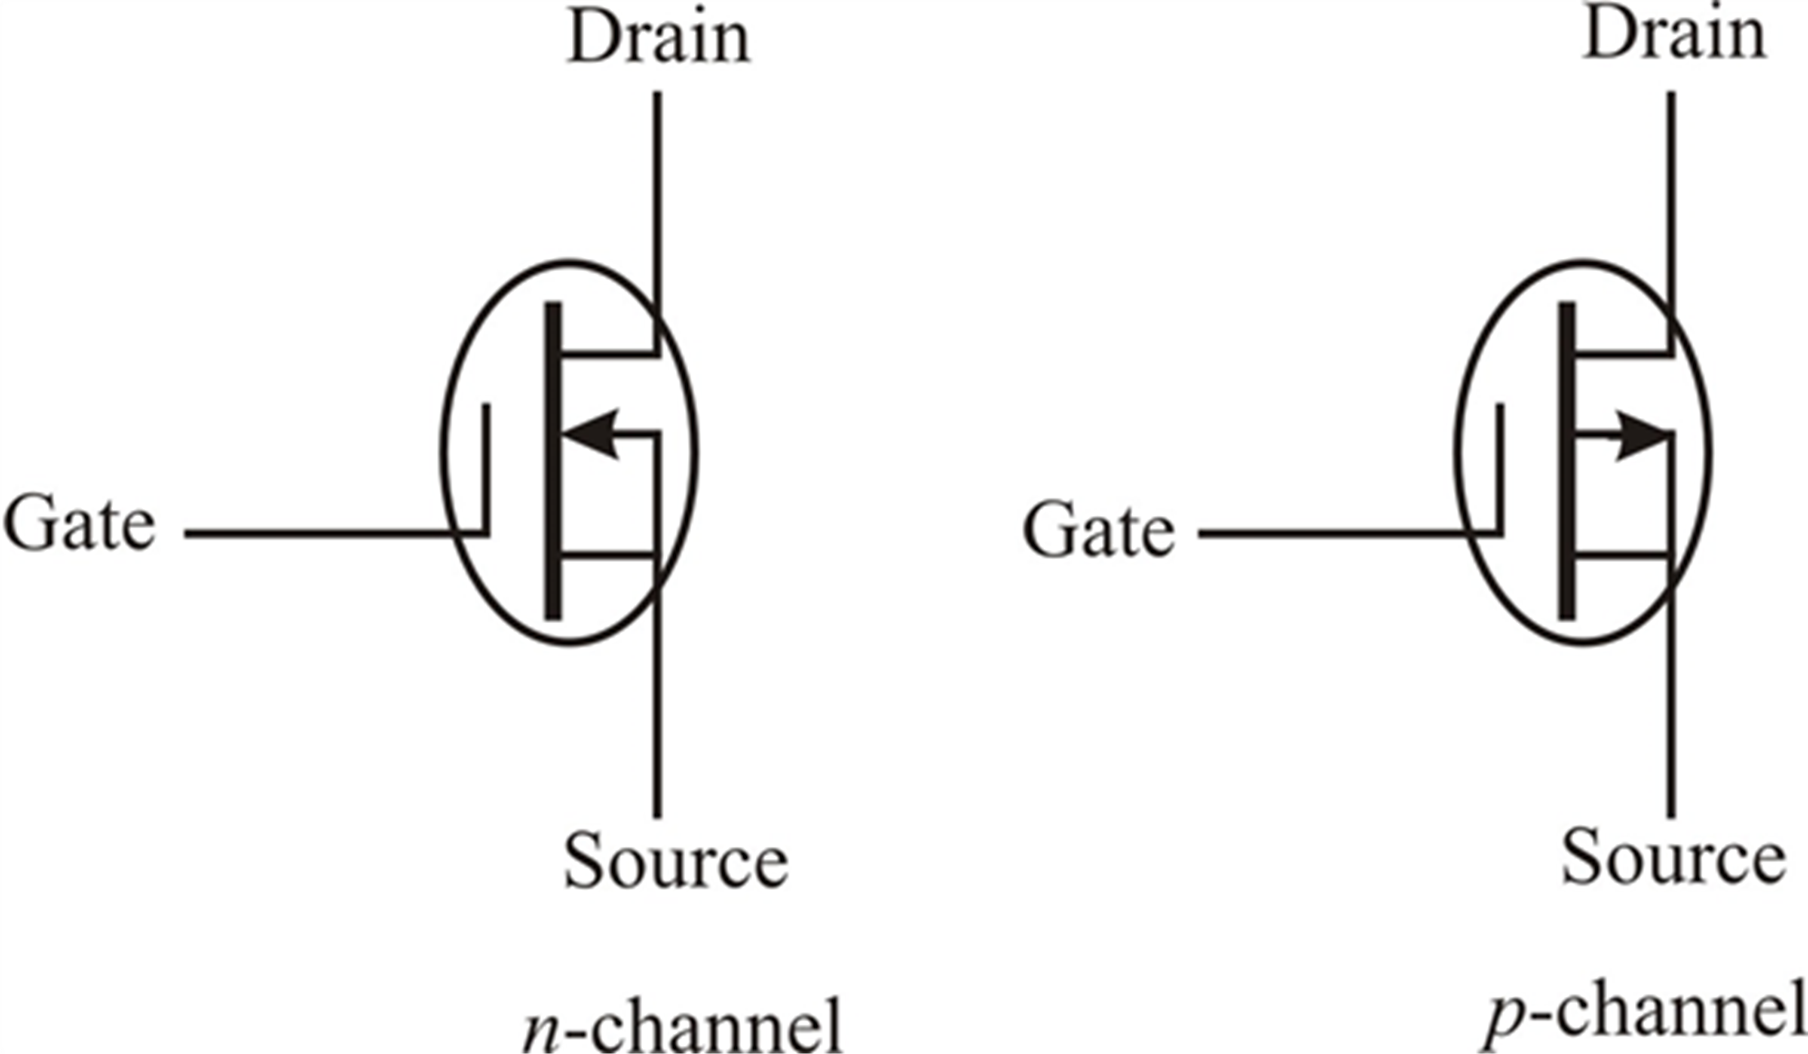
Circuit symbols: n-channel and p-channel
1 · STRUCTURE AND OPERATION
In these symbols the arrow is on the body: it points in for an n-channel device and out for a p-channel device.
Figure: web source, via the original lecture slides
ELEC1 · Lecture 3 · MOSFETs
18

Slide 19
Circuit symbols: n-channel and p-channel
1 · STRUCTURE AND OPERATION
In these symbols the arrow is on the body: it points in for an n-channel device and out for a p-channel device.
PMOS: holes carry the current and every voltage and current is reversed. It conducts when v_{GS} < V_{t}, with V_{t} negative.
Figure: web source, via the original lecture slides
ELEC1 · Lecture 3 · MOSFETs
19

Slide 20
I–V characteristics
02
1
Structure and operation
2
I–V characteristics
3
MOSFETs in DC circuits
4
The MOSFET as an amplifier
The i_{D}–v_{DS} family
5
The MOSFET as a switch
Saturation: the square law
Triode and saturation equations
Resistor and large-signal models

Slide 21
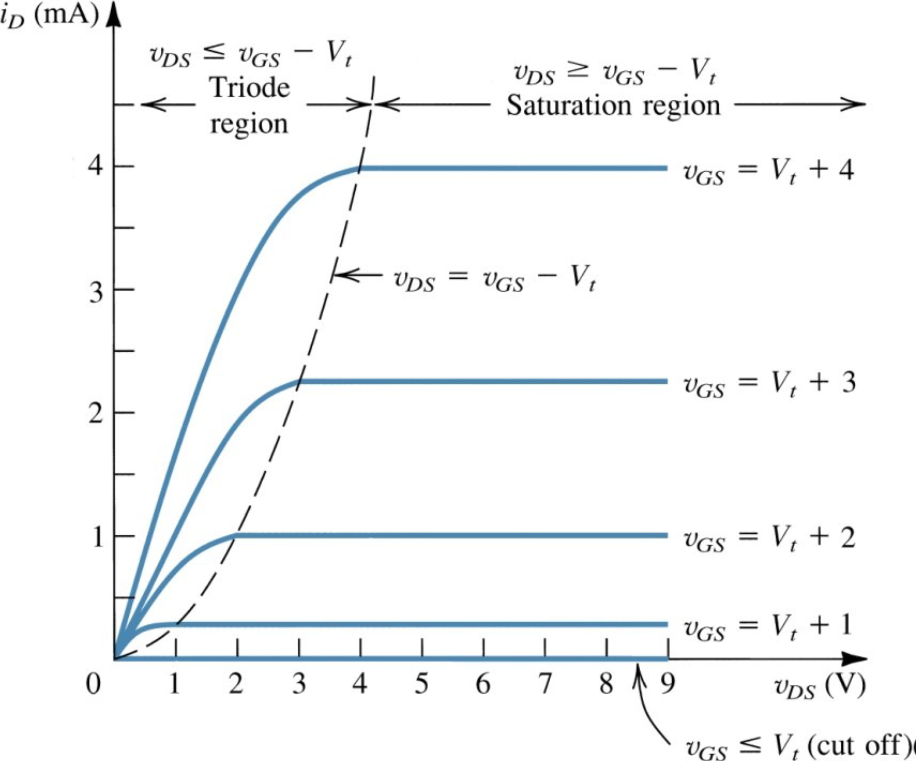
The i_{D}–v_{DS} family of curves
2 · I–V CHARACTERISTICS
Each curve is one value of v_{GS} > V_{t}.
Figure: Sedra & Smith, Microelectronic Circuits
ELEC1 · Lecture 3 · MOSFETs
21

Slide 22
The i_{D}–v_{DS} family of curves
2 · I–V CHARACTERISTICS
Each curve is one value of v_{GS} > V_{t}.
Left of the dashed line (v_{DS} < v_{GS} − V_{t}): triode. i_{D} rises with v_{DS}.
Figure: Sedra & Smith, Microelectronic Circuits
ELEC1 · Lecture 3 · MOSFETs
22

Slide 23
The i_{D}–v_{DS} family of curves
2 · I–V CHARACTERISTICS
Each curve is one value of v_{GS} > V_{t}.
Left of the dashed line (v_{DS} < v_{GS} − V_{t}): triode. i_{D} rises with v_{DS}.
Right of it: saturation. i_{D} is set by v_{GS} alone.
Figure: Sedra & Smith, Microelectronic Circuits
ELEC1 · Lecture 3 · MOSFETs
23

Slide 24
The i_{D}–v_{DS} family of curves
2 · I–V CHARACTERISTICS
Each curve is one value of v_{GS} > V_{t}.
Left of the dashed line (v_{DS} < v_{GS} − V_{t}): triode. i_{D} rises with v_{DS}.
Right of it: saturation. i_{D} is set by v_{GS} alone.
For v_{GS} ≤ V_{t}: cutoff, i_{D} = 0.
Figure: Sedra & Smith, Microelectronic Circuits
ELEC1 · Lecture 3 · MOSFETs
24

Slide 25

In saturation, i_{D} depends only on v_{GS}
2 · I–V CHARACTERISTICS
Measured in saturation, the transfer characteristic is a parabola that starts at v_{GS} = V_{t}.
Figure: Sedra & Smith, Microelectronic Circuits
ELEC1 · Lecture 3 · MOSFETs
25

Slide 26
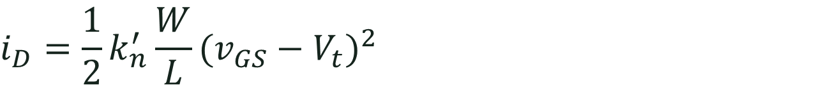
In saturation, i_{D} depends only on v_{GS}
2 · I–V CHARACTERISTICS
Measured in saturation, the transfer characteristic is a parabola that starts at v_{GS} = V_{t}.
$$i_{D}=\frac{1}{2}k_{n}^{′}\frac{W}{L}(v_{GS}−V_{t})^{2}$$
Figure: Sedra & Smith, Microelectronic Circuits
ELEC1 · Lecture 3 · MOSFETs
26

Slide 27
In saturation, i_{D} depends only on v_{GS}
2 · I–V CHARACTERISTICS
Measured in saturation, the transfer characteristic is a parabola that starts at v_{GS} = V_{t}.
$$i_{D}=\frac{1}{2}k_{n}^{′}\frac{W}{L}(v_{GS}−V_{t})^{2}$$
Doubling (v_{GS} − V_{t}) quadruples i_{D}: the square law.
Figure: Sedra & Smith, Microelectronic Circuits
ELEC1 · Lecture 3 · MOSFETs
27

Slide 28

Triode and saturation: one curve, two equations
2 · I–V CHARACTERISTICS
Figure: Sedra & Smith, Microelectronic Circuits
ELEC1 · Lecture 3 · MOSFETs
28

Slide 29
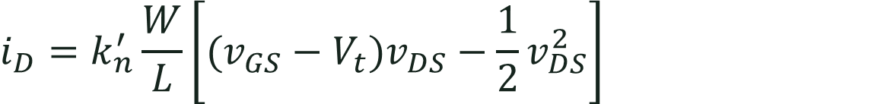
Triode and saturation: one curve, two equations
2 · I–V CHARACTERISTICS
TRIODE
v_{DS} < v_{GS} − V_{t}
$$i_{D}=k_{n}^{′}\frac{W}{L}\left[(v_{GS}−V_{t})v_{DS}−\frac{1}{2}v_{DS}^{2}\right]$$
Figure: Sedra & Smith, Microelectronic Circuits
ELEC1 · Lecture 3 · MOSFETs
29

Slide 30
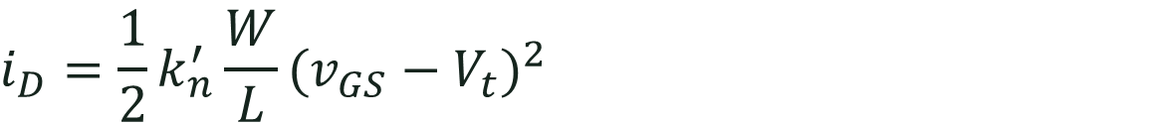
Triode and saturation: one curve, two equations
2 · I–V CHARACTERISTICS
TRIODE
v_{DS} < v_{GS} − V_{t}
$$i_{D}=k_{n}^{′}\frac{W}{L}\left[(v_{GS}−V_{t})v_{DS}−\frac{1}{2}v_{DS}^{2}\right]$$
SATURATION
v_{DS} ≥ v_{GS} − V_{t}
$$i_{D}=\frac{1}{2}k_{n}^{′}\frac{W}{L}(v_{GS}−V_{t})^{2}$$
Figure: Sedra & Smith, Microelectronic Circuits
ELEC1 · Lecture 3 · MOSFETs
30

Slide 31
Triode and saturation: one curve, two equations
2 · I–V CHARACTERISTICS
TRIODE
v_{DS} < v_{GS} − V_{t}
$$i_{D}=k_{n}^{′}\frac{W}{L}\left[(v_{GS}−V_{t})v_{DS}−\frac{1}{2}v_{DS}^{2}\right]$$
SATURATION
v_{DS} ≥ v_{GS} − V_{t}
$$i_{D}=\frac{1}{2}k_{n}^{′}\frac{W}{L}(v_{GS}−V_{t})^{2}$$
Both require v_{GS} > V_{t}: without a channel, i_{D} = 0 (cutoff).
Figure: Sedra & Smith, Microelectronic Circuits
ELEC1 · Lecture 3 · MOSFETs
31

Slide 32
Small v_{DS}: a voltage-controlled resistor
2 · I–V CHARACTERISTICS
For v_{DS} ≪ 2(v_{GS} − V_{t}) the v_{DS}² term is negligible:
$$i_{D}≈k_{n}^{′}\frac{W}{L}(v_{GS}−V_{t})v_{DS}$$
Figure: Sedra & Smith, Microelectronic Circuits
ELEC1 · Lecture 3 · MOSFETs
32

Slide 33
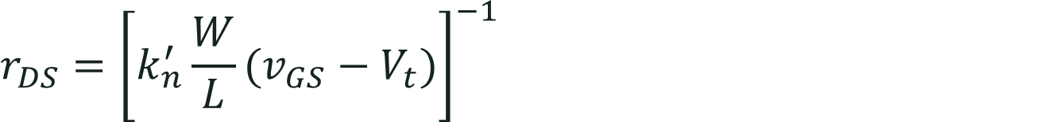
Small v_{DS}: a voltage-controlled resistor
2 · I–V CHARACTERISTICS
For v_{DS} ≪ 2(v_{GS} − V_{t}) the v_{DS}² term is negligible:
$$i_{D}≈k_{n}^{′}\frac{W}{L}(v_{GS}−V_{t})v_{DS}$$
The channel behaves as a resistor whose value v_{GS} sets:
$$r_{DS}={\left[k_{n}^{′}\frac{W}{L}(v_{GS}−V_{t})\right]}^{−1}$$
Figure: Sedra & Smith, Microelectronic Circuits
ELEC1 · Lecture 3 · MOSFETs
33

Slide 34
Small v_{DS}: a voltage-controlled resistor
2 · I–V CHARACTERISTICS
For v_{DS} ≪ 2(v_{GS} − V_{t}) the v_{DS}² term is negligible:
$$i_{D}≈k_{n}^{′}\frac{W}{L}(v_{GS}−V_{t})v_{DS}$$
The channel behaves as a resistor whose value v_{GS} sets:
$$r_{DS}={\left[k_{n}^{′}\frac{W}{L}(v_{GS}−V_{t})\right]}^{−1}$$
This is the region used when the MOSFET acts as a closed switch (Section 5).
Figure: Sedra & Smith, Microelectronic Circuits
ELEC1 · Lecture 3 · MOSFETs
34

Slide 35
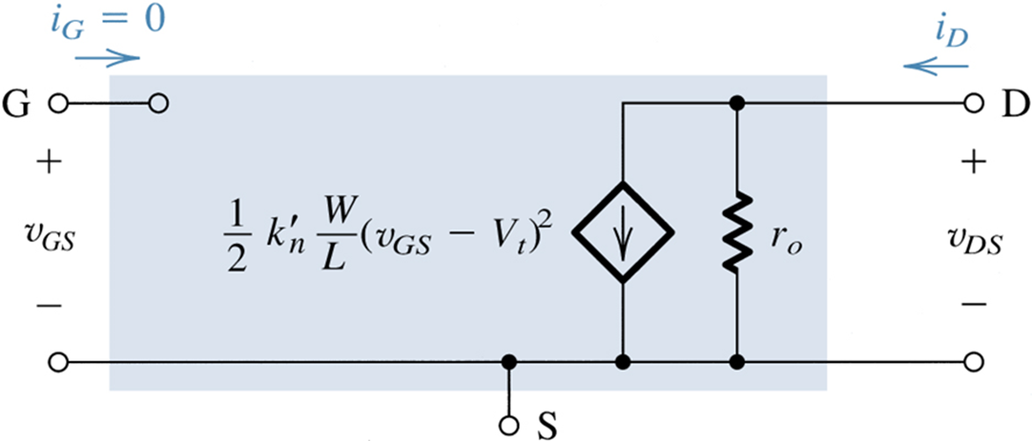
Large-signal model in saturation
2 · I–V CHARACTERISTICS
Figure: Sedra & Smith, Microelectronic Circuits
In saturation the MOSFET acts as a voltage-controlled current source from drain to source.
ELEC1 · Lecture 3 · MOSFETs
35

Slide 36
Large-signal model in saturation
2 · I–V CHARACTERISTICS
Figure: Sedra & Smith, Microelectronic Circuits
In saturation the MOSFET acts as a voltage-controlled current source from drain to source.
The gate draws no current: i_{G} = 0.
ELEC1 · Lecture 3 · MOSFETs
36

Slide 37
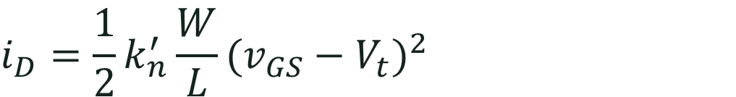
Large-signal model in saturation
2 · I–V CHARACTERISTICS
Figure: Sedra & Smith, Microelectronic Circuits
In saturation the MOSFET acts as a voltage-controlled current source from drain to source.
$$i_{D}=\frac{1}{2}k_{n}^{′}\frac{W}{L}(v_{GS}−V_{t})^{2}$$
The gate draws no current: i_{G} = 0.
ELEC1 · Lecture 3 · MOSFETs
37

Slide 38
MOSFETs in DC circuits
03
1
Structure and operation
2
I–V characteristics
3
MOSFETs in DC circuits
4
The MOSFET as an amplifier
Assume, solve, check
5
The MOSFET as a switch
Example: the drain voltage
The current mirror

Slide 39
DC analysis: assume, solve, check
3 · MOSFETS IN DC CIRCUITS
1
Assume
a region, usually saturation (and v_{GS} > V_{t}).
ELEC1 · Lecture 3 · MOSFETs
39

Slide 40
DC analysis: assume, solve, check
3 · MOSFETS IN DC CIRCUITS
1
2
Assume
Solve
a region, usually saturation (and v_{GS} > V_{t}).
with that region’s i_{D} equation and KVL/KCL. Reject roots that give v_{GS} < V_{t}.
ELEC1 · Lecture 3 · MOSFETs
40

Slide 41
DC analysis: assume, solve, check
3 · MOSFETS IN DC CIRCUITS
1
2
3
Assume
Solve
Check
a region, usually saturation (and v_{GS} > V_{t}).
with that region’s i_{D} equation and KVL/KCL. Reject roots that give v_{GS} < V_{t}.
the assumption: saturation needs v_{DS} ≥ v_{GS} − V_{t}. If it fails, redo it in triode.
ELEC1 · Lecture 3 · MOSFETs
41

Slide 42
DC analysis: assume, solve, check
3 · MOSFETS IN DC CIRCUITS
1
2
3
Assume
Solve
Check
a region, usually saturation (and v_{GS} > V_{t}).
with that region’s i_{D} equation and KVL/KCL. Reject roots that give v_{GS} < V_{t}.
the assumption: saturation needs v_{DS} ≥ v_{GS} − V_{t}. If it fails, redo it in triode.
The gate draws no current, so gate-bias resistors form an unloaded divider.
ELEC1 · Lecture 3 · MOSFETs
42

Slide 43
Example: find the drain voltage
3 · MOSFETS IN DC CIRCUITS
Given V_{t} = 1 V and k′_{n}(W/L) = 1 mA/V². The gate draws no current.
+V_{DD} = 10 V
R_{D} = 6 kΩ
R_{G1} = 10 MΩ
R_{G2} = 10 MΩ
R_{S} = 6 kΩ
ELEC1 · Lecture 3 · MOSFETs
43

Slide 44
Example: find the drain voltage
3 · MOSFETS IN DC CIRCUITS
Given V_{t} = 1 V and k′_{n}(W/L) = 1 mA/V². The gate draws no current.
1
Gate voltage: the divider is unloaded
+V_{DD} = 10 V
$$V_{G}=V_{DD}\frac{R_{G2}}{R_{G1}+R_{G2}}=5 V$$
R_{D} = 6 kΩ
R_{G1} = 10 MΩ
V_{G} = 5 V
R_{G2} = 10 MΩ
R_{S} = 6 kΩ
ELEC1 · Lecture 3 · MOSFETs
44

Slide 45
Example: find the drain voltage
3 · MOSFETS IN DC CIRCUITS
Given V_{t} = 1 V and k′_{n}(W/L) = 1 mA/V². The gate draws no current.
1
Gate voltage: the divider is unloaded
+V_{DD} = 10 V
$$V_{G}=V_{DD}\frac{R_{G2}}{R_{G1}+R_{G2}}=5 V$$
2
Assume saturation, with V_{GS} = V_{G} − I_{D}R_{S} (I in mA, R in kΩ)
$$I_{D}=\frac{1}{2}(1)(5−6I_{D}−1)^{2}$$
R_{D} = 6 kΩ
R_{G1} = 10 MΩ
V_{G} = 5 V
R_{G2} = 10 MΩ
R_{S} = 6 kΩ
ELEC1 · Lecture 3 · MOSFETs
45

Slide 46
Example: find the drain voltage
3 · MOSFETS IN DC CIRCUITS
Given V_{t} = 1 V and k′_{n}(W/L) = 1 mA/V². The gate draws no current.
1
Gate voltage: the divider is unloaded
+V_{DD} = 10 V
$$V_{G}=V_{DD}\frac{R_{G2}}{R_{G1}+R_{G2}}=5 V$$
2
Assume saturation, with V_{GS} = V_{G} − I_{D}R_{S} (I in mA, R in kΩ)
$$I_{D}=\frac{1}{2}(1)(5−6I_{D}−1)^{2}$$
R_{D} = 6 kΩ
R_{G1} = 10 MΩ
3
Solve the quadratic
$$18I_{D}^{2}−25I_{D}+8=0 ⇒ I_{D}=0.89 or 0.5 mA$$
V_{G} = 5 V
R_{G2} = 10 MΩ
R_{S} = 6 kΩ
ELEC1 · Lecture 3 · MOSFETs
46

Slide 47
Example: find the drain voltage
3 · MOSFETS IN DC CIRCUITS
Given V_{t} = 1 V and k′_{n}(W/L) = 1 mA/V². The gate draws no current.
1
Gate voltage: the divider is unloaded
+V_{DD} = 10 V
$$V_{G}=V_{DD}\frac{R_{G2}}{R_{G1}+R_{G2}}=5 V$$
2
Assume saturation, with V_{GS} = V_{G} − I_{D}R_{S} (I in mA, R in kΩ)
$$I_{D}=\frac{1}{2}(1)(5−6I_{D}−1)^{2}$$
R_{D} = 6 kΩ
R_{G1} = 10 MΩ
3
Solve the quadratic
$$18I_{D}^{2}−25I_{D}+8=0 ⇒ I_{D}=0.89 or 0.5 mA$$
V_{G} = 5 V
4
I_{D} = 0.89 mA would give V_{GS} = −0.33 V < V_{t} (no channel): reject.
So I_{D} = 0.5 mA and V_{GS} = 2 V.
R_{G2} = 10 MΩ
R_{S} = 6 kΩ
ELEC1 · Lecture 3 · MOSFETs
47

Slide 48
Example: find the drain voltage
3 · MOSFETS IN DC CIRCUITS
Given V_{t} = 1 V and k′_{n}(W/L) = 1 mA/V². The gate draws no current.
1
Gate voltage: the divider is unloaded
+V_{DD} = 10 V
$$V_{G}=V_{DD}\frac{R_{G2}}{R_{G1}+R_{G2}}=5 V$$
2
Assume saturation, with V_{GS} = V_{G} − I_{D}R_{S} (I in mA, R in kΩ)
$$I_{D}=\frac{1}{2}(1)(5−6I_{D}−1)^{2}$$
R_{D} = 6 kΩ
R_{G1} = 10 MΩ
3
Solve the quadratic
V_{D} = 7 V
$$18I_{D}^{2}−25I_{D}+8=0 ⇒ I_{D}=0.89 or 0.5 mA$$
V_{G} = 5 V
4
I_{D} = 0.89 mA would give V_{GS} = −0.33 V < V_{t} (no channel): reject.
V_{S} = 3 V
So I_{D} = 0.5 mA and V_{GS} = 2 V.
5
Drain voltage
R_{G2} = 10 MΩ
$$V_{D}=V_{DD}−I_{D}R_{D}=10−0.5(6)=7 V$$
R_{S} = 6 kΩ
V_{D} = 7 V
✓ V_{DS} = 4 V ≥ V_{GS} − V_{t} = 1 V: saturation holds.
ELEC1 · Lecture 3 · MOSFETs
48

Slide 49
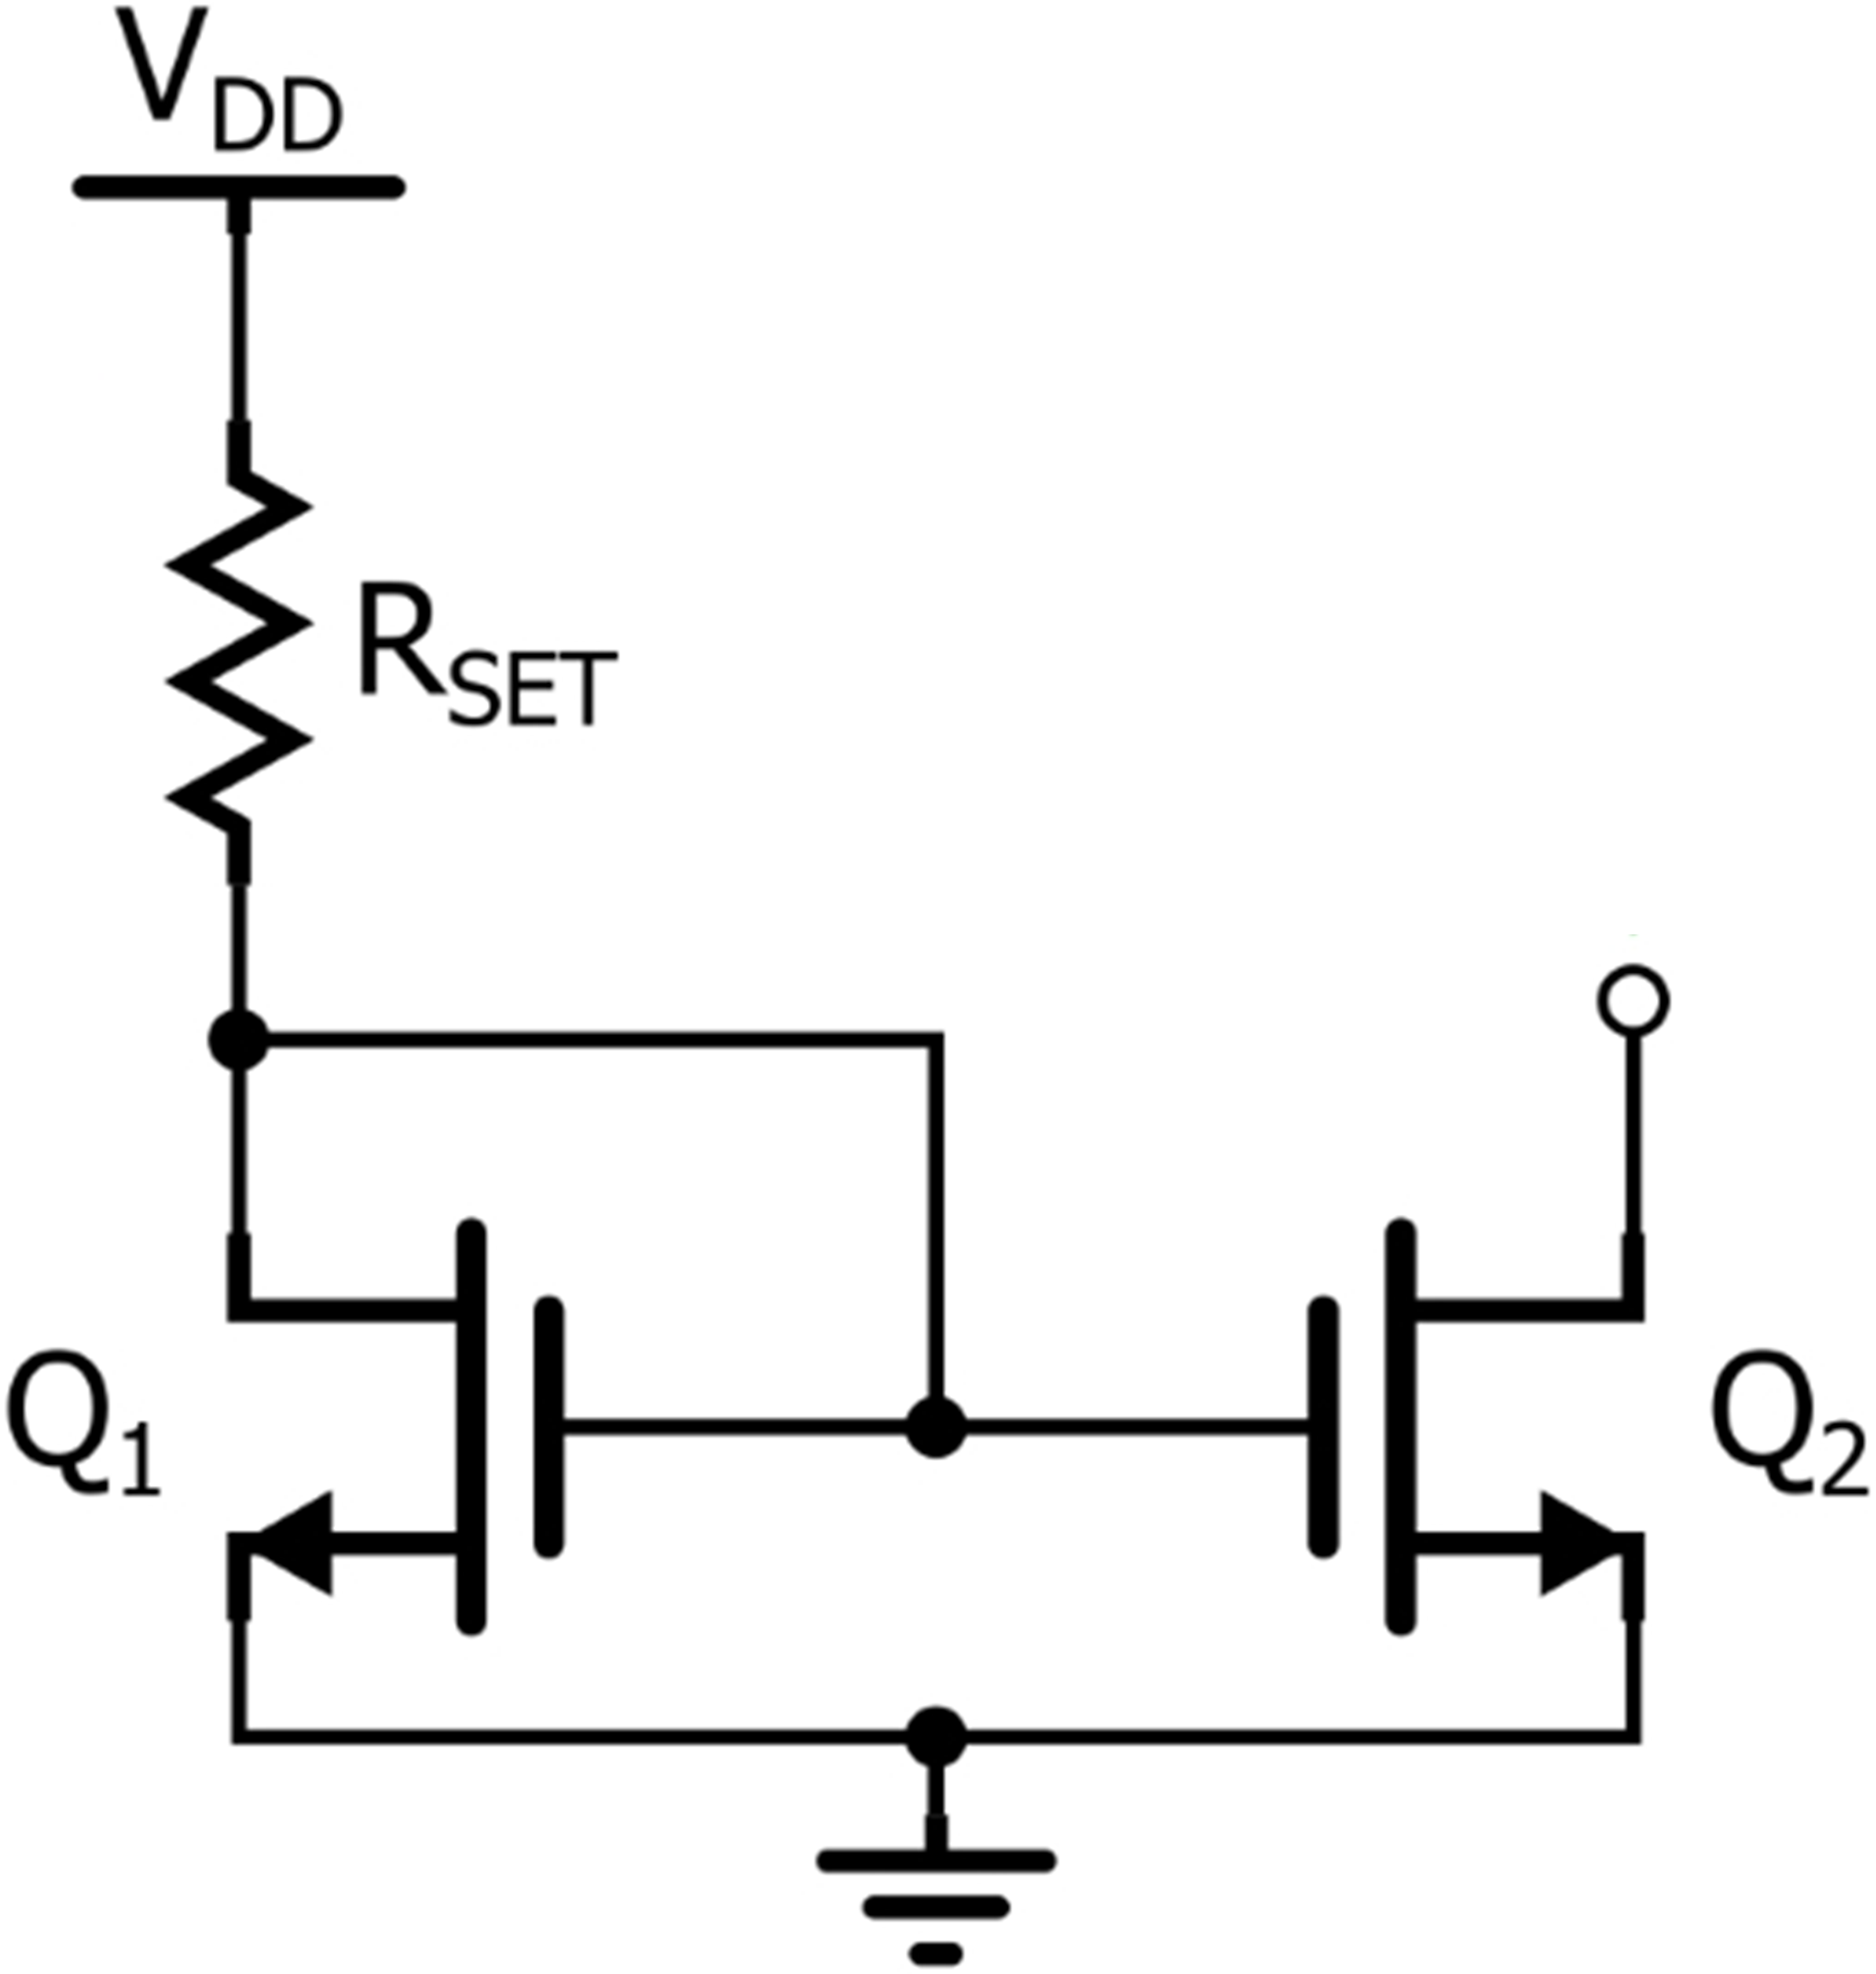
The current mirror
3 · MOSFETS IN DC CIRCUITS
Q₁ is diode-connected (gate tied to drain), so it is in saturation. R_{SET} sets its current I_{REF}, and with it V_{GS}.
Figure: web source, via the original lecture slides
ELEC1 · Lecture 3 · MOSFETs
49

Slide 50
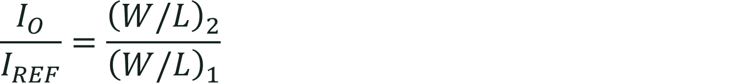
The current mirror
3 · MOSFETS IN DC CIRCUITS
Q₁ is diode-connected (gate tied to drain), so it is in saturation. R_{SET} sets its current I_{REF}, and with it V_{GS}.
Q₂ has the same V_{GS}. If it is also in saturation, its current scales with W/L:
$$\frac{I_{O}}{I_{REF}}=\frac{{\left(W/L\right)}_{2}}{{\left(W/L\right)}_{1}}$$
Figure: web source, via the original lecture slides
ELEC1 · Lecture 3 · MOSFETs
50

Slide 51
The current mirror
3 · MOSFETS IN DC CIRCUITS
Q₁ is diode-connected (gate tied to drain), so it is in saturation. R_{SET} sets its current I_{REF}, and with it V_{GS}.
Q₂ has the same V_{GS}. If it is also in saturation, its current scales with W/L:
$$\frac{I_{O}}{I_{REF}}=\frac{{\left(W/L\right)}_{2}}{{\left(W/L\right)}_{1}}$$
Identical transistors copy the current: I_{O} = I_{REF}.
Figure: web source, via the original lecture slides
ELEC1 · Lecture 3 · MOSFETs
51

Slide 52
The MOSFET as an amplifier
04
1
Structure and operation
2
I–V characteristics
3
MOSFETs in DC circuits
4
The MOSFET as an amplifier
The load line
5
The MOSFET as a switch
Transconductance g_{m}
Small-signal models
Example: gain and input resistance

Slide 53

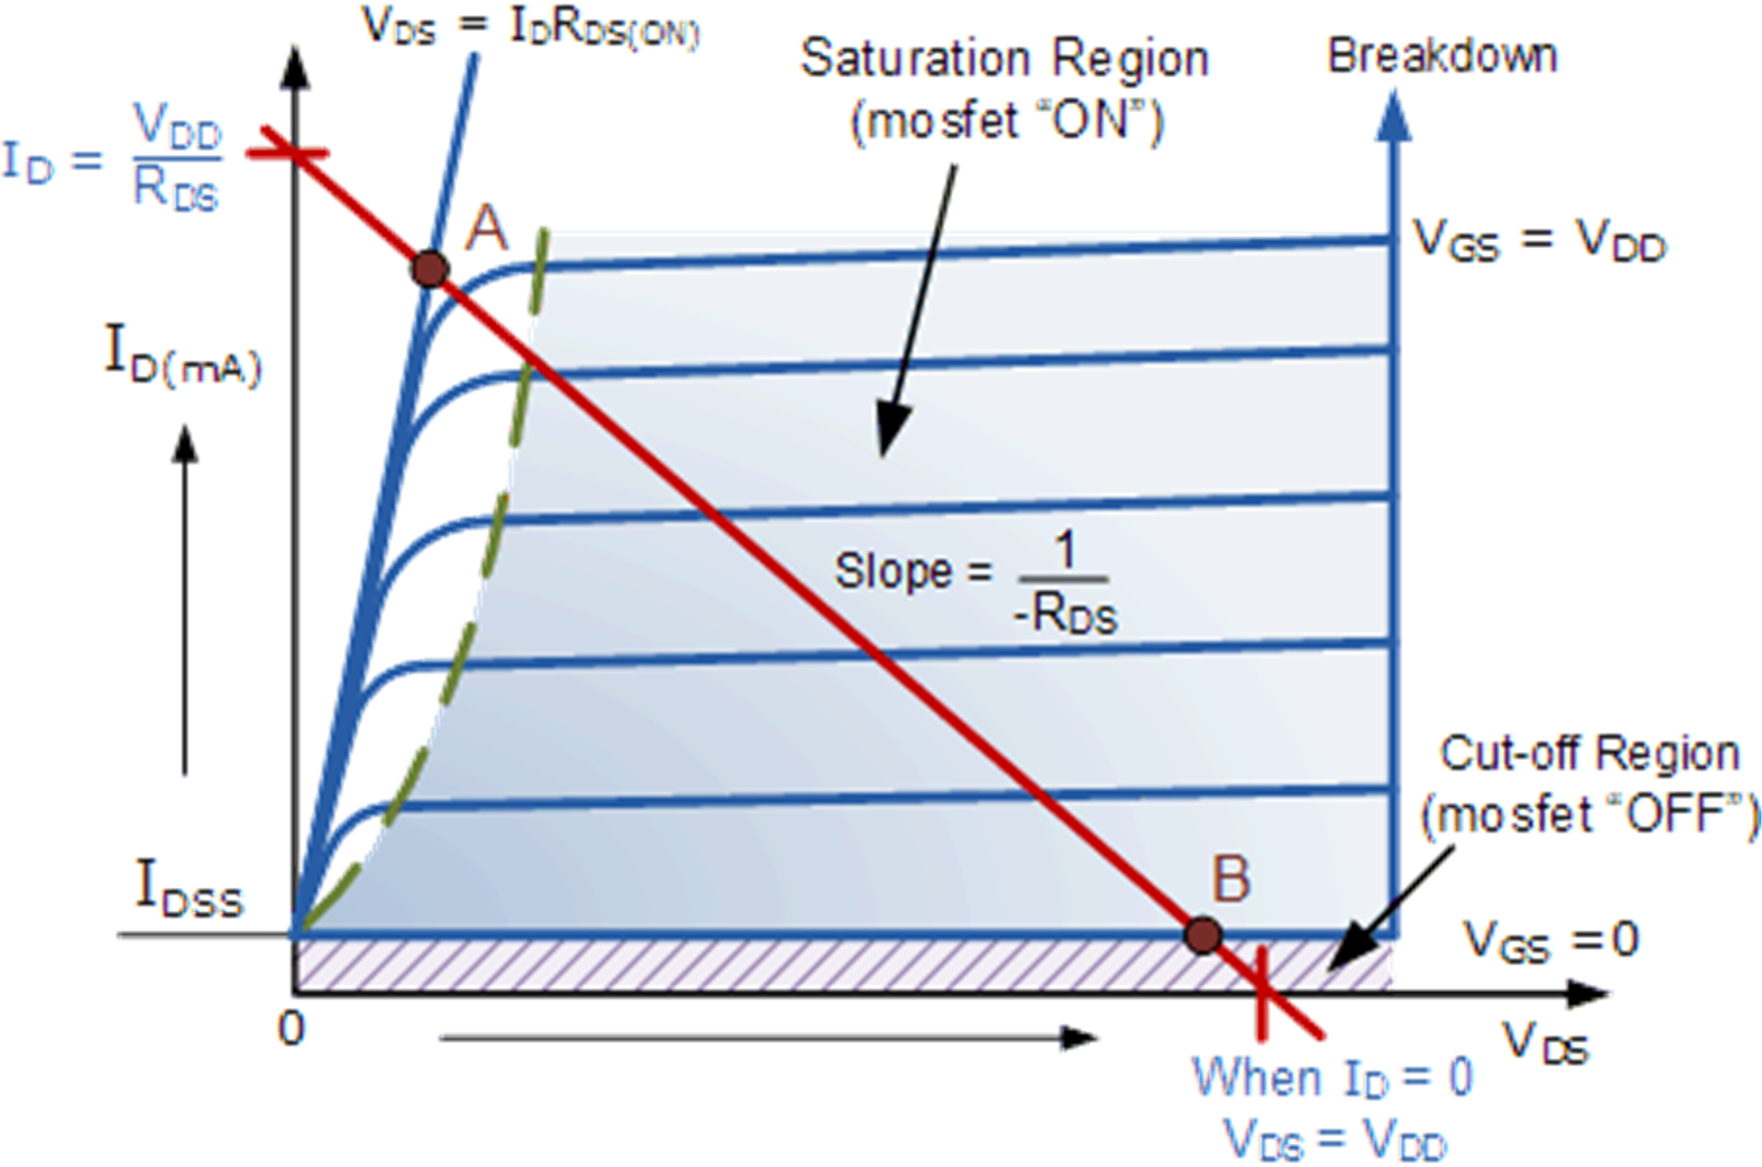
Amplifier action: the load line
4 · THE MOSFET AS AN AMPLIFIER
$$v_{DS}=V_{DD}−R_{D}i_{D}$$
Figure: Sedra & Smith, Microelectronic Circuits
Figure: web source, via the original lecture slides
ELEC1 · Lecture 3 · MOSFETs
53

Slide 54

Amplifier action: the load line
4 · THE MOSFET AS AN AMPLIFIER
$$v_{DS}=V_{DD}−R_{D}i_{D}$$
Bias the MOSFET in saturation, between A and B.
Figure: Sedra & Smith, Microelectronic Circuits
Figure: web source, via the original lecture slides
ELEC1 · Lecture 3 · MOSFETs
54

Slide 55
Amplifier action: the load line
4 · THE MOSFET AS AN AMPLIFIER
$$v_{DS}=V_{DD}−R_{D}i_{D}$$
Bias the MOSFET in saturation, between A and B.
A small change in v_{GS} moves the operating point along the line: a large change in v_{DS}.
Figure: Sedra & Smith, Microelectronic Circuits
Figure: web source, via the original lecture slides
ELEC1 · Lecture 3 · MOSFETs
55

Slide 56
Small-signal operation: the transconductance g_{m}
4 · THE MOSFET AS AN AMPLIFIER
1
The gate voltage is the bias plus a small signal
$$v_{GS}=V_{GS}+v_{gs}$$
ELEC1 · Lecture 3 · MOSFETs
56

Slide 57
Small-signal operation: the transconductance g_{m}
4 · THE MOSFET AS AN AMPLIFIER
1
The gate voltage is the bias plus a small signal
$$v_{GS}=V_{GS}+v_{gs}$$
2
Substitute into the saturation equation
$$i_{D}=\frac{1}{2}k_{n}^{′}\frac{W}{L}(V_{GS}−V_{t})^{2}+k_{n}^{′}\frac{W}{L}(V_{GS}−V_{t})v_{gs}+\frac{1}{2}k_{n}^{′}\frac{W}{L}v_{gs}^{2}$$
ELEC1 · Lecture 3 · MOSFETs
57

Slide 58
Small-signal operation: the transconductance g_{m}
4 · THE MOSFET AS AN AMPLIFIER
1
The gate voltage is the bias plus a small signal
$$v_{GS}=V_{GS}+v_{gs}$$
2
Substitute into the saturation equation
$$i_{D}=\frac{1}{2}k_{n}^{′}\frac{W}{L}(V_{GS}−V_{t})^{2}+k_{n}^{′}\frac{W}{L}(V_{GS}−V_{t})v_{gs}+\frac{1}{2}k_{n}^{′}\frac{W}{L}v_{gs}^{2}$$
3
If v_{gs} ≪ 2(V_{GS} − V_{t}), the last term is negligible: the signal current is linear in v_{gs}
$$i_{d}=g_{m}v_{gs}, g_{m}=k_{n}^{′}\frac{W}{L}(V_{GS}−V_{t})$$
ELEC1 · Lecture 3 · MOSFETs
58

Slide 59
Small-signal operation: the transconductance g_{m}
4 · THE MOSFET AS AN AMPLIFIER
1
The gate voltage is the bias plus a small signal
$$v_{GS}=V_{GS}+v_{gs}$$
2
Substitute into the saturation equation
$$i_{D}=\frac{1}{2}k_{n}^{′}\frac{W}{L}(V_{GS}−V_{t})^{2}+k_{n}^{′}\frac{W}{L}(V_{GS}−V_{t})v_{gs}+\frac{1}{2}k_{n}^{′}\frac{W}{L}v_{gs}^{2}$$
3
If v_{gs} ≪ 2(V_{GS} − V_{t}), the last term is negligible: the signal current is linear in v_{gs}
$$i_{d}=g_{m}v_{gs}, g_{m}=k_{n}^{′}\frac{W}{L}(V_{GS}−V_{t})$$
4
With a drain resistor R_{D}, the voltage gain is
$$A_{v}=\frac{v_{ds}}{v_{gs}}=−g_{m}R_{D}$$
ELEC1 · Lecture 3 · MOSFETs
59

Slide 60
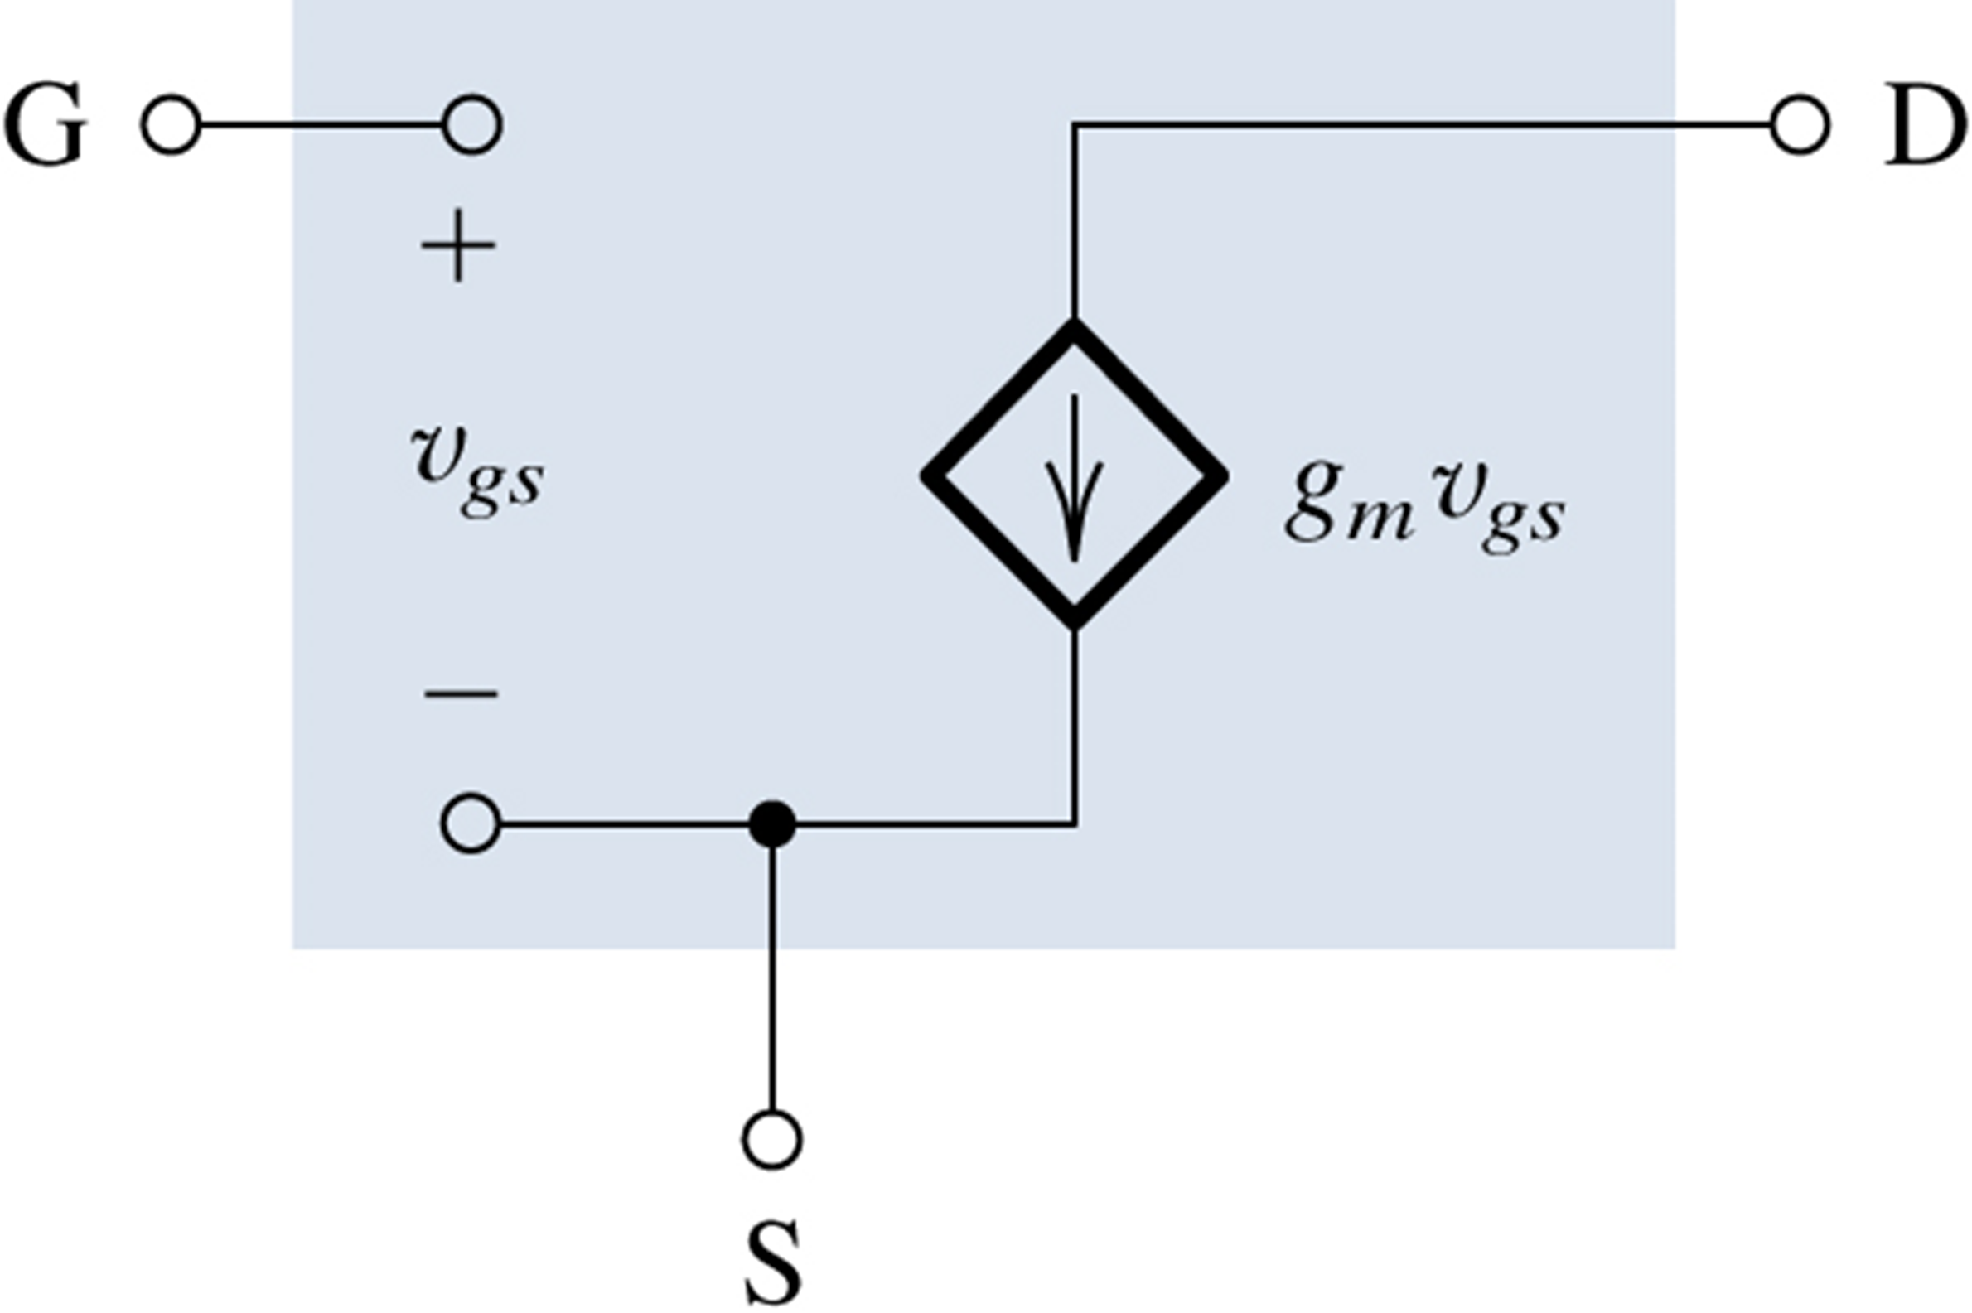
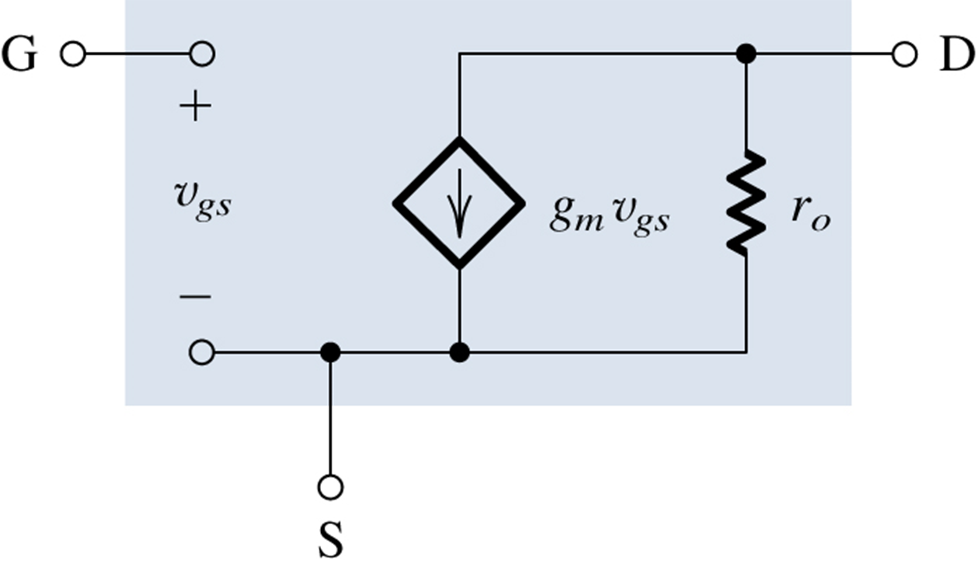
Small-signal equivalent circuits
4 · THE MOSFET AS AN AMPLIFIER
Figure: Sedra & Smith, Microelectronic Circuits
Figure: Sedra & Smith, Microelectronic Circuits
The MOSFET as a voltage-controlled current source g_{m}v_{gs}; no current into the gate.
ELEC1 · Lecture 3 · MOSFETs
60

Slide 61
Small-signal equivalent circuits
4 · THE MOSFET AS AN AMPLIFIER
Figure: Sedra & Smith, Microelectronic Circuits
Figure: Sedra & Smith, Microelectronic Circuits
The MOSFET as a voltage-controlled current source g_{m}v_{gs}; no current into the gate.
Adding r_{o} = V_{A}/I_{D} models the slight slope of the saturation curves (V_{A}: the Early voltage).
ELEC1 · Lecture 3 · MOSFETs
61

Slide 62
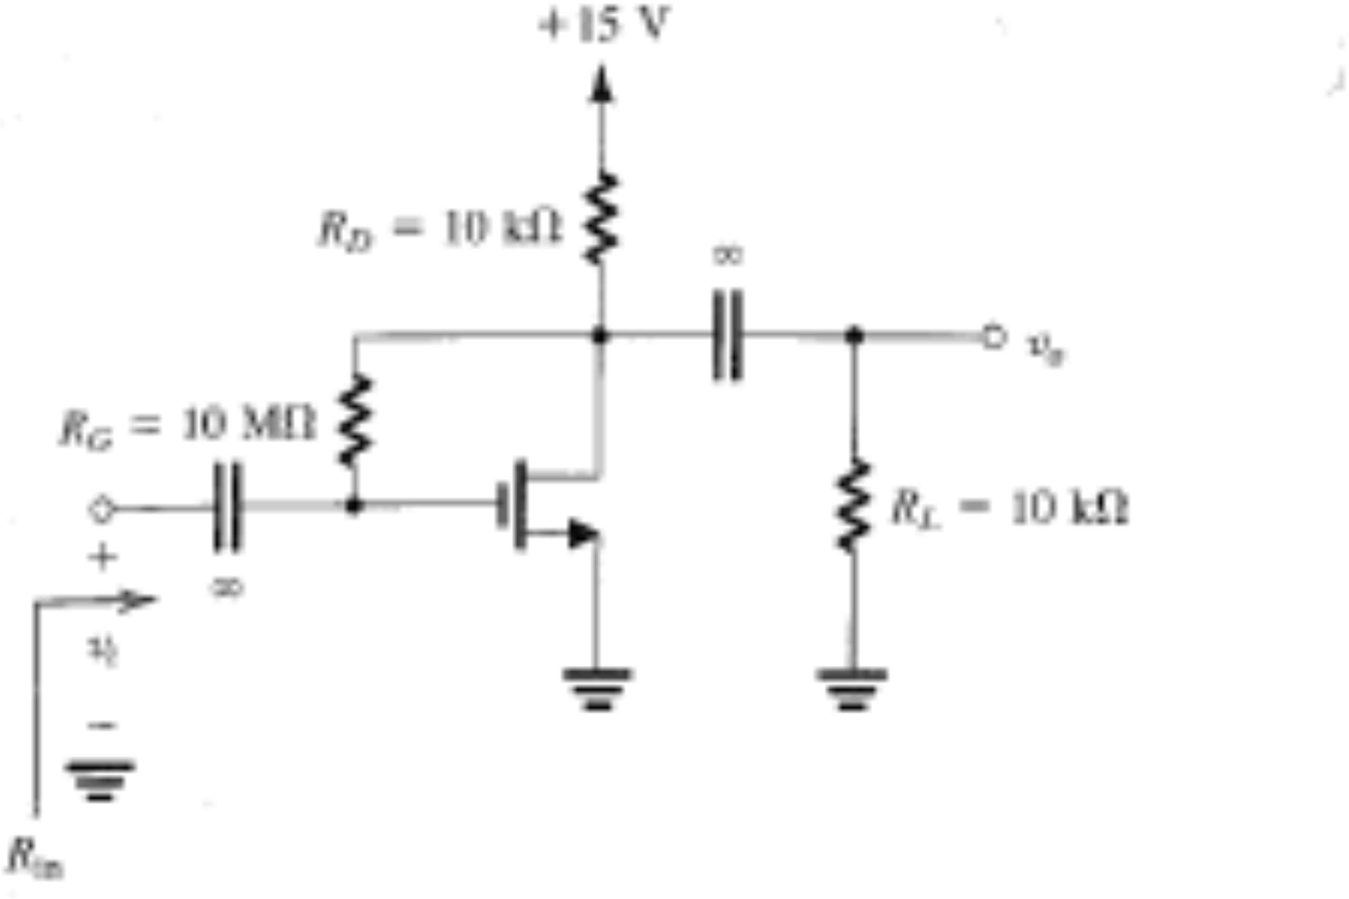
Example: gain and input resistance
4 · THE MOSFET AS AN AMPLIFIER
V_{t} = 1.5 V, k′_{n}(W/L) = 0.25 mA/V², V_{A} = 50 V. Coupling capacitors are short circuits for the signal. Find A_{v} = v_{o}/v_{i} and R_{in}.
Figure: Sedra & Smith, Microelectronic Circuits
ELEC1 · Lecture 3 · MOSFETs
62

Slide 63
Example: gain and input resistance
4 · THE MOSFET AS AN AMPLIFIER
V_{t} = 1.5 V, k′_{n}(W/L) = 0.25 mA/V², V_{A} = 50 V. Coupling capacitors are short circuits for the signal. Find A_{v} = v_{o}/v_{i} and R_{in}.
1
DC: no gate current, so V_{GS} = V_{D} (I in mA)
$$V_{D}=15−10I_{D}, I_{D}=\frac{1}{2}(0.25)(V_{D}−1.5)^{2}$$
I_{D} = 1.06 mA, V_{GS} = V_{D} = 4.4 V
Figure: Sedra & Smith, Microelectronic Circuits
ELEC1 · Lecture 3 · MOSFETs
63

Slide 64
Example: gain and input resistance
4 · THE MOSFET AS AN AMPLIFIER
V_{t} = 1.5 V, k′_{n}(W/L) = 0.25 mA/V², V_{A} = 50 V. Coupling capacitors are short circuits for the signal. Find A_{v} = v_{o}/v_{i} and R_{in}.
1
DC: no gate current, so V_{GS} = V_{D} (I in mA)
$$V_{D}=15−10I_{D}, I_{D}=\frac{1}{2}(0.25)(V_{D}−1.5)^{2}$$
I_{D} = 1.06 mA, V_{GS} = V_{D} = 4.4 V
2
Small-signal parameters
$$g_{m}=0.25(4.4−1.5)=0.728 mA/V, r_{o}=\frac{50}{1.06}=47 kΩ$$
Figure: Sedra & Smith, Microelectronic Circuits
ELEC1 · Lecture 3 · MOSFETs
64

Slide 65
Example: gain and input resistance
4 · THE MOSFET AS AN AMPLIFIER
V_{t} = 1.5 V, k′_{n}(W/L) = 0.25 mA/V², V_{A} = 50 V. Coupling capacitors are short circuits for the signal. Find A_{v} = v_{o}/v_{i} and R_{in}.
1
DC: no gate current, so V_{GS} = V_{D} (I in mA)
$$V_{D}=15−10I_{D}, I_{D}=\frac{1}{2}(0.25)(V_{D}−1.5)^{2}$$
I_{D} = 1.06 mA, V_{GS} = V_{D} = 4.4 V
2
Small-signal parameters
$$g_{m}=0.25(4.4−1.5)=0.728 mA/V, r_{o}=\frac{50}{1.06}=47 kΩ$$
3
Gain (R_{G} carries negligible signal current)
$$A_{v}≈−g_{m}(R_{D}‖R_{L}‖r_{o})=−0.728(4.52)=−3.29 V/V$$
Figure: Sedra & Smith, Microelectronic Circuits
ELEC1 · Lecture 3 · MOSFETs
65

Slide 66
Example: gain and input resistance
4 · THE MOSFET AS AN AMPLIFIER
V_{t} = 1.5 V, k′_{n}(W/L) = 0.25 mA/V², V_{A} = 50 V. Coupling capacitors are short circuits for the signal. Find A_{v} = v_{o}/v_{i} and R_{in}.
1
DC: no gate current, so V_{GS} = V_{D} (I in mA)
$$V_{D}=15−10I_{D}, I_{D}=\frac{1}{2}(0.25)(V_{D}−1.5)^{2}$$
I_{D} = 1.06 mA, V_{GS} = V_{D} = 4.4 V
2
Small-signal parameters
$$g_{m}=0.25(4.4−1.5)=0.728 mA/V, r_{o}=\frac{50}{1.06}=47 kΩ$$
3
Gain (R_{G} carries negligible signal current)
$$A_{v}≈−g_{m}(R_{D}‖R_{L}‖r_{o})=−0.728(4.52)=−3.29 V/V$$
4
Input resistance: R_{G} bridges input and output (Miller effect)
$$R_{in}=\frac{R_{G}}{1−A_{v}}=\frac{10}{4.29}=2.33 MΩ$$
Figure: Sedra & Smith, Microelectronic Circuits
A_{v} ≈ −3.3 V/V
R_{in} = 2.33 MΩ
ELEC1 · Lecture 3 · MOSFETs
66

Slide 67
The MOSFET as a switch
05
1
Structure and operation
2
I–V characteristics
3
MOSFETs in DC circuits
4
The MOSFET as an amplifier
Cutoff: an open switch
5
The MOSFET as a switch
Deep triode: a closed switch

Slide 68
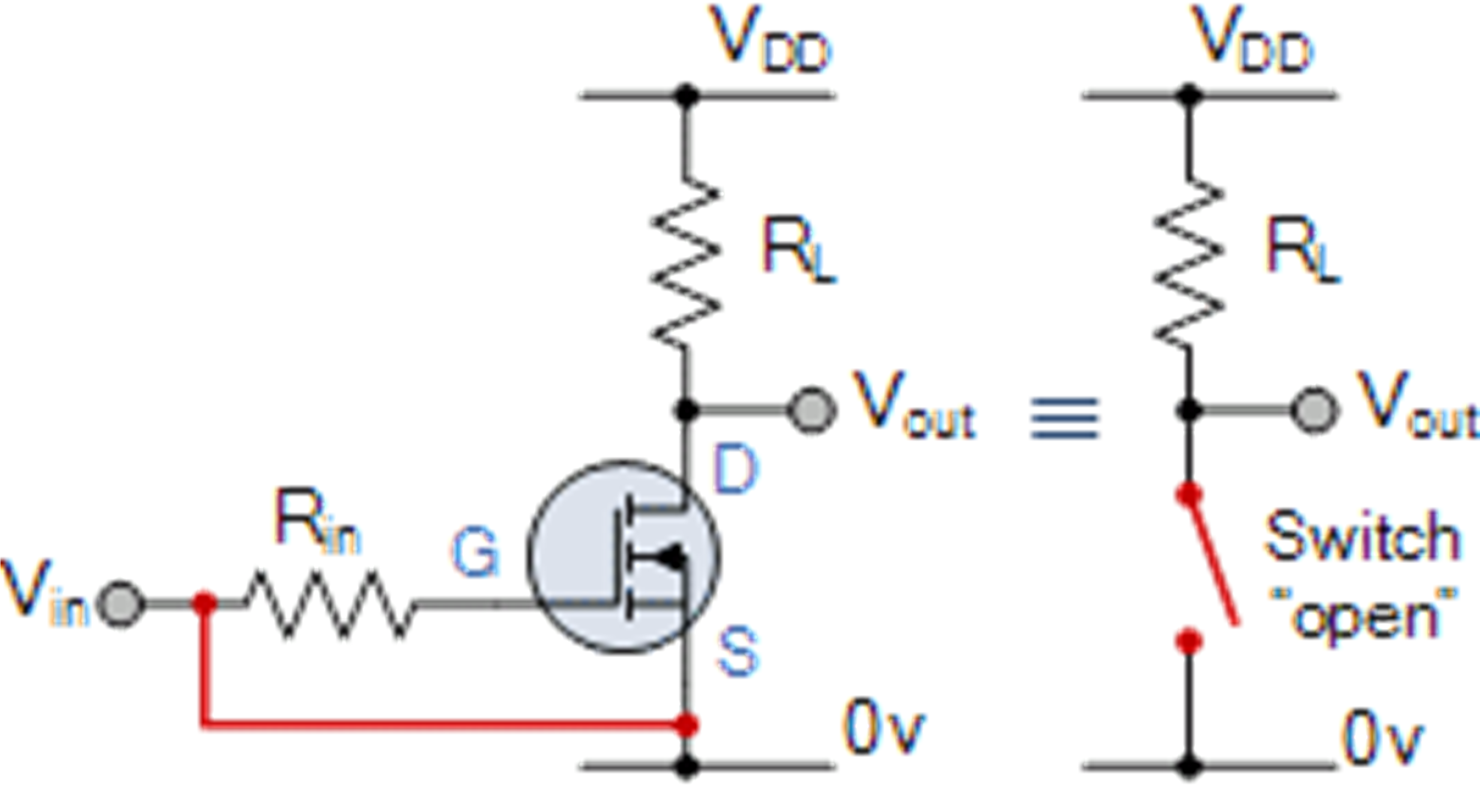
The MOSFET as a switch
5 · THE MOSFET AS A SWITCH
v_{GS} < V_{t}: cutoff. The switch is open and i_{D} = 0.
Figure: web source, via the original lecture slides
ELEC1 · Lecture 3 · MOSFETs
68

Slide 69
The MOSFET as a switch
5 · THE MOSFET AS A SWITCH
v_{GS} < V_{t}: cutoff. The switch is open and i_{D} = 0.
v_{GS} high and v_{DS} small: deep triode. The switch is closed, with a small resistance r_{DS}.
Figure: web source, via the original lecture slides
ELEC1 · Lecture 3 · MOSFETs
69

Slide 70
The MOSFET as a switch
5 · THE MOSFET AS A SWITCH
v_{GS} < V_{t}: cutoff. The switch is open and i_{D} = 0.
v_{GS} high and v_{DS} small: deep triode. The switch is closed, with a small resistance r_{DS}.
Driving the gate between these two states is the basis of digital logic.
Figure: web source, via the original lecture slides
ELEC1 · Lecture 3 · MOSFETs
70

Slide 71
Summary: three regions of operation
LECTURE 3 · SUMMARY
REGION
CONDITION
DRAIN CURRENT
Cutoff
v_{GS} ≤ V_{t}
$$i_{D}=0$$
Triode
v_{GS} > V_{t}, v_{DS} < v_{GS} − V_{t}
$$i_{D}=k_{n}^{′}\frac{W}{L}\left[(v_{GS}−V_{t})v_{DS}−\frac{1}{2}v_{DS}^{2}\right]$$
Saturation
v_{GS} > V_{t}, v_{DS} ≥ v_{GS} − V_{t}
$$i_{D}=\frac{1}{2}k_{n}^{′}\frac{W}{L}(v_{GS}−V_{t})^{2}$$
DC problems: assume a region, solve, then check the assumption.
Small signals: g_{m} = k′_{n}(W/L)(V_{GS} − V_{t}); a common-source stage has A_{v} = −g_{m}R_{D}.
ELEC1 · Lecture 3 · MOSFETs
71

Slide 72
Thank you
NEXT LECTURE
Lecture 4: Bipolar junction transistors (BJTs)
With thanks to Dr. Sameh Osama Ezzat, who prepared the original material for this lecture.
Figures: Sedra & Smith, Microelectronic Circuits (Oxford University Press); other diagrams from web sources via the original slides.

