Slide 1



Starting in 15 minutes
Computer Engineering
Academic Year: 2025/2026
Semester: One
25CPES102
Electronics material and devices
Lecture 2
Metal-Oxide Semiconductor Field Effect Transistor `
Prepared by:
Dr. Sameh Osama Ezzat Abdellatif
PhD, Nano-semiconductor devices and photonics
Lecturer @ BUE
Start

Slide 2

Metal-Oxide Semiconductor Field Effect Transistor `

Slide 3
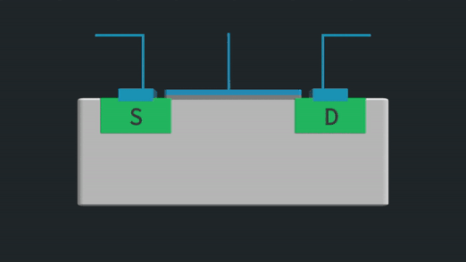
MOSFETs: Operation with no gate voltage

Slide 4
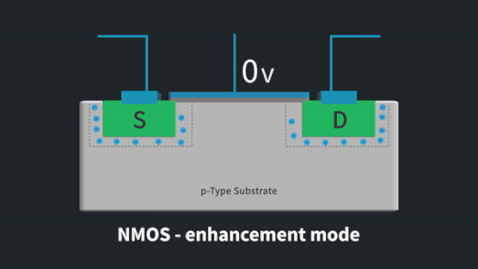
MOSFETs: Creating a channel for current flow
The value of VGS at which a sufficient number of electrons accumulate in the channel region to form a conducting channel is called the threshold voltage Vt.
inversion layer.

Slide 6
MOSFETs: Operation as V_{DS} is increased

Slide 7
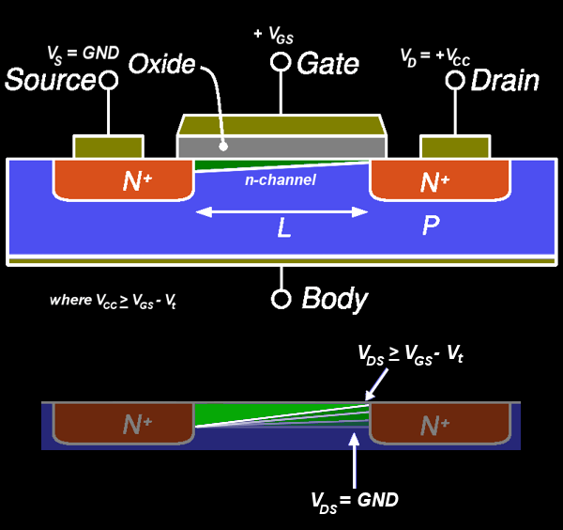
MOSFETs: Operation as V_{DS} is increased
When VGS-VDS = Vt or VDS = VGS-Vt, the channel depth at the drain end decreases to almost zero and the channel is said to be pinched off.

Slide 8
Complementary MOS or CMOS

Slide 9
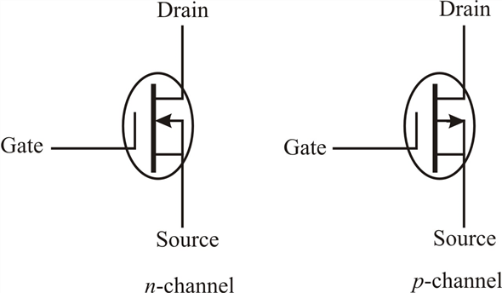
n-channel vs. p-channel MOSEFTs

Slide 10
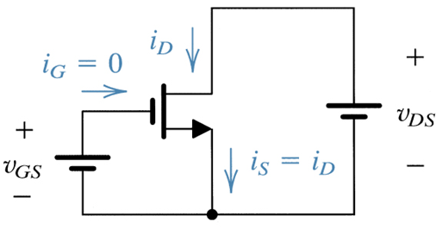
MOSFETs I-V curves

Slide 11

MOSFETs I-V curves

Slide 12
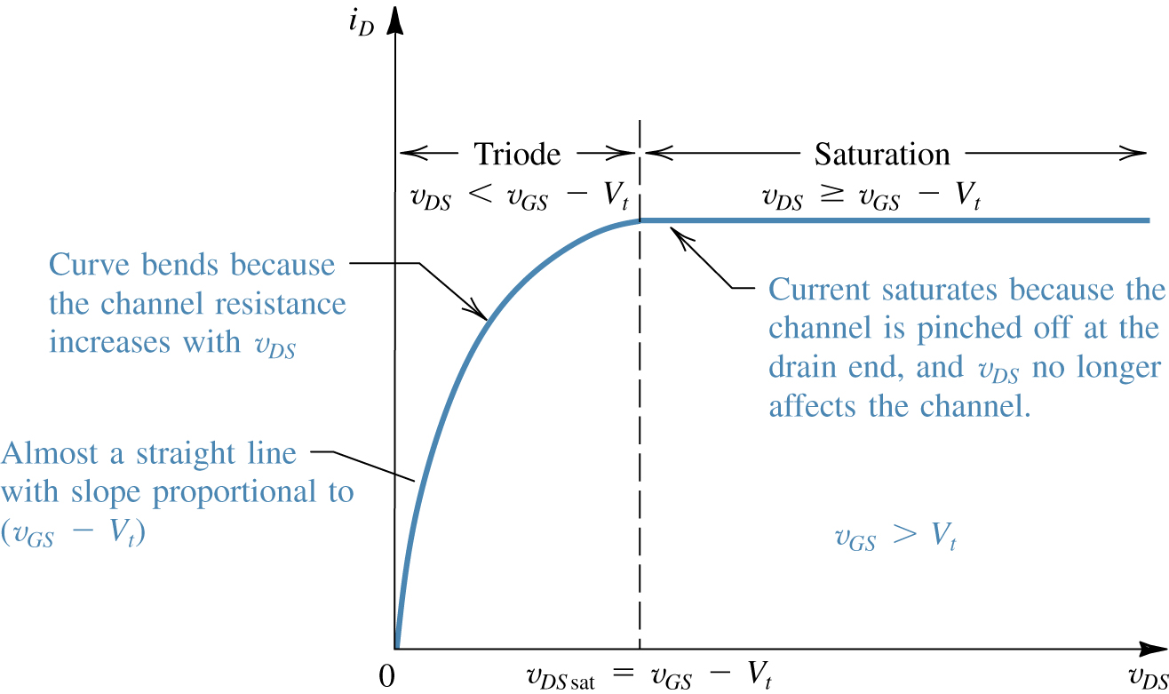


The I_{D}-V_{DS} characteristics: Triode region

Slide 13

The I_{D}-V_{DS} characteristics: Triode region

Slide 14

The I_{D}-V_{DS} characteristics: Saturation region

Slide 15
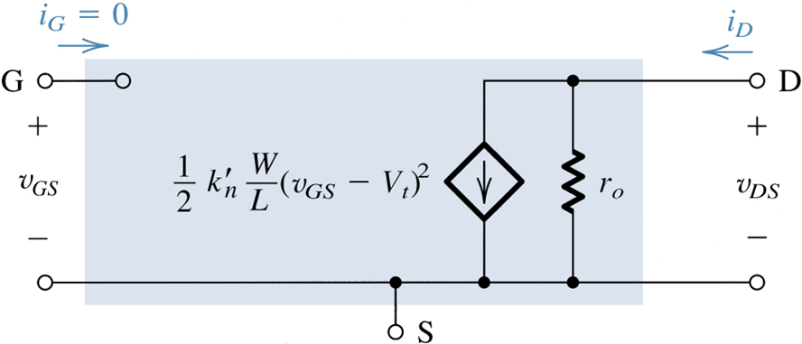
The I_{D}-V_{DS} characteristics: Saturation region

Slide 16
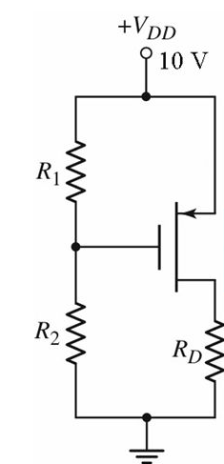
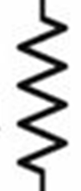
MOSFETs in DC Circuits
Ex:
For the shown circuit, calculate the drain voltage. Let V_{t} = 1 V,
= 1 mA / V².
6 KΩ
10 MΩ
10 MΩ
6 KΩ

Slide 17
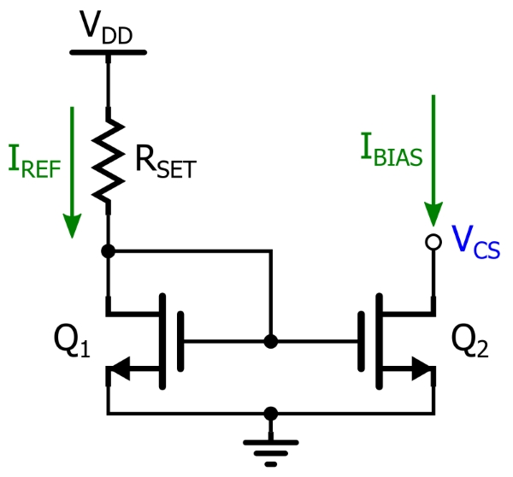
Current Mirror

Slide 18

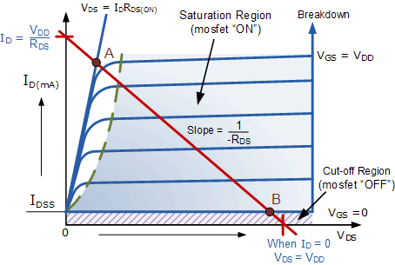
MOSFET as amplifier

Slide 19
MOSFET as a Linear amplifier
>>
The MOSFET transconductance

Slide 20
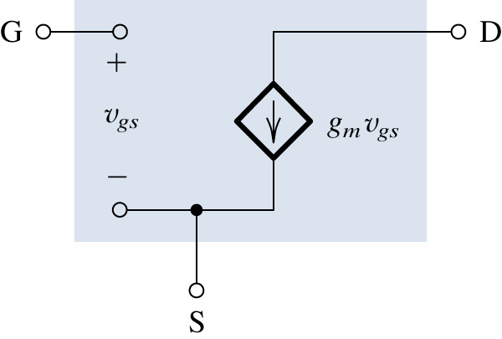
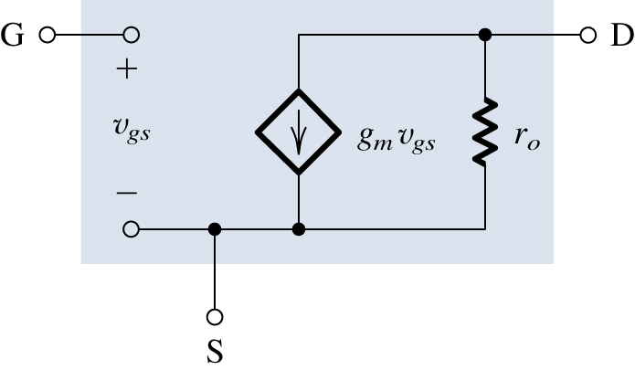
MOSFET as a Linear amplifier
The MOSFET transconductance

Slide 21
MOSFET as a Linear amplifier
Example:
For the shown amplifier, determine the small signal voltage gain and the input resistance. The transistor has V_{t} = 1.5 V,
, V_{A}= 50 V. Assume coupling capacitors to be sufficiently large so as to act as short circuits at the signal frequencies of interest.

Slide 22
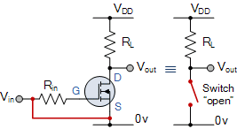
MOSFET as switch

Slide 23

Thank You
See You Next Lecture:
BJTs
18ELEC05H; Semiconductor devices, Dr. Sameh Osama

