Slide 1
Computer Architecture
Reference:
Hennessy and Patterson, “Computer Architecture: A Quantitative Approach”, Appendix C
Mano, “Computer System Architecture”, Chapter 9
Computer Architecture Module Content
Central Processing Unit Architecture
  Design Approaches [Stack – Pipelining – Interrupt – Processor Organization
– Registers Organization]
  Instruction Set Architecture [Instruction Format – Addressing modes –
Data Transfer and Manipulation]
  Example architectures (e.g. CISC, RISC)
Timing, Clock Parameters, and Processor Performance
Memory Hierarchy
  Main Memory
  Cache Memory
  Virtual Memory
2

Slide 2

Pipelining
Part: 1 Basics
  What is pipelining
  RISC and its five-stage pipeline
Part 2: Challenges: Pipeline Hazards
  Structural hazard
  Data hazard
  Control hazard
Part 3: Timing Analysis
What’s Pipelining
Laundry Example
Ann, Brian, Cathy, Dave
Each has one load of clothes to wash,
dry,
fold.
washer 30 mins
dryer 40 mins
folder 20 mins
Every task takes 90 min = 1.5 hr

Slide 3


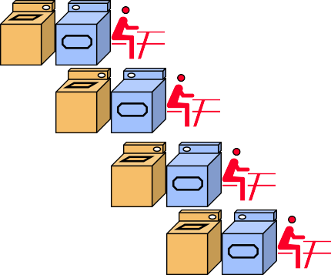
Sequential Laundry
6 Hours
Time
30 40 20 30 40 20 30 40 20 30 40 20
A
B
C D
Task Order
Pipelined Laundry
4 Hours
Time
40 40 40 40 40 40
A
B
C D
Task Order

Slide 4

Pipelined Laundry
4 Hours
40 40 40 40 40 40
Observations
Time
A task has a series of stages
Stage dependency: e.g., wash before dry
Multi-tasks with overlapping stages
Simultaneously use different resources to speed up
Slowest stage determines the finish time
Task Order
A
B
C D
Pipelining
Improve performance by increasing the throughput (the number of tasks per
second).
No speed-up in the individual task, Conversely
e.g., A takes 40 * 3 = 120 min
In the perfect case, the task will take the same time
But speed up the overall tasks time and the average task execution time:
  Speed up = 6 hrs /4 hrs = 1.5
  Average task execution time = 4 hrs / 4 tasks = 1 hr/task

Slide 5

Automotive Assembly Line
Pipelining
The name "pipeline" implies a flow of information similar to an industrial assembly line.
Several computations can be in progress in distinct segments at the same time.
The overlapping of computation is made possible by associating a register with each segment in the pipeline. The registers provide isolation between each segment so that each can operate on distinct data simultaneously.

Slide 6
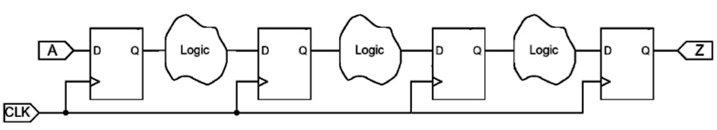
Implementation Technique in Digital Systems
Determine the number of pipeline segments (pipeline stages)
  Try to balance the pipeline (Equal-length pipe stages)
Save the output of each segment to avoid data overlap
→ use registers between pipeline segments/stages
Determine the stage period. It specifies the clock period and the maximum frequency
→ Longest segment
Pipelining
The simplest way of viewing the pipeline structure is to imagine that each segment consists of an input register followed by a combinational circuit. The register holds the data and the combinational circuit performs the sub-operation in the particular segment. The output of the combinational circuit in a given segment is applied to the input register of the next segment.
A clock is applied to all registers after enough time has elapsed to perform all segment activity.
In this way the information flows through the pipeline one step at a time.
Segment 1 Segment 2 Segment 3
Segment 4

Slide 7
Speed-up
^{𝑪𝑷𝑼}𝒏𝒐𝒏−𝒑𝒊𝒑𝒆𝒍𝒊𝒏𝒆𝒅
Speed-up = =
^{𝒕}𝒏 ₌ ^{𝒏 × 𝑻}𝒏𝒐𝒏−𝒑𝒊𝒑𝒆𝒍𝒊𝒏𝒆𝒅/𝒐𝒏𝒆_𝒕𝒂𝒔𝒌
𝒕_{𝒑} 𝒌+𝒏−𝟏 ×𝒕_{𝐜𝐥𝐤}
^{𝑪𝑷𝑼}𝒑𝒊𝒑𝒆𝒍𝒊𝒏𝒆𝒅
where k = no. pipeline segments (stages), n = no. of tasks
Best Case:
For large number of instructions (i.e. Tasks) and with best pipeline balance
𝐒𝐩𝐞𝐞𝐝𝐮𝐩
𝒎𝒂𝒙.
_{= 𝒌 =} 𝑡_{𝑛 =} non−pipelined clock period ₌ 𝑇_{𝑛}
𝑡_{𝑝} pipelined clock period
𝑇_{𝑛}
𝑘
Pipelining Types
Arithmetic Pipeline
Instruction Pipeline

Slide 8

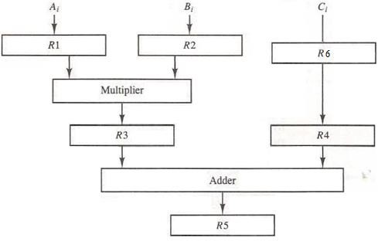
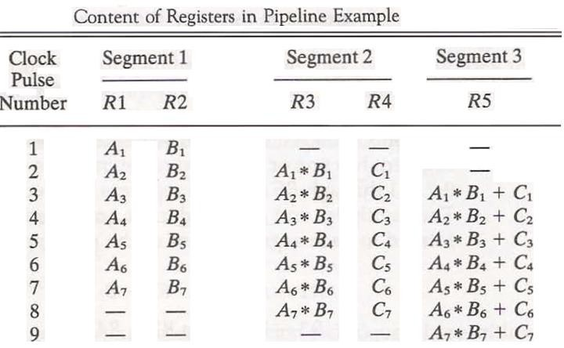
Arithmetic Pipeline Example1
Suppose that we want to perform the combined multiply and add operations with a stream of numbers.
  List the contents of all registers in the pipeline for i = 1 through 7
Arithmetic Pipeline Example1
R6
C1 C2 C3 C4 C5 C6 C7
-
-
3 segment , 7 tasks → 3 + (7-1) = 9 clock cycles

Slide 9
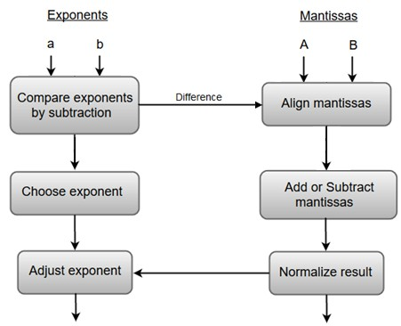
Arithmetic Pipeline Example2
Pipeline for floating-point addition and subtraction. X = A * 2ª
Y = B * 2^{b}
i.e.
X = 100010 * 2¹⁰¹ , Y = 10100 * 2¹¹¹
X = 100010 * 2¹⁰¹ , Y = 1010000 * 2¹⁰¹
shifting
X + Y = 1110010 * 2¹⁰¹
X + Y = 111001 * 2¹¹⁰
Arithmetic Pipeline Example2
Pipeline for floating-point addition and subtraction. X = A * 2ª
Y = B * 2^{b}
20 ns
5 ns
Min. period = 62 ns
2 ns
20 ns
2 ns
15 ns
Notes:
Floating-Point Representation
In floating-point representation, numbers are expressed as:
$$X=A×2^{a}, Y=B×2^{b}$$
where:
$A$and $B$are the significands (or mantissas)
$a$and $b$are the exponents
Example Values
Given:
$$X=100010×2^{101}$$
$$Y=10100×2^{111}$$
This can be interpreted as:
$$X=34×2^{5}$$
$$Y=20×2^{7}$$
Step-by-Step Pipeline for Addition
1. Normalize the Exponents
Before adding, the exponents must be aligned. The greater exponent will dictate the normalization process.
Current Exponents:
$a=101$(5 in decimal)
$b=111$(7 in decimal)
Since $b>a$, we need to shift $A$to match the exponent of $Y$:
$$A→A×2^{\left(111−101\right)}=100010×2^{101}→100010×2^{101}→100010×2^{110} \text{(}\text{Shift} \text{right} \text{by} \text{1}\text{)}$$
Now we have:
$$X=100010×2^{110}$$
$$Y=10100×2^{111}$$
2. Adjust the Representation
Now the two numbers can be represented as:
$$X=100010×2^{110}$$
$$Y=10100×2^{111}$$
Align the significands so they are on the same exponent:
Convert $Y$to the same exponent as $X$:
$$Y→Y×2^{−1}=10100×2^{111}→10100×2^{110}$$
Now:
$$X=100010×2^{110}$$
$$Y=10100×2^{110}$$
3. Add the Significands
Now that the exponents are aligned:
$$X+Y=\left(100010+10100\right)×2^{110}$$
Performing the addition between $A$and $B$:
$$100010+10100=111110$$
So,
$$X+Y=111110×2^{110}$$
Summary of Results
Intermediate Step:
Align $Y$to $X$:
$$X=100010×2^{110}$$
$$Y=10100×2^{110}$$
Final Step:
After addition:
$$X+Y=111110×2^{110}$$

Slide 10
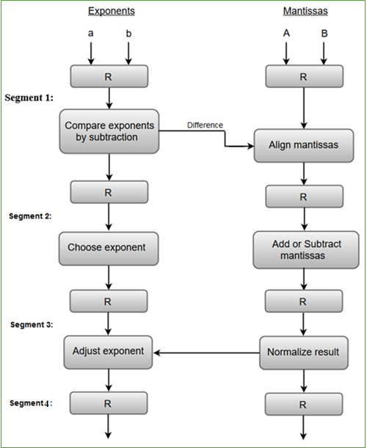
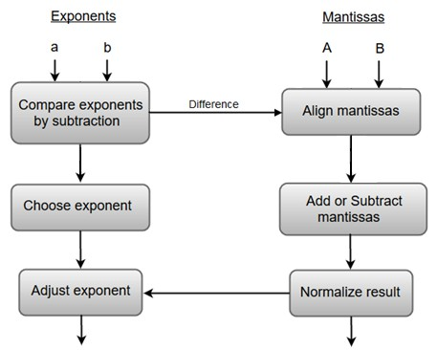
Arithmetic Pipeline Example2
Pipeline for floating-point addition and subtraction.
Arithmetic Pipeline Example2
Determine the maximum frequency:
20 ns
5 ns
Segment timing:
Compare Exp.+ Align = 25
Choose exponent // Add/sub = 20
Adjust + Normalize = 17
2 ns
20 ns
Min. period = 25 ns
Max. Frequency = 40 MHz
2 ns
15 ns

Slide 11
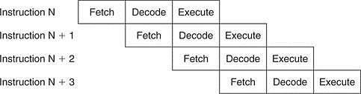
Instruction Pipeline Example
RISC and its five-stage Pipeline Architecture (Instruction Pipeline)

Slide 12





RISC: Reduced Instruction Set Computer
5 clock cycles per instruction
IF ID EX MEM WB
Instruction Fetch cycle: IF
  send the PC to memory
  fetch the current instruction from mem;
  PC = PC + 4; //each instruction is 4 bytes
Instruction Decode/register fetch cycle: ID
  decode the instruction
  read the registers (corresponding to register source specifiers).
RISC: Reduced Instruction Set Computer
Execution/effective address cycle: EX
ALU operates on the operands from ID, 3 functions depending on the instruction type
  Memory reference: ALU adds base register and offset to form effective address
  Register-Register ALU instruction: ALU performs the operation specified by opcode on the values read from the register file.
  Register-Immediate ALU instruction: ALU operates on the first value read from
the register file and the sign-extended immediate.
5 clock cycles per instruction
IF ID EX MEM WB

Slide 13


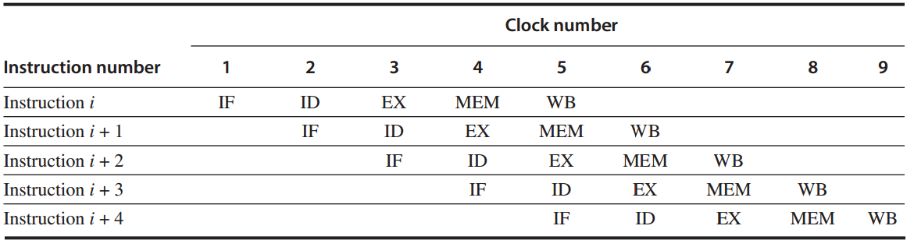
RISC: Reduced Instruction Set Computer
5 clock cycles per instruction
IF ID EX MEM WB
MEMory access MEM
  for load instruction: the memory does a read using the effective address.
  for store instruction: the memory writes the data from the second register using the effective address.
Write-Back cycle WB
  for Register-Register ALU or load instruction.
  Write the result into the register file, whether it comes from the memory (for load) or from the ALU (for ALU instruction).
RISC: Reduced Instruction Set Computer
Introduce pipeline registers between successive stages. To store the results of a stage and use them as input for the next stage.
Speedup = 5
Notes:
Instruction Cycle Stages
1. Instruction Fetch Cycle (IF)
Purpose: Retrieve the instruction that will be executed.
Steps:
Send the Program Counter (PC) to Memory: The address stored in the PC is sent to the memory to fetch the instruction.
Fetch the Current Instruction: The instruction at the memory location specified by the PC is retrieved.
Update the PC: The PC is incremented by 4 (assuming each instruction is 4 bytes long) to point to the next instruction:
$$\text{PC}=\text{PC}+4$$
2. Instruction Decode/Register Fetch Cycle (ID)
Purpose: Decipher the fetched instruction and access the necessary registers.
Steps:
Decode the Instruction: The control unit decodes the instruction to determine the operation and the registers involved.
Read the Registers: The values from the source registers indicated by the instruction are read from the register file.
3. Execution/Effective Address Cycle (EX)
Purpose: Perform the arithmetic operation or determine the effective address for memory accesses.
Steps:
ALU Operations: The Arithmetic Logic Unit (ALU) performs operations based on the instruction type:
Memory Reference: For instructions that require memory access (like Load or Store), the ALU computes the effective address by adding a base register value to an offset.
Register-Register ALU Instruction: The ALU executes the operation specified by the opcode on the values obtained from the register file.
Register-Immediate ALU Instruction: ALU operates on the value from the register file and a sign-extended immediate value.
4. Memory Access Cycle (MEM)
Purpose: Access memory for load or store operations.
Steps:
For Load Instructions:
Perform a read operation using the effective address calculated in the EX stage. The data from memory is fetched.
For Store Instructions:
Write the value from the specified register to the memory location determined by the effective address.
5. Write-Back Cycle (WB)
Purpose: Store the result of an operation back into the register file.
Steps:
Write to Register File:
For Register-Register ALU Instructions: Write the result from the ALU back to the specified register.
For Load Instructions: Write the data fetched from memory into the appropriate register.
Summary of the Instruction Cycle
IF Phase: Fetch the instruction and increment the PC.
ID Phase: Decode the instruction and read the corresponding registers.
EX Phase: Execute the operation or compute the effective address.
MEM Phase: Access memory for load or store operations.
WB Phase: Write the result back to the register file.
Example Instruction Flow
Let’s take an example of a simple load instruction LOAD R1, 0(R2):
IF: Fetch the instruction from memory where the PC points.
ID: Decode this instruction to determine that we need to load into R1 and use R2 as the base address with an offset of 0.
EX: Calculate the effective address using the value in R2.
MEM: Access memory at the calculated effective address to retrieve the data.
WB: Write the loaded data into register R1.
This structured approach ensures that the CPU can process instructions efficiently and effectively in a pipelined fashion. If you need more specific details or clarifications, let me know!

Slide 14
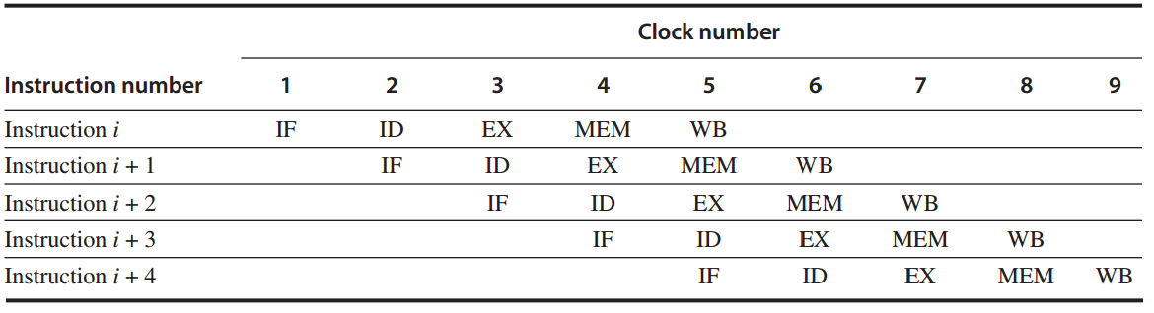
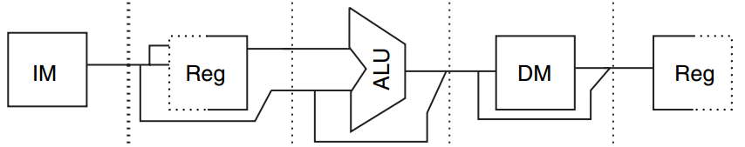

RISC: Reduced Instruction Set Computer
RISC: Reduced Instruction Set Computer
Implementation:
  Separate instruction and data memories to eliminate conflicts for a single memory between instruction fetch and data memory access.
Instr. mem
Data mem
IF
MEM

Slide 15

RISC: Reduced Instruction Set Computer
RISC: Reduced Instruction Set Computer
Implementation:
  Use the register file in two stages, either with half Clock Cycle (in one clock cycle,
write before read).
ID
read
WB
write
Notes:
ISC: Reduced Instruction Set Computer
A Reduced Instruction Set Computer (RISC) is a type of computer architecture that utilizes a small set of simple instructions. RISC designs focus on executing instructions in a single cycle and often use pipelining to improve performance.
Implementation of RISC with Register File in Two Stages
To achieve efficient instruction execution, RISC architectures often implement a register file that can be accessed in two stages. This allows for reading and writing registers within the same clock cycle, improving instruction throughput.
Key Concepts
Register File:
A collection of registers available for CPU operations.
Allows for quick access to operands needed for instructions.
Two-Stage Access:
This implementation allows one half of the clock cycle to be dedicated to writing to a register while the other half is used for reading from a register. This "write before read" approach helps maximize throughput.
How It Works
1. Stages of Register File Access:
Stage 1: Write Operation
During the first half of the clock cycle, the CPU writes data to a specified register.
Once the ALU or memory has computed the result of the previous instruction, that result can be written back to the register file in this stage.
Stage 2: Read Operation
In the second half of the clock cycle, the CPU can read data from another register for the next operation or instruction.
This ensures that operands required for the next instruction are available without waiting for the write operation to complete.
2. Timing Diagram:
A basic timing diagram for the two-stage register access can illustrate how these operations overlap during a single clock cycle.
gherkin
Clock Cycle: |---|---|---|---|---|---|---|---| (Each "-" represents equal time)
| W | | | | R | | |
| r | | | | e | | |
| i | | | | a | | |
| t | | | | d | | |
| | | | | | | |
Where:
W represents writing to the register.
R represents reading from the register.
3. Pipeline Example:
Let’s consider a sequence of instructions using this two-stage implementation:
Instruction 1: ADD R1, R2, R3
This adds the values in R2 and R3, storing the result in R1.
Instruction 2: SUB R4, R1, R5
This instruction needs the result from the previous instruction which is stored in R1.
Execution Flow:
During the first clock cycle, R1 is updated with the sum of R2 and R3.
In the second half of the same cycle, the CPU can read R1, which is ready for the SUB instruction in the next cycle.
Benefits of Two-Stage Register File Access
Increased Throughput: By performing write and read operations in the same clock cycle, instructions can complete more quickly.
Reduced Latency: It minimizes the wait time for results from previous instructions, allowing for a smoother pipeline flow.
Efficient Resource Usage: The RISC architecture focuses on efficient use of register resources, maintaining a small and fast register file.
Conclusion
The implementation of a two-stage register access in RISC architecture enhances performance by allowing register writes and reads to overlap within the same clock cycle. This approach effectively utilizes pipeline methodologies to optimize the execution of instructions, contributing to the overall efficiency and effectiveness of the RISC design.
If you have any more questions or need further clarification, feel free to ask!

Slide 16
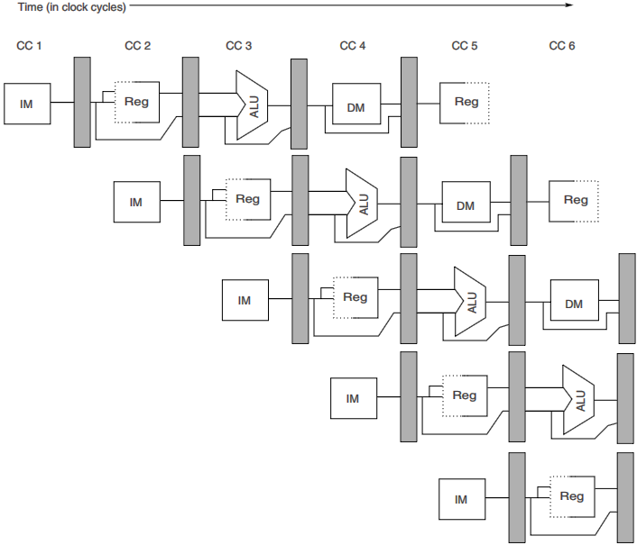
RISC:

