Slide 1
Computer Architecture
Reference:
Hennessy and Patterson, “Computer Architecture: A Quantitative Approach”, Appendix C
Mano, “Computer System Architecture”, Chapter 9
Computer Architecture Module Content
Central Processing Unit Architecture
  Design Approaches [Stack – Pipelining – Interrupt – Processor Organization
– Registers Organization]
  Instruction Set Architecture [Instruction Format – Addressing modes –
Data Transfer and Manipulation]
  Example architectures (e.g. CISC, RISC)
Timing, Clock Parameters, and Processor Performance
Memory Hierarchy
  Main Memory
  Cache Memory
  Virtual Memory
2

Slide 2
Pipelining
Part: 1 Basics
  What is pipelining
  RISC and its five-stage pipeline
Part 2: Challenges: Pipeline Hazards
  Structural hazard
  Data hazard
  Control hazard
Part 3: Timing Analysis / Clock Parameters
Pipeline Hazards

Slide 3
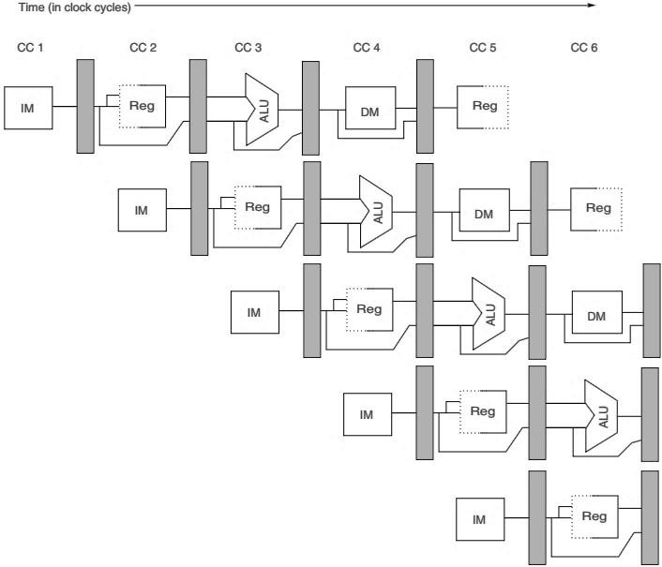
RISC Pipelining
Pipeline Hazards
Hazards: situations that prevent the next instruction from executing in the designated clock cycle.
3 classes of hazards:
  Structural hazard – resource conflicts
  Data hazard – data dependency
  Control hazard – PC changes (e.g., branches)
Notes:
Hazards in a pipelined architecture can significantly impact the performance of a CPU by preventing instructions from executing during their intended clock cycles. Let's dive deeper into the three classes of hazards: structural hazards, data hazards, and control hazards.
1. Structural Hazards
Definition:
Structural hazards occur when two or more instructions in the pipeline require the same hardware resource at the same time. This can happen if the architecture does not have enough resources to support simultaneous operations.
Example:
Scenario: If a CPU has only one memory port, it cannot fetch a new instruction while also accessing memory to load or store data.
Impact: If an instruction needs to read from memory while another is trying to fetch the next instruction, one of them must wait, creating a stall in the pipeline.
Mitigation:
Add additional resources: Increase the number of memory ports or replicate functional units.
Resource scheduling: Use scheduling algorithms to manage resource allocation dynamically.
2. Data Hazards
Definition:
Data hazards arise from data dependencies between instructions. They occur when an instruction depends on the result of a previous instruction that has not yet completed.
Types of Data Hazards:
Read After Write (RAW): An instruction is trying to read a value before it has been written by a previous instruction.
Write After Read (WAR): An instruction writes to a location before a previous instruction reads from it (usually occurs in out-of-order execution).
Write After Write (WAW): Two instructions write to the same location; the order of these writes must be preserved.
Example:
Scenario:
ADD R1, R2, R3 (R1 = R2 + R3)
SUB R4, R1, R5 (R4 = R1 - R5)
If the SUB instruction executes before the ADD instruction has finished writing to R1, it will use an incorrect value.
Mitigation:
Data forwarding: Use an additional pathway to send the result of an instruction directly to later stages in the pipeline without writing to the register file first.
Stalling: Introduce bubbles (no-operation instructions) in the pipeline to wait until the data is ready.
3. Control Hazards
Definition:
Control hazards, also known as branch hazards, occur when the pipeline makes wrong assumptions about the flow of control (for example, due to a branch instruction). This happens when the next instruction to be executed depends on the outcome of a branch instruction.
Example:
Scenario:
BEQ R1, R2, LABEL (Branch if R1 equals R2)
If the condition is met, the program counters need to jump to LABEL, changing the flow of instruction execution.
The pipeline may continue executing instructions following the BEQ, which may not be correct.
Mitigation:
Branch prediction: Guess whether a branch will be taken or not and preload the predicted path.
Delayed branching: Include both the branch instruction and the next sequential instruction to execute if the branch is taken.
Flushing the pipeline: If a branch prediction is incorrect, discard the incorrectly fetched instructions and fetch the correct ones.
Conclusion
Understanding and managing hazards are crucial for optimizing the performance of pipelined architectures. By recognizing structural, data, and control hazards, and implementing strategies to mitigate them, computer architects can enhance instruction throughput and overall efficiency.
If you need more details or specific examples for any of these points, let me know!

Slide 4
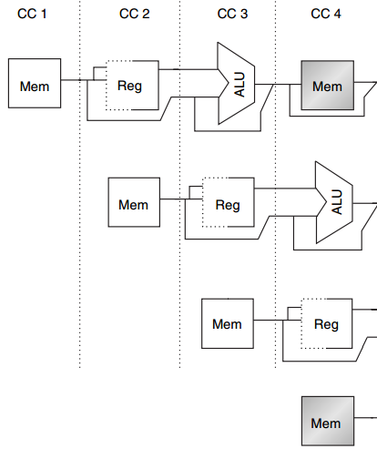
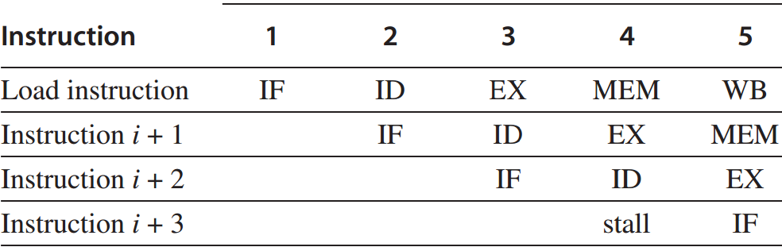
1. Structural Hazard
Example: 1 memory port, memory conflict
MEM
Load
Instr i+1
Instr i+2
data access vs
instruction fetch
Instr i+3
IF
1. Structural Hazard
After each Load/Store instruction, Stop (instruction i+3) for one clock cycle

Slide 5
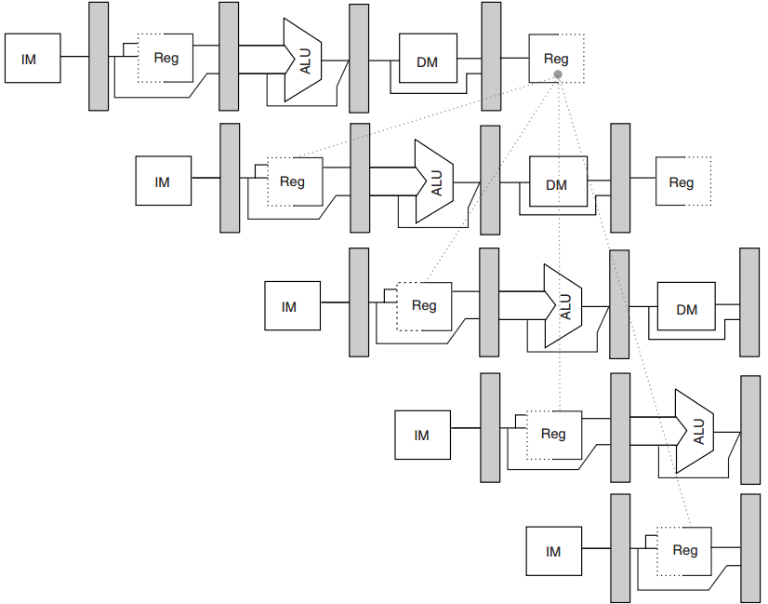
Structural Hazard
  Root Cause: resource conflicts/lack of resources
  Solution
    stall one instruction until the required unit is available
    Add Resources
2. Data Hazard
R1
ADD R1, R2, R3
SUB R4, R1, R5 AND R6, R1, R7
OR R8, R1, R9
No hazard
1st half cycle: w 2nd half cycle: r
XOR R10, R1, R11

Slide 6
2. Data Hazard
EX/MEM
R1
ADD R1, R2, R3
SUB R4, R1, R5
AND R6, R1, R7
OR R8, R1, R9 XOR R10, R1, R11
2. Data Hazard
MEM/WB
ADD R1, R2, R3
R1
SUB R4, R1, R5
AND R6, R1, R7
OR
R8, R1, R9
XOR
R10, R1, R11
6

Slide 7
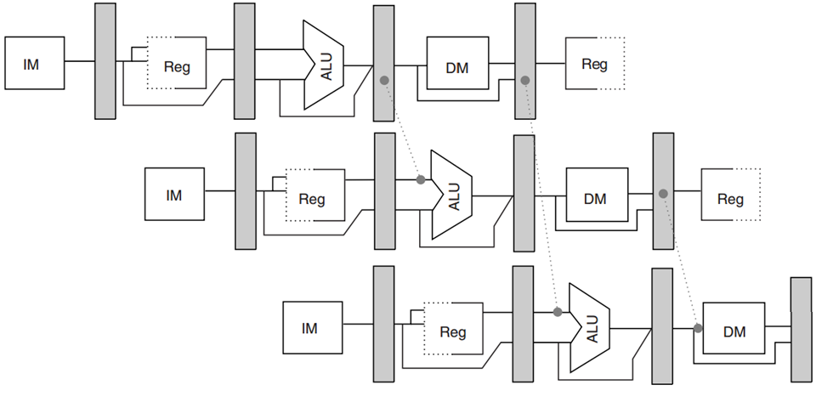
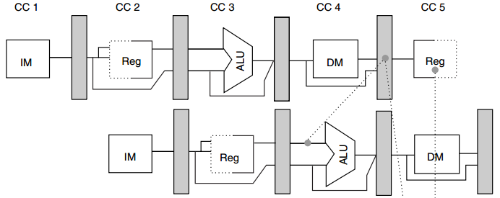








2. Data Hazard
forward results to not only ALU inputs but also other types of functional units
ADD R1, R2, R3
R1
R1
R4
LD R4, 0(R1)
R1
SD R4, 12(R1)
R1
R4
Data Hazard
  Sometimes stall is necessary
MEM/WB R1
LD R1, 0(R2)
R1 ← M[R2+0]
SUB R4, R1, R5
R1
Forwarding cannot be backward. It has to stall.
7

Slide 8
Data Hazard
  Root Cause: data dependency
  Solution:
    Stall
    Forwarding
    Delay load
Data Hazard: Solutions
  Stall (hardware interlocks)
    The most straightforward method is to insert hardware interlocks. An interlock is a circuit that detects instructions whose source operands are destinations of instructions farther up in the pipeline.
    Detection of this situation causes the instruction whose source is not available to be delayed by enough clock cycles to resolve the conflict.
    This approach maintains the program sequence by using hardware to insert the required delays.
    Sometime only stall can solve the data hazards
Notes:
Let’s delve deeper into the techniques for addressing hazards in pipelines, specifically focusing on stalls, operand forwarding, delayed load, and handling branches and jumps.
1. Stall (Hardware Interlocks)
Definition:
A stall introduces a delay in the instruction pipeline when a data hazard is detected. This technique leverages hardware interlocks to maintain the program's correct execution sequence.
How It Works:
Detection: The interlock circuitry monitors the pipeline stages for situations where an instruction's source operands are not yet available because they are results of earlier instructions still being processed.
Stalling: When a conflict is detected, the instruction needing the operand is delayed (stalled) for a sufficient number of clock cycles until the required data is written back to the registers.
Example:
Scenario:
ADD R1, R2, R3 (R1 = R2 + R3)
SUB R4, R1, R5 (R4 = R1 - R5)
If SUB is ready to execute before ADD completes, the interlock will stall SUB until ADD finishes and writes to R1.
2. Operand Forwarding
Definition:
Operand forwarding (or data forwarding) is a technique to eliminate data hazards by routing the results of instructions directly to the inputs of subsequent instructions without writing them back to the register file first.
How It Works:
Conflict Detection: Hardware checks if the destination operand of an earlier instruction is needed as a source operand in a subsequent instruction.
Data Routing: If a conflict is detected, the result from the pipeline stage generating the data can bypass the register file and be forwarded directly to the ALU or other functional units.
Example:
Scenario:
ADD R1, R2, R3
SUB R4, R1, R5
Instead of waiting for R1 to be written back to the register file before SUB can execute, the result of ADD is forwarded directly to the inputs of the ALU being used for SUB.
Hardware Requirements:
Additional multiplexers (MUX) to select between the routing paths for the operands.
Suitable conflict detection logic to enable forwarding paths.
3. Delayed Load
Definition:
The delayed load strategy shifts the responsibility for handling data hazards from the hardware to the compiler.
How It Works:
Compiler Role: The compiler detects possible data hazards during the instruction scheduling phase and reorders the instructions to avoid conflicts.
No-Operation Instructions: When a potential hazard is identified, the compiler may insert no-operation (NOP) instructions to delay the execution of a load instruction until the data it depends on is available.
Example:
Scenario:
Original sequence:
LOAD R1, 0(R2)
ADD R3, R1, R4
The compiler can detect that ADD depends on the LOAD operation. It can rearrange the instructions or insert NOPs, turning the sequence into:
LOAD R1, 0(R2)
NOP
NOP
ADD R3, R1, R4
4. Branches and Jumps
Definition:
Branches can introduce control hazards in pipelined architectures, affecting the program counter (PC). There are two main outcomes for branches: taken and untaken.
Branch Hazards:
Taken Branch: If the branch condition is true, the PC is changed to the target address specified by the branch instruction.
Example: In the instruction BEQ R1, R2, LABEL, if R1 equals R2, the PC updates to LABEL.
Untaken Branch: The branch does not alter the flow, and the next sequential instruction after the branch is executed.
Example: If the branch condition fails, execution continues with the instruction following the branch.
Handling Branch Hazards:
Branch Prediction: Predict the outcome of a branch instruction to prefetch instructions.
Branch Delay Slot: Some architectures allow a few instructions to execute after a branch instruction regardless of the branch taken or not, minimizing stalls.
Flushing the Pipeline: If the prediction is incorrect, the incorrect instructions are flushed from the pipeline, and the correct ones are fetched.
Conclusion
Hazard management is crucial for maintaining high performance in pipelined architectures. Techniques like stalls, operand forwarding, delayed load, and carefully managed branch operations help mitigate the negative impacts of hazards. Understanding and implementing these strategies allows for more efficient instruction execution and improved CPU throughput.
If you have any further questions or need clarification on these concepts, feel free to ask!

Slide 9
Data Hazard: Solutions
  Operand Forwarding
    It uses special hardware to detect a conflict and then avoid it by routing the data through special paths between pipeline segments.
    For example, the hardware checks the destination operand, and if it is needed as a source in the next instruction, it passes the result directly into the ALU input.
    This method requires additional hardware paths through multiplexers as well as the circuit that detects the conflict.
    In the same way, it directly feeds any other functional unit.
Data Hazard: Solutions
  Delayed load
    It gives the responsibility for solving data conflict problems to the compiler that translates the high-level programming language into a machine language program.
    The compiler for such computers is designed to detect a data conflict and reorder the instructions as necessary to delay the loading of the conflicting data by inserting no-operation instructions.

Slide 10
Control Hazard
  Branches and jumps
  Branch Hazard: a branch may or may not change PC
Taken branch: changes PC to its target address
Untaken branch: falls through (in-line addressing)
Branch Hazard: Solutions
  Freeze the pipeline, hold or delete instructions after the branch till the branch destination is known.
  Branch prediction
    Predicted-untaken, treat every branch as untaken.
    Predicted-taken, treat every branch as taken.
  Delayed branch
  Prefetch target Instruction

Slide 11
Branch Hazard: Solutions
  Branch prediction
    A pipeline with branch prediction uses some additional logic to guess the outcome of a conditional branch instruction before it is executed.
    The pipeline then begins prefetching the instruction stream from the predicted path.
    A correct prediction eliminates the wasted time caused by branch penalties.
Branch Hazard: Solutions
  Delayed branch
    In this procedure, the compiler detects the branch instructions and rearranges the machine language code sequence by inserting useful instructions that keep the pipeline operating without interruptions.
Notes:
Branch Hazards
Definition:
Branch hazards occur in pipelined architectures when the flow of execution can change due to a branch instruction. The pipeline may have already started fetching subsequent instructions before determining whether the branch will be taken or not.
Types of Branches:
Taken Branch: The program counter (PC) changes to the target address specified by the branch instruction.
Untaken Branch: The PC continues to the next sequential instruction.
Handling Branch Hazards
1. Freeze the Pipeline
When a branch instruction is encountered:
The pipeline may be frozen, meaning that instructions following the branch are held or deleted until the branch destination is known.
This avoids executing incorrect instructions but introduces a delay (or stall) in the pipeline, which can reduce performance.
2. Branch Prediction
Idea: To improve performance, modern processors implement branch prediction techniques, allowing for a more efficient handling of branch instructions.
Strategies:
Predicted-Untaken: Assume that every branch will not be taken. The processor continues fetching the next sequential instruction.
Impact: This can lead to performance penalties if the prediction is wrong, as it may need to flush already fetched incorrect instructions.
Predicted-Taken: Assume that every branch will be taken. The processor fetches and prepares to execute instructions from the target address.
Impact: If the prediction is correct, it reduces branch penalties. If wrong, the pipeline still needs to be flushed.
Benefits of Branch Prediction:
Reduced Latency: Correct predictions mean fewer stalls.
Increased Throughput: Helps keep the pipeline full, improving overall instruction execution rates.
3. Delayed Branch
Definition: This technique relies on the compiler's ability to reorder instructions in a way that minimizes disruptions caused by branches.
How It Works:
The compiler analyzes the program and identifies branch instructions.
It rearranges the instruction sequence, inserting useful instructions (that can be executed without waiting for the branch outcome) into the “branch delay slots.” These slots are the instructions that follow the branch.
Example:
Consider the following sequence with a branch instruction:
BEQ R1, R2, LABEL
NOP (originally the next instruction)
If the compiler can insert useful computations that do not depend on whether the branch is taken or not, it would look like:
Original:
assembly
BEQ R1, R2, LABEL
ADD R3, R4, R5
After reordering (assuming ADD can be executed regardless of the branch):
assembly
BEQ R1, R2, LABEL
ADD R3, R4, R5 ; Useful instruction in the delay slot
Conclusion
Managing branch hazards effectively is crucial for optimizing the performance of pipelined processors. Techniques such as freezing the pipeline, branch prediction, and delayed branching help minimize the performance impact of branch instructions, ensuring smoother and more efficient instruction execution.
If you need further clarification on these strategies or any other related topics, feel free to ask!

Slide 12
Branch Hazard: Solutions
  Prefetch target Instruction
    Prefetch the target instruction in addition to the instruction following the branch. Both are saved until the branch is executed.
    If the branch condition is successful, the pipeline continues from the branch target instruction. An extension of this procedure is to continue fetching instructions from both places until the branch decision is made. At that time control chooses the instruction stream of the correct program flow.
Pipeline Hazards
Hazards solved by
  Software Solution
  Hardware Solution
Notes:
Prefetching Target Instructions
Definition:
Prefetching target instructions is a technique used in pipelined architectures to minimize the delay caused by branch instructions. By preloading both the target instruction and subsequent instructions, the pipeline can continue executing with minimal interruptions.
How it Works
Branch Instruction Detection:
When a branch instruction is encountered, the processor starts the prefetching process immediately.
Instruction Fetching:
Two streams of instructions are fetched:
The instruction at the branch target address.
The next sequential instruction that follows the branch.
Storing Prefetched Instructions:
Both fetched instructions are stored temporarily in a buffer until the branch condition is evaluated.
Branch Condition Evaluation:
Once the processor determines the outcome of the branch condition:
If the branch is taken (i.e., the condition is successful), the pipeline switches to the instruction at the target location.
If the branch is not taken (i.e., the condition fails), execution resumes with the instruction following the branch.
Extension: Dual Instruction Stream Fetching
In an enhanced version of this prefetching technique, the processor can continue fetching instructions from both the branch target and the following sequential address until the branch decision is finalized. Here’s how it works:
Branch Instruction Encountered:
Begin prefetching instructions from both the target and the following instruction address.
Simultaneous Fetching:
Continue fetching instructions from both directions:
Fetching the instruction stream from the target address.
Fetching the instruction stream of the next sequential instruction.
Decision Point:
When the branch condition is resolved:
Control logic selects the correct instruction stream based on the branch evaluation.
Advantages
Reduced Stalls: Minimizing delays associated with branch instructions helps maintain pipeline efficiency.
Increased Throughput: By prefetching, the processor can avoid idle cycles waiting for branches to resolve.
Better Instruction Flow: Ensures a smoother execution flow by having potential instructions ready as soon as the branch decision is made.
Example
Instruction Sequence:
Consider the following instructions:
assembly
BEQ R1, R2, LABEL ; Branch if R1 equals R2
ADD R3, R4, R5 ; Next sequential instruction
Prefetching:
On detecting BEQ, the processor starts to prefetch:
The instruction at LABEL.
The ADD instruction that follows.
Branch Resolution:
If R1 equals R2, execution will proceed with the fetched instruction at LABEL.
If the branch is not taken, the processor will execute the ADD instruction.
Conclusion
Prefetching target instructions is an effective technique for managing control hazards in pipelined architectures. By anticipating the outcome of branch instructions and preloading instructions from both potential execution paths, processors can significantly enhance performance and maintain efficient instruction flow.
If you have more questions or need additional examples, feel free to ask!

Slide 13
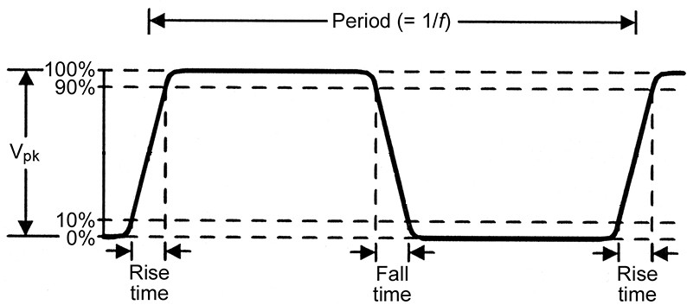
Timing Analysis / Clock Parameters
Clock Parameters
t_{r} : Rise time: The time for the waveform to rise from 10% to 90% of V_{peak}
t_{f} : Fall time: The time for the waveform to drop from 90% to 10% of V_{peak}

Slide 14
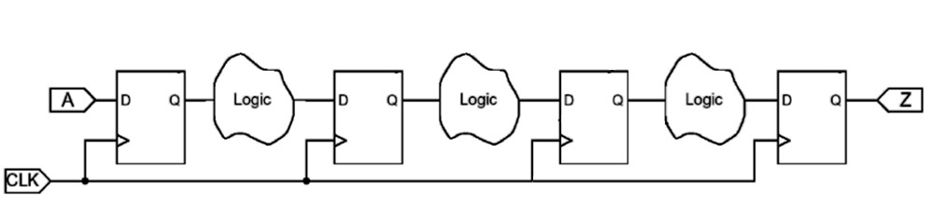
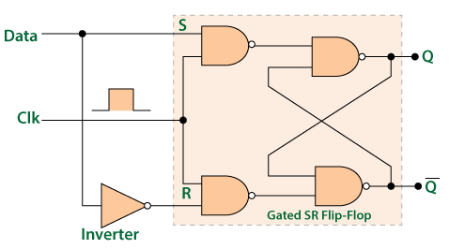
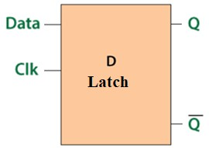
Timing Definitions
^{t}pd
t_{pd} = combinational circuit Propagation delay
Latch

Slide 15
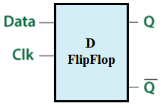
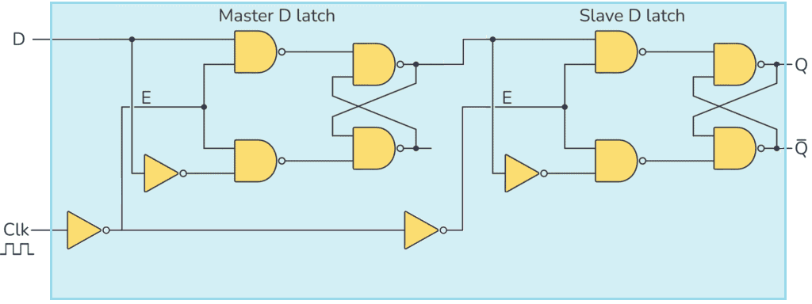
Register
Register Parameters
t_{cq} : Time after the clock edge for data to propagate from D to Q.
Setup time: Time data must be stable at the input before the clock edge comes.
Hold time: Time data must be held stable at input after the clock edge comes.

Slide 16
Register Parameters
^{T}period
Clk
^{t}hold
D
^{t}su
Q
^{t}c-q
Timing Definitions
^{t}pd
t_{pd} = combinational circuit Propagation delay

Slide 17
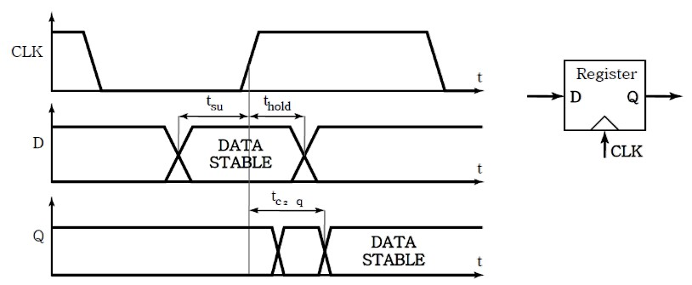
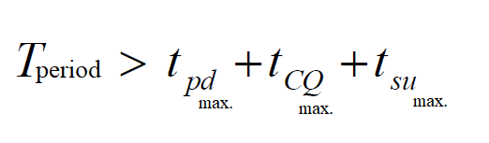
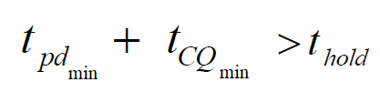
Timing Definitions
Timing Definitions
No new data overwrites the old data before the register t_{hold} time finishes

Slide 18
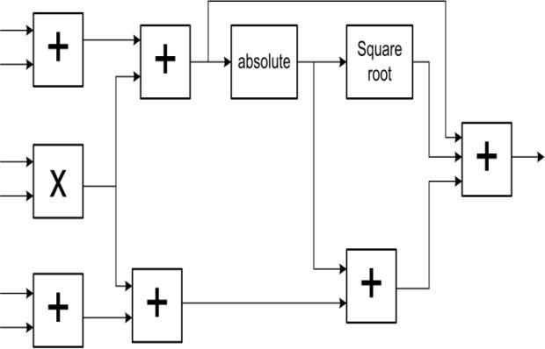
Example 1
The following combinational circuit is pipelined at all its inputs and output. The circuit uses one clock.
The delays for combinational blocks: 2-input adder = 2ns, 3-input adder = 3ns, multiplier = 5ns, absolute = 3ns, square root = 7ns. Registers Setup time = 1ns, propagation(CQ) = 1ns
Identify the longest and shortest combinational paths.
Find the min. clock period & the max. freq.
Find the condition on hold time.
Example 1
a) Longest path = t_{pd_max} = 5 + 2 + 3 + 7 + 3 = 20 ns
Shortest path = t_{pd_min} = 2 + 2 + 3 = 7 ns
^{b) T}clk ^{> T}cq ^{+ t}setup ^{+ T}pd
Min. clock period = 1 + 1 + 20 = 22 ns
1
Max. freq. = = 45.5 MHz
22𝑛𝑠
c)
^{T}hold ^{< T}cq ^{+ t}pd_min
T_{hold} < 1 + 7 → T_{hold} < 8ns
Notes:
1. Identify the Longest and Shortest Combinational Paths
From the given components and their respective delays:
2-input adder: 2 ns
3-input adder: 3 ns
Multiplier: 5 ns
Absolute: 3 ns
Square root: 7 ns
Path Analysis:
Assuming the longest path sequence goes through the multiplier, the absolute value, and the square root, we can identify the longest path as follows:
Longest Path:
Multiplier → Absolute → Square Root
Total delay:
$$t_{pd_max}=5 \text{ns}+3 \text{ns}+7 \text{ns}=15 \text{ns}$$
Shortest Path:
Shortest possible path can be through two 2-input adders.
Total delay:
$$t_{pd_min}=2 \text{ns}+2 \text{ns}+3 \text{ns}=7 \text{ns}$$
2. Find the Minimum Clock Period and Maximum Frequency
Clock Period Condition:
To ensure proper operation, we apply the formula:
$$T_{clk}>T_{cq}+t_{setup}+t_{pd_max}$$
Where:
$T_{cq}$= 1 ns (Propagation delay of the register)
$t_{setup}$= 1 ns (Register setup time)
$$t_{pd_max}=15 \text{ns}$$
Minimum Clock Period Calculation:
$$T_{clk}>1 \text{ns}+1 \text{ns}+15 \text{ns}=17 \text{ns}$$
Maximum Frequency:
$$f_{max}=\frac{1}{T_{clk}}$$
For the minimum clock period calculated:
$$f_{max}=\frac{1}{17 \text{ns}}≈58.82 \text{MHz}$$
3. Find the Condition on Hold Time
Hold Time Condition:
To ensure that data is not read too early, the following condition must be satisfied:
$$T_{hold}<T_{cq}+t_{pd_min}$$
Where $t_{pd_min}$can be taken as the shortest path delay:
$$t_{pd_min}=7 \text{ns}$$
Hold Time Condition Calculation:
$$T_{hold}<1 \text{ns}+7 \text{ns}⇒T_{hold}<8 \text{ns}$$
Summary of Results
Longest Path: $t_{pd_max}=15 \text{ns}$
Shortest Path: $t_{pd_min}=7 \text{ns}$
Minimum Clock Period: $T_{clk}>17 \text{ns}$
Maximum Frequency: $f_{max}≈58.82 \text{MHz}$
Hold Time Condition: $T_{hold}<8 \text{ns}$
If you have any further calculations or details you'd like to add, let me know!

Slide 19
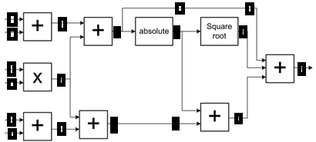
Example 1
The combinational circuit below is pipelined at all its inputs and output. The circuit uses one clock. The delays for combinational blocks: 2-input adder = 2ns, 3-input adder = 3ns, multiplier = 5ns, absolute = 3ns, square root = 7ns. Delays for registers:
Setup = 1ns, propagation(CQ) = 1ns
Maximally pipeline the circuit (internal and I/O).
What are the period and the frequency in part (d)?
Example 1
6 pipeline segments/stages
^{T}clk ^{> T}cq ^{+ t}setup ^{+ T}pd
Min. clock period = 1 + 1 + 7 = 9 ns
1
Max. freq. = = 111 MHz
9𝑛𝑠
Notes:
To analyze the described pipelined combinational circuit, we’ll break down the details and calculate the minimum clock period and maximum frequency based on the provided information.
Given Information
Delays for Combinational Blocks:
2-input adder = 2 ns
3-input adder = 3 ns
Multiplier = 5 ns
Absolute = 3 ns
Square root = 7 ns
Register Delays:
Setup time = 1 ns
Propagation delay (CQ) = 1 ns
Pipelining Configuration
With maximally pipelining the circuit, we can break it down into 6 pipeline stages.
When pipelining is applied, each combinational block can be treated as a separate stage in the pipeline.
Pipeline Delays
In this configuration, the longest path through the circuit determines the clock period. Given that we are pipelining through 6 segments, we will focus on the longest combinational path, which is commonly found in the square root operation or other complex operations.
Longest Path Calculation
With pipelining:
Maximum Pipelines Segments: The longest delay from any stage, typically follows:
Assume the longest delay comes from the square root operation.
Clock Period Calculation
Using the formula:
$$T_{clk}>T_{cq}+t_{setup}+T_{pd_max}$$
Where:
$T_{cq}$= 1 ns (propagation delay)
$t_{setup}$= 1 ns (setup time)
$t_{pd_max}$= 7 ns (derived from the square root operation itself)
Calculating the minimum clock period:
$$T_{clk}>1 \text{ns}+1 \text{ns}+7 \text{ns}=9 \text{ns}$$
Maximum Frequency Calculation
The maximum frequency is determined using the minimum clock period:
$$f_{max}=\frac{1}{T_{clk}}$$
Using the calculated clock period:
$$f_{max}=\frac{1}{9 \text{ns}}≈111.11 \text{MHz}$$
Summary of Results
Minimum Clock Period: $T_{clk}>9 \text{ns}$
Maximum Frequency: $f_{max}≈111.11 \text{MHz}$
This pipelined structure allows the circuit to efficiently manage multiple instruction streams while maintaining high performance. If you have any more details or further questions, feel free to ask!

Slide 20
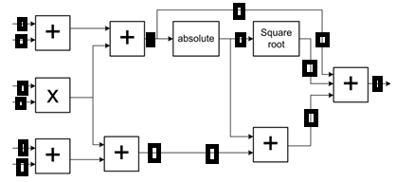
Example 1
The combinational circuit below is pipelined at all its inputs and output. The circuit uses one clock. The delays for combinational blocks: 2-input adder = 2ns, 3-input adder = 3ns, multiplier = 5ns, absolute = 3ns, square root = 7ns. Delays for registers:
Setup = 1ns, propagation(CQ) = 1ns
As optimal as possible pipeline the circuit, and show all registers on the circuit.
What are the period and the frequency in part (f)?
Example 1
5 pipeline segments/stages
^{T}clk ^{> T}cq ^{+ t}setup ^{+ T}pd
Min. clock period = 1 + 1 + 7 = 9 ns
1
Max. freq. = = 111 MHz
9𝑛𝑠
Advantages:
Decrease area
first operation after 5 clock cycles
Notes:
To create an optimal pipelining structure for the given combinational circuit and determine the clock period and frequency, we need to analyze the circuit in the context of its stages.
Pipelining the Circuit
Based on your description, we'll organize the circuit into 5 pipeline stages, adding registers between stages to separate the computations.
Circuit Structure with Registers
Pipeline Stage 1:
Input to 2-input Adder 1
Output: Register R1
Pipeline Stage 2:
Input to 2-input Adder 2 and Multiplier using the output from Register R1 and the second input stream (likely from another input like X).
Output: Register R2
Pipeline Stage 3:
Absolute operation applied to the output of Register R2.
Output: Register R3
Pipeline Stage 4:
Square Root operation applied to the output of Register R3.
Output: Register R4
Pipeline Stage 5:
Final 2-input Adder to combine the outputs from the previous operations.
Output: Final result.
Register Placement
Each stage will have a register added at the output to separate the stages effectively while minimizing delays. The following placements ensure that the latencies from one stage do not affect the following one:
R1: After the first 2-input adder.
R2: After the second adder and multiplier operations.
R3: After the absolute value operation.
R4: After the square root operation.
Delays for Clock Period Calculation
Using the longest delay from any stage to determine the clock period:
Longest Delay: The square root operation at 7 ns is the maximum delay in any segment:
Using the formula:
$$T_{clk}>T_{cq}+t_{setup}+t_{pd_max}$$
Where:
$T_{cq}$= 1 ns (propagation delay of the register),
$t_{setup}$= 1 ns (setup time),
$t_{pd_max}$= 7 ns (for the square root).
Calculating:
$$T_{clk}>1 \text{ns}+1 \text{ns}+7 \text{ns}=9 \text{ns}$$
Maximum Frequency Calculation
To determine the maximum frequency:
$$f_{max}=\frac{1}{T_{clk}}=\frac{1}{9 \text{ns}}≈111.11 \text{MHz}$$
Summary of Results
Minimum Clock Period: $T_{clk}>9 \text{ns}$
Maximum Frequency: $f_{max}≈111.11 \text{MHz}$
Visual Representation
The circuit diagram would include the following elements:
2-input adders at the beginning.
Multiplier and absolute operations in the next stages.
Square root operation as the last complex operation.
Registers placed after each operation, connecting the stages.
If you need further visual representation or additional details, feel free to ask!

