Slide 1
Computer Architecture
Reference:
Mano, “Computer System Architecture”, Chapter 12
Mano, “Mano Logic and Computer Design Fundamentals”
Computer Architecture Module Content
Central Processing Unit Architecture
  Design Approaches [Stack – Pipelining – Interrupt – Processor Organization
– Registers Organization]
  Instruction Set Architecture [Instruction Format – Addressing modes –
Data Transfer and Manipulation]
  Example architectures (e.g., CISC, RISC)
Timing, Clock Parameters, and Processor Performance
Memory Hierarchy
  Main Memory
  Cache Memory
  Virtual Memory
2

Slide 2

Memory
Memory Hierarchy
RAM/ROM Memory Basics
Memory Technology
Memory
Memory is a major component of a digital computer and is present in many digital systems.
Not all data is needed by the processor at the same time.
Therefore, it is more economical to use low-cost storage devices to serve as a backup for storing the information that is not currently used by the CPU. And use Fast memory to communicate with the CPU.

Slide 3
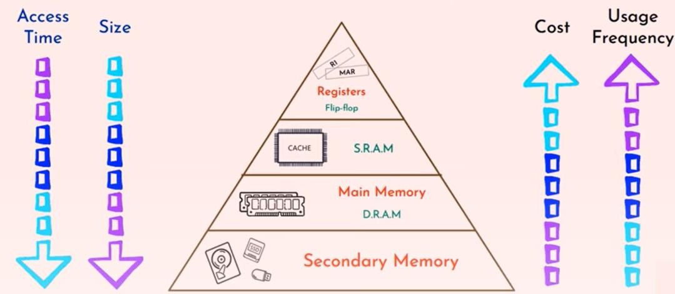
Main Principles
The memory unit that communicates directly with the CPU is called the
Main Memory (RAM).
  Only programs and data currently needed by the processor reside in the main memory.
Devices that provide backup storage are called Auxiliary Memory or Secondary Memory.
  The most common auxiliary memory devices used in computer systems are
magnetic disks and tapes.
  They store programs, large data files, and any other backup information.
Memory Hierarchy Levels
Cache Memory
Magnetic Disk
Magnetic Tape
The arrows direction from low to high
Notes:
Memory hierarchy (fast → slow, small → large)
Registers (inside CPU)
Smallest and fastest storage.
Holds values the CPU is currently operating on.
Cache (SRAM)
Very small and very fast, sits close to the CPU.
Holds recently used data and instructions to reduce average access time.
Main memory (DRAM)
Much larger than cache but slower.
Stores programs and data currently in use by the processor.
Secondary (auxiliary) memory (magnetic disks, tapes, SSDs)
Largest and slowest.
Used for long-term storage and backups (programs, large files).
Key relationships
Size: registers << SRAM (cache) << DRAM (main memory) << secondary storage.
Latency (access time): registers << SRAM << DRAM << secondary storage.
Cost per byte: registers and SRAM are more expensive than DRAM, which is more expensive than disk.
Usage frequency: items closer to the top (registers, cache) are used more frequently.
Why caches exist
Goal: reduce average memory-access latency seen by the CPU.
Strategy: keep small, fast memories that store copies of the data most likely to be needed soon.
Caching works because of locality:
Temporal locality: recently accessed data is likely to be accessed again soon.
Spatial locality: data near recently accessed addresses is likely to be accessed soon.
Typical data movement (overview)
Store everything on disk (secondary storage).
Copy recently accessed (and nearby) items from disk to main memory (DRAM).
Copy more recently accessed (and nearby) items from DRAM to cache (SRAM) so the CPU can access them quickly.
The CPU reads/writes from registers and cache; cache controllers and the OS/hardware manage movement and consistency between levels.
Visual/pyramid interpretation (from top to bottom)
Top (smallest, fastest): Registers → Cache (SRAM)
Middle: Main memory (DRAM)
Bottom (largest, slowest): Secondary memory (disks, tapes, SSDs)
Arrows across the pyramid:
Access time increases going down.
Size increases going down.
Cost per byte decreases going down.
Usage frequency decreases going down.
Short summary
The memory hierarchy balances speed, size, and cost: fast small memories (registers, cache) reduce average latency for the CPU, while larger slower memories (DRAM, disks) provide capacity and persistence. Cache memories exploit locality to store frequently or imminently needed data closer to the CPU.

Slide 4
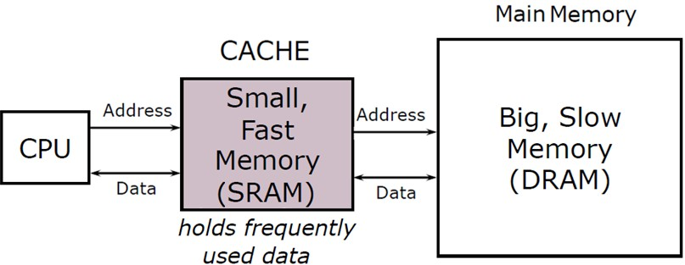
Cache Memory
Strategy: Reduce average latency using small, and fast memories called Caches.
Size: Register << SRAM << DRAM
Latency: Register << SRAM << DRAM
Memory hierarchy
Store everything on the disk.
Copy recently accessed (and nearby) items from disk to smaller DRAM
memory
  Main memory
Copy more recently accessed (and nearby) items from DRAM to smaller
SRAM memory
  Cache memory attached to CPU

Slide 5
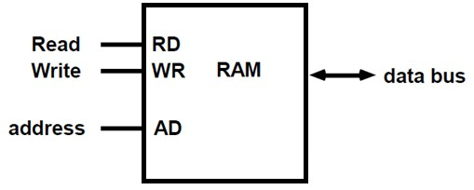
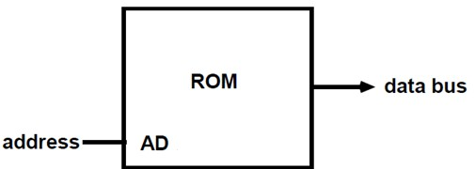
RAM/ROM Memory Basic Architecture
Memory
Random-access memory (RAM) stores data temporarily
  RAM is volatile memory that temporarily stores the files you are working on.
Read-Only memory (ROM) stores data permanently.
  ROM is a non-volatile memory that permanently stores instructions for your computer.
Notes:
RAM (Random-Access Memory) Volatile: loses content when power is removed.
Temporary storage for programs and files currently in use.
Fast access compared with secondary storage.
ROM (Read-Only Memory) Non‑volatile: retains contents without power.
Stores permanent instructions (e.g., firmware, boot code).

Slide 6
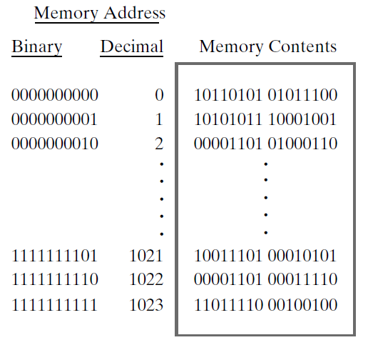
Random-Access Memory (RAM)
Random-Access Memory (RAM)
Memory is a collection of binary storage cells together with associated circuits needed to transfer information into and out of the cells.
Memory cells can be accessed to transfer information to or from any desired location, with the access taking the same time regardless of the location, hence the name random-access memory.

Slide 7
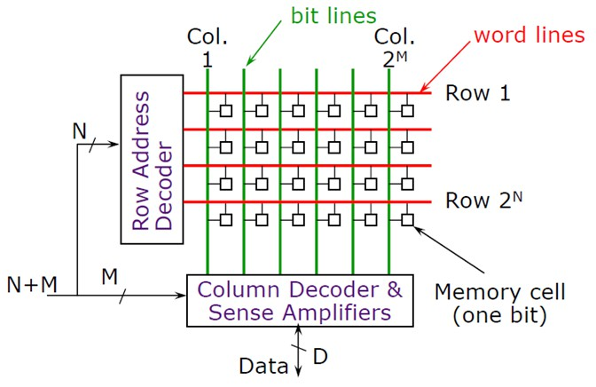
RAM Structure
Random-Access Memory (RAM)
Binary information is stored in memory in groups of bits, each group of which is called a word.
A word is an entity of bits that moves in and out of memory as a unit.
A group of eight bits is called a byte.
Most computer memories use words that are multiples of eight bits in length.
Thus, a 16-bit word contains two bytes, and a 32-bit word is made up of four bytes.
The capacity of a memory unit is usually stated as the total number of bytes that it can store.
Notes:
Memory is a collection of binary storage cells plus the circuits to read/write them. Data is stored in bits; groups of bits are moved as units called words. Byte = 8 bits. Common word sizes are multiples of 8 bits (16-bit = 2 bytes, 32-bit = 4 bytes, etc.). Capacity is usually measured in bytes.

Slide 8
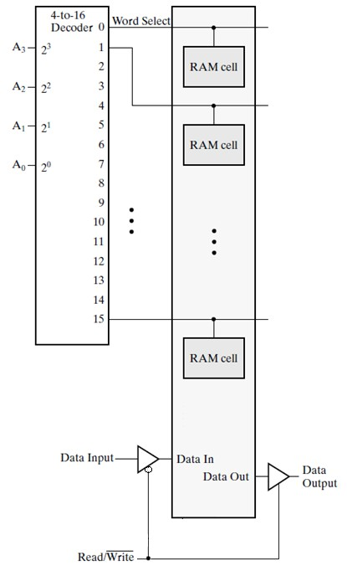
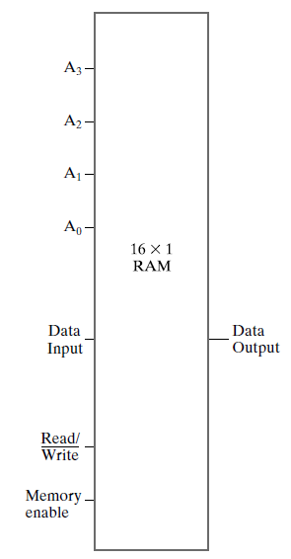
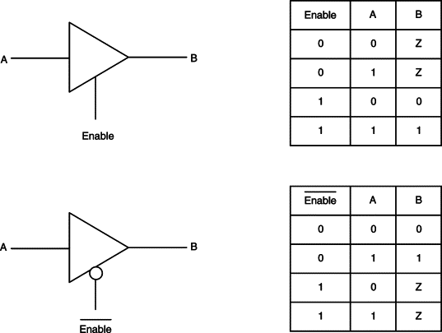
RAM Cell Selection
Tri-State buffer
Active high enable
Active low enable

Slide 9
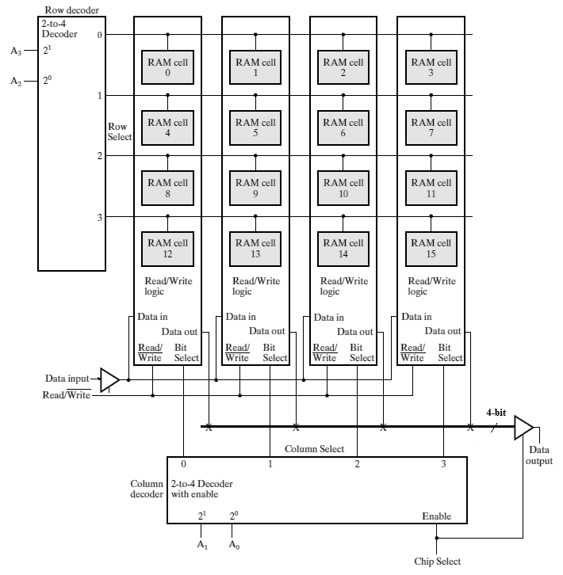
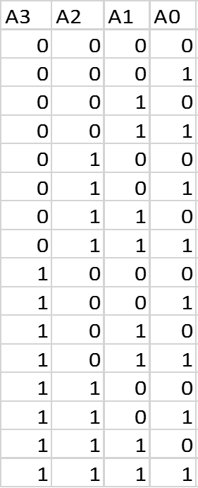
RAM Cell Selection
Row 0
Row 1
Row 2
Row 3
RAM Cell Selection
Every cell has word line, bit line
Notes:
Physical organization (row/column decoding)
Large memories are typically organized in arrays of RAM cells arranged in rows and columns.
Row (word) decoders select the appropriate row (word). Column decoders select specific bit lines or groups of bits in that row (for narrow data outputs).
Chip select lines enable/disable entire memory chips in larger systems.
Capacity notation (binary prefixes)
K = 2^10 = 1,024
M = 2^20 = 1,048,576
G = 2^30 = 1,073,741,824
Examples: 64K = 2^16, 2M = 2^21 (as given in your notes), 4G = 2^32.
Example: specifying a memory
If a memory is 2^k × n:
Number of address lines = k.
Addresses run 0..(2^k − 1).
Data bus width = n bits.
Example: a 2^16 × 8 memory has 16 address lines and an 8-bit (1‑byte) data bus; it stores 65,536 bytes (64 KB).
Practical notes
Real systems use multiple levels of memory (cache, DRAM, secondary storage) to trade off speed, cost, and capacity.
Decoders, multiplexers, and sense amplifiers are key supporting circuits in memory chips.
When building larger memories from smaller chips, use address-line partitioning and chip‑select signals to map chip blocks into unique address ranges.

Slide 10
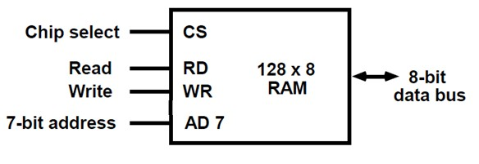
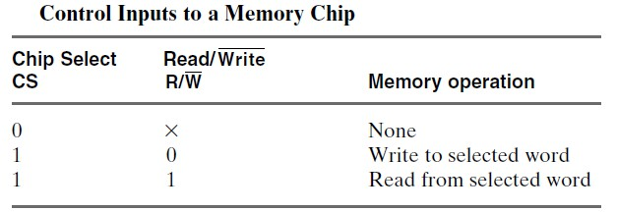
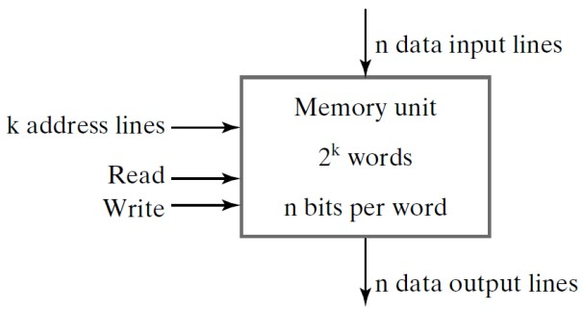
Random-Access Memory (RAM)
Random-Access Memory (RAM)
Communication between a memory and its environment is achieved through data input and data output lines, address lines, and control lines that specify the direction of transfer of information.
The memory unit is specified by the number of words it contains and the number of bits in each word. (2^{k} × n)
Notes:
“Random-access” means any memory cell (word) can be accessed in roughly the same time, independent of location.
A memory unit is specified as (2^k × n) where:
2^k = number of words (k = number of address lines).
n = number of bits per word.
Address range: 0 to 2^k − 1.
Each address selects one word; a decoder takes the k-bit address and activates the selected word line.
Memory interface signals
Data input / output lines: carry the bits of the word being read or written.
Address lines: specify which word to access.
Control lines: read/write enable, chip select, and other control signals.

Slide 11
Random-Access Memory (RAM)
Each address selects one particular word.
Addresses range from 0 to 2^{k} – 1, where k is the number of address lines.
A decoder accepts this address and opens the paths needed to select the word
specified.
Computer memory varies greatly in size. It is customary to refer to the number of words (or bytes) in memory with one of the letters K (Kilo), M (Mega), or G (Giga). K is equal to 2¹⁰, M to 2²⁰, and G to 2³⁰.
Thus, 64K = 2^{l6}, 2M = 2²¹, and 4G = 2³².
Memory Technology

Slide 12
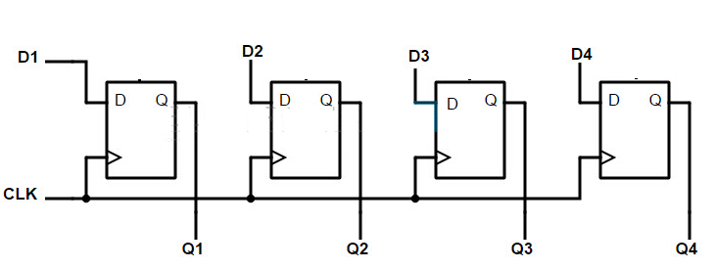
Memory Technology
Registers
RAM Memory
ROM Memory
Magnetic Tapes
Magnetic Disk
Registers Digital circuit
Flip-flop is a 1 bit memory cell which can be used for storing the digital data.
To increase the storage capacity in terms of number of bits, we have to use a
group of flip-flop. Such a group of flip-flop is known as a Register.
Ex.: 4bit register

Slide 13
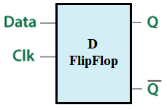
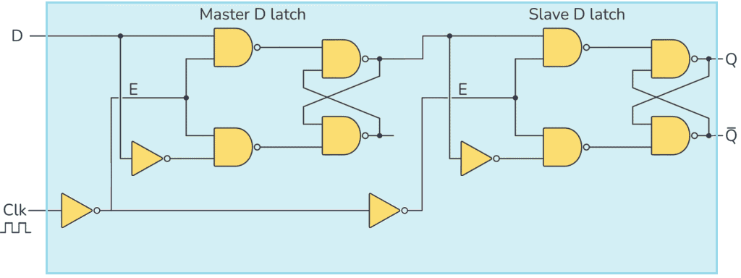
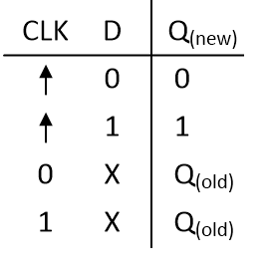
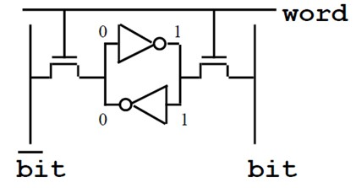
Edge trigger Flip Flop
Number of transistors = 8 NAND gate *4 + 4 NOT gate * 2
= 40 transistor / bit
Static RAM (SRAM) Basic Cell
6 Transistor SRAM cell
Standby:
If the word line = 0 , the access transistors disconnect the cell from the bit lines.
The two cross-coupled inverters reinforce each other as long as they are connected to the supply.
Reading
Assert the word line WL = 1 and read the bit line.
Writing
Apply the value to be written to the bit lines. WL is then asserted and the value is stored in the cell.
The bit line input-drivers are designed to be much stronger than the cell transistors so they can override the previous state.
Notes:
SRAM (6‑transistor cell)
Structure
Two cross-coupled inverters form a bistable latch + two access (pass) transistors connected to bit lines.
No capacitor; uses full CMOS latch — hence static.
States / operations
Standby: WL = 0 → access transistors off, latch holds value as long as power is present.
Read: WL = 1 → cell is connected to bit lines; sense amplifier detects the stored value (reads non‑destructively).
Write: Drive bit lines with desired value; assert WL so strong bit-line drivers overwrite latch.
Properties
Fastest on-chip memory (used for caches, registers).
Relatively large cell area (6 transistors), higher cost per bit.
Volatile but does not require refresh while powered.
DRAM (1 transistor + capacitor cell)
Structure
Single transistor (access device) plus a storage capacitor per cell.
States / operations
Standby: WL = 0 → capacitor isolated from bit line.
Read: WL = 1 → charge on capacitor is shared with bit line; sense amplifier detects small voltage change (read is destructive in many DRAM designs, so the row must be restored).
Write: Drive bit line to strong 1 or 0; assert WL to store charge on capacitor.
Properties
Much smaller cell area than SRAM → higher density, lower cost per bit.
Dynamic: capacitor leaks charge → requires periodic refresh (every few ms).
Slower than SRAM but much denser; used for main memory (DRAM DIMMs).
Non‑volatile solid-state memories
ROM (Read-Only Memory)
Permanently stores data/instructions (e.g., boot code); non‑volatile.
EPROM (Erasable PROM)
Programmed once (or erased by UV exposure) off‑chip; cell smaller than SRAM.
EEPROM (Electrically Erasable PROM)
Can be erased/programmed on‑chip electrically (byte- or block-level); cell smaller than SRAM.
Flash (type of EEPROM)
Block-erasable, widely used for SSDs, USB drives — non‑volatile, retains data without power.
Magnetic disk storage
Physical layout
Circular platters coated with magnetic material; often multiple platters on a spindle; both surfaces can be used.
Data stored on concentric tracks; tracks subdivided into sectors (minimum transfer unit).
Read/write heads move radially to select a track; platters rotate to bring the sector under the head.
Access characteristics
Seek time: time to move heads to the desired track.
Rotational latency: wait for sector to rotate under head.
Transfer rate: once head is over sector, data transfer is fast.
Many disks use zoned bit recording (higher linear density near outer tracks) or vary recording density to equalize bytes per sector.
Addressing
Addresses specify disk, surface, track (cylinder), and sector.
Parallelism
Multiple heads or multiple platters can be used for concurrent transfers (e.g., RAID, multi-head read).
Magnetic tape
Characteristics
Sequential-access medium (read/write only sequentially).
Very high capacity, low cost per bit, long archival life.
Access is slow (seek/rewind can be seconds to minutes); no efficient random access.
Commonly used for backups and long‑term archiving.
Comparative summary (common tradeoffs)
Volatility
SRAM/DRAM: volatile (lose data when power off).
ROM/EPROM/EEPROM/Flash/Disk/Tape: non‑volatile.
Speed (fastest → slowest)
SRAM (cache) > DRAM (main memory) > Disk (secondary) > Tape.
Density / cost per bit (cheapest → most expensive)
Tape/Disk/Flash > DRAM > SRAM.
Access pattern
RAM and disk: random access (DRAM random within memory, disk random but with mechanical latency).
Tape: sequential access only.
Refresh / maintenance
DRAM: requires periodic refresh.
SRAM: no refresh but consumes static power while powered.
Non‑volatile: no refresh required.
Practical implications
Caches use SRAM because of speed despite cost and area.
Main memory uses DRAM for a balance of speed and density.
Long-term storage and archival use magnetic disks or tape depending on performance needs and cost considerations.
Nonvolatile flash/EEPROM technologies are used where durability and no‑power retention are required with solid‑state access (SSDs, embedded storage).
If you want, I can:
Draw a labeled diagram of a 6‑T SRAM cell and a 1T‑1C DRAM cell showing read/write paths and bit/word lines.
Produce a comparative table summarizing latency, density, cost, volatility, and typical uses.
Explain DRAM refresh operation in detail (RAS/CAS, row‑buffer, refresh scheduling) or describe sense‑amplifier operation for DRAM reads. Which would you like?

Slide 14
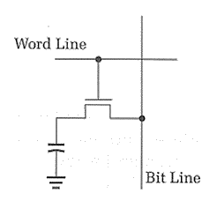
Dynamic RAM (DRAM) Architecture
Memory cell consist of a capacitor and a transistor.
Standby:
If the word line = 0 , the capacitor is disconnect from the bit lines.
Reading
Assert the word line WL = 1 and read the bit line.
Writing
Apply the value to be written to the bit lines (Strong 1 or 0). WL is then asserted and the value is stored in the cell.
A DRAM storage cell is dynamic, meaning that it needs to be refreshed or given a new electronic charge every few milliseconds to compensate for charge leaks from the capacitor. (i.e. read the write operation for each row)
ROM Technologies
Fuse (one-time programmed)
EPROM (its cell is smaller than SRAM but out of chip programmed and erased)
EEPROM (its cell is smaller than SRAM and on-chip programmed and erased)

Slide 15
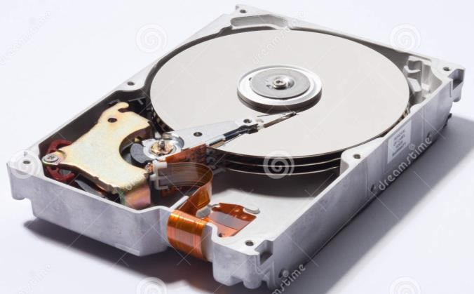
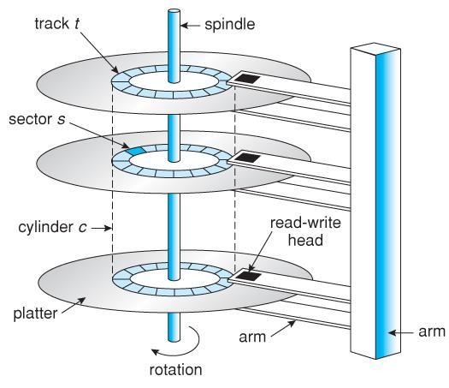
Magnetic Disk
Magnetic Disk (Hard disk)
A magnetic disk is a circular plate constructed of metal or plastic coated with magnetized material.
Often both sides of the disk are used and several disks may be stacked on one spindle with read/write heads available on each surface.
All disks rotate together at high speed.
Bits are stored in the magnetized surface in spots along concentric circles called
tracks.
The tracks are commonly divided into sections called sectors.
In most systems, the minimum quantity of information which can be transferred is a sector.

Slide 16
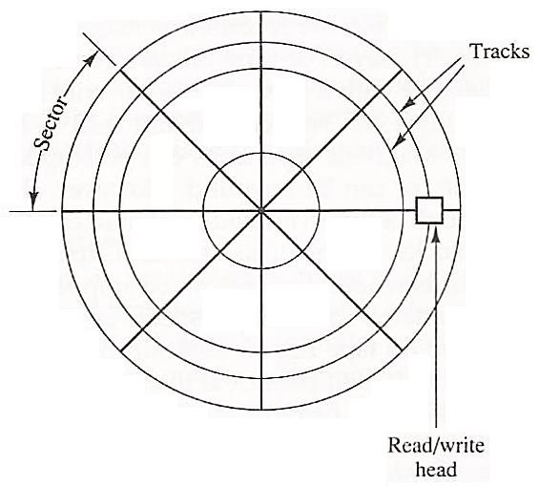
Magnetic Disk (Hard disk)
A disk system is addressed by address bits that specify the disk number, the disk surface, the sector number, and the track within the sector.
After the read/write heads are positioned in the specified track, the system has to wait until the rotating disk reaches the specified sector under the read/write head.
Information transfer is very fast once the beginning of a sector has been reached.
Magnetic Disk (Hard disk)
Disks may have multiple heads and simultaneous transfer of bits from several tracks at the same time.
To make all the records in a sector of equal length, some disks use a variable recording density with higher density on tracks near the center than on tracks near the circumference. This equalizes the number of bits on all tracks of a given sector.

Slide 17
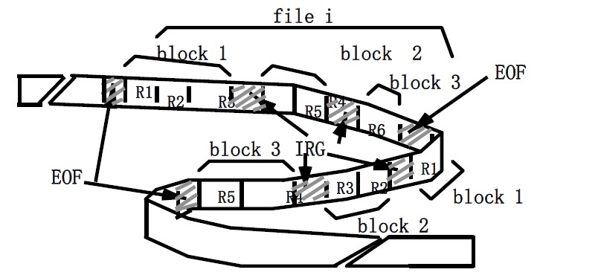
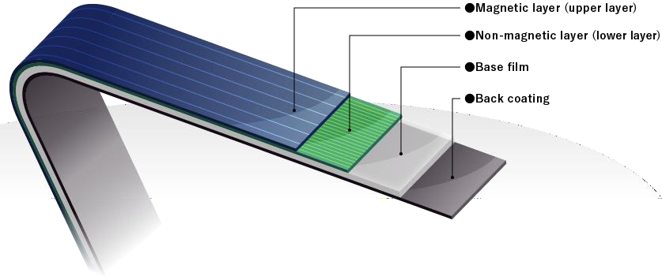
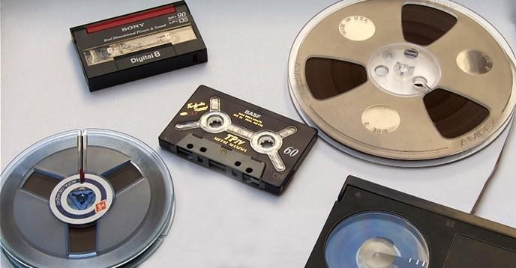
Magnetic Tapes
Magnetic Tapes

Slide 18
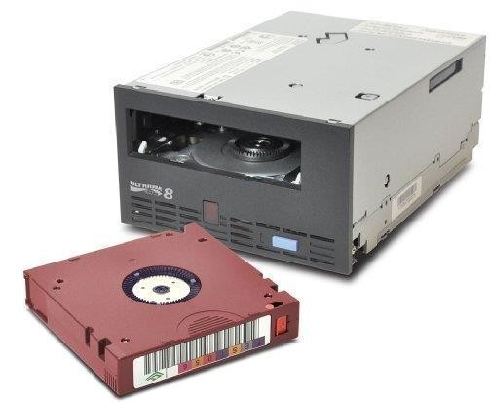
Magnetic Tapes
Magnetic tape is one of the oldest technologies for electronic data storage.
It is well-suited for archiving because of its
high capacity, low cost, and long durability.
Content on tape can only be read or written in a sequential format.
Tape is slower than disk.
Tape not support random access.
Disk access times are measured in milliseconds, while tape access times can be seconds or minutes long.
The important characteristics of any Memory device
Access time (Transfer rate)
Capacity
Cost

Slide 19
Memory Technology
Static RAM (SRAM)
0.5 ns - 2.5 ns $500 – $1000 per GB
Dynamic RAM (DRAM)
50 ns – 70 ns $3 – $6 per GB
Magnetic disk
5 ms – 20 ms
$0.01 – $0.02 per GB
Memory Address Map Example

Slide 20
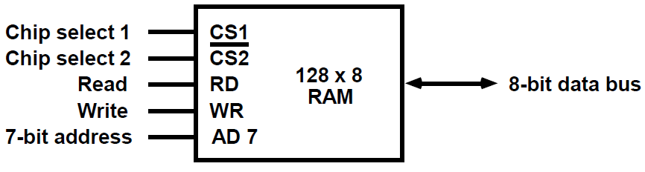
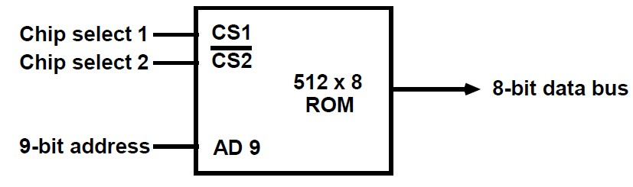
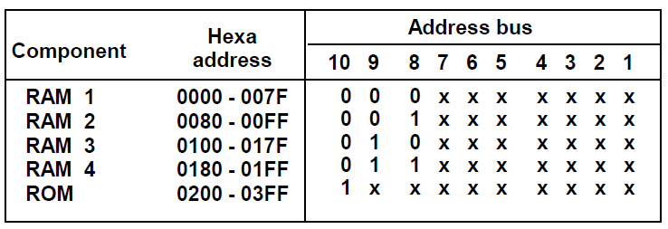
Memory Address MAP Example
Given RAM chip
Given ROM chip
Show the memory address map for CPU with 1K Main Memory, 512 RAM and 512 ROM
Memory Address MAP Example
CPU with 1K Memory, 512 RAM and 512 ROM (10 address bits)
→ Four 128 bytes RAM and one 512 bytes ROM,

Slide 21
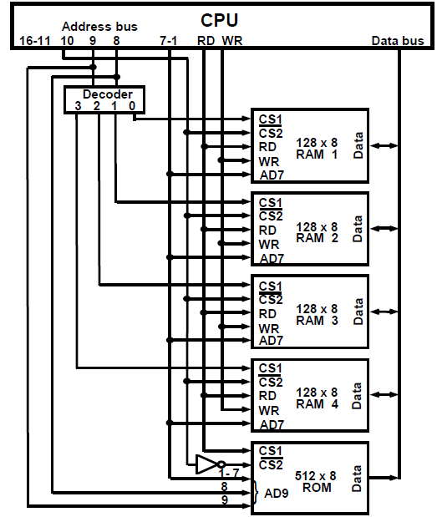
Memory Address MAP
Their connection to the CPU address bus
Memory Address MAP
RAM and ROM chips are connected to a CPU through the data and address buses
The low-order lines in the address bus select the byte within the chips and high-order lines in the address bus select a particular chip through its chip select inputs

Slide 22

Example 1

Slide 23
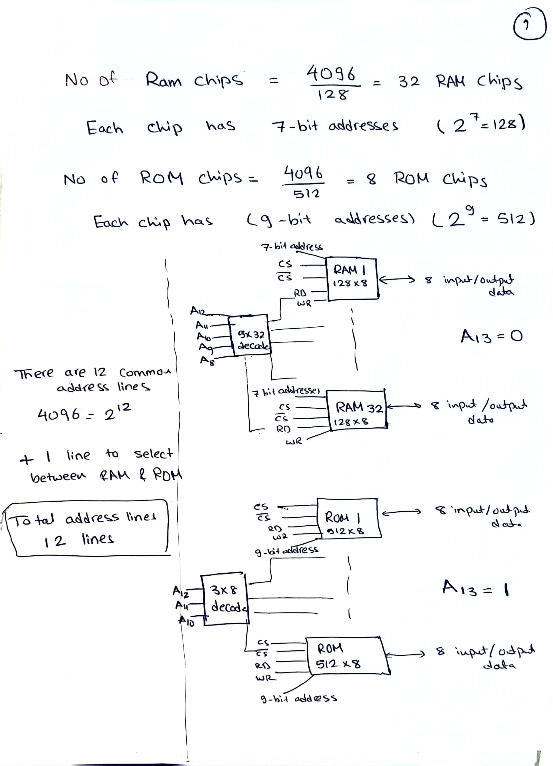
13

Slide 24
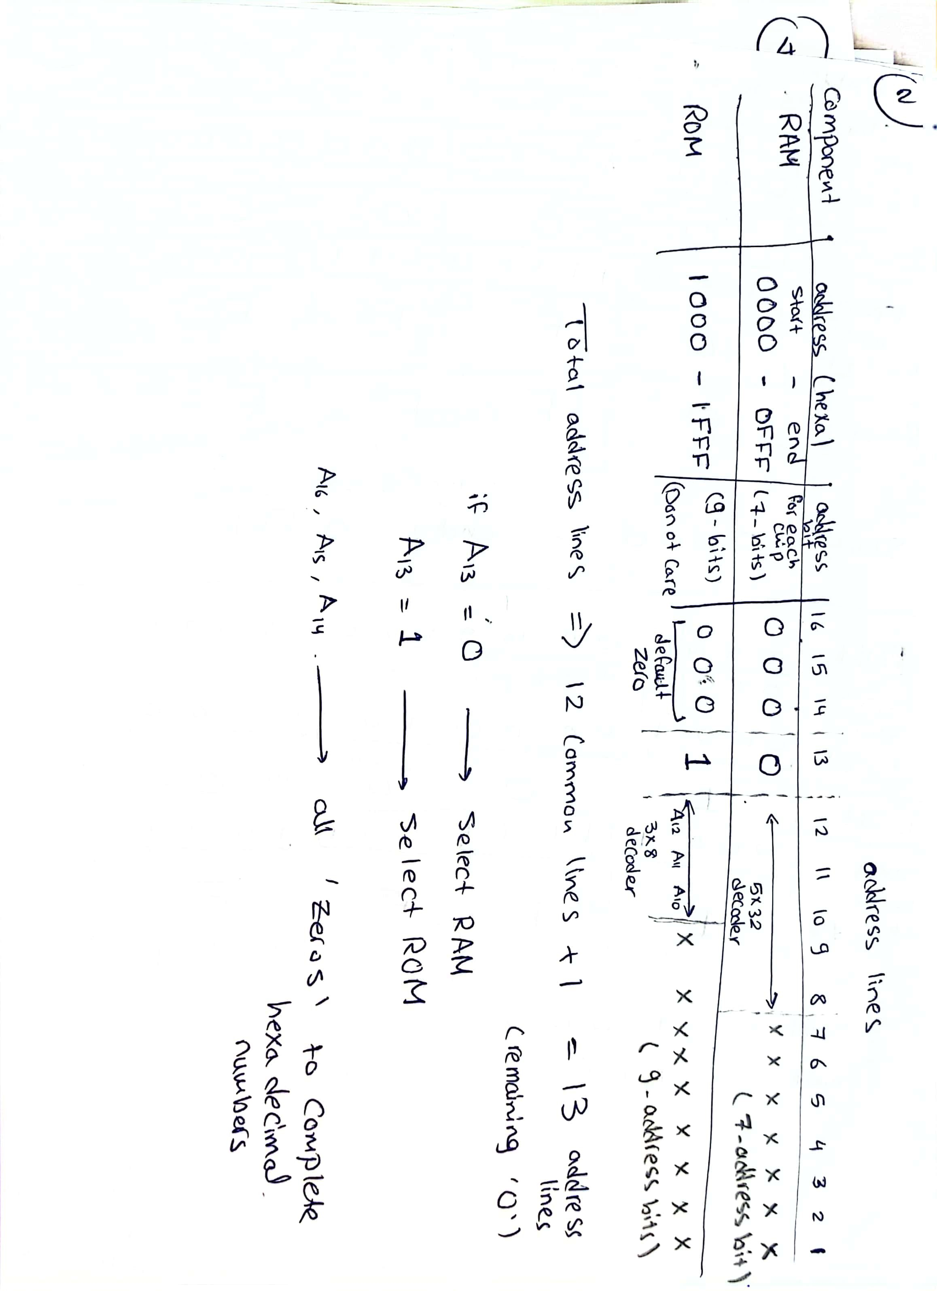

Slide 25
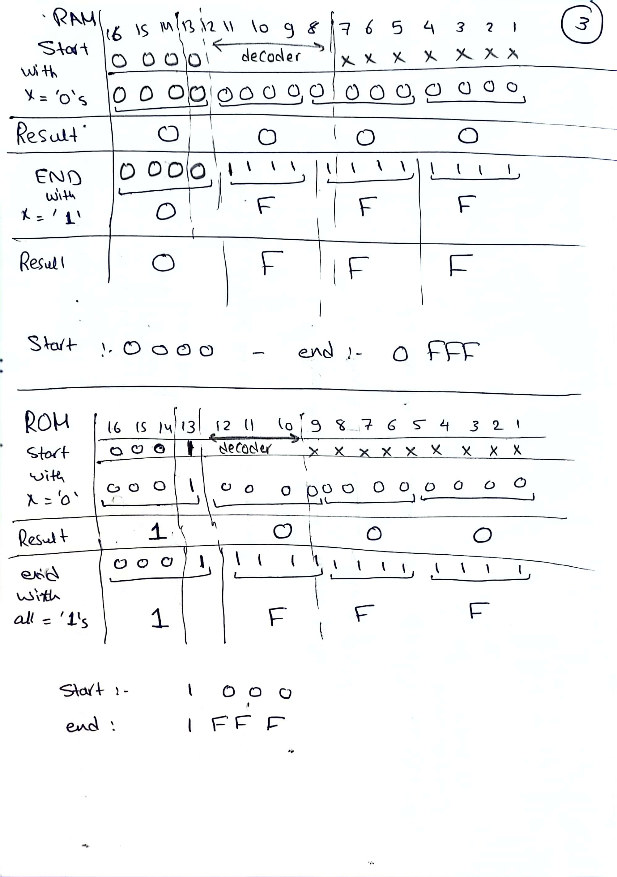

Slide 26
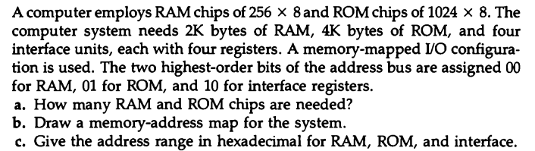
Example 2

Slide 27
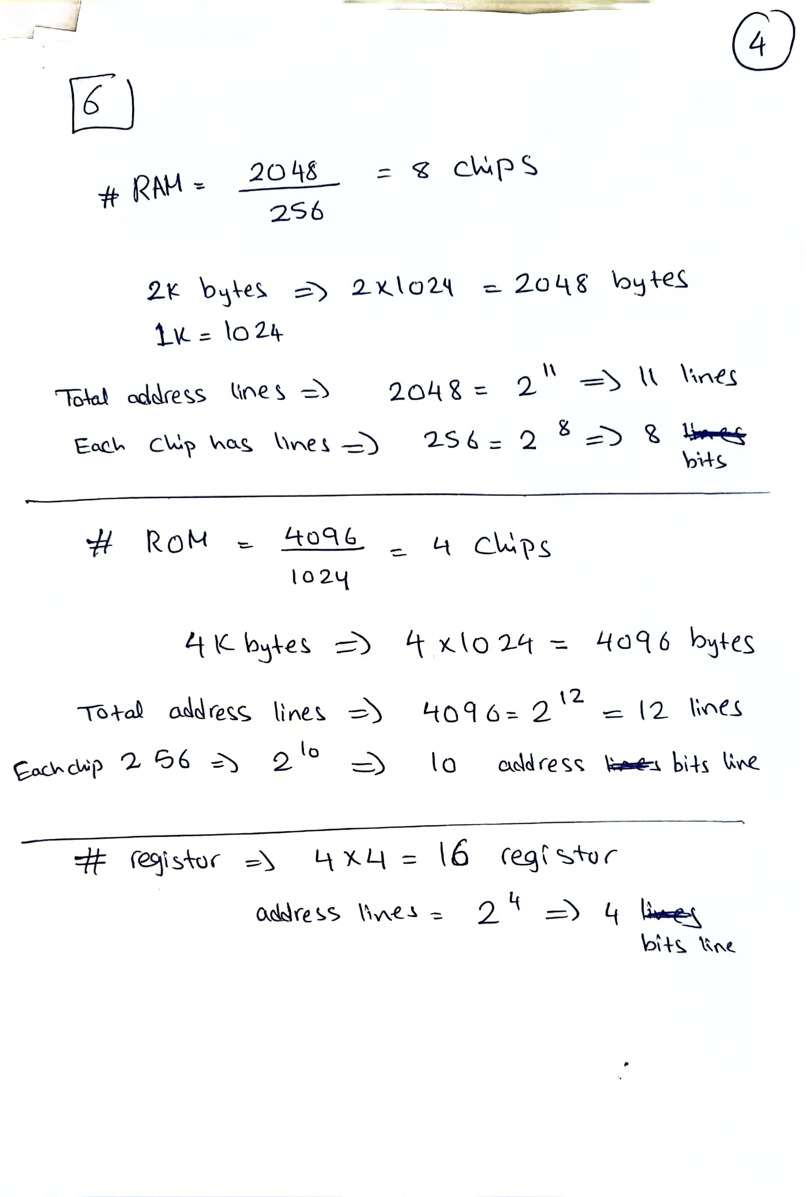

Slide 28
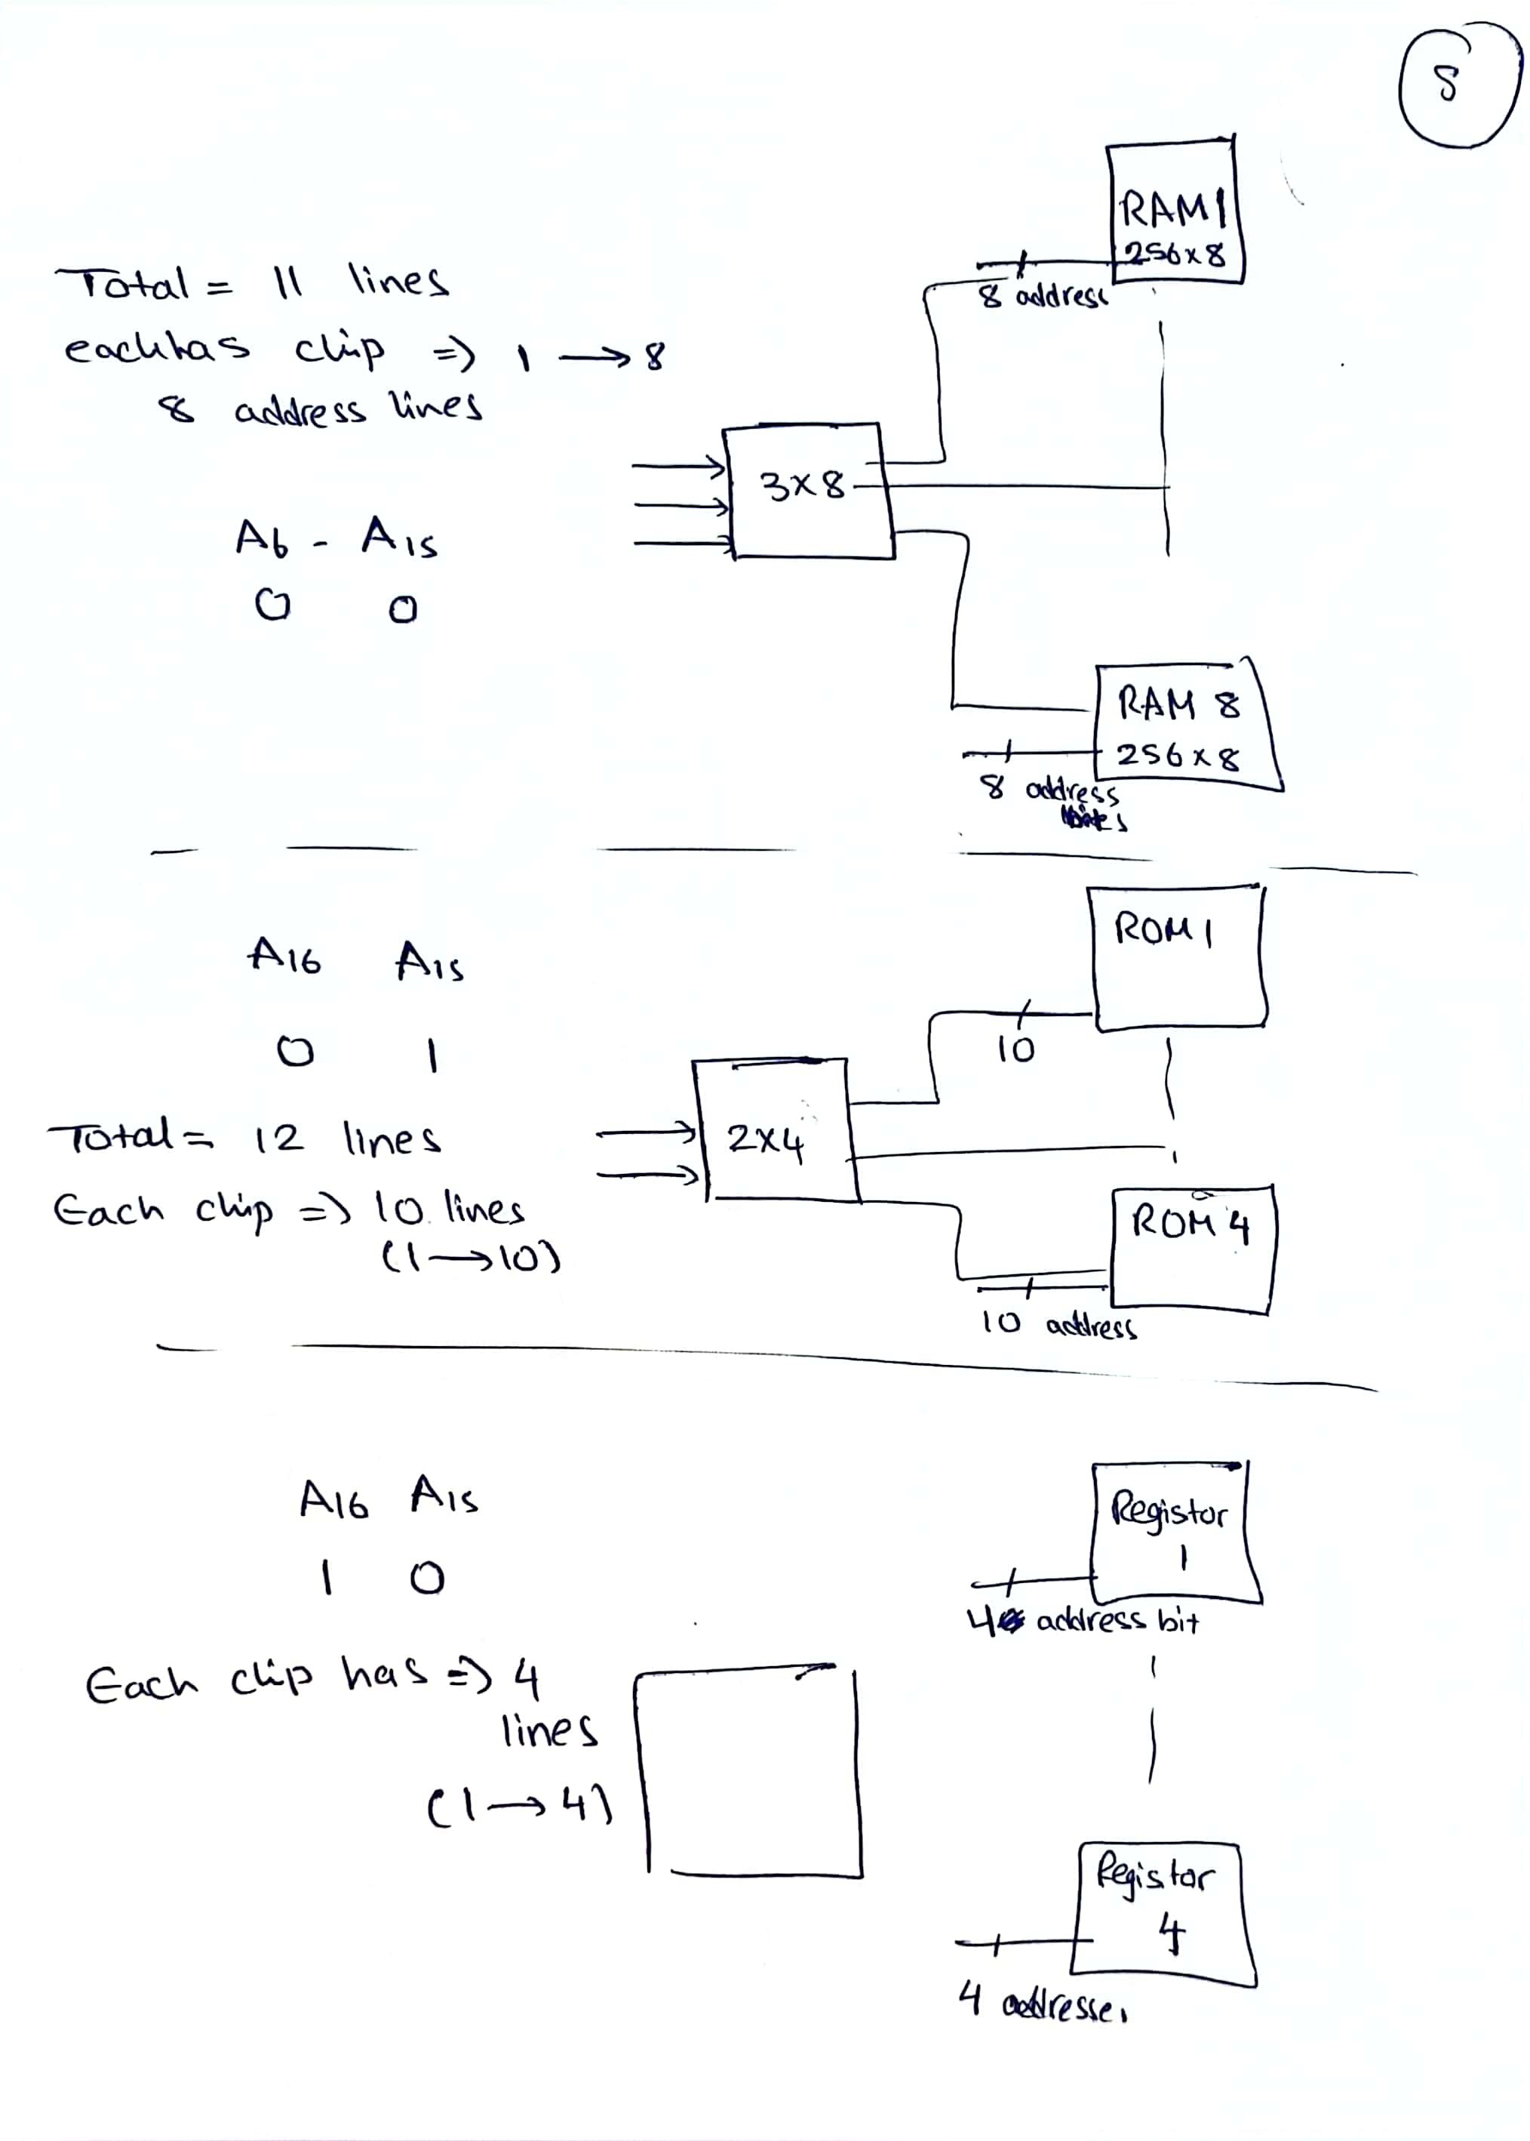

Slide 29
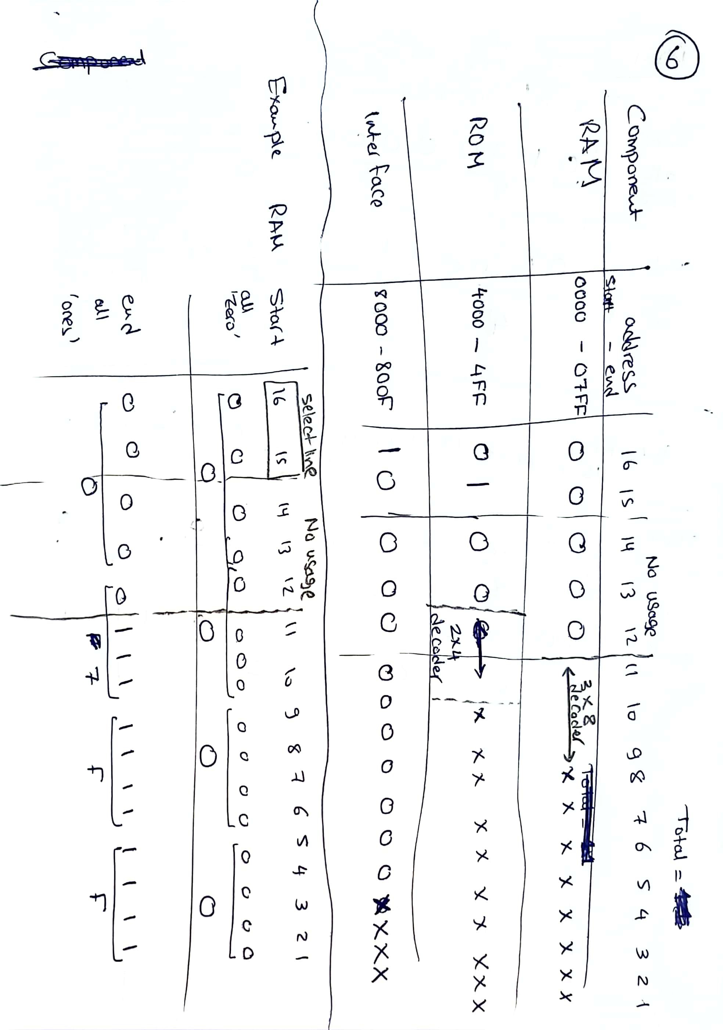

Slide 30
