Slide 1



Starting in 15 minutes
Electrical Engineering Department
Academic Year: 2025/2026
Semester: One
25CPES102
Electronic material and Devices
Lecture 4
Bipolar Junction Transistor `
Prepared by:
Dr. Sameh Osama Ezzat Abdellatif
PhD, Nano-semiconductor devices and photonics
Lecturer @ BUE
Start

Slide 2
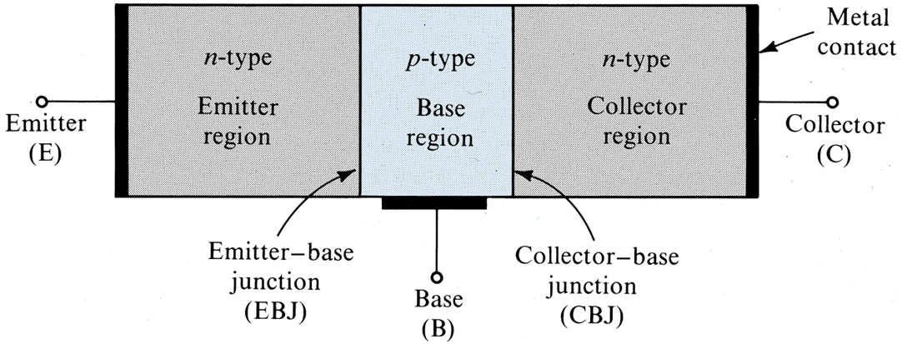
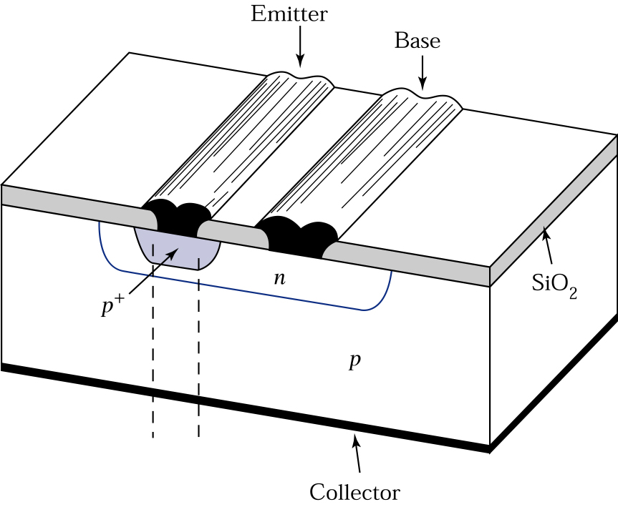
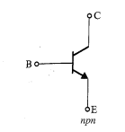
Bipolar Junction Transistor
p
n⁺
n

Slide 3
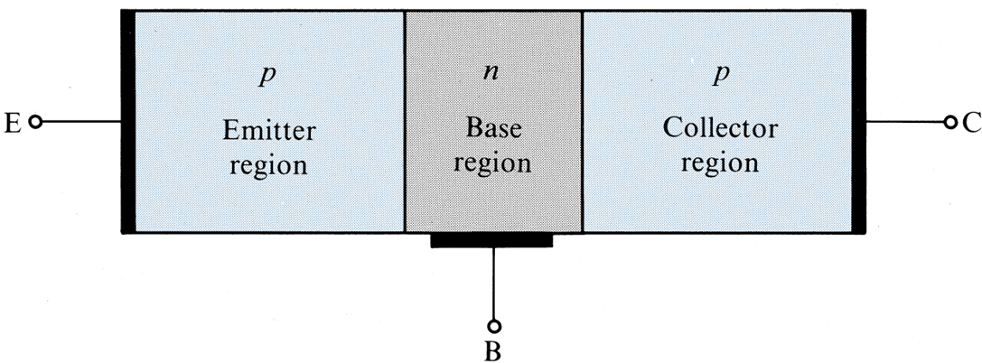
Bipolar Junction Transistor

Slide 4
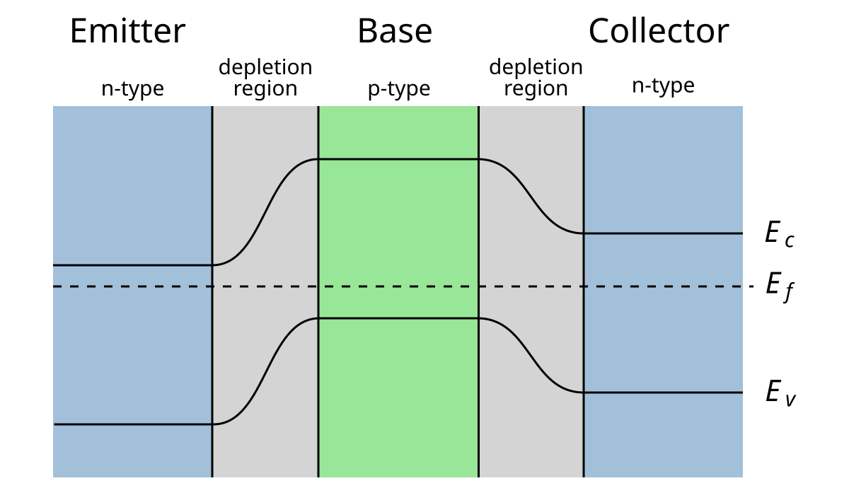
Bipolar Junction Transistor
p
n⁺
n

Slide 5
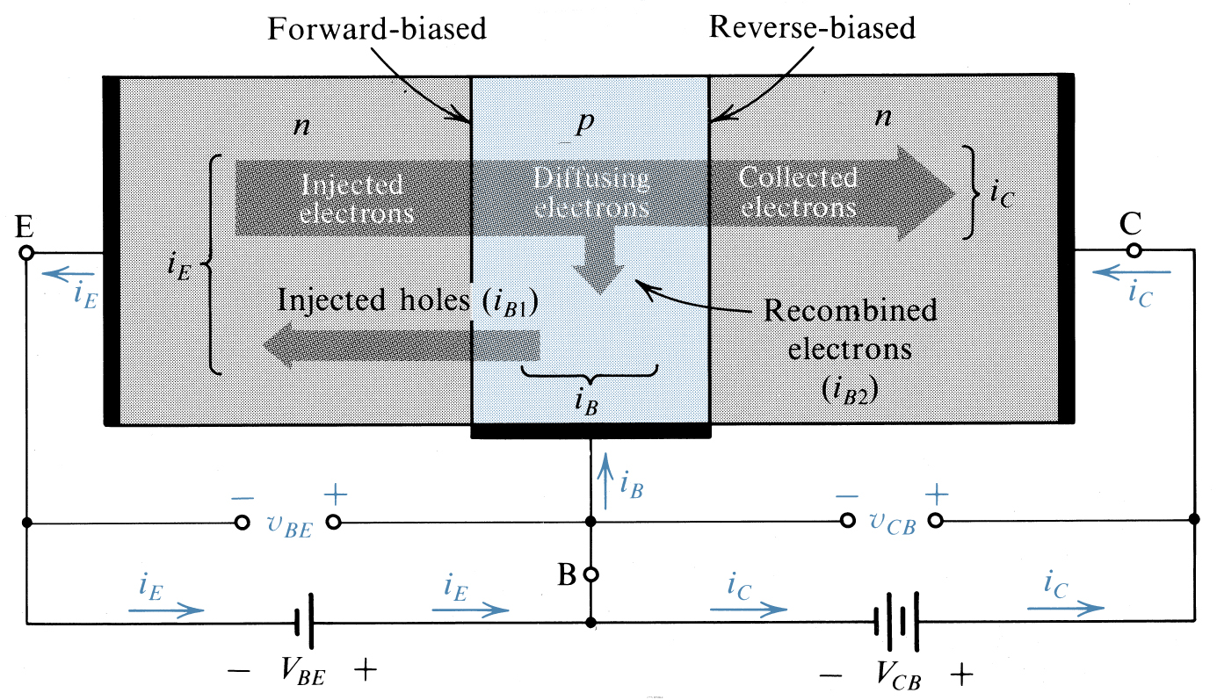
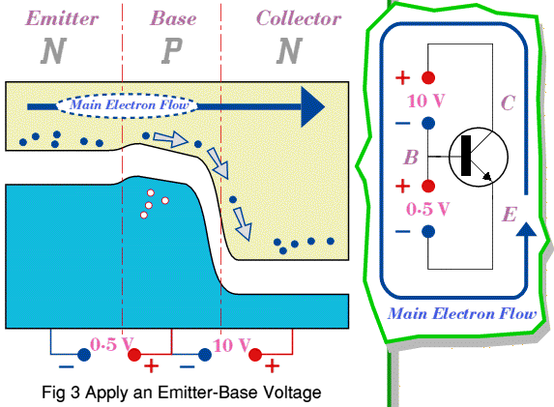
Bipolar Junction Transistor
Active mode

Slide 6
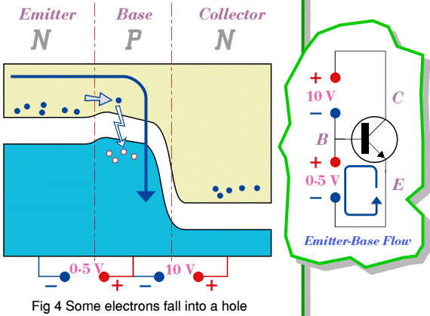
Bipolar Junction Transistor
+
The common-emitter current gain

Slide 7
Bipolar Junction Transistor
+
common-base current gain

Slide 8
Bipolar Junction Transistor

Slide 9
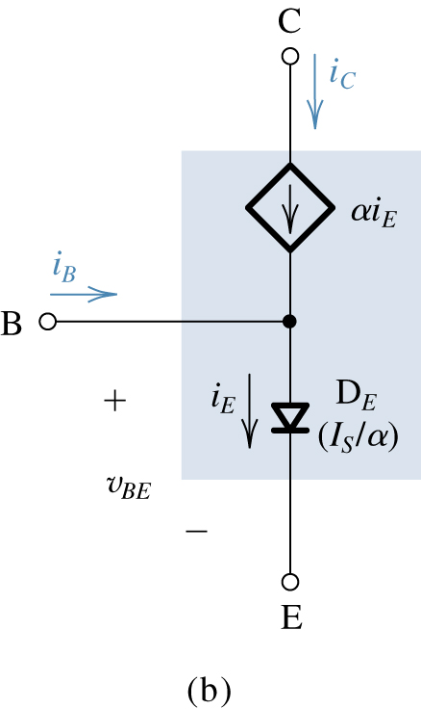
Bipolar Junction Transistor

Slide 10
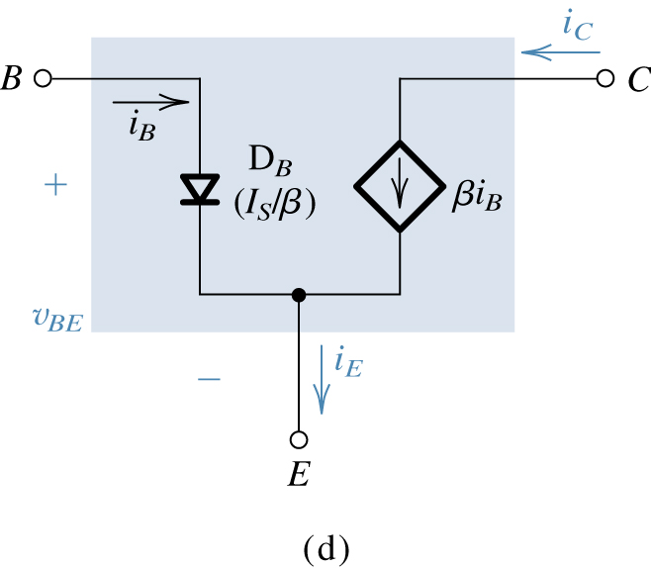
Bipolar Junction Transistor

Slide 11
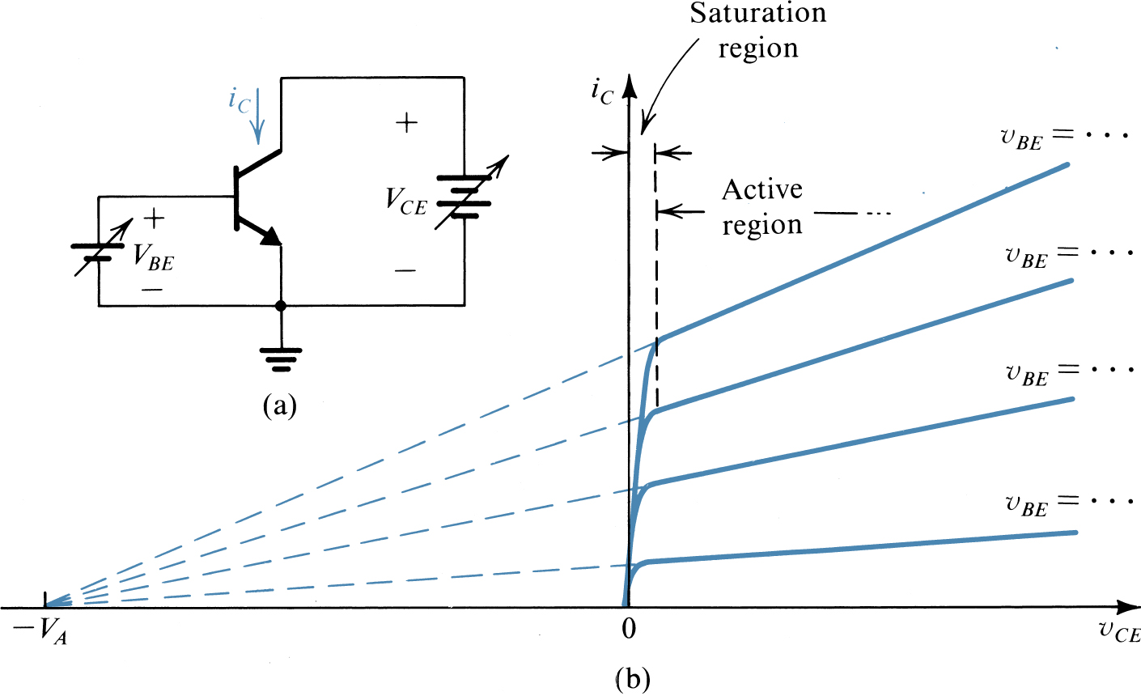
BJT modes of operation

Slide 12
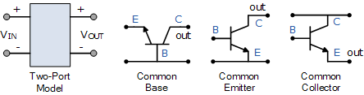
BJT Configurations

Slide 13
BJT: DC Circuits
Example: Analyze the shown circuit to determine all node voltages and branch currents. Assume β = 100.

Slide 14
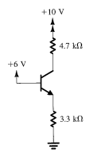
BJT: DC Circuits
Example: Analyze the shown circuit to determine all node voltages and branch currents. Assume β = 100.

Slide 15
BJT: DC Circuits
Example: Analyze the shown circuit to determine all node voltages and branch currents. Assume β = 100.

Slide 16
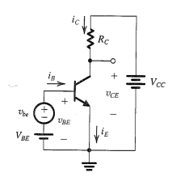
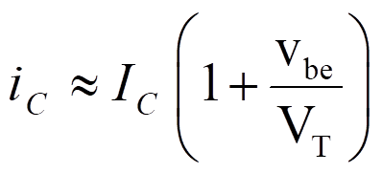
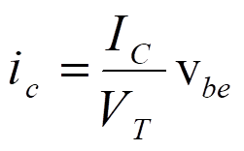
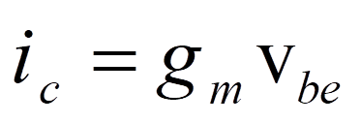
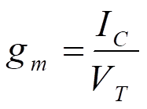
Small signal operation
The transconductance

Slide 17
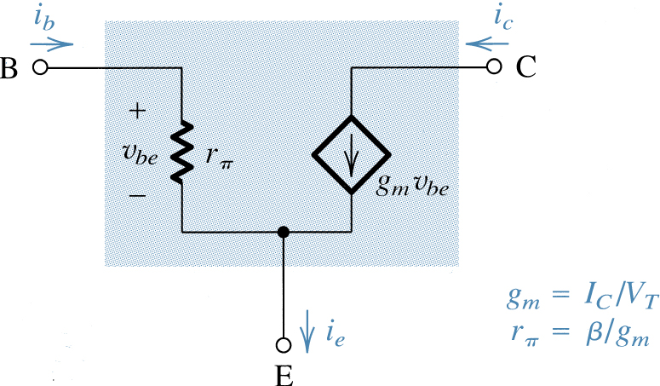
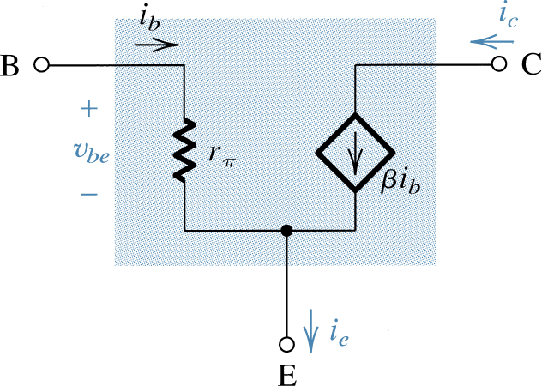
The hybrid-π model

Slide 18
The common emitter (CE) amplifier

Slide 19

Thank You
See You Next Lecture:
Op Amps
18ECE05C; Electronics (1), Dr. Sameh Osama

