Slide 1

MOSFETs
25CPES102 · ELECTRONIC MATERIALS AND DEVICES
Metal-oxide-semiconductor
field-effect transistors
LECTURE 3
Figure: Sedra & Smith, Microelectronic Circuits
Dr. Zahraa Ismail
Computer Engineering · Academic Year 2025/2026 · Semester One

Slide 2
Lecture map
LECTURE 3
1
Structure and operation
how a channel forms; the threshold voltage
BY THE END YOU CAN
2
I–V characteristics
Explain how v_{GS} creates a channel and how v_{DS} pinches it off
cutoff, triode and saturation
Pick the right region and use its i_{D} equation
3
MOSFETs in DC circuits
finding the operating point
Find the DC operating point of a MOSFET circuit
4
The MOSFET as an amplifier
transconductance, small-signal model
Find g_{m} and the gain of a simple MOSFET amplifier
5
The MOSFET as a switch
ELEC1 · Lecture 3 · MOSFETs
2

Slide 3
Structure and operation
01
1
Structure and operation
2
I–V characteristics
3
MOSFETs in DC circuits
4
The MOSFET as an amplifier
The device and its terminals
5
The MOSFET as a switch
No gate voltage: no current
The threshold voltage
Tapering and pinch-off
CMOS; n- and p-channel symbols

Slide 4
The n-channel enhancement MOSFET
1 · STRUCTURE AND OPERATION
Figure: Sedra & Smith, Microelectronic Circuits
Four terminals: source (S), gate (G), drain (D) and body (B).
A thin oxide (SiO₂) insulates the gate, so the gate draws no current.
The channel region between the n⁺ source and drain has length L and width W.
ELEC1 · Lecture 3 · MOSFETs
4

Slide 5
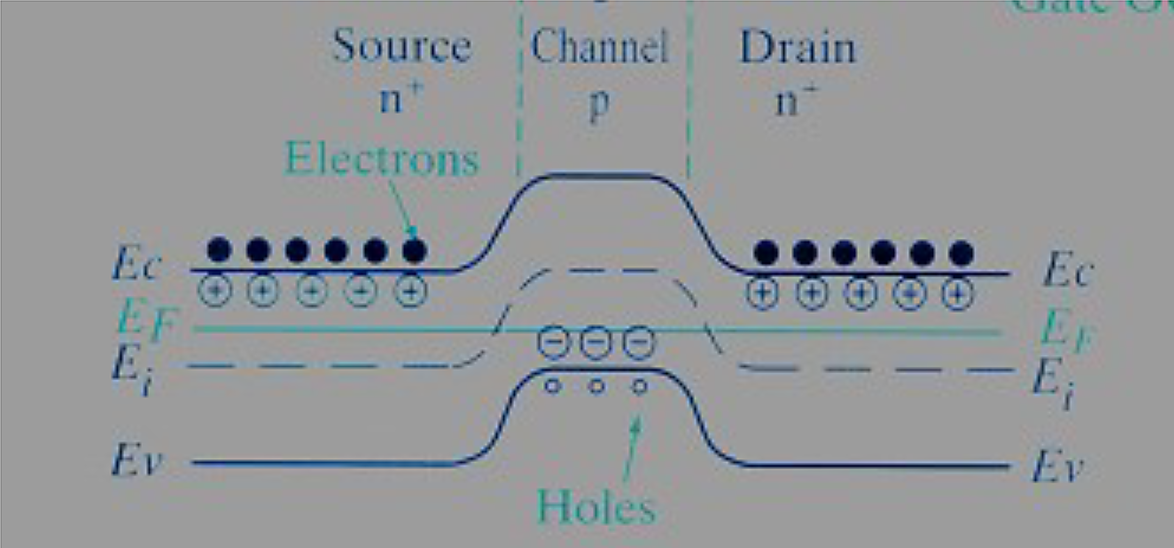
With no gate voltage, no current flows
1 · STRUCTURE AND OPERATION
Source and drain are n⁺, the body is p-type: two back-to-back pn junctions lie between source and drain.
Whatever the polarity of v_{DS}, one junction is reverse-biased, so i_{D} ≈ 0.
The energy barrier (left) keeps the electrons of the source away from the drain.
Figure: web source, via the original lecture slides
ELEC1 · Lecture 3 · MOSFETs
5

Slide 6
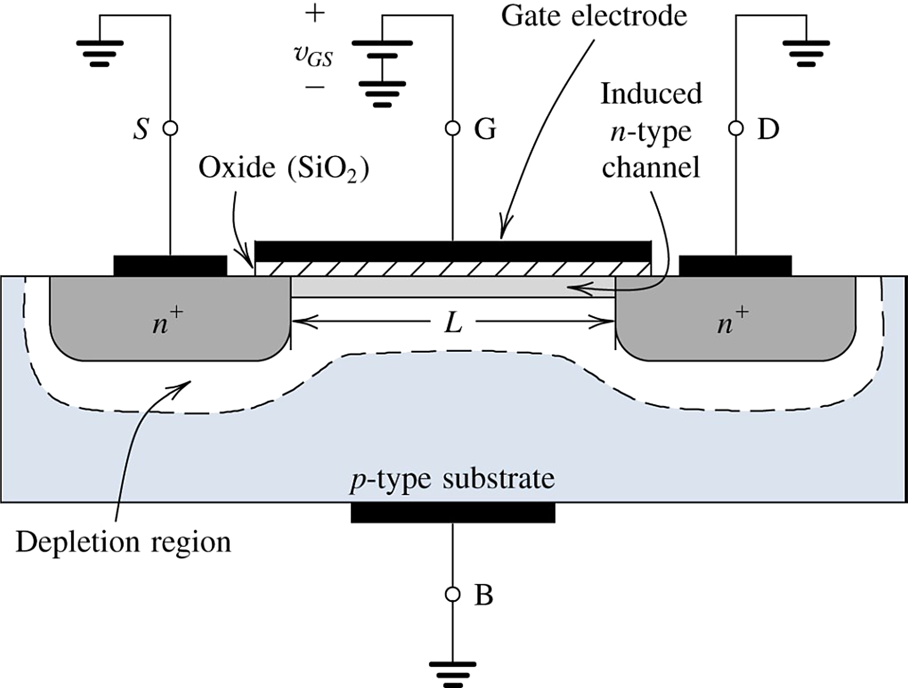
Creating a channel: the threshold voltage
1 · STRUCTURE AND OPERATION
A positive v_{GS} pushes holes away from the region under the gate and draws electrons in from the n⁺ source and drain.
Once enough electrons gather, they form an n-type inversion layer: the channel linking source to drain.
DEFINITION
Threshold voltage V_{t}: the value of v_{GS} at which the channel just forms.
Figure: Sedra & Smith, Microelectronic Circuits
ELEC1 · Lecture 3 · MOSFETs
6

Slide 7
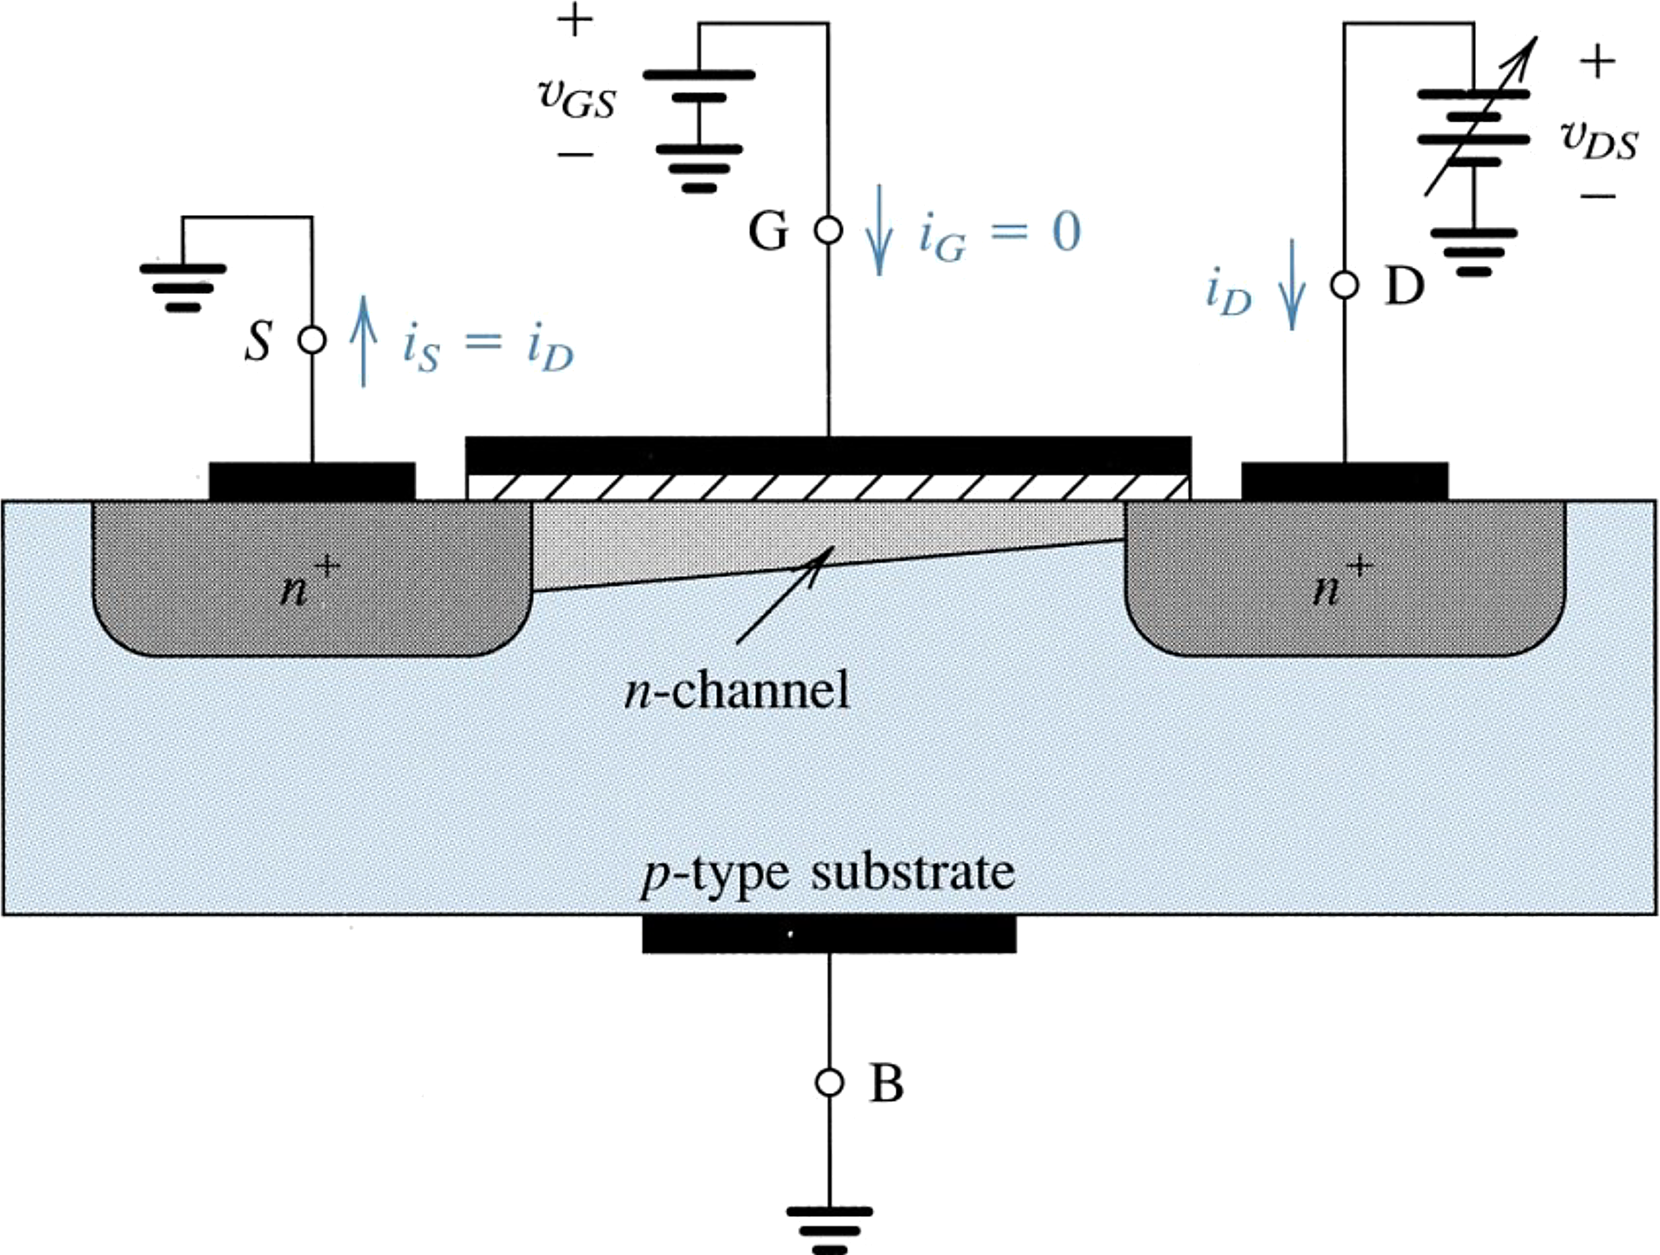
Increasing v_{DS}: the channel tapers and pinches off
1 · STRUCTURE AND OPERATION
Along the channel, the voltage rises from 0 at the source to v_{DS} at the drain.
The gate-to-channel voltage therefore falls from v_{GS} to v_{GS} − v_{DS}: the channel gets shallower toward the drain.
PINCH-OFF
When v_{DS} = v_{GS} − V_{t}, the channel depth at the drain end falls to almost zero. Increasing v_{DS} further barely changes i_{D}: the current saturates.
Figure: Sedra & Smith, Microelectronic Circuits
ELEC1 · Lecture 3 · MOSFETs
7

Slide 8
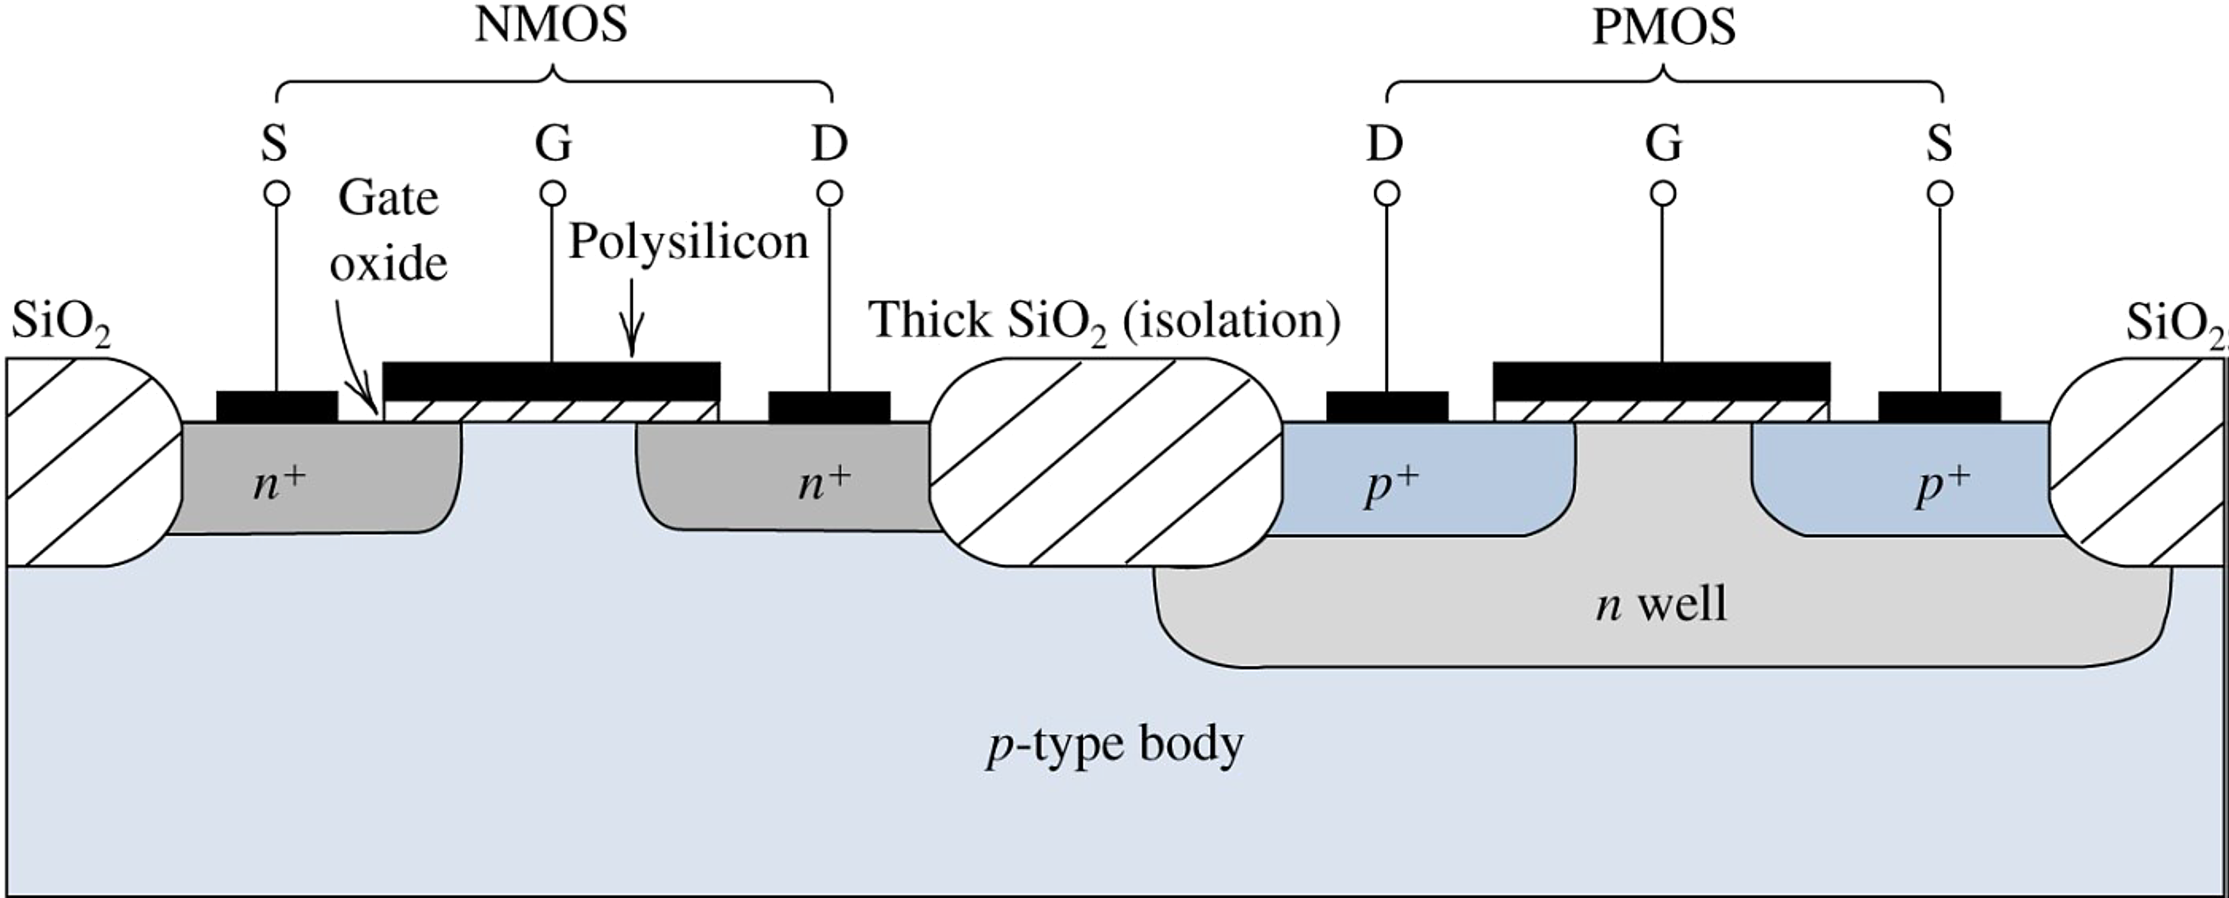
CMOS: NMOS and PMOS on one chip
1 · STRUCTURE AND OPERATION
Figure: Sedra & Smith, Microelectronic Circuits
The PMOS transistor is built in an n-well, with p⁺ source and drain.
Thick oxide isolates neighbouring devices. CMOS circuits use both types together.
ELEC1 · Lecture 3 · MOSFETs
8

Slide 9
Circuit symbols: n-channel and p-channel
1 · STRUCTURE AND OPERATION
In these symbols the arrow is on the body: it points in for an n-channel device and out for a p-channel device.
D
D
PMOS: holes carry the current and every voltage and current is reversed. It conducts when v_{GS} < V_{t}, with V_{t} negative.
G
B
G
B
S
S
n-channel
p-channel
ELEC1 · Lecture 3 · MOSFETs
9

Slide 10
I–V characteristics
02
1
Structure and operation
2
I–V characteristics
3
MOSFETs in DC circuits
4
The MOSFET as an amplifier
The i_{D}–v_{DS} family
5
The MOSFET as a switch
Saturation: the square law
Triode and saturation equations
Resistor and large-signal models

Slide 11
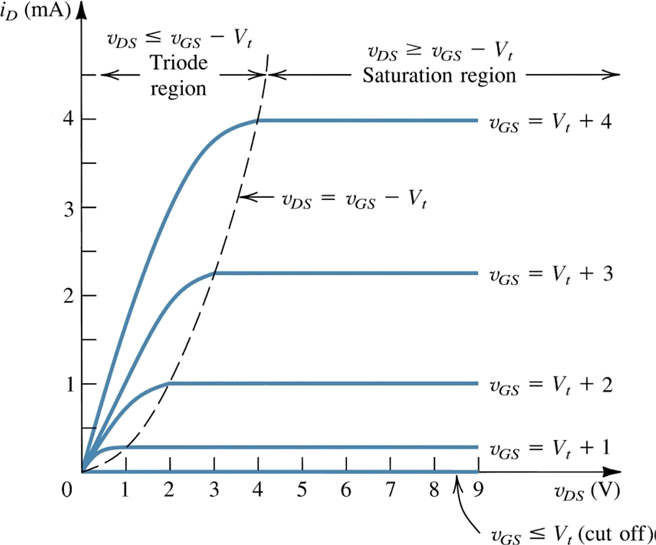
The i_{D}–v_{DS} family of curves
2 · I–V CHARACTERISTICS
Each curve is one value of v_{GS} > V_{t}.
Left of the dashed line (v_{DS} < v_{GS} − V_{t}): triode. i_{D} rises with v_{DS}.
Right of it: saturation. i_{D} is set by v_{GS} alone.
For v_{GS} ≤ V_{t}: cutoff, i_{D} = 0.
Figure: Sedra & Smith, Microelectronic Circuits
ELEC1 · Lecture 3 · MOSFETs
11

Slide 12

In saturation, i_{D} depends only on v_{GS}
2 · I–V CHARACTERISTICS
Measured in saturation, the transfer characteristic is a parabola that starts at v_{GS} = V_{t}.
$$i_{D}=\frac{1}{2}k_{n}^{′}\frac{W}{L}(v_{GS}−V_{t})^{2}$$
Doubling (v_{GS} − V_{t}) quadruples i_{D}: the square law.
Figure: Sedra & Smith, Microelectronic Circuits
ELEC1 · Lecture 3 · MOSFETs
12

Slide 13

Triode and saturation: one curve, two equations
2 · I–V CHARACTERISTICS
TRIODE
v_{DS} < v_{GS} − V_{t}
$$i_{D}=k_{n}^{′}\frac{W}{L}\left[(v_{GS}−V_{t})v_{DS}−\frac{1}{2}v_{DS}^{2}\right]$$
SATURATION
v_{DS} ≥ v_{GS} − V_{t}
$$i_{D}=\frac{1}{2}k_{n}^{′}\frac{W}{L}(v_{GS}−V_{t})^{2}$$
Both require v_{GS} > V_{t}: without a channel, i_{D} = 0 (cutoff).
Figure: Sedra & Smith, Microelectronic Circuits
ELEC1 · Lecture 3 · MOSFETs
13

Slide 14
Small v_{DS}: a voltage-controlled resistor
2 · I–V CHARACTERISTICS
For v_{DS} ≪ 2(v_{GS} − V_{t}) the v_{DS}² term is negligible:
$$i_{D}≈k_{n}^{′}\frac{W}{L}(v_{GS}−V_{t})v_{DS}$$
The channel behaves as a resistor whose value v_{GS} sets:
$$r_{DS}={\left[k_{n}^{′}\frac{W}{L}(v_{GS}−V_{t})\right]}^{−1}$$
This is the region used when the MOSFET acts as a closed switch (Section 5).
Figure: Sedra & Smith, Microelectronic Circuits
ELEC1 · Lecture 3 · MOSFETs
14

Slide 15
Large-signal model in saturation
2 · I–V CHARACTERISTICS
In saturation the MOSFET acts as a voltage-controlled current source from drain to source.
G
i_{G} = 0
D
+
i_{D}
The gate draws no current: i_{G} = 0.
The drain current is set by v_{GS} alone:
v_{GS}
−
S
$$i_{D}=\frac{1}{2}k_{n}^{′}\frac{W}{L}(v_{GS}−V_{t})^{2}$$
ELEC1 · Lecture 3 · MOSFETs
15

Slide 16
MOSFETs in DC circuits
03
1
Structure and operation
2
I–V characteristics
3
MOSFETs in DC circuits
4
The MOSFET as an amplifier
Assume, solve, check
5
The MOSFET as a switch
Example: the drain voltage
The current mirror

Slide 17
DC analysis: assume, solve, check
3 · MOSFETS IN DC CIRCUITS
1
2
3
Assume
Solve
Check
a region, usually saturation (and v_{GS} > V_{t}).
with that region’s i_{D} equation and KVL/KCL. Reject roots that give v_{GS} < V_{t}.
the assumption: saturation needs v_{DS} ≥ v_{GS} − V_{t}. If it fails, redo it in triode.
The gate draws no current, so gate-bias resistors form an unloaded divider.
ELEC1 · Lecture 3 · MOSFETs
17

Slide 18
Example 1: find the drain voltage (1 of 2)
3 · MOSFETS IN DC CIRCUITS
Find the drain voltage V_{D}. The MOSFET’s region is not given.
+V_{DD} = 10 V
1
Find the gate voltage V_{G}
No current flows into the gate, so R_{G1} and R_{G2} form an unloaded voltage divider.
R_{D} = 6 kΩ
$$V_{G}=V_{DD}\frac{R_{G2}}{R_{G1}+R_{G2}}=10·\frac{10}{10+10}=5 V$$
R_{G1} = 10 MΩ
2
Assume the MOSFET is in saturation
V_{G} = 5 V
The region is unknown. Saturation is the usual bias region; we check this assumption at the end.
$$I_{D}=\frac{1}{2}k_{n}^{′}\frac{W}{L}(V_{GS}−V_{t})^{2}$$
R_{G2} = 10 MΩ
3
Express V_{GS} through the source resistor
R_{S} = 6 kΩ
I_{D} flows through R_{S}, lifting the source to V_{S} = I_{D}R_{S}. With I_{D} in mA and R in kΩ, the products are in volts.
$$V_{GS}=V_{G}−I_{D}R_{S}=5−6I_{D}$$
GIVEN
V_{DD} = 10 V
R_{G1} = R_{G2} = 10 MΩ
R_{D} = R_{S} = 6 kΩ
V_{t} = 1 V, k′_{n}(W/L) = 1 mA/V²
ELEC1 · Lecture 3 · MOSFETs
18

Slide 19
Example 1: find the drain voltage (2 of 2)
3 · MOSFETS IN DC CIRCUITS
4
Substitute V_{GS} into the saturation equation and solve
+V_{DD} = 10 V
Units: I_{D} in mA. Expanding gives a quadratic with two roots.
$$I_{D}=\frac{1}{2}(1)(5−6I_{D}−1)^{2}$$
R_{D} = 6 kΩ
$$18I_{D}^{2}−25I_{D}+8=0 ⇒ I_{D}=0.89 or 0.5 mA$$
R_{G1} = 10 MΩ
5
Keep the physical root
V_{D} = 7 V
A valid solution must leave V_{GS} > V_{t}; otherwise there is no channel and no current.
$$I_{D}=0.89: V_{GS}=5−6(0.89)=−0.33 V<V_{t} (reject)$$
V_{G} = 5 V
$$I_{D}=0.5: V_{GS}=5−6(0.5)=2 V>V_{t} (keep)$$
V_{S} = 3 V
Find the drain (and source) voltage
6
R_{G2} = 10 MΩ
$$V_{D}=V_{DD}−I_{D}R_{D}=10−0.5(6)=7 V, V_{S}=I_{D}R_{S}=3 V$$
7
Check the saturation assumption
R_{S} = 6 kΩ
Saturation needs V_{DS} ≥ V_{GS} − V_{t}.
$$V_{DS}=7−3=4 V ≥ V_{GS}−V_{t}=1 V$$
✓ The assumption holds.
GIVEN
V_{D} = 7 V
with I_{D} = 0.5 mA, V_{GS} = 2 V
V_{DD} = 10 V
R_{G1} = R_{G2} = 10 MΩ
R_{D} = R_{S} = 6 kΩ
V_{t} = 1 V, k′_{n}(W/L) = 1 mA/V²
ELEC1 · Lecture 3 · MOSFETs
19

Slide 20
The current mirror
3 · MOSFETS IN DC CIRCUITS
Q₁ is diode-connected (gate tied to drain), so it is in saturation. R_{SET} sets its current I_{REF}, and with it V_{GS}.
V_{DD}
Q₂ has the same V_{GS}. If it is also in saturation, its current scales with W/L:
R_{SET}
I_{REF}
I_{O}
$$\frac{I_{O}}{I_{REF}}=\frac{{\left(W/L\right)}_{2}}{{\left(W/L\right)}_{1}}$$
Identical transistors copy the current: I_{O} = I_{REF}.
Q₁
Q₂
ELEC1 · Lecture 3 · MOSFETs
20

Slide 21
The MOSFET as an amplifier
04
1
Structure and operation
2
I–V characteristics
3
MOSFETs in DC circuits
4
The MOSFET as an amplifier
The load line
5
The MOSFET as a switch
Transconductance g_{m}
Small-signal models
Example: gain and input resistance

Slide 22
Amplifier action: the load line
4 · THE MOSFET AS AN AMPLIFIER
i_{D} (mA)
$$v_{DS}=V_{DD}−R_{D}i_{D}$$
V_{DD}
V_{DD}/R_{D}
v_{GS} = V_{t} + 4
KVL at the drain: every operating point lies on this line.
i_{D}
R_{D}
v_{DS}
A
Between A (edge of triode) and B (cutoff) the MOSFET is in saturation: bias it there.
v_{GS} = V_{t} + 3
load line: i_{D} = (V_{DD} − v_{DS})/R_{D}
A small change in v_{GS} moves the point along the line: a large change in v_{DS}.
v_{GS} = V_{t} + 2
+
v_{GS}
−
v_{GS} = V_{t} + 1
B
v_{DS} (V)
V_{DD}
Curves computed for k′_{n}(W/L) = 1 mA/V², V_{DD} = 10 V, R_{D} = 1.25 kΩ.
ELEC1 · Lecture 3 · MOSFETs
22

Slide 23
Small-signal operation: the transconductance g_{m}
4 · THE MOSFET AS AN AMPLIFIER
1
The gate voltage is the bias plus a small signal
$$v_{GS}=V_{GS}+v_{gs}$$
2
Substitute into the saturation equation
$$i_{D}=\frac{1}{2}k_{n}^{′}\frac{W}{L}(V_{GS}−V_{t})^{2}+k_{n}^{′}\frac{W}{L}(V_{GS}−V_{t})v_{gs}+\frac{1}{2}k_{n}^{′}\frac{W}{L}v_{gs}^{2}$$
3
If v_{gs} ≪ 2(V_{GS} − V_{t}), the last term is negligible: the signal current is linear in v_{gs}
$$i_{d}=g_{m}v_{gs}, g_{m}=k_{n}^{′}\frac{W}{L}(V_{GS}−V_{t})$$
4
With a drain resistor R_{D}, the voltage gain is
$$A_{v}=\frac{v_{ds}}{v_{gs}}=−g_{m}R_{D}$$
ELEC1 · Lecture 3 · MOSFETs
23

Slide 24
Small-signal equivalent circuits
4 · THE MOSFET AS AN AMPLIFIER
G
D
G
D
+
+
v_{gs}
g_{m}v_{gs}
v_{gs}
g_{m}v_{gs}
r_{o}
−
−
S
S
The MOSFET as a voltage-controlled current source g_{m}v_{gs}; no current into the gate.
Adding r_{o} = V_{A}/I_{D} models the slight slope of the saturation curves (V_{A}: the Early voltage).
ELEC1 · Lecture 3 · MOSFETs
24

Slide 25
Example 2: bias point (1 of 2)
4 · THE MOSFET AS AN AMPLIFIER
Find the gain A_{v} = v_{o}/v_{i} and the input resistance R_{in}. First, the DC bias point.
+V_{DD} = 15 V
1
Keep only the DC circuit
R_{D} = 10 kΩ
Coupling capacitors are open circuits at DC, so v_{i}, R_{L} and the output terminal drop out.
C_{C}
v_{o}
2
Relate V_{GS} to V_{D}
No gate current flows, so there is no drop across R_{G}: V_{G} = V_{D}. With the source grounded, V_{GS} = V_{DS} ≥ V_{GS} − V_{t}: saturation is guaranteed.
R_{G} = 10 MΩ
$$V_{GS}=V_{D}=15−10I_{D}$$
3
Solve for the bias current (I_{D} in mA)
+
C_{C}
$$I_{D}=\frac{1}{2}(0.25)(V_{D}−1.5)^{2}$$
v_{i}
R_{in}
R_{L} = 10 kΩ
$$12.5I_{D}^{2}−34.75I_{D}+22.78=0 ⇒ I_{D}=1.06 or 1.72 mA$$
I_{D} = 1.72 mA gives V_{GS} = −2.21 V < V_{t}: reject. So I_{D} = 1.06 mA and V_{GS} = V_{D} = 4.41 V.
GIVEN
V_{DD} = 15 V
R_{G} = 10 MΩ
R_{D} = R_{L} = 10 kΩ
V_{t} = 1.5 V, k′_{n}(W/L) = 0.25 mA/V², V_{A} = 50 V
ELEC1 · Lecture 3 · MOSFETs
25

Slide 26
Example 2: gain and input resistance (2 of 2)
4 · THE MOSFET AS AN AMPLIFIER
4
Small-signal parameters at the bias point
+V_{DD} = 15 V
$$g_{m}=k_{n}^{′}\frac{W}{L}(V_{GS}−V_{t})=0.25(4.41−1.5)=0.728 mA/V$$
$$r_{o}=\frac{V_{A}}{I_{D}}=\frac{50}{1.06}=47.2 kΩ$$
R_{D} = 10 kΩ
C_{C}
5
Find the load seen by the drain
v_{o}
Capacitors are shorts for the signal. R_{G} is so large that its signal current is negligible.
R_{G} = 10 MΩ
$$R_{D}‖R_{L}‖r_{o}=10‖10‖47.2=4.52 kΩ$$
6
Voltage gain
$$A_{v}=\frac{v_{o}}{v_{i}}≈−g_{m}(R_{D}‖R_{L}‖r_{o})=−0.728×4.52=−3.29 V/V$$
+
C_{C}
v_{i}
R_{in}
R_{L} = 10 kΩ
7
Input resistance (Miller effect)
R_{G} joins input and output. The output swings by A_{v}v_{i}, so the current into R_{G} is (1 − A_{v})v_{i}/R_{G}: the input sees R_{G} divided by (1 − A_{v}).
$$R_{in}=\frac{R_{G}}{1−A_{v}}=\frac{10}{1+3.29}=2.33 MΩ$$
GIVEN
A_{v} ≈ −3.3 V/V
R_{in} = 2.33 MΩ
V_{DD} = 15 V
R_{G} = 10 MΩ
R_{D} = R_{L} = 10 kΩ
V_{t} = 1.5 V, k′_{n}(W/L) = 0.25 mA/V², V_{A} = 50 V
ELEC1 · Lecture 3 · MOSFETs
26

Slide 27
The MOSFET as a switch
05
1
Structure and operation
2
I–V characteristics
3
MOSFETs in DC circuits
4
The MOSFET as an amplifier
Cutoff: an open switch
5
The MOSFET as a switch
Deep triode: a closed switch

Slide 28
The MOSFET as a switch
5 · THE MOSFET AS A SWITCH
v_{GS} < V_{t}: cutoff. The switch is open and i_{D} = 0.
V_{DD}
V_{DD}
v_{GS} high and v_{DS} small: deep triode. The switch is closed, with a small resistance r_{DS}.
R_{D}
R_{D}
v_{O}
v_{O}
Driving the gate between these two states is the basis of digital logic.
≡
v_{I}
open: v_{I} < V_{t}
closed: v_{I} high
ELEC1 · Lecture 3 · MOSFETs
28

Slide 29
Summary: three regions of operation
LECTURE 3 · SUMMARY
REGION
CONDITION
DRAIN CURRENT
Cutoff
v_{GS} ≤ V_{t}
$$i_{D}=0$$
Triode
v_{GS} > V_{t}, v_{DS} < v_{GS} − V_{t}
$$i_{D}=k_{n}^{′}\frac{W}{L}\left[(v_{GS}−V_{t})v_{DS}−\frac{1}{2}v_{DS}^{2}\right]$$
Saturation
v_{GS} > V_{t}, v_{DS} ≥ v_{GS} − V_{t}
$$i_{D}=\frac{1}{2}k_{n}^{′}\frac{W}{L}(v_{GS}−V_{t})^{2}$$
DC problems: assume a region, solve, then check the assumption.
Small signals: g_{m} = k′_{n}(W/L)(V_{GS} − V_{t}); a common-source stage has A_{v} = −g_{m}R_{D}.
ELEC1 · Lecture 3 · MOSFETs
29

Slide 30
Thank you
NEXT LECTURE
Lecture 4: Bipolar junction transistors (BJTs)
With thanks to Dr. Sameh Osama Ezzat, who prepared the original material for this lecture.
Figures: Sedra & Smith, Microelectronic Circuits (Oxford University Press); other diagrams from web sources via the original slides; circuits and the load-line plot redrawn for this lecture.

