Slide 1

Design Patterns
SE2 – Spring Semester 2022
Olivier Lischer
Computer Science

Slide 2
Design Patterns
Builder
Prototype
Flyweight
Iterator
Memento
Mediator

Slide 3
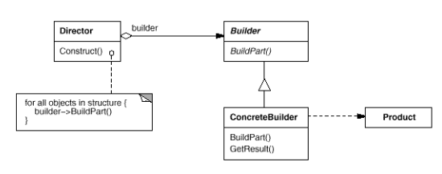
Builder
Creational Patterns
Separates construction of complex class
Can hide the creation of complex objects

Slide 4
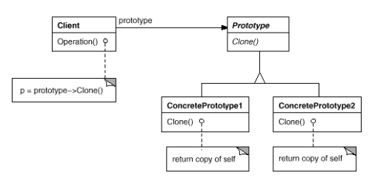
Prototype
Creational Patterns
Factory Method for objects
Cloning a concrete object
Clone function is crucial

Slide 5
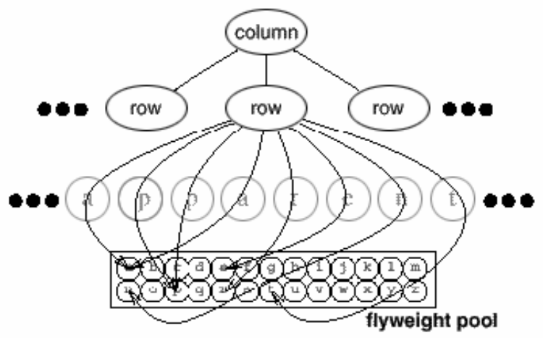
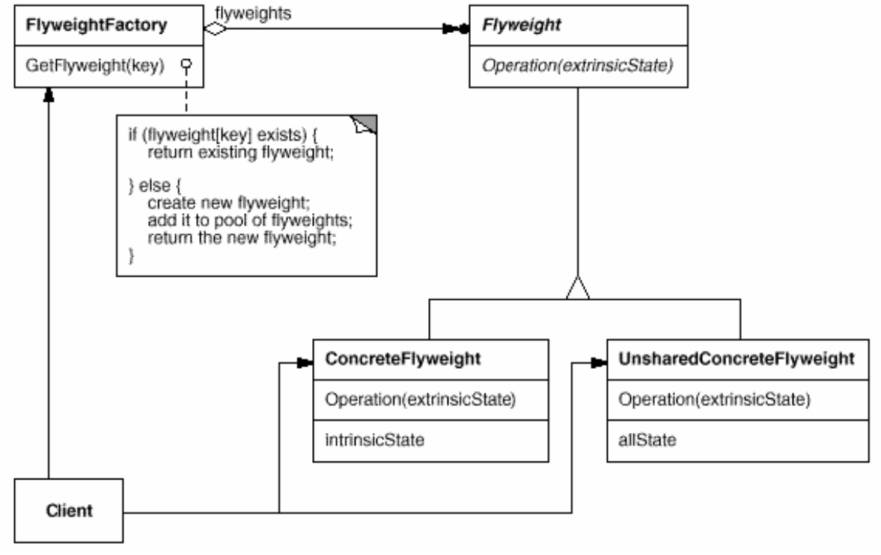
Flyweight
Structural Patterns

Slide 6
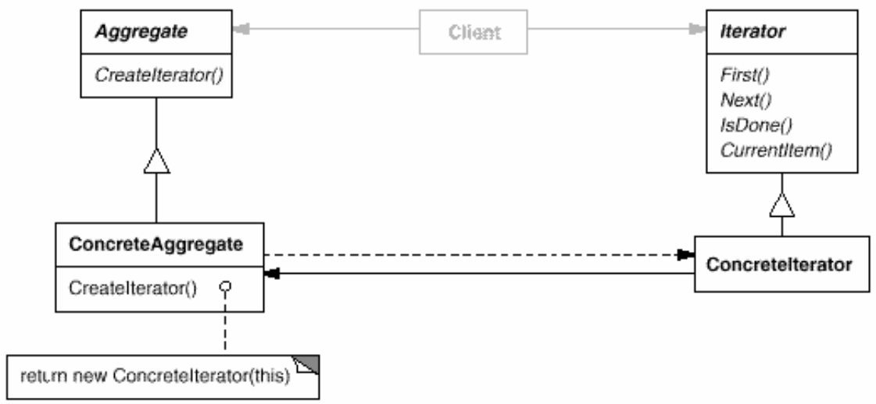
Iterator
Behavioral Patterns
Used to access items in data structure uniformly
Hides implementation of the data structure

Slide 7
Memento
Behavioral Patterns
Store internal state
Restore internal state

Slide 8
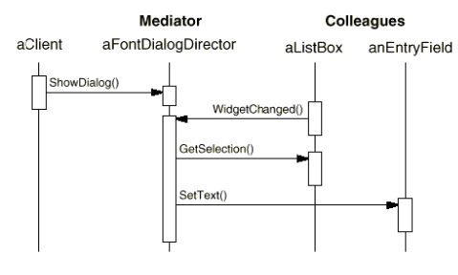
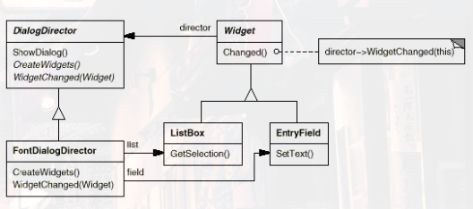
Mediator
Behavioral Patterns

