Slide 1

ORIE 5255 Leveraging AI for EVM Layer-1 Blockchain Insights (Leo Xu)

Slide 2
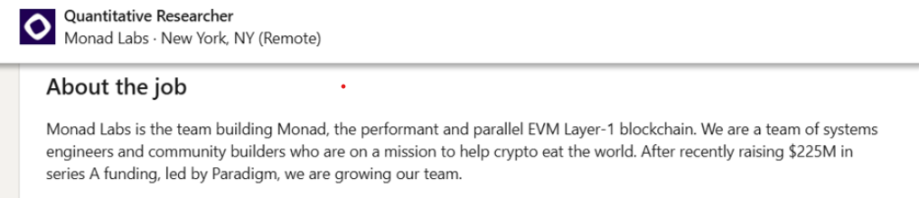
JD we are working with
Monad Labs:
Hiring quantitative researcher working on open-ended problems related to blockchain performance and system/user behavior

Slide 3
Objective
Provide insights to optimize transaction costs, uncover transaction dependency, and enhance the economic efficiency of blockchain infrastructure.
1. Exploratory Data Analysis
2. Principal Component Analysis
3. Clustering with K-means

Slide 4
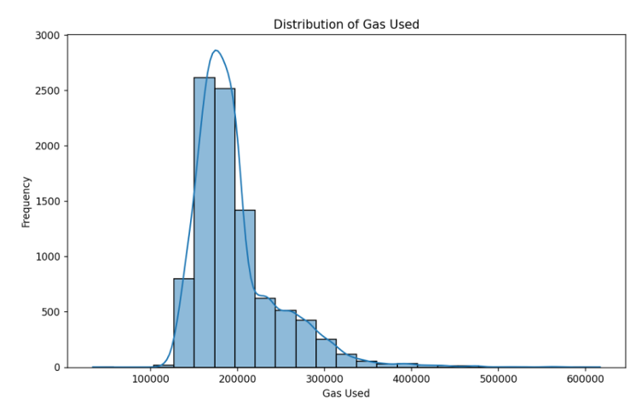
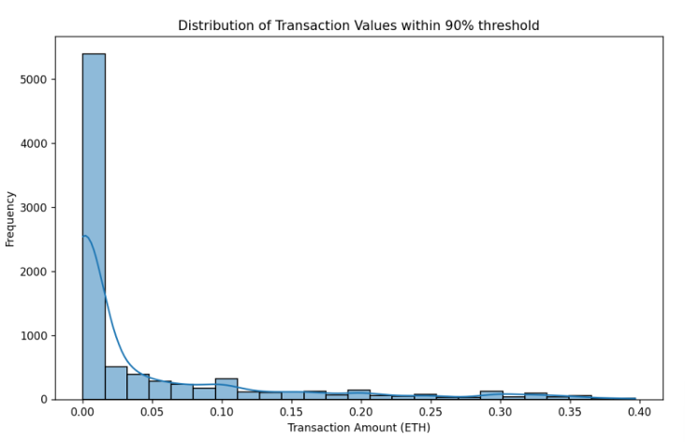
Exploratory Data Analysis
10000 Uniswap Universal Router transactions with 20 columns downloaded from EtherScan API: From, To, timeStamp, transactionIndex, gas, gasPrice, gasUsed, value, IsError, functionName, etc. The maximum transaction value is 46.43ETH

Slide 5
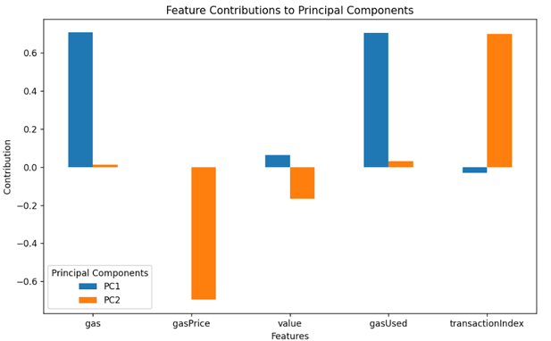
PCA
PC1 capturing 37.7% and PC2 accounting for 24.3%.
PC1 dominated by gas and gasUsed (computational complexity)
PC2 dominated by gasPrice and transactionIndex (economic dynamics)

Slide 6
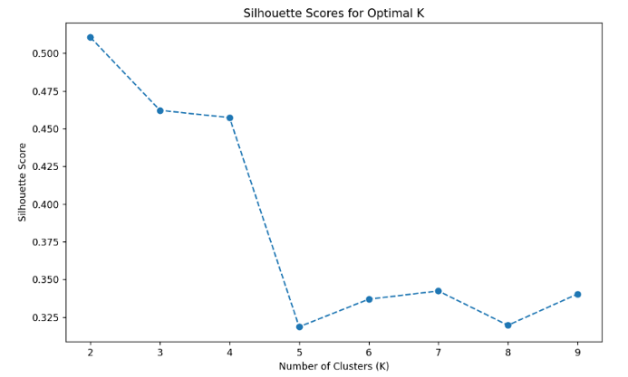
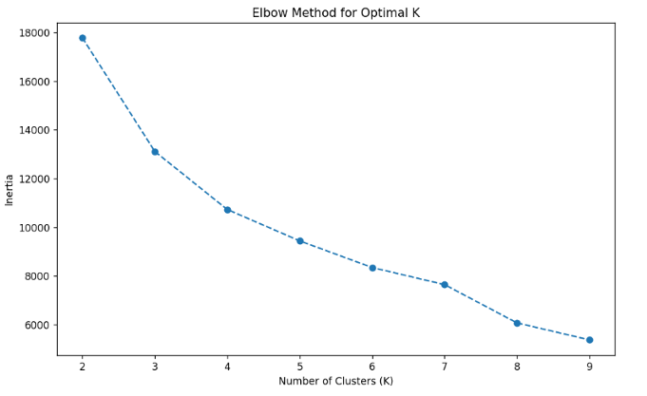
K means and clustering
We choose K=3 in this analysis

Slide 7
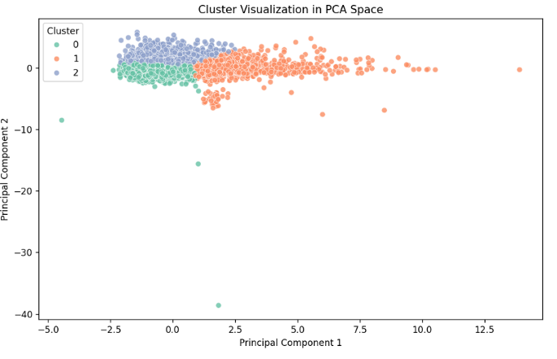
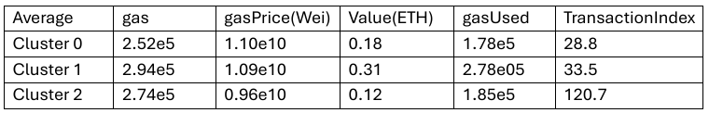
Cluster 1 have higher gas used. Cluster 0 and Cluster 2 have lower gas used while Cluster 0 have higher transaction index that Cluster 2

Slide 8
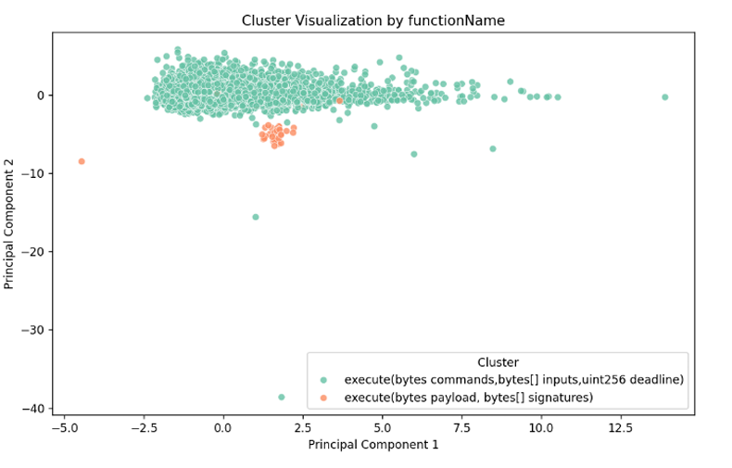
Clustering with functionaName
Over half of the multisignature wallets transactions had their gas limit set to 50,000 units

Slide 9
Further Study
Cluster transaction with transaction value and frequencies
Predictive modelling for gas price and gas usage
Analyze transaction not included in the block (Memepool)
Github Link: liolio66666/ORIE5255_Crypto_Project

