Slide 1
Data Pre-Processing:Loading Data and Basic Visualisations

Slide 2
Learning Outcomes
How to generate, load and process different datasets from different sources
Notes:
The chapter begins by explaining, using examples, the difference between system-1 and system-2 decision making.
It further uses examples for each of the cognitive heuristics described in the chapter, including its potential benefits and risks.

Slide 3
The Data
We have a series of data files that we will be working with. They are located in data folder
auto: data on automobiles
personality: data on Big Five personality traits for 434 persons
birth1.sas7bdat: data on birth weight
fertz: data on fertilizer
who_suicide_statistics: data on suicide
potatoes: impact of storage and cooking on potatoes’ flavor
Employees: data on employees of certain company

Slide 4
Reading Comma delimited files (csv) using read.table()
who_suicide <- read.table(file.choose(),sep = “,” header=TRUE)
head(who_suicide)
## country year sex age suicides_no population ## 1 Albania 1985 female 15-24 years NA 277900 ## 2 Albania 1985 female 25-34 years NA 246800 ## 3 Albania 1985 female 35-54 years NA 267500 ## 4 Albania 1985 female 5-14 years NA 298300 ## 5 Albania 1985 female 55-74 years NA 138700 ## 6 Albania 1985 female 75+ years NA 34200

Slide 5
read.table()
Generally used to load data in different format into R
file: Path to the file containing the data to be imported into R.
sep: field separator character. \t is used for tab-delimited file. _ header: logical value. If TRUE, read.table() assumes that your file has a header row, so row 1 is the name of each column. If that’s not the case, you can add the argument header = FALSE.
dec: the character used in the file for decimal points.

Slide 6
Reading Comma Seperated File (txt) using read.table()
auto <- read.table(file.choose(),sep = “,”, header=F)
head(auto[,4:9])
## V4 V5 V6 V7 V8 V9 ## 1 gas std two convertible rwd front ## 2 gas std two convertible rwd front ## 3 gas std two hatchback rwd front ## 4 gas std four sedan fwd front ## 5 gas std four sedan 4wd front ## 6 gas std two sedan fwd front
read.table() can be used to read Comma Seperated file (.txt) by specifying the argument sep = “,”

Slide 7
Reading TAB delimited files (txt) using read.table()
potato <- read.table(file.choose(),sep = "\t", header=F)
head(auto[,4:9])
## V1 V2 V3 V4 V5 V6 V7 V8 ## 1 1 1 1 1 1 2.9 3.2 3.0 ## 2 1 1 1 1 2 2.3 2.5 2.6 ## 3 1 1 1 1 3 2.5 2.8 2.8 ## 4 1 1 1 1 4 2.1 2.9 2.4 ## 5 1 1 1 1 5 1.9 2.8 2.2 ## 6 1 1 1 2 1 1.8 3.0 1.7
read.table() can also be used to TAB delimited files (txt) by specifying the argument sep = "\t"

Slide 8
Reading comma delimited files using read.csv()
who_suicide<-read.csv(file.choose(), header=TRUE)
head(who_suicide)
## country year sex age suicides_no population ## 1 Albania 1985 female 15-24 years NA 277900 ## 2 Albania 1985 female 25-34 years NA 246800 ## 3 Albania 1985 female 35-54 years NA 267500 ## 4 Albania 1985 female 5-14 years NA 298300 ## 5 Albania 1985 female 55-74 years NA 138700 ## 6 Albania 1985 female 75+ years NA 34200
read.csv is used in reading comma delimited files into R.

Slide 9
Reading semicolon separated files using read.csv2
who_suicide_1<-read.csv2(file.choose(), header=TRUE)
head((who_suicide_1)
## country year sex age suicides_no population ## 1 Albania 1985 female 15-24 years NA 277900 ## 2 Albania 1985 female 25-34 years NA 246800 ## 3 Albania 1985 female 35-54 years NA 267500 ## 4 Albania 1985 female 5-14 years NA 298300 ## 5 Albania 1985 female 55-74 years NA 138700 ## 6 Albania 1985 female 75+ years NA 34200
The read.csv2 is often used to read semicolon separated files into R. Setting sep argument is optional when using read.csv2 as seen in the case of read.csv

Slide 10
Reading “Tab-separated value” files (“.txt”) using read.delim()
potato <- read.delim(file.choose(),sep = "\t", header=F)
head(auto[,4:9])
## V1 V2 V3 V4 V5 V6 V7 V8 ## 1 1 1 1 1 1 2.9 3.2 3.0 ## 2 1 1 1 1 2 2.3 2.5 2.6 ## 3 1 1 1 1 3 2.5 2.8 2.8 ## 4 1 1 1 1 4 2.1 2.9 2.4 ## 5 1 1 1 1 5 1.9 2.8 2.2 ## 6 1 1 1 2 1 1.8 3.0 1.7
read.delim() is used for reading TAB delimited files (txt) by specifying the argument sep = `"

Slide 11
Using readr Package
In terms of speed, readr is ~10x faster than base read.table() functions (read.csv,read.csv2).
By default , strings are untouched and common date/time formats are automatically passed.

Slide 12
Readr functions
read_csv(): comma delimited files
read_csv2(): semicolon separated files
read_tsv(): tab delimited files
read_delim(): files with any delimiter

Slide 13
Import Excel files
We can always use the readxl package to get data out of Excel and into R. The readxl package supports both .xls format and the modern xml-based .xlsx format.
To import excel sheet into R, we use the function read_excel() and specify the sheet number in the arguments.

Slide 14
Import Excel files using read_excel() in readxlPackage
sht1 <- read_excel(file.choose(), sheet = 1)
sht2 <- read_excel(file.choose(), sheet = 2)
str(sht1)
## Classes 'tbl_df', 'tbl' and 'data.frame': 20 obs. of 8 variables: ## $ EmployeeID: num 120 121 123 124 125 126 127 128 129 130 ... ## $ Last_Name : chr "Collins" "Kenobi" "Bouchard" "White" ... ## $ First_Name: chr "Barnabas" "Obi-wan" "Angelique" "Cassandra" ... ## $ Gender : chr "M" NA "F" "F" ... ## $ HireDate : POSIXct, format: "2015-08-01" "2011-07-13" ... ## $ JobTitle : chr "CEO" "Accountant II" "Analyst I" NA ... ## $ Salary : num 500000 91000 76 358000 65000 85000 94000 89000 60000 120000 ... ## $ Department: chr "Administration" "Jedi" "Research" "Administration" ...

Slide 15
Importing data from databases
To import data from a database you first have to create a connection to it. We use the package DBI to connect to SQL server through R and RMYSQL to perform SQL queries within R. The Function dbConnect() creates a connection between your R session and a SQL database. The first argument is mapping the data between R and the database. For hosted SQL DB , we need to specify the following arguments in dbConnect(): dbname, host, port, user and password.

Slide 16
Establish a connection
To extract data from database in a remote server, we need to first establish the connection to the server in R.
host <- "courses.csrrinzqubik.us-east-1.rds.amazonaws.com" connect <- dbConnect(RMySQL::MySQL(), dbname = "tweater", host = host, port = 3306, user = "student", ` password = “datacamp”)``

Slide 17
List the database tables
Once we are connected to the database. We can use dbListTables() to see what tables the database contains:
tables <- dbListTables(connect)
tables
## [1] "comments" "tweats" "users"

Slide 18
Import data from tables
We can use the dbReadTable() function to import data from the database tables. users <- dbReadTable(connect, "users")
users
## id name login ## 1 1 elisabeth elismith ## 2 2 mike mikey ## 3 3 thea teatime ## 4 4 thomas tomatotom ## 5 5 oliver olivander ## 6 6 kate katebenn ## 7 7 anjali lianja

Slide 19
Importing data from the web
We can also import csv file hosted on remote server directly into R. You can use read_csv to directly import csv files from the web.
house <- read.csv("https://factual.ng/training/house.csv", header = T)
str(house)
## 'data.frame': 781 obs. of 8 variables: ## $ MLS. : int 132842 134364 135141 135712 136282 136431 137036 137090 137159 137570 ... ## $ Location : Factor w/ 34 levels "Arroyo Grande",..: 1 24 24 19 30 22 30 30 19 2 ... ## $ Price : int 795000 399000 545000 909000 109900 324900 192900 215000 999000 319000 ... ## $ Bedrooms : int 3 4 4 4 3 3 4 3 4 3 ... ## $ Bathrooms : int 3 3 3 4 1 3 2 2 3 2 ... ## $ SQFT : int 2371 2818 3032 3540 1249 1800 1603 1450 3360 1323 ... ## $ Price.SQFT: num 335 142 180 257 88 ... ## $ Status : Factor w/ 3 levels "Foreclosure",..: 3 3 3 3 3 3 3 3 3 3 ...

Slide 20
Importing data from other statistical software
To import data from other statistical software such as Stata, SPSS, Sas. We use the package called haven.
SAS: read_sas()
STATA: read_dta()
SPSS: read_sav()

Slide 21
read_sas() to read SAS data file
we use the read_sas() function in haven package to read sas files into R
birth <- read_sas(file.choose())
head(birth)
## # A tibble: 6 x 10 ## Weight Black Married Boy MomAge MomSmoke CigsPerDay MomWtGain Visit ## <dbl> <dbl> <dbl> <dbl> <dbl> <dbl> <dbl> <dbl> <dbl> ## 1 4111 0 1 1 -3 0 0 -16 1 ## 2 3997 0 1 0 1 0 0 2 3 ## 3 3572 0 1 1 0 0 0 -3 3 ## 4 1956 0 1 1 -1 0 0 -5 3 ## 5 3515 0 1 1 -6 0 0 -20 3 ## 6 3757 0 1 0 3 0 0 0 3 ## # ... with 1 more variable: MomEdLevel <dbl>

Slide 22
read_dta() to read Stata data file
we use the read_dta() function in haven package to Stata files into R
alcohol <- read_dta(file.choose())
head(alcohol)
## # A tibble: 6 x 4 ## adults kids income consume ## <dbl> <dbl> <dbl> <dbl> ## 1 2 2 758 1 ## 2 2 3 1785 1 ## 3 3 0 1200 1 ## 4 1 0 545 1 ## 5 4 1 547 1 ## 6 2 2 1264 1

Slide 23
read_sav() to read SPSS data file into R
we use the read_sav() function in haven package to Stata files into R
pers <- read_sav("data/personality.sav")
head(pers)
## # A tibble: 6 x 4 ## Neurotic Extroversion Agreeableness Conscientiousness ## <dbl> <dbl> <dbl> <dbl> ## 1 39 38 31 12 ## 2 6 38 27 12 ## 3 17 39 32 13 ## 4 28 35 39 13 ## 5 26 35 46 14 ## 6 17 37 28 15

Slide 24
Basic Visualisations : Scatter Plot
Scatter Plot is used to see the relationship between two continuous variables. Let’s load in the data on housing price in California.
hs<-read.csv(file.choose(),header=T)
str(hs)
## 'data.frame': 781 obs. of 8 variables: ## $ MLS. : int 132842 134364 135141 135712 136282 136431 137036 137090 137159 137570 ... ## $ Location : Factor w/ 34 levels "Arroyo Grande",..: 1 24 24 19 30 22 30 30 19 2 ... ## $ Price : int 795000 399000 545000 909000 109900 324900 192900 215000 999000 319000 ... ## $ Bedrooms : int 3 4 4 4 3 3 4 3 4 3 ... ## $ Bathrooms : int 3 3 3 4 1 3 2 2 3 2 ... ## $ SQFT : int 2371 2818 3032 3540 1249 1800 1603 1450 3360 1323 ... ## $ Price.SQFT: num 335 142 180 257 88 ... ## $ Status : Factor w/ 3 levels "Foreclosure",..: 3 3 3 3 3 3 3 3 3 3 ...

Slide 25
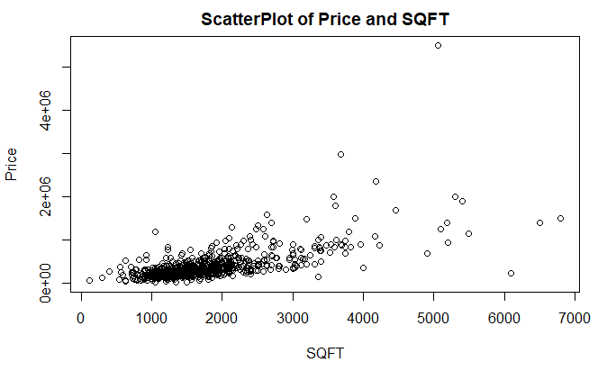
Relationship between the Price of the House and SQFT
plot(SQFT,Price, xlab="SQFT",ylab="Price", main="ScatterPlot of Price and SQFT")

Slide 26
Histogram
Histogram is used to plot continuous variable. It breaks the data into bins and shows frequency distribution of these bins. We can always change the bin size and see the effect it has on visualization. It’s often used to see the distribution of a variable.
hist(hs$Price, xlab="Price", main="Histogram of Price")

Slide 27
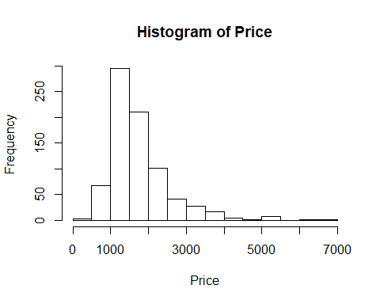
Histogram of SQFT

Slide 28
Boxplots
Box Plots are used to plot a combination of categorical and continuous variables. This plot is useful for visualizing the spread of the data and detect outliers.
boxplot(Price~Status, data = hs, main="Boxplot of Price based on HS Status")

Slide 29
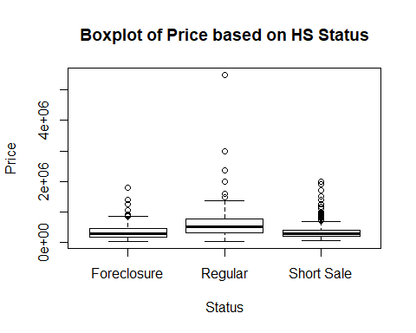
Boxplot of Price based on the House Status

