Slide 1
Cloud definitions and services models (IAAS, PAAS, SAAS)
Liubomyr Zalisko
<EPAM> LVIV UA

Slide 2
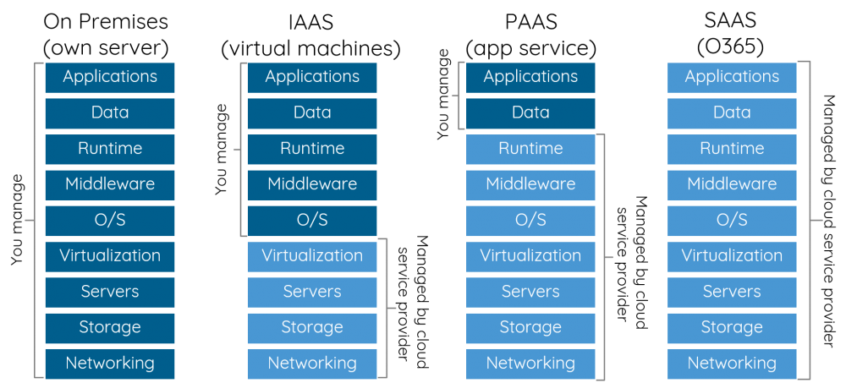
Type of cloude service models

Slide 3
ON PREMISES
On-premises is the software and technology that is located within the physical confines of an enterprise – often in the company's data center – as opposed to running remotely on hosted servers or in the cloud.
By installing and running software on hardware located within the premises of the company, internet technology (IT) staff has physical access to the data and can directly control the configuration, management and security of the computing infrastructure and data.

Slide 4
SAAS: SOFTWARE AS A SERVICE
Cloud application services, or Software as a Service (SaaS), represent the largest cloud market and are still growing quickly. SaaS uses the web to deliver applications that are managed by a third-party vendor and whose interface is accessed on the clients’ side. Most SaaS applications can be run directly from a web browser without any downloads or installations required, although some require plugins.
Because of the web delivery model, SaaS eliminates the need to install and run applications on individual computers. With SaaS, it’s easy for enterprises to streamline their maintenance and support, because everything can be managed by vendors: applications, runtime, data, middleware, OSes, virtualization, servers, storage and networking.
SaaS Examples: Google Apps, Salesforce, Workday, Concur, Citrix GoToMeeting, Cisco WebEx

Slide 5
PAAS: PLATFORM AS A SERVICE
Cloud platform services, or Platform as a Service (PaaS), are used for applications, and other development, while providing cloud components to software. What developers gain with PaaS is a framework they can build upon to develop or customize applications. PaaS makes the development, testing, and deployment of applications quick, simple, and cost-effective. With this technology, enterprise operations, or a third-party provider, can manage OSes, virtualization, servers, storage, networking, and the PaaS software itself. Developers, however, manage the applications.
Enterprise PaaS provides line-of-business software developers a self-service portal for managing computing infrastructure from centralized IT operations and the platforms that are installed on top of the hardware. The enterprise PaaS can be delivered through a hybrid model that uses both public IaaS and on-premise infrastructure or as a pure private PaaS that only uses the latter.
Enterprise PaaS Examples: Apprenda

Slide 6
IAAS: INFRASTRUCTURE AS A SERVICE
Cloud infrastructure services, known as Infrastructure as a Service (IaaS), are self-service models for accessing, monitoring, and managing remote datacenter infrastructures, such as compute (virtualized or bare metal), storage, networking, and networking services (e.g. firewalls). Instead of having to purchase hardware outright, users can purchase IaaS based on consumption, similar to electricity or other utility billing.
Compared to SaaS and PaaS, IaaS users are responsible for managing applications, data, runtime, middleware, and OSes. Providers still manage virtualization, servers, hard drives, storage, and networking. Many IaaS providers now offer databases, messaging queues, and other services above the virtualization layer as well. Some tech analysts draw a distinction here and use the IaaS+ moniker for these other options. What users gain with IaaS is infrastructure on top of which they can install any required platform. Users are responsible for updating these if new versions are released.
IaaS Examples: Amazon Web Services (AWS), Cisco Metapod, Microsoft Azure, Google Compute Engine (GCE), Joyent

Slide 7
Thank you

