Slide 1
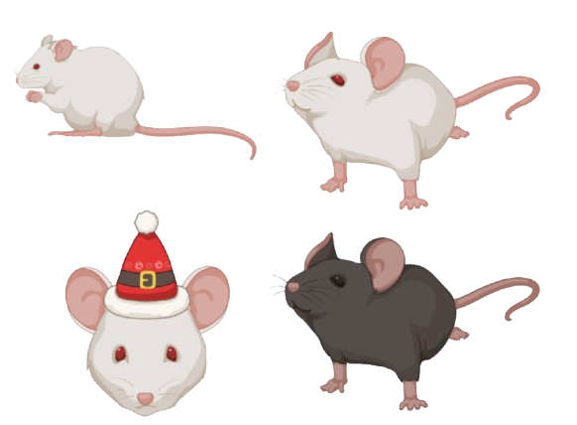
Evaluation of Different Machine Learning Classifiers in the Muridae Taxon Group
Assignment 04
BINF 6210
By: Liona Vu

Slide 2
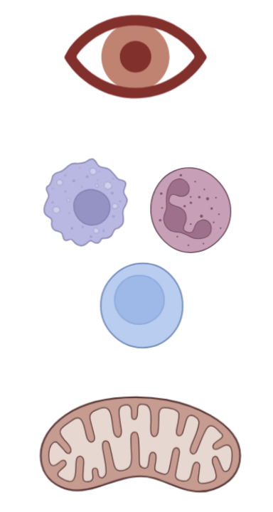



The Muridae taxon and its importance in biomedical research
The Muridae group is a scientifically important taxonomic class as it contains known research model organisms such as both the Mus musculus (Standley et al., 2024) and the Rattus norvegicus (Modlinska & Pisula, 2020) species. In fact, decades of important discoveries have been done extensively in Mus musculus (Standley et al., 2024). Since mice and rats are important to biomedical research, having the ability to distinguish Muridae species can help with the reproducibility and validation of biological results.
Various genes have been well-studied in the Muridae group. Thus, its roles are well established in their respective biological processes. In fact, these genes are well annotated in Muridae making them ideal for comparative genomic studies. These genes include, Cytb, a mitochondrial gene that codes for a protein that is part of complex III in the electron transport chain, Irbp, a gene known for its function in eye vision, and Rag1, a gene involved in the variable, diversity, and joining, (V(D)J) recombination process of immune cells (UniProt Consortium, 2025).
Irbp
Rag1
Cytb
Created in BioRender. com

Slide 3
Supervised machine learning can be used for classification
Many supervised machine learning models algorithms have been developed over the past decades. In fact, machine learning can be applied to distinguish species and validate previous work on species classification (Salles & Domingos., 2025). In addition, machine learning is useful to detect subtle differences between species that previous methods may have overlooked.
One feature that is commonly used for machine learning sequence analysis is k-mers, combinations of nucleotides A, T, C, and G of varying lengths such as dinucleotide k-mers (for a total of 16 combinations). This alignment-free approach is useful and computationally efficient because the number of sequencing data increases with each passing day.
The current gap in knowledge is that with larger genomic datasets, more automated analysis for species identification is needed while preserving accuracy and reliability. Thus, supervised machine learning models can address this.
Dinucleotide combos
AA
AT
AC
AG
TA
TT
TC
TG
CA
CT
CC
CG
GA
GT
GC
GG

Slide 4

Why use several machine learning classification algorithms?
Each machine learning model has its own inherit strengths and weaknesses. For example, random forests (RF) can control for overfitting and has high predictive accuracy (Sipper & Moore., 2021) but can be slow if too many trees are introduced. Partial least squares (PLS) use dimension reduction techniques to make data easier to interpret visually when there are lot of features but can easily overfit the data (Brereton & Lloyd., 2014).
By using multiple machine learning algorithms, it can cover the weaknesses of another model while strengthening the robustness of classification analysis. In addition, it can allow for direct comparisons and see whether each result of each machine learning algorithm is consistent with each other.

Slide 5
Defining the Hypothesis and Objectives
Hypothesis
K-mer dinucleotide frequencies have enough succinct features such that supervised machine learning algorithms can accurately train and detect different gene sequences and Muridae species
Null hypothesis
K-mer dinucleotide frequencies do not differ amongst different gene sequences and Muridae species (and is due to random chance)
Objectives
Apply multiple supervised machine learning classifiers such as RF and PLS to classify gene sequences and Muridae species
Compare and contrast how each machine learning model evaluates, trains, and classifies Cytb, Irbp, and Rag1 gene sequences, and Muridae species

Slide 6

Methodological framework to investigate Muridae machine learning classification
STEP 3. Filter unknown nucleotides, clean, quality check, and transform data (i.e. adding k-mers) (R Packages: tidyverse, Biostrings, caret)
STEP 1: Define the hypothesis and objectives, and outline analysis
STEP 2: Extract Muridae dataset from NCBI nucleotide databases
(R package: Rentrez)
STEP 6. Communicate findings and interpretation via storyboard
STEP 5: Analysis of machine learning error rates, confusion matrix, and statistical tests (PERMANOVA)
STEP 4. Apply machine learning and visualization (ROC, heatmaps, MDA)
(R Packages: base R, ggplot2, caret, Random Forests, pROC, vegan)

Slide 7
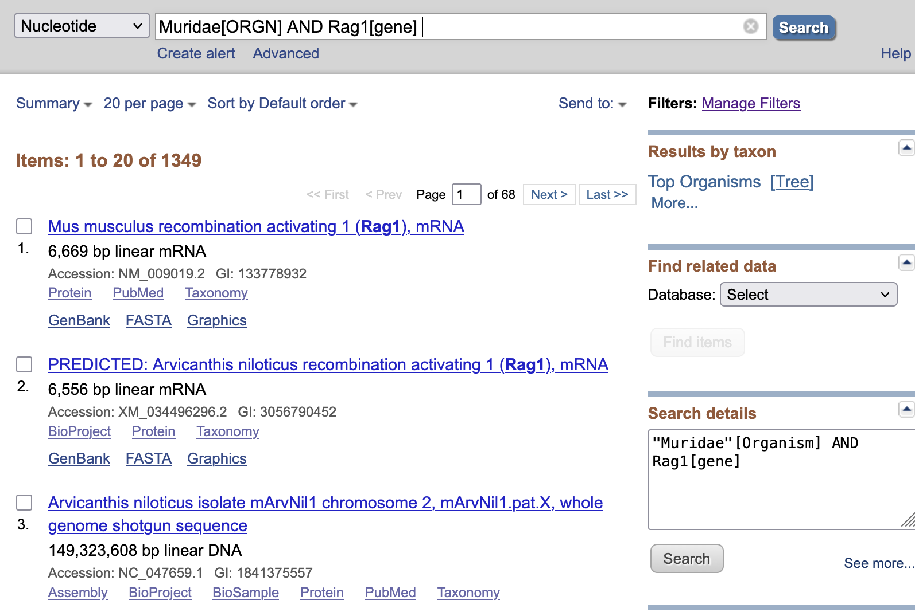

STEP 2: NCBI web search and Rentrez can be used to obtain relevant datasets
The National Center for Biotechnology Information (NCBI) is a well-established public resource that contains relevant bioinformatics databases for this analysis. Therefore, nucleotide sequences for Cytb, Irbp, and Rag1 genes were obtained from NCBI. These genes were chosen because they have good number of sequencing records and are well-studied.
These genes were filtered for 1000 – 1500 base pairs because this was their average gene sequence size. In fact, some entries were over 100,000,000 base pairs long (shotgun sequences, see below for an example) and some sequences were low quality and are error prone such as short read sequences.
Therefore, both needed to be
filtered out. In addition, the Rentrez R Package was used to interact with the NCBI database to also download nucleotide sequences (Winter, 2017).

Slide 8
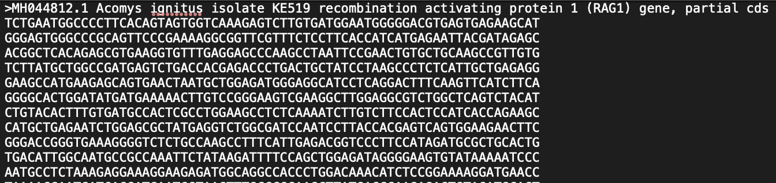
STEP 2: The dataset includes key properties and sequencing information
Properties of the data from NCBI include metadata such as the accession number, the species name (useful for grabbing species name for classifier), the isolate number, the gene/protein name and its full name, its coding DNA sequence (CDS) status and its accompanying nucleotide sequence in a FASTA file format. See below for an example:
These were the number of hits (sample size) for each gene search result with the
following search features in both NCBI and Rentrez searches:
Muridae[ORGN] AND Gene[gene] AND
1000:1500[SLEN]
Gene | Number of hits
Cytb | 740
Irbp | 1804
Rag1 | 854

Slide 9
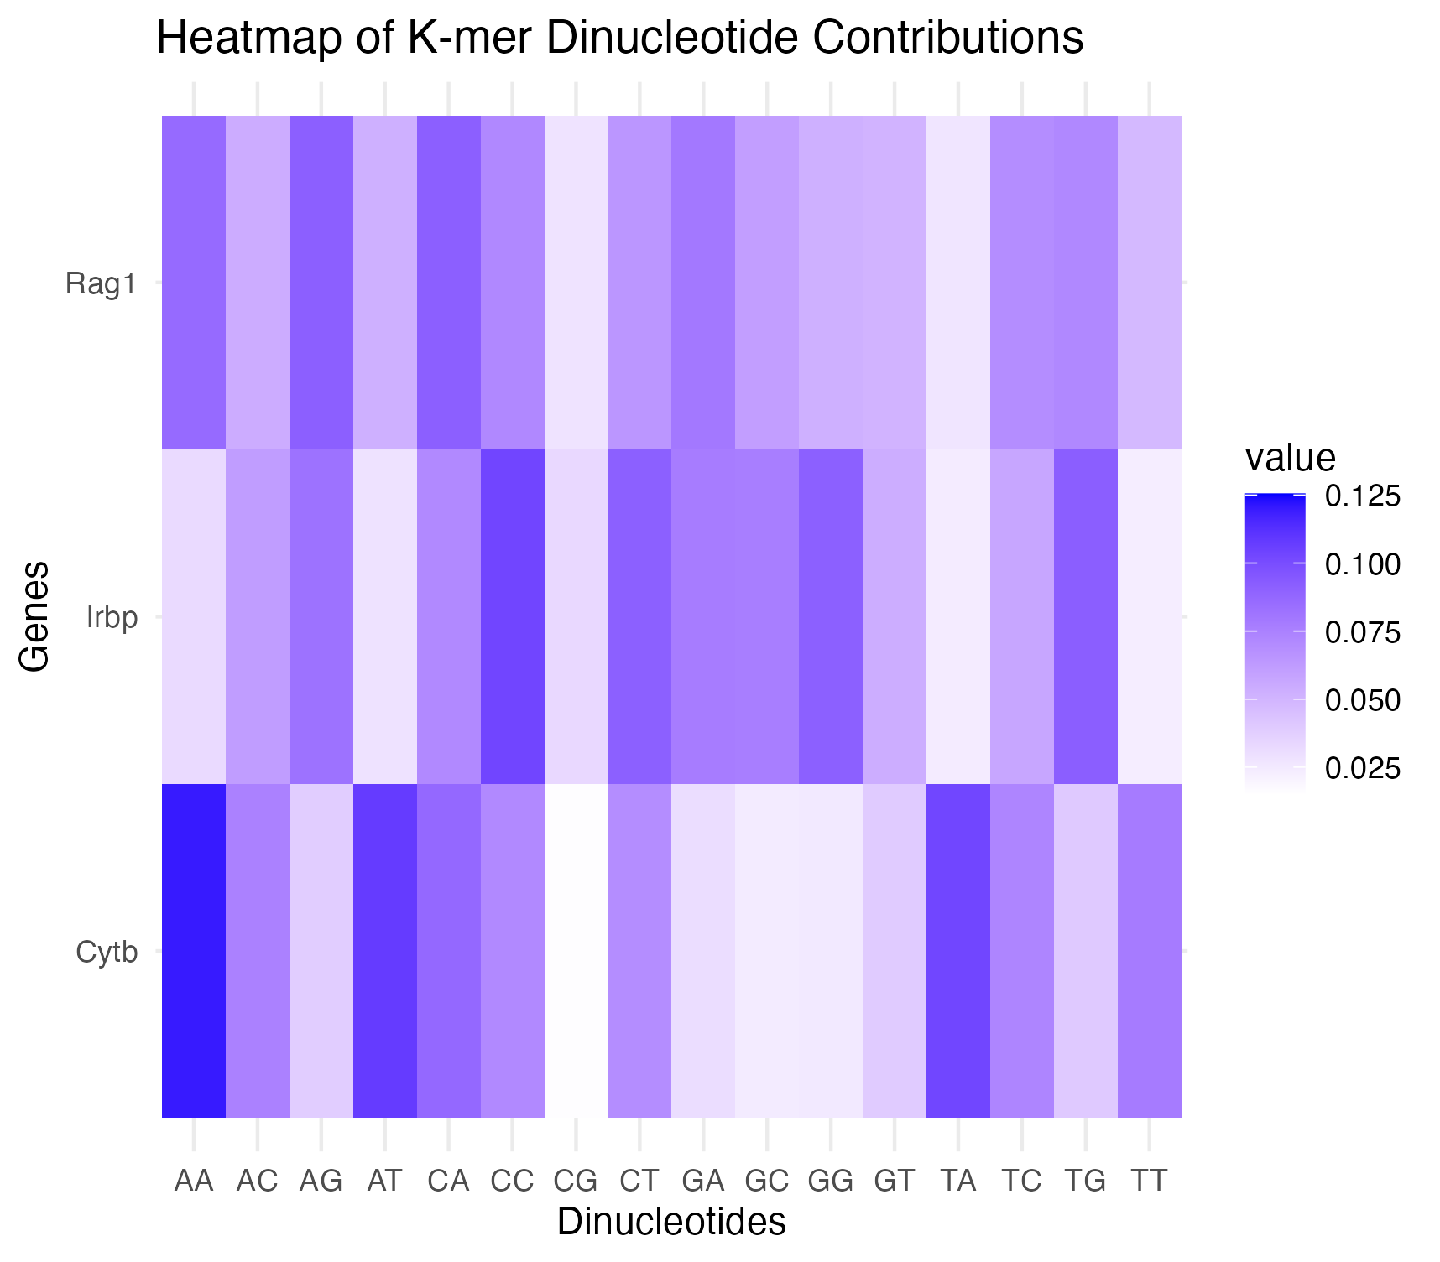
Kmer contributions for RF classifier differs for all 3 genes

Slide 10
Kmer contributions for RF classifier differs for all 3 genes
From the heatmap before, the proportions of k-mer contributions during the training classification for each gene differs. Specifically, some notable observations include:
Rag1 has all k-mers of varying frequency values contribute to the training except for CG and TA where has low expression
Irbp has a greater frequency of CC, CT, GG , and TG k-mers than Rag1 and Cytb.
Cytb gene has a higher proportion of AA, AT, and TA kmer contributions than the proportions in Rag1 and Irbp.
CG k-mer contributed very little to all 3 genes for the classifier. This suggests that this may be a key feature that distinguishes the Muridae taxon from other taxons.
This result suggest that each gene has different k-mer contributions and are different enough from each other for the RF machine learning model to classify each gene. This figure accomplished the first objective where machine learning (RF) was successfully applied for gene classifiers. The results were to be expected since each gene differs in their sequence composition.

Slide 11
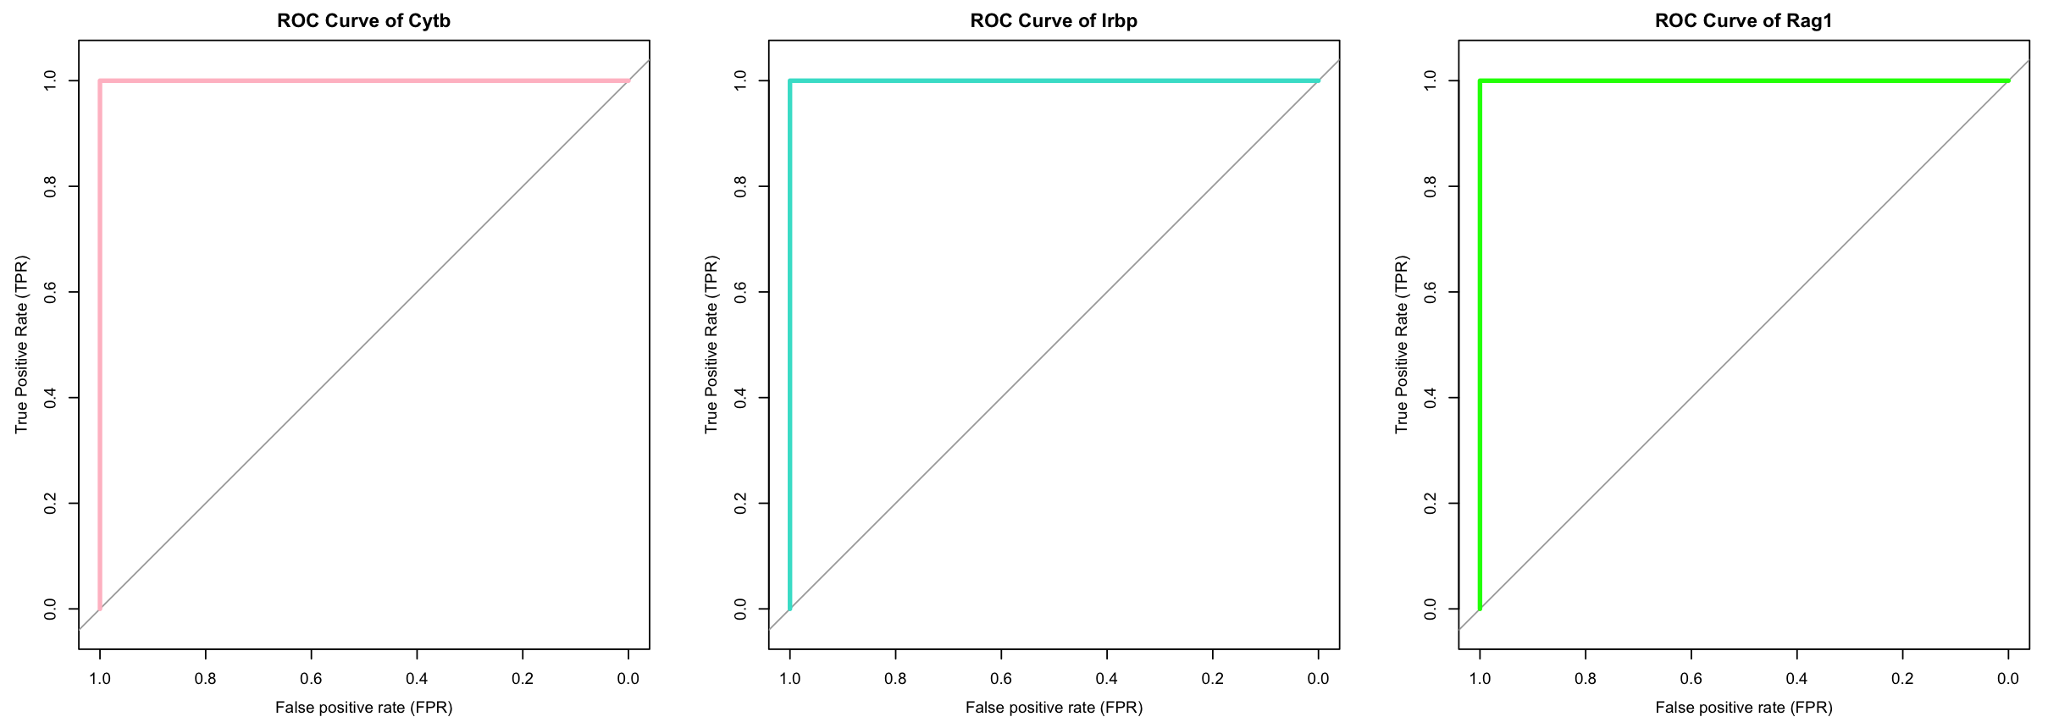
ROC curves reveals perfect RF classifier for all 3 genes

Slide 12
ROC curves reveals perfect RF classifier for all 3 genes
The receiving operator characteristics (ROC) curve can indicate performance on a machine learning model. The steep rise on the left side for each plot indicate that the model rarely makes false positives and indicate a perfect classifier for all 3 genes: Cytb, Irbp, and Rag1. Confusion matrix was also calculated on Rstudio and indicated an accuracy of 1 (not shown here).
This suggests that the classifier can classify gene classes with extremely high specificity, even on unseen data. In fact, the k-mer gene classification for Muridae was able to separate each gene, indicating that the RF is a strong classifier for the gene classification task.
This figure supports the main hypothesis where features such as dinucleotide k-mers in machine learning algorithms can accurately train and detect different gene sequences and Muridae species.

Slide 13
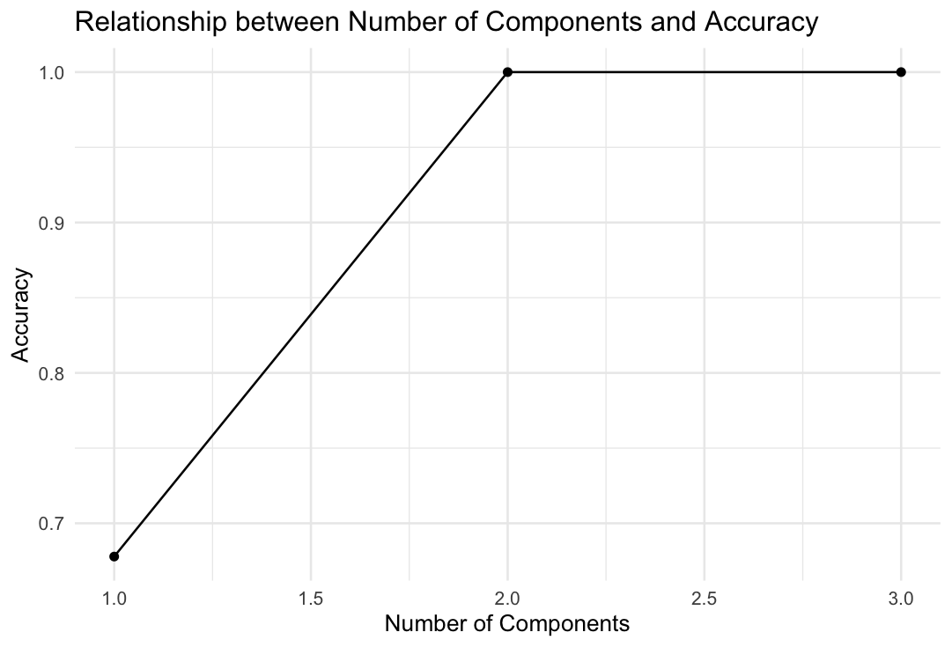
Accuracy increases as number of components increases in PLS

Slide 14
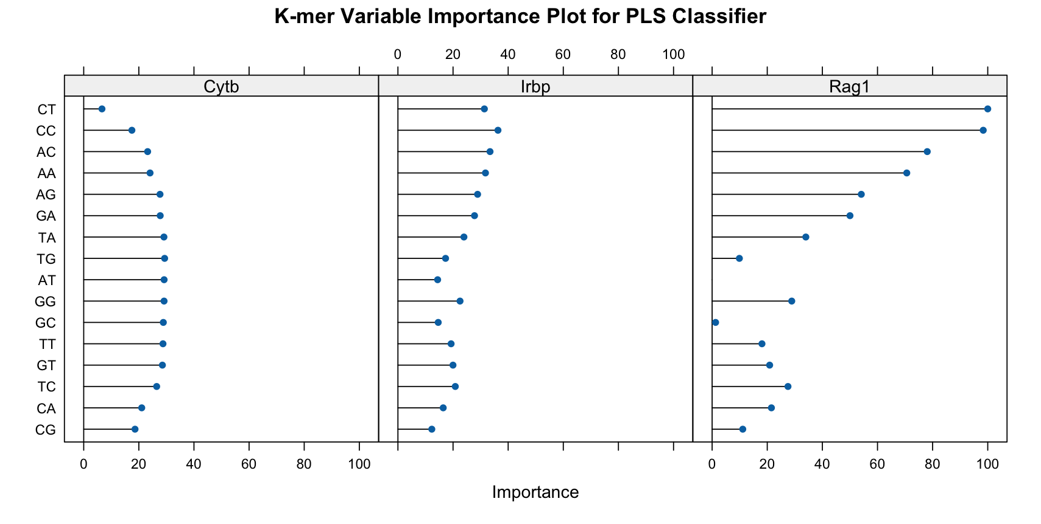
K-mers contributions differs for each gene of the PLS classifier during training

Slide 15
PLS and its classification on Muridae gene
From the previous figures, the accuracy of gene classifiers increased as the number of components increased, up to a maximum accuracy of 1.0 at 2 components and plateaus.
In addition, the proportions of k-mer contributions during the training classification for each gene differs. Specifically, some observations include:
Cytb gene has equal importance of k-mer contribution but is low for CT, results are not consistent RF model
Irbp has a wide variety of k-mer contributing to the training model, with the CC k-mer contributing the most(CC k-mer consistent with the RF model)
Rag1 shows more distinct contributions, with CT, CC, AC, AA contributing the most while AT and GC k-mer contributing the least (GC k-mer consistent with the RF model)
This suggests that each gene has different k-mer contributions and are different enough for the PLS algorithm learning to classify each gene. Some PLS k-mer contributions are consistent with the RF model.
This figure accomplished the first and second objectives where machine learning (RF) was successfully applied for gene classifiers and comparisons were made.

Slide 16
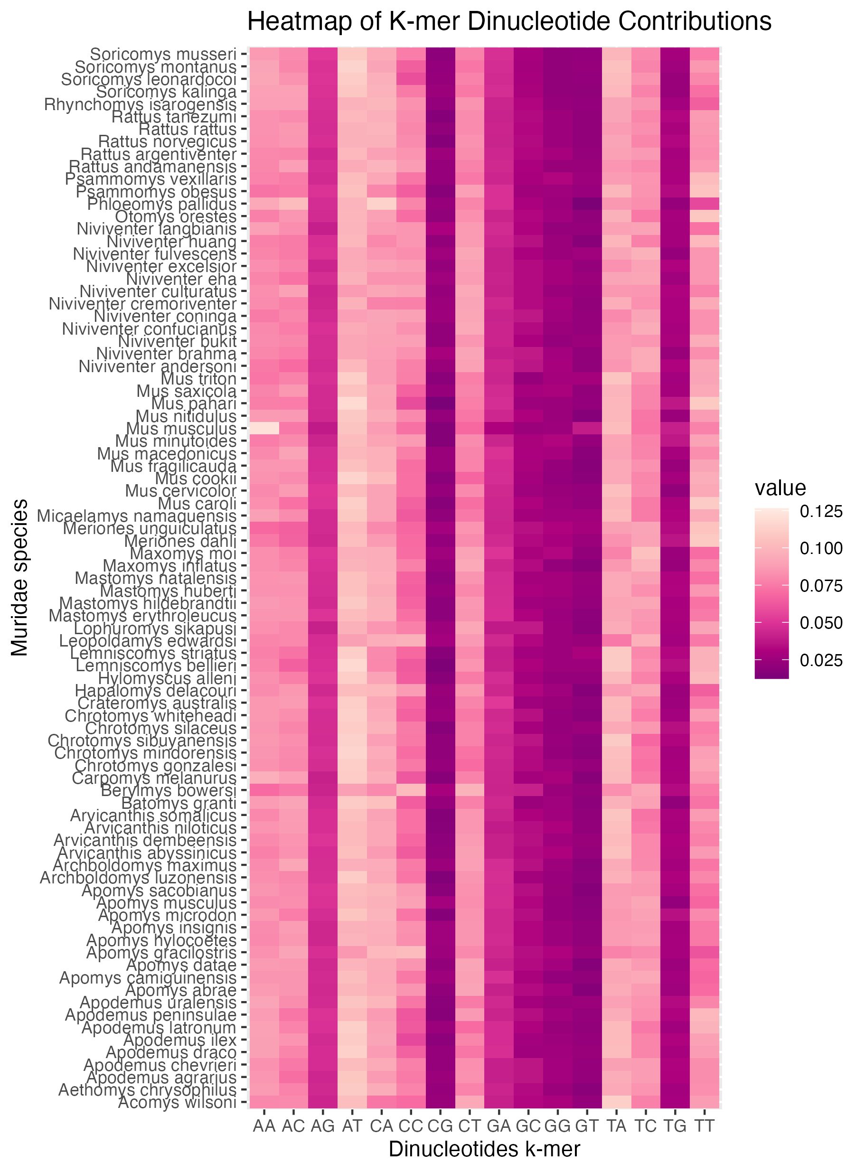
The RF model uses different kmers combinations during training to classify each Muridae species based on the Cytb gene
Dinucleotide combos
AA
AT
AC
AG
TA
TT
TC
TG
CA
CT
CC
CG
GA
GT
GC
GG

Slide 17
RF model uses different kmers combinations to classify each Muridae species based on the Cytb gene
From the heatmap, it shows the proportions of K-mers contributions for each species and how it differs for each species. For example, Mus musculus has a higher frequency of AA as compared to other species. This is consistent with the first heatmap, where the AA k-mer contributes to the most and was probably biased by the Mus musculus species.
AG, CG, GA, GC, GG, GT and TG k-mers has low frequency values across all species indicating a potentially conserved feature in the Muridae Cytb gene. To really confirm this observation, an outgroup from another taxon (i.e. Rodentia which is the higher classification or a sister taxon, Cricetidae) should be included to perform comparisons.
This figure supports the main hypothesis where k-mer dinucleotide frequencies contribute differently to each Muridae species.

Slide 18
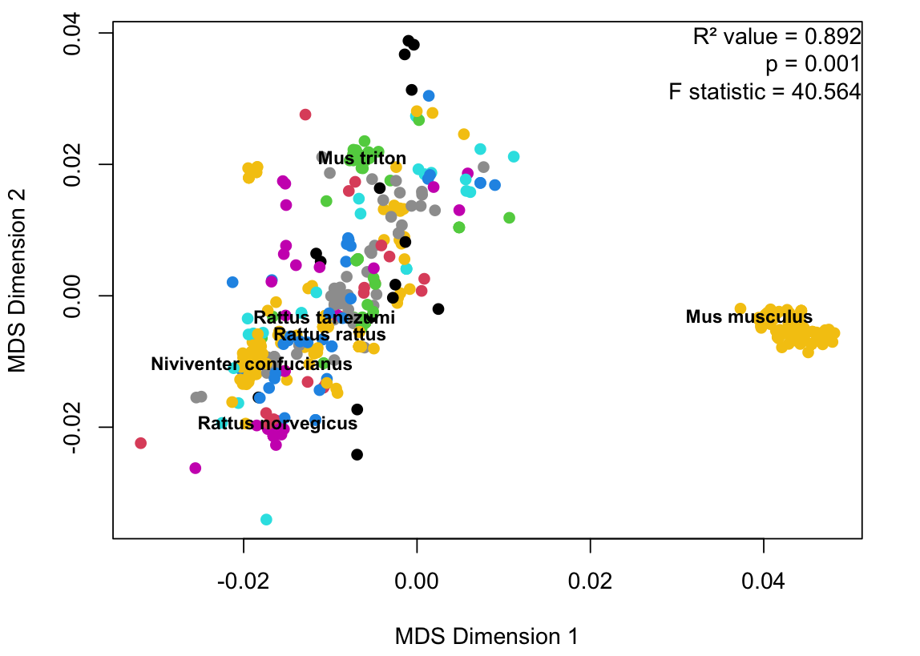
The RF clusters Muridae species during training

Slide 19
Discussion: RF model training on Muridae species
From the previous figure, we can observe that the Muridae species cluster in species. Specifically, this can be seen with the Mus musculus species as it makes its own distinct cluster on the middle right (yellow cluster). The Rattus norvegicus (magenta cluster) and the Mus triton (green cluster) species also form their own distinct cluster.
The PERMANOVA test can also tell a lot of information:
significant (p = 0.001)
R² value is 0.892 and is close to 1, indicating a good fit
F statistic value of 40.564 which is a high value and indicates that there is a greater variation between sample means relative to the variations within samples
Potential bias - An explanation to the one cluster formed for the Mus musculus group is that it is such as well-studied model organism as compared to other Muridae species and thus they have vast amounts of information available (Standley & Xie., 2024). If more sampling was done to other Muridae species, we can anticipate they can form their own distinct group as opposed to one giant mixed cluster.

Slide 20
Next steps and follow-ups in investigating Muridae species
Some of the Muridae species were misclassified in the RF model (such as the Apodemus draco misclassified as Apodemus ilex). To generate a more robust method of classification, other features and models can be used. Some include:
GC content and different k-mer sizes in Muridae species (Li et al., 2020)
Multi-gene classifier that combines the multiple genes at once instead of each gene separately (Klimov et al., 2019). For this analysis, it would be to use all 3 genes at once. This will let us see if using all 3 genes increases the accuracy of species classification.
Due to the limit of time, some next steps is to graph the validation data to see whether it lines up with the training data. This way, we can see if the training model is either overfitted or underfitted. In addition, the PLS model can be used to apply to the species classifier. In addition, we can repeat the analysis with another gene such as Irbp and Rag1 for the species classifier.
In the broader context of classification, if there are unknown Muridae species with unknown IDs, analysis on machine learning models can identify these new sequences and identify them to be either current species or newly discovered species. In addition, population structure within species can be further investigated to see whether new species have emerged.

Slide 21
Bonus Reflection slide
I learned a lot from this assignment. Specifically, I learned that many different types of machine learning model functions are finicky and only like specific data formats. Most of the time, I was troubleshooting on how to get the data to the right format. Else it will throw errors to the console. I now realized that bioinformatics is 90% data wrangling and 10% visualizations.
I want to work on my understanding on more machine learning pipelines and why some are used more often than others and the context behind it. I believe that with more opportunities to practice, the better I will become at it. Some opportunities include replicating published pipelines on GitHub and in publications. This would give me an opportunity to learn more about what is standard in the field, the rationale as to why it was done that way, and the advantages and disadvantage of each pipeline. Moving forward, I learned a lot from plotting heatmaps and MDS graph since it has applications to gene expression analysis which I am interested in analyzing. This
also may become relevant my future BINF6999 summer project where
I am interested in looking at gene expression in the mouse brain.

Slide 22
Acknowledgement Slide
I would like to thank Farah Sadoon for helping me narrow down on some genes for my analysis and suggesting good ones. The Shh gene would have been interesting!
I would also like to thank the teaching assistant, Saira Asif, for helping me choose some candidate genes for my analysis.
I also want to thank Britany MacIntyre as her seminar, “Urinary metabolites as non-invasive biomarkers of cardiometabolic health: identification and validation” helped me to ultimately decide on which machine learning model algorithm to choose. I noticed that she used partial least square which inspired me to try to do the same with my assignment.
I want to thank my friends, Kazeera Aliar and Rebekah Hest, for helping me run the code and ensuring everything ran smoothly and providing me the suggestion to declutter my environment. I had a lot of data frames!

Slide 23
References and Resources Consulted
Standley A, Xie J, Lau AW, Grote L, Gifford AJ. Working with Miraculous Mice: Mus musculus as a Model Organism. Curr Protoc. 2024 Oct;4(10):e70021. doi: 10.1002/cpz1.70021. PMID: 39435766.
Modlinska, K., & Pisula, W. (2020). The Norway rat, from an obnoxious pest to a laboratory pet. ELife, 9, e50651. https://doi.org/10.7554/eLife.50651
Standley, A., Xie, J., Lau, A. W., Grote, L., & Gifford, A. J. (2024). Working with miraculous mice: Mus musculus as a model organism. Current Protocols, 4, e70021. doi: 10.1002/cpz1.70021
The UniProt Consortium , UniProt: the Universal Protein Knowledgebase in 2025, Nucleic Acids Research, Volume 53, Issue D1, 6 January 2025, Pages D609–D617, https://doi.org/10.1093/nar/gkae1010. Accession numbers B1P8W3, A0A0A7NWN0, and P15919 were used to review gene and protein function
Sipper, M., Moore, J.H. Conservation machine learning: a case study of random forests. Sci Rep 11, 3629 (2021). https://doi.org/10.1038/s41598-021-83247-4
Brereton, R.G. and Lloyd, G.R. (2014), Partial least squares discriminant analysis: taking the magic away. J. Chemometrics, 28: 213-225. https://doi.org/10.1002/cem.2609
Salles, M. M. A., & Domingos, F. M. C. B. (2025). Towards the next generation of species delimitation methods: an overview of machine learning applications. Molecular Phylogenetics and Evolution, 210, 108368. https://doi.org/https://doi.org/10.1016/j.ympev.2025.108368
Winter DJ. 2017. rentrez: An R package for the NCBI eUtils API. PeerJ Preprints 5:e3179v2 https://doi.org/10.7287/peerj.preprints.3179v2
Li, X., Li, H., Yang, Z. et al. Exploring objective feature sets in constructing the evolution relationship of animal genome sequences. BMC Genomics 24, 634 (2023). https://doi.org/10.1186/s12864-023-09747-x
Klimov, P.B., Skoracki, M. & Bochkov, A.V. Cox1 barcoding versus multilocus species delimitation: validation of two mite species with contrasting effective population sizes. Parasites Vectors 12, 8 (2019). https://doi.org/10.1186/s13071-018-3242-5
Figures were taken from BioRender.com
Tutorials
https://cran.r-project.org/web/packages/caret/vignettes/caret.html
https://topepo.github.io/caret/using-your-own-model-in-train.html#illustrative-example-1-svms-with-laplacian-kernels
https://cran.r-project.org/web/packages/vip/vignettes/vip.html
https://r-graph-gallery.com/79-levelplot-with-ggplot2.html
https://www.geeksforgeeks.org/r-language/multidimensional-scaling-using-r/
https://www.sthda.com/english/wiki/ggplot2-quick-correlation-matrix-heatmap-r-software-and-data-visualization
https://www.sthda.com/english/articles/31-principal-component-methods-in-r-practical-guide/122-multidimensional-scaling-essentials-algorithms-and-r-code/

