Slide 2
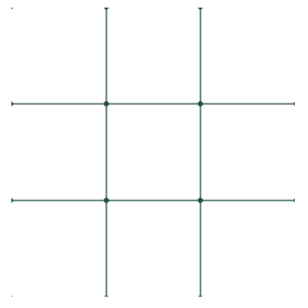
Basic Tile Idea
Tiles are actually “buttons” and the lines are image background.
Tiles has incremental names. (bt1-bt9)
When a tile is clicked, it will programmatically output “X” or “O” as text.

Slide 3
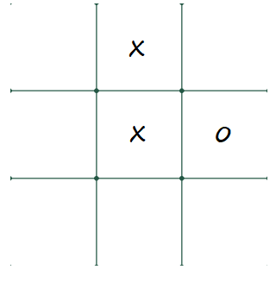
Basic Tile Algorithm: When tile is clicked
Is the tile is blank?
If yes do the following
Check whose turn it is
Output the char to the tile (X/O)
Lastly, check if the game is won or
draw, or the game is not finished
Else do nothing

Slide 4
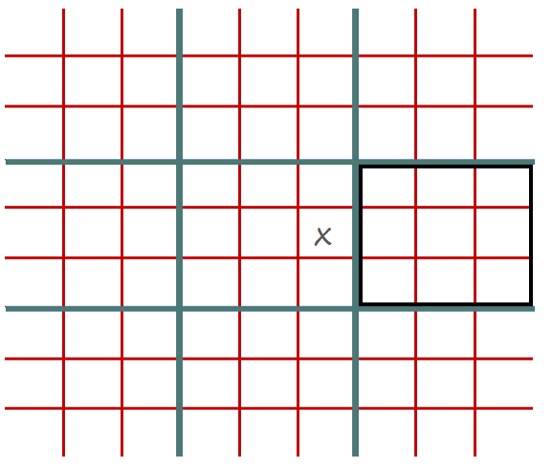
Ultimate Tile Idea
Consists of 9 basic (3x3) tiles
There are 9 group boxes. Per box 9 tiles (buttons)
To restrict selection, groupbox border color is programmatically adjusts

Slide 5
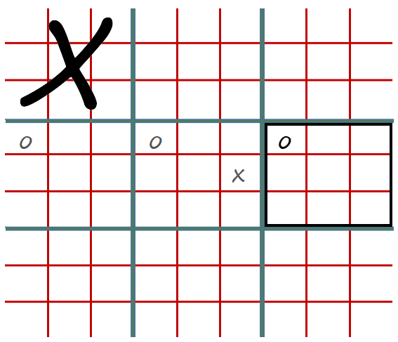
Ultimate Tile Algorithm: When tile is clicked
Is the tile is blank?
If yes do the following
Check whose turn it is
Output the char to the tile (X/O)
Restrict next player move
Check if the group tile has won then output
Lastly, check if the game is won or
draw, or the game is not finished
Else do nothing

